Slide 1
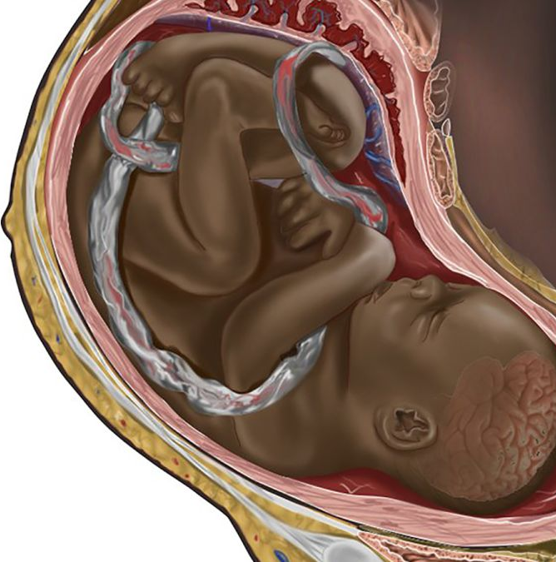
Anatomy through the lens of Agenda 2030-Part 2
Dr. Amani Eltayb - amani.eltayb@ki.se
Unit for Teaching and Learning
Department of Learning, Informatics, Management and Ethics / Karolinska Institutet

Slide 2
Interviews
Qualitative research approach
Target group: teachers teaching anatomy courses in Pecs, Zagreb and Masaryk universities.
Explore pedagogical knowledge and teaching practices
Amani Eltayb
Notes:
AE 10 min

Slide 3
Preliminary Results
Knowledge on constructive alignment was low
Most of participants were aware of the intended learning outcomes however no formal regular revision, some universities define and present ILOs to students at the start of the courses others don’t.
Potential gaps as perceived by the teachers at the institutional, departmental and individual levels with regards to anatomy teaching
Amani Eltayb
Notes:
AE 10 min

Slide 4
Gaps
No pedagogical training before teaching
Time limitation and high workload
Old rules and traditions
High number of students and low number of teachers (quantity not quality)
Level of English Language is low for international students
Students' motivation is low
Hierarchical system
No consideration for diversity
Resistance of some staff members to reforms
Source: Exploring your mind
Amani Eltayb
Notes:
AE
4 min

Slide 5
Common Themes
No standardize teaching practices, it rely on teacher’s style, motivation and routines/traditions that were created by previous educators
Teaching and learning is affected by students’ attitudes, expectations and motivations; high numbers of students; time limitations; teachers’ style and motivations
Summative assessment is the formal way of assessment, formative assessment depends on traditions and teachers’ motivation/teaching style
Rethinking the way of collecting feedback from students
Curriculum update is needed however, hierarchical system within institutions causes communication barriers and interferes with curriculum updates/reforms
Amani Eltayb
Notes:
Drinking alcohol
It's easier with English because they like to test themselves. And the Hungarians come in with the idea that you have to survive the anatomy. If they realise that anatomy can be understood and not just memorised, it's easier to get them involved. Especially to practice it yourself, touch it, look at it, see what's next to it. Especially when practicing you can involve them.
Standardise systems

Slide 6
Quotes
"I help them, but I'm also strict, I don't lecture, I engage them in the lesson. There are always people who write in the feedback that they don't like me calling them by name, even though there are no consequences if they don't know the answer, I regularly get feedback from my students.”
“I really like teaching, it motivates me, and the fact that I am teaching a subject that is undoubtedly important, the students take it seriously, so it is not a question of dealing with uninterested masses. There is a lot of positive feedback, which keeps me motivated.”
Amani Eltayb
Notes:
Teaching style and feedback

Slide 7
Quotes
“ Trust should be there, they can always ask me questions but I'm in control in a good sense as 'captain'. I also try to conduct the exercises in a more direct style. With a lot of jokes. I think it's much easier to teach this difficult subject in this way, because they relax a bit and feel more comfortable. Nevertheless, I have some students whose voices I never hear for a year and a half, and there are one or two of them in every group.”
Amani Eltayb

Slide 8
Values of teaching and learning
Do you recognise yourself?
Do you recognise your teachers?
How do these different value systems impact feedback?
Respect for lecturer authority Lecturer should not be questioned Motivation: pressure to excel Effacement and silence Group orientation to learning
Lecturer as mentor/facilitator
Lecturer is open to challenge Motivation: desire for individual development Self-expression of ideas Personal growth and creativity
Lauridsen & Lillemose (eds) 2015
Notes:
AE

Slide 9
Quotes
“Ten years ago, we did a lot of mid-year tests and we got feedback through that, but it didn't work, the results were poor and didn't correlate with the exam mark, so it wasn't clear to us, and it demanded a lot of work, so we stopped. Now, there is no official mid-year assessment, it's up to everyone how to get feedback. I used to try my own tests, now I ask questions 10 minutes before class or ask my demonstrators to go in 10 minutes early and ask questions. It works well.”
Amani Eltayb

Slide 10
Quotes
“I know ILOs, but it is not written down, the minimum requirements that you need to know is not defined. It's more of a tradition that the previous teacher or the teacher I studied with created. I think that I am aware of what the head of the institute and senior colleagues expect.”
Amani Eltayb

Slide 11
Quotes
“ILOs are defined before the course started and given to both students and teachers, before everything starts. We usually did this in groups, but not in large groups, so there are at least twenty of us at the department and I think five or six of us were most involved in creating the ILOs. Everyone else, looked at the learning outcomes to suggest any improvements, but I think doing something like that with 20 people involved would be probably too much of a mess. Better to leave it for people when know how to construct the outcomes.”
Amani Eltayb

Slide 12
Quotes
“ I think we teach a lot of things that don't make sense and irrelevant. There is no standard by which this can be followed. It would be nice if we could update the curricula and take away materials that are completely outdated and have no use for students. The problem is that a lot of people still think that quantity is more important than quality. We know that there are teachers who are not willing to change much. So, it would be good to standardise this somehow. And I don't know how that can be done. At university, pretty much anybody can do anything and there are no consequences”
Amani Eltayb

Slide 13
Quotes
“We have both formative and summative assessments. These are usually various types of online quizzes which we say that they are obligatory in the sense that students must do the quiz. But then we are not strict about applying some certain grade. Here we just motivate them to do the quiz because we know that assessing your knowledge is usually a good way of improving engagement and learning.”
Amani Eltayb

Slide 14
Bologna process
“The pedagogical consequences of the Bologna process are primarily about the transfer from a teacher centred to a student centred and outcome focused view within higher education. The overarching principle can in short terms be described as planning the course after what the students are supposed to know and know how to do after a completed course rather than as earlier from what a course is supposed to contain and give.”
Adamson, Duhs och Ekecrantz, 2005
Amani Eltayb
Notes:
Under the Bologna Process, European governments engage in discussions regarding higher education policy reforms and strive to overcome obstacles to create a European Higher Education Area.

Slide 15
4.7 By 2030, ensure that all learners acquire the knowledge and skills needed to promote sustainable development, including, among others, through education for:
sustainable development and sustainable lifestyles
human rights
gender equality
promotion of a culture of peace and non-violence
global citizenship
appreciation of cultural diversity and of culture’s contribution to sustainable development
Amani Eltayb

Slide 16
The different cultures in academia
Ethnic
Local
Academic
Disciplinary
Professional
Cultural backgrounds of supervisors and students, values, expectations, attitudes, etc.
Examples, concepts, local and cultural communication conventions, etc.
Supervision styles, beliefs and learner identities, use of humour, academic practices, power distance, plagiarism, etc.
Discourse conventions and nomenclatures, conceptual frameworks, interdisciplinarity, etc.
Professionalism, professional behaviours, hierarchies between professions, exposure to different professions
Notes:
NJ Diagram of 5 dimensions
4 min
Professional cultures to be added to diagram
Workshop will cover ethnic, local and

Slide 17
Let’s practise cultural humility!
“a lifelong process of self-reflection and self-critique whereby the individual not only learns about another’s culture, but one starts with an examination of her/his own beliefs and cultural identities.”
The term was first coined in 1998 by healthcare professionals Melanie Tervalon and Jann Murray-García, who originally described cultural humility as a tool to educate physicians to work with culturally, ethnically, and racially diverse populations in the United States.
Amani Eltayb
Notes:
Demonstrate respect for others
Practice listening for understanding
Cultivate curiosity about similarities and differences with others
Gain increased cultural self-awareness
Develop empathy
Engage in critical reflection on one’s own intercultural competence development, as well as on the intercultural experience
Develop relationships with culturally diverse others

Slide 18
Discussion: Student-centered
Teaching is approached from the perspective that students are co-creators of and bear responsibility for their own learning.
The teacher is a facilitator, a guide who supports the development of knowledge and competence
What does it mean? do you use it in your own work? How?
What does students as co-creators mean? Teacher as facilitator? Share examples!
Is it reflected in the work at your university?
Amani Eltayb
Notes:
From your own perspective
What is said in the room stays, try not to mention names.
Be respectful, a good listener
think (3)-pair (10) –share (10)

Slide 19
KI's pedagogical policy
Scholarship of teaching and learning
Structure, activities, and processes that contribute include:
Systematic reflection – Individually and peer
Unit for Teaching and Learning’s resources and activities
Faculty Board Grants for research and development
Psychological safety
Essential to create the best possible conditions for learning and the scholarship of teaching and learning.
In a psychological safe environment, participants can present ideas, ask questions, share concerns, or admit mistakes without running the risk for being punished, ridiculed, or embarrassed.
Student-centered:
Teaching is approached from the perspective that students are co-creators of and bear responsibility for their own learning
The teacher is a facilitator, a guide who supports the development of knowledge and competence
Active learning:
Learning is an active process – the student needs to process the content themselves in order to develop their knowledge.
Notes:
Purpose
KI’s education and research need to be and be experienced as relevant to the needs and challenges facing society and the future roles of our students. Relevance requires a long-term commitment to continual short-term iterations of adaptation.
The Pedagogical policy contributes to the university developing as a learning organization to achieve the highest quality in learning, with sustainable relevance for the needs of both students, teachers and the surrounding society.
KI's Pedagogical policy complements and relates to a number of other steering documents, plans and processes.
The Pedagoical policy was endorsed by the Faculty Board in June 2022.

Slide 20
References
Colonization, cadavers, and color: Considering decolonization of anatomy curricula. Finn GM, Danquah A, Matthan J. Anat Rec (Hoboken). 2022 Apr;305(4):938-951. doi: 10.1002/ar.24855. Epub 2022 Jan 5.
Biggs J., (2003). Teaching for Quality Learning at University: what the student does. Society for Research in to Higher Education. 2 ed, Open University Press, Philadelphia.
Ekecrantz S., Adamson L., Duhs R., (2005) Bolognaprocessen vid SU. Att arbeta med betygskriterier - alternativ och exempel. Universitetspedagogiskt centrum, Stockholms universitet.
Psacharopoulos, G., & Patrinos, H. (2018). Returns to investment in education: A decennial review of the global literature. Education Economics, 26(5), 445–458.
McMahon, W. W. (2010). The external benefts of education. In P. Peterson, E. Baker, & B. McGaw (Eds.), International encyclopedia of education (3rd ed., pp. 260–271). Amsterdam: Elsevier
Groenez, S., Desmedt, E., & Nicaise, I. (2007). Participation in lifelong learning in the EU-15: The role of macro-level determinants. Paper presented at the European Conference for Education Research (ECER), held 19–21 September 2007 in Ghent, Belgium
Keele University. (2021). Decolonising the curriculum. https://www. keele.ac.uk/equalitydiversity/equalityframeworksandactivities/ decolonisingthecurriculum/Keele%20University%20DTC% 20Staff%20Guide%20.pdf
Psacharopoulos, G., & Patrinos, H. (2018). Returns to investment in education: A decennial review of the global literature. Education Economics, 26(5), 445–458.
McMahon, W. W. (2010). The external benefts of education. In P. Peterson, E. Baker, & B. McGaw (Eds.), International encyclopedia of education (3rd ed., pp. 260–271). Amsterdam: Elsevier
Groenez, S., Desmedt, E., & Nicaise, I. (2007). Participation in lifelong learning in the EU-15: The role of macro-level determinants. Paper presented at the European Conference for Education Research (ECER), held 19–21 September 2007 in Ghent, Belgium
Amani Eltayb

