Slide 1
Student support at UPMS according to WFME Standards
Laura Berta CSÍK
Head of Student Services
UPMS
June 20, 2023

Slide 2
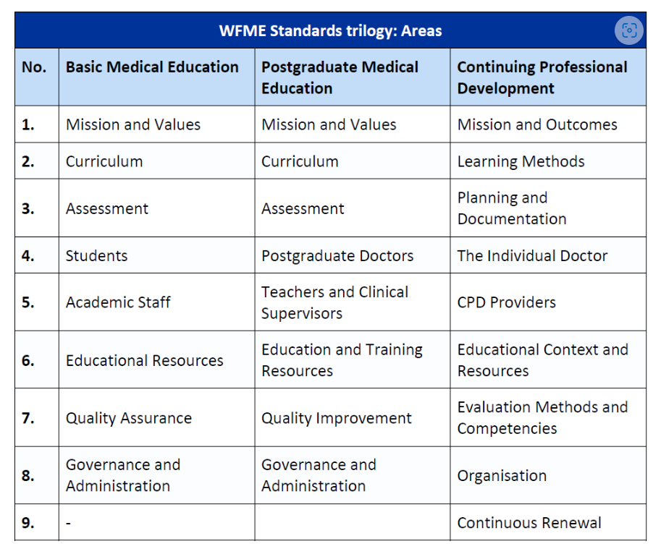
WFME Standards for Medical Education
LEANDODY 2023 PÉCS
Internet source:
WFME Standards - World Federation for Medical Education
https://wfme.org/standards/

Slide 3
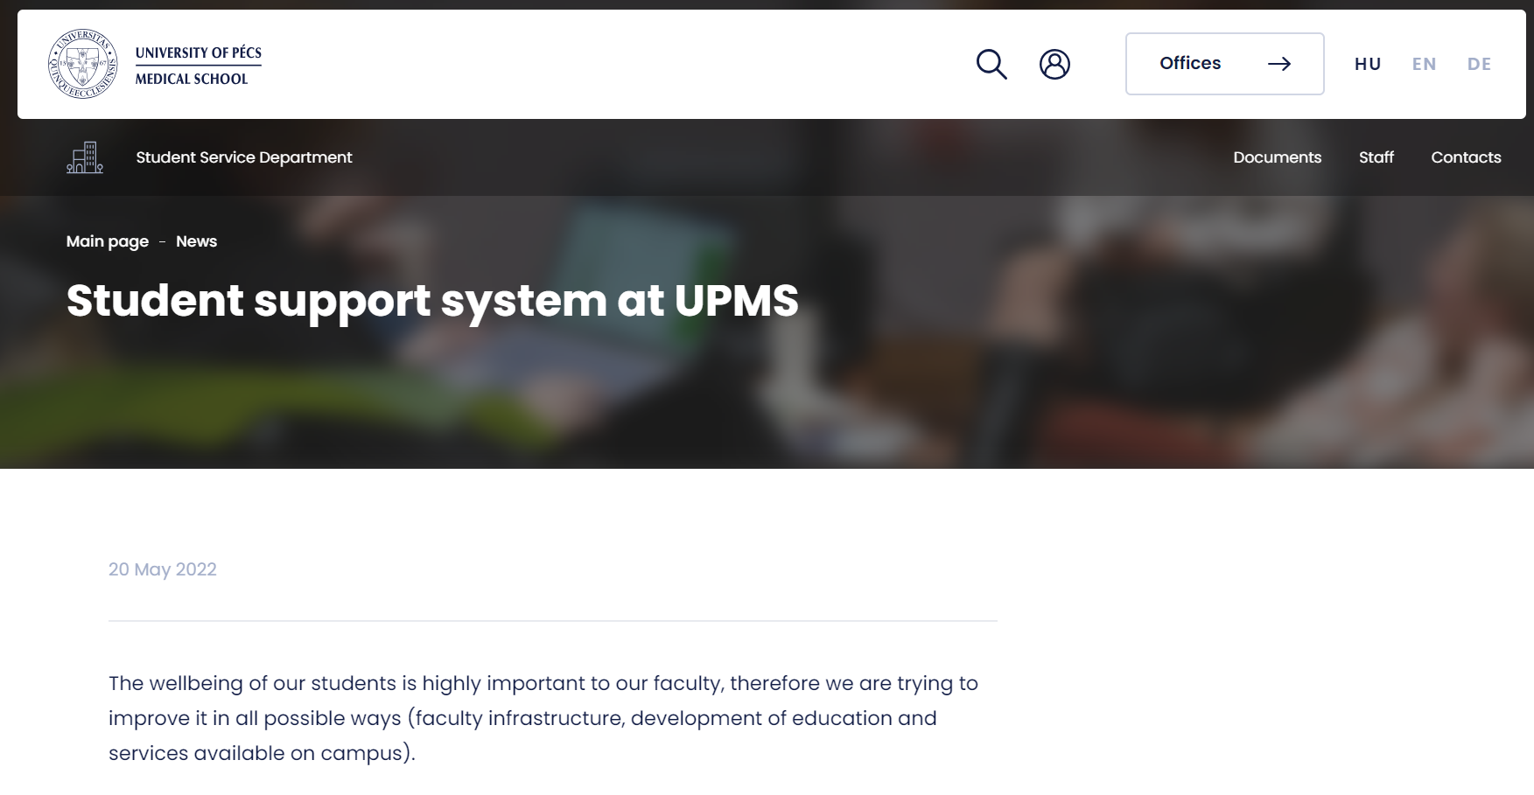
Student Support System at UPMS
LEANDODY 2023 PÉCS

Slide 4
Student Support System at UPMS
LEANDODY 2023 PÉCS
Our Goal: Mental and Psysical Well-being of Students
Student Service Department- student events and programmes
Peer Program- student support system
Financial Support: Dormitory Fee Subsidies
Psychological Counselling
Individual Coaching Services (YourLife and Division of Medical Education Development and Communication)
Mentor Program
Student Councils: HÖK and EGSC (English-German Student Counsil)
Legal Clinic

Slide 5
Student Support System at UPMS
LEANDODY 2023 PÉCS
Type of problem
Educational
Personal
Registrar's Office
HÖK
Student Service Department
Pszikon
EGSC
Mentor Club
DMEDC
YourLife
HÖK
EGSC
Peer Program
The wellbeing of our students is highly important to our faculty, therefore we are trying to improve it in all possible ways (faculty infrastructure, development of education and services available on campus).
Within the PotePillars faculty strategic plan (https://aok.pte.hu/potepillars-en), the WellBeing concept puts high emphasis on operating and developing the student support system, that should allow us to be able to support students in all sorts of roadblocks and hardships; thereby providing a safety net for them, be it for personal or educational issues. Student hardships can be divided into two main areas:
(1) problems connected to studies;
(2) problems connected to university life, personal life and student life in Pécs.

Slide 6
Student Support System at UPMS
LEANDODY 2023 PÉCS
Category/Problem | Who to turn to? | Contact
Abuse, relationship issues | Pszikon | https://pszikon.aok.pte.hu/en
Immigration office | Admissions and Student Service Offices | https://aok.pte.hu/en/egyseg/1680
Health issues | Centre for Occupational Medicine | https://aok.pte.hu/university-gp
 | Admissions and Student Service Offices | https://aok.pte.hu/en/egyseg/1680
Personal physiotherapy | YourLife | https://yourlife.aok.pte.hu/en/
Life management, education problems | DMEDC - coaching | https://aok.pte.hu/en/egyseg/180/index/almenu/716
 | YourLife - Life Coaching | https://yourlife.aok.pte.hu/en/
 | Peer Program | https://peer.aok.pte.hu/en
Quitting smoking | YourLife | https://yourlife.aok.pte.hu/en/
Supporting students with disabilities | Support Services | https://aok.pte.hu/en/egyseg/680/szolgaltatasok/121
Questions and administration of student lockers | Admissions and Student Service Offices | https://aok.pte.hu/en/egyseg/1680
Student support (in any topic) | Peer Program | https://peer.aok.pte.hu/en
Foreign environment | Peer Program | https://peer.aok.pte.hu/en
Legal support | Legal Clinic | https://ajk.pte.hu/en/campus-legal-aid-clinic/about-us

Slide 7
Student Support System at UPMS
LEANDODY 2023 PÉCS
Credit transfer | Registrar’s Office | https://aok.pte.hu/en/egyseg/570
Issues of international students (student advocacy, educational issues, acclimatisation and personal support, guidance) | EGSC | http://egsc.aok.pte.hu/ https://www.facebook.com/pte.aok.egsc/
Life in Pécs (best places, shopping) | Peer Program | https://peer.aok.pte.hu/en
Preventative consultation (expert consultation) | YourLife | https://yourlife.aok.pte.hu/en/
Sports options, free time activities | YourLife | https://yourlife.aok.pte.hu/en/
 | HÖK | https://www.facebook.com/pteaokhok/ https://aok.pte.hu/en/egyseg/680
Administration of studies | Registrar’s Office | https://aok.pte.hu/en/egyseg/570
Guidance in educational, advocacy and tender issues | HÖK | https://www.facebook.com/pteaokhok/ https://aok.pte.hu/en/egyseg/680 https://aok.pte.hu/en/egyseg/680/munkatarsak
Study problems, mentoring, tutoring, career coaching | Mentor Club (under construction) | https://aok.pte.hu/en/egyseg/706
Nutrition counselling | YourLife | https://yourlife.aok.pte.hu/en/
Body composition evaluation | YourLife | https://yourlife.aok.pte.hu/en/
Scientific life | Undergraduate Research Society | https://aok.pte.hu/en/egyseg/1700

Slide 8
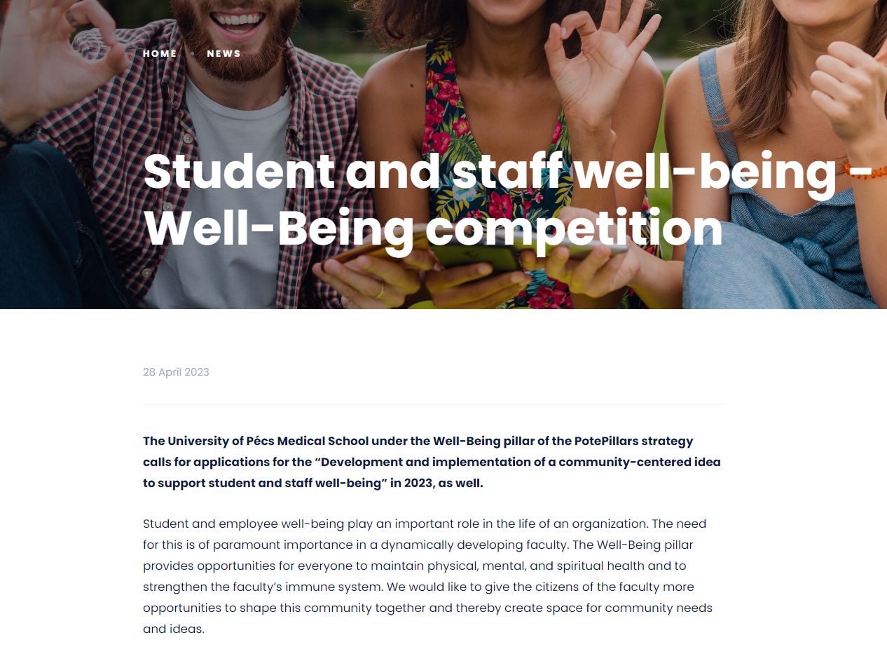
Well-Being projects
LEANDODY 2023 PÉCS

Slide 9
UPMS Student Service Department

Slide 10
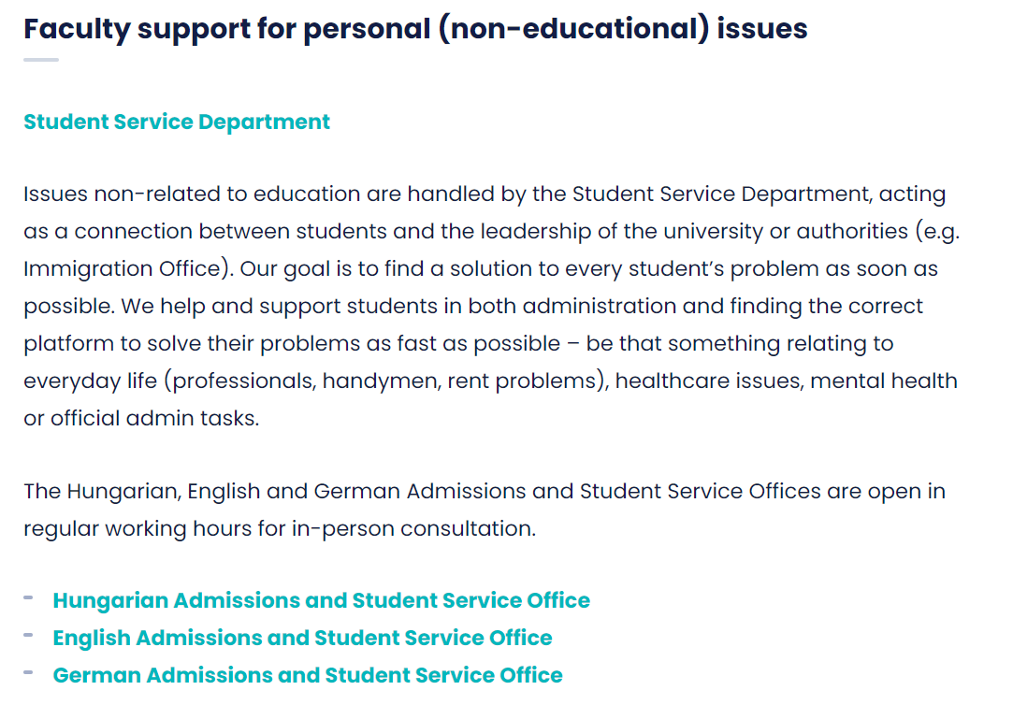
Student Service Department
LEANDODY 2023 PÉCS

Slide 11
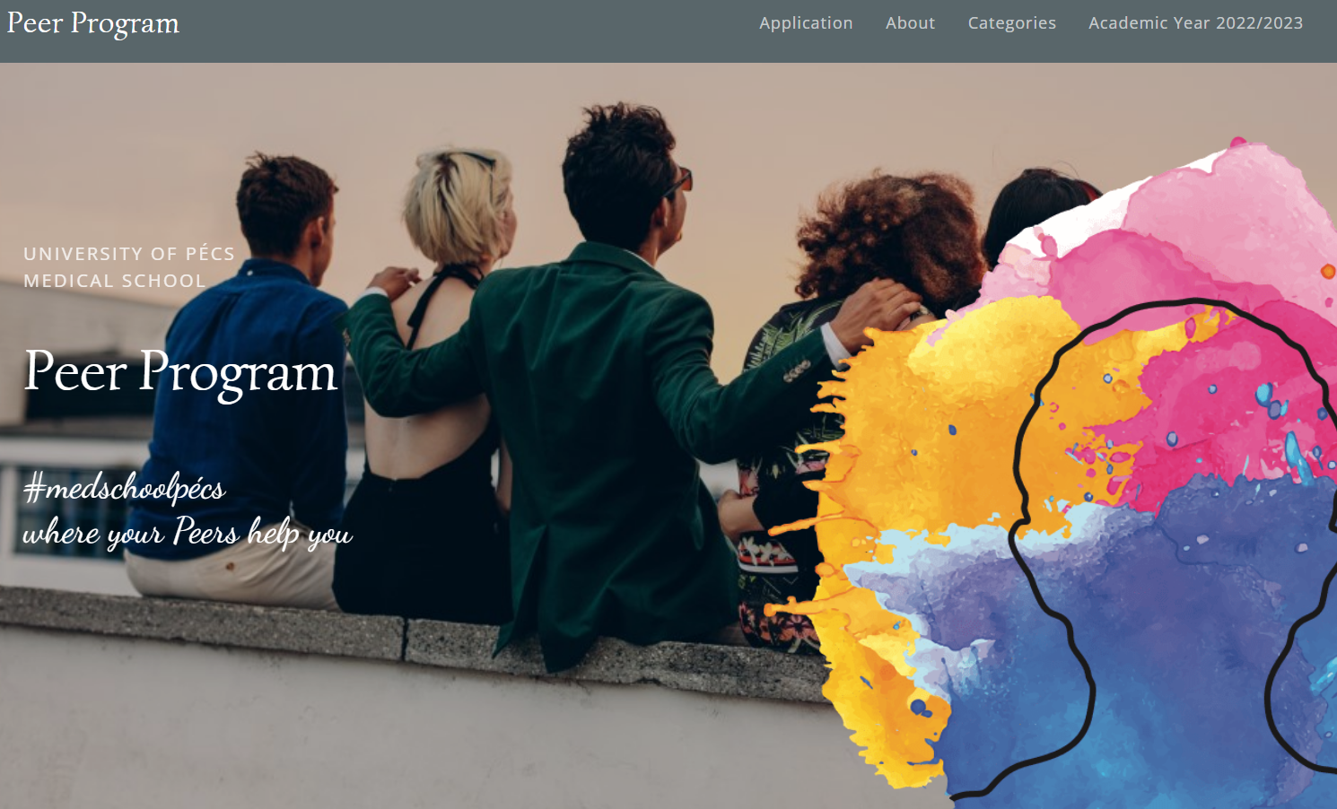
Peer Program
LEANDODY 2023 PÉCS

Slide 12
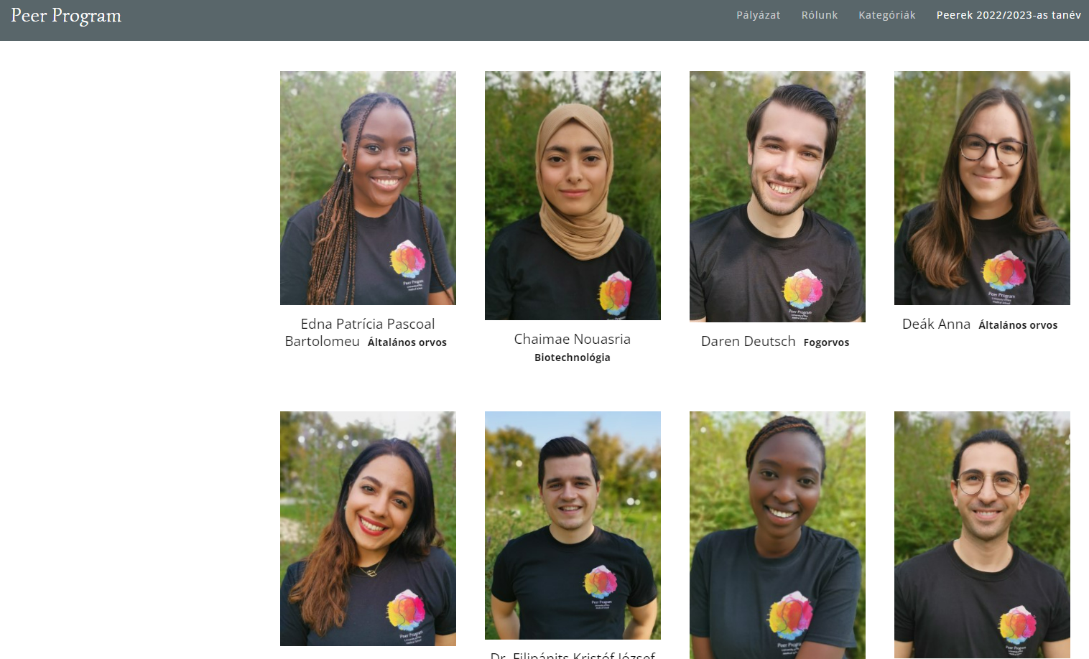
LEANDODY 2023 PÉCS
44 Peers from all Study Programs

Slide 13
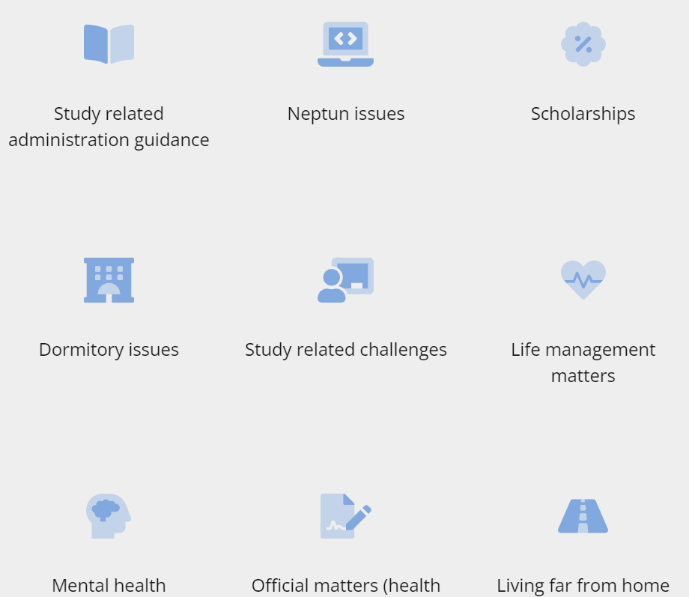
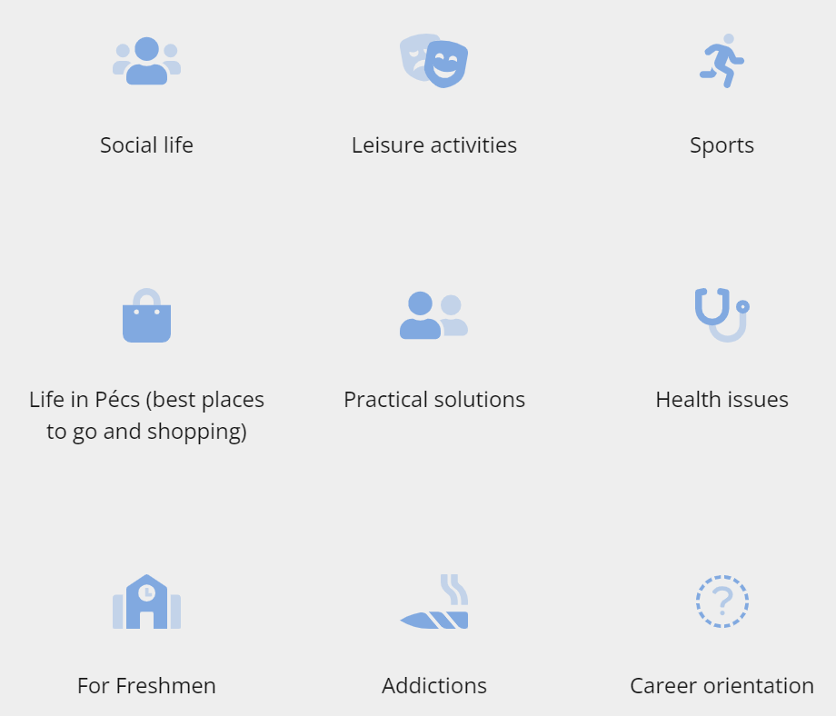
LEANDODY 2023 PÉCS
Peer Program Support Categories

Slide 14
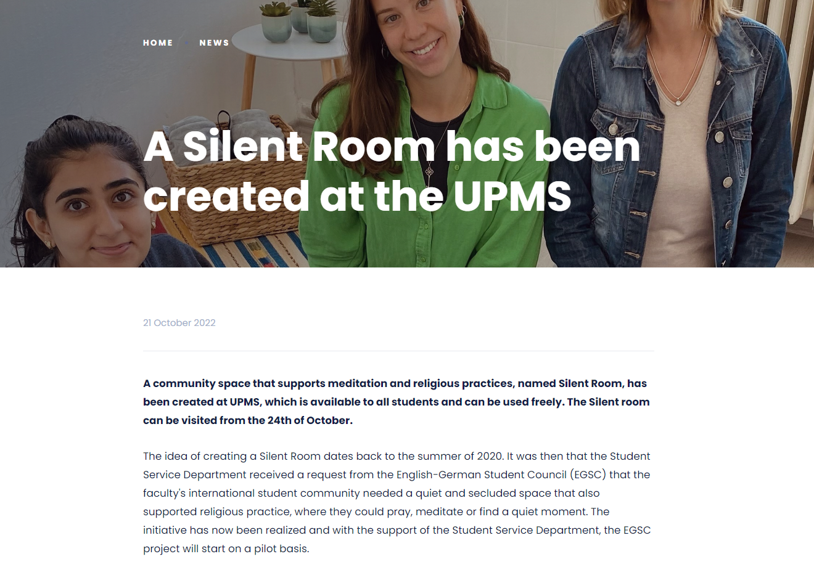
Silent Room
LEANDODY 2023 PÉCS

Slide 15
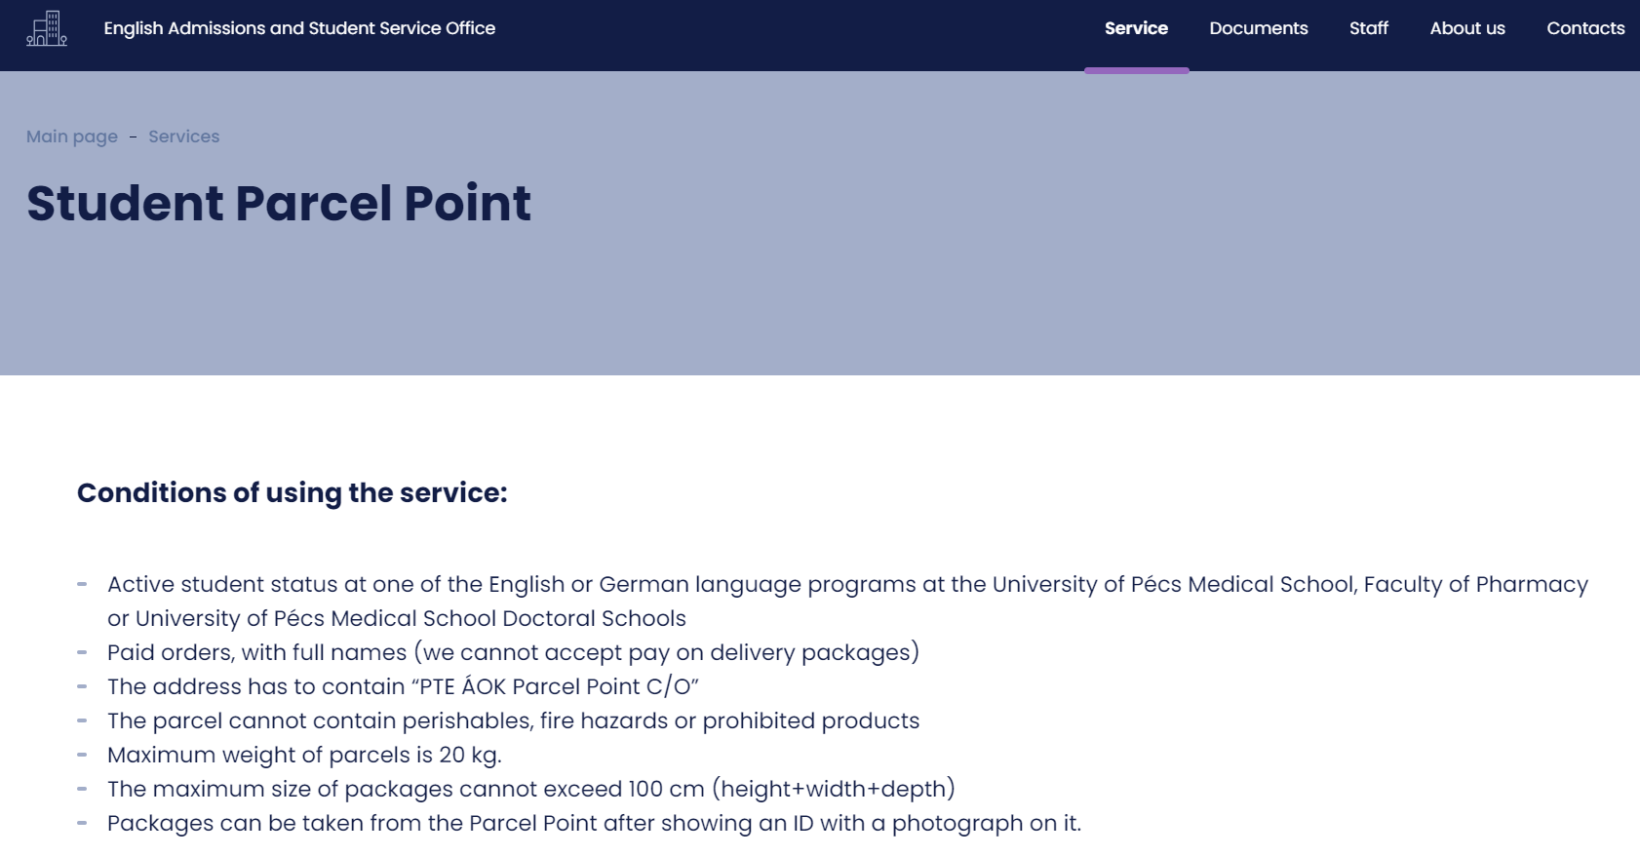
LEANDODY 2023 PÉCS
Student Parcel Point

Slide 16
Dormitory Fee Subsidies
LEANDODY 2023 PÉCS

Slide 17
LEANDODY 2023 PÉCS
Advent and Spring Concerts

Slide 18
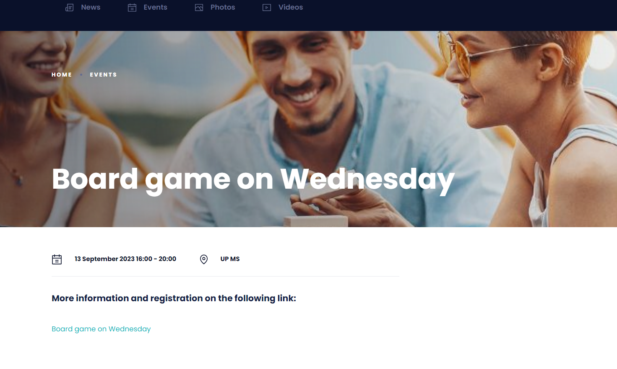
LEANDODY 2023 PÉCS
Board Game Wednesday

Slide 19
Mental and Physical Health

Slide 20
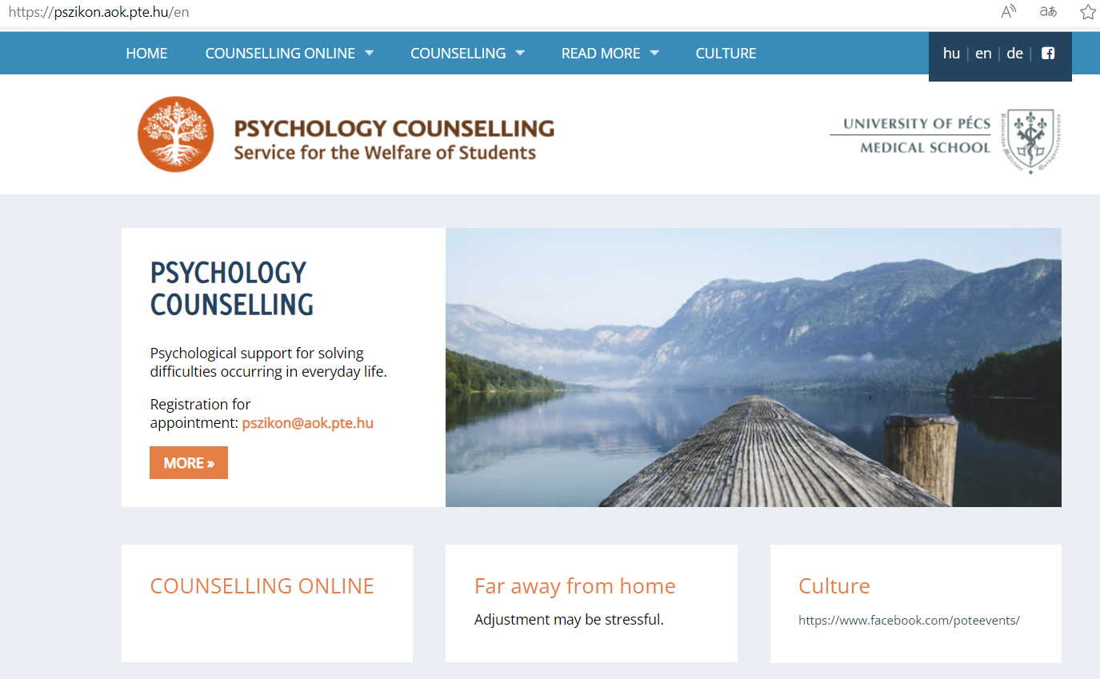
Psychological Counselling- PSZIKON
LEANDODY 2023 PÉCS

Slide 21
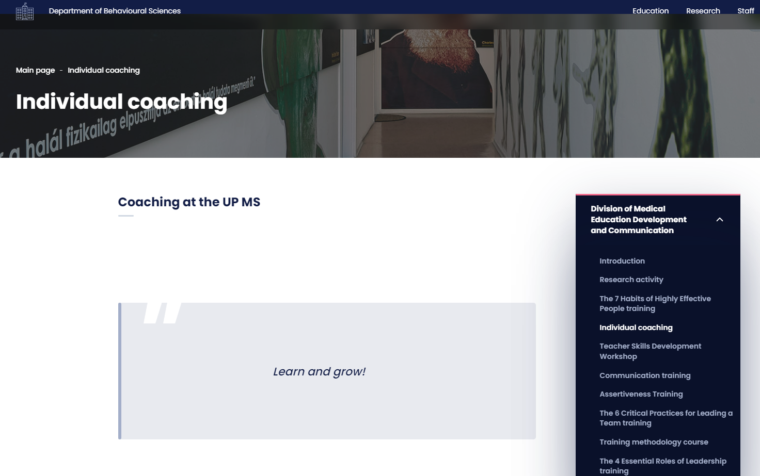
Individual Coaching
LEANDODY 2023 PÉCS

Slide 22
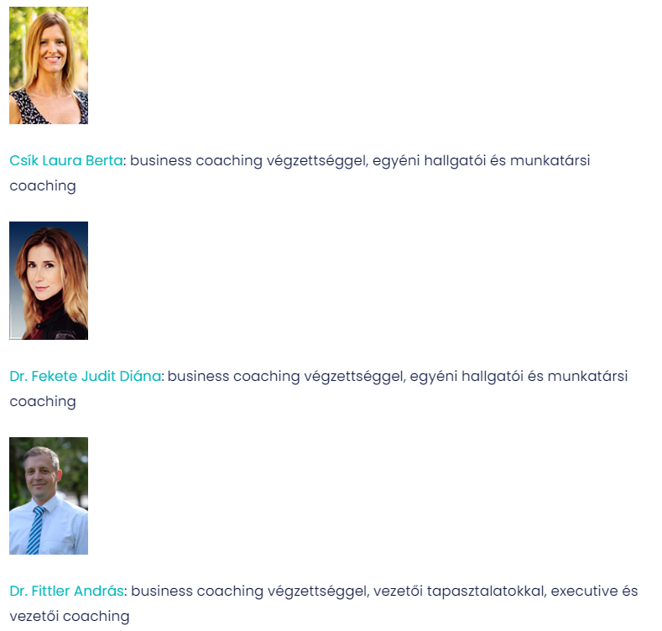
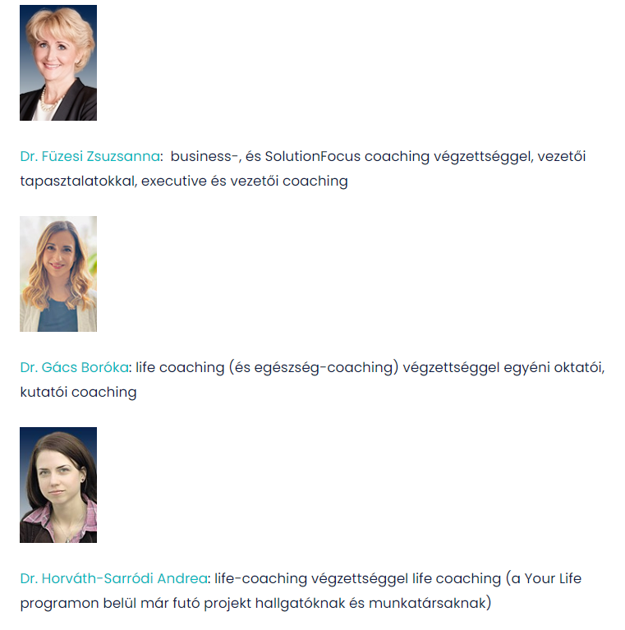
Individual Coaching- Coach Team
LEANDODY 2023 PÉCS

Slide 23
YourLife- Services
LEANDODY 2023 PÉCS

Slide 24
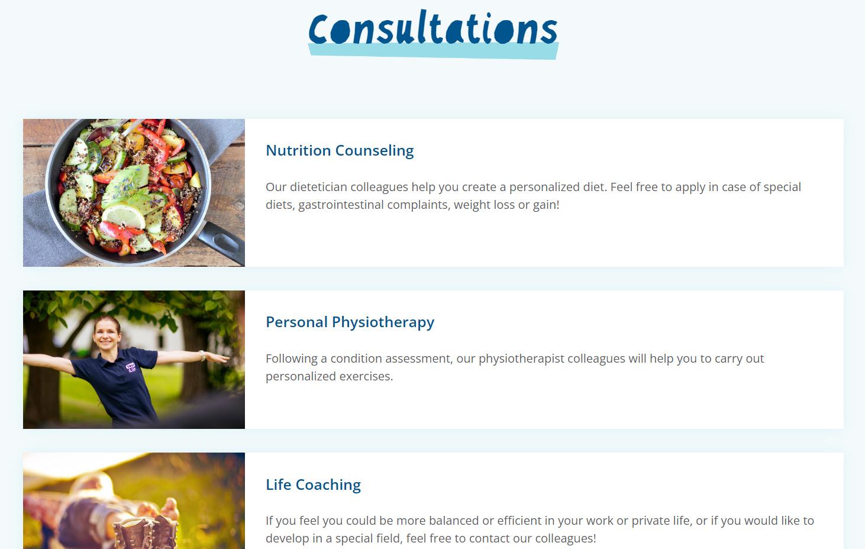
YourLife- Consultations
LEANDODY 2023 PÉCS

Slide 25
Mentor Program

Slide 26
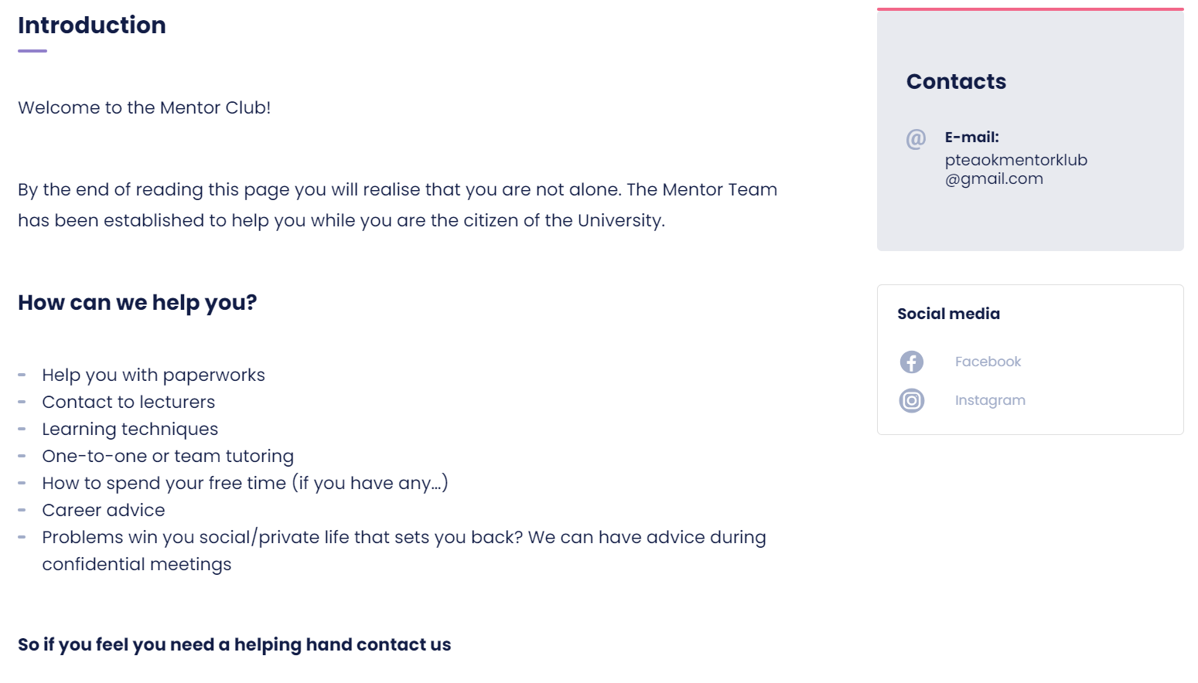
Mentor Club
LEANDODY 2023 PÉCS
The Mentor Program is currently under development, temporarily not available

Slide 27
Student Counsils

Slide 28
Student Counsils (HÖK and EGSC)
LEANDODY 2023 PÉCS
Student Informations on Social Media- continuous
Freshman Camp- August
White Coat Ceremony- September
Octoberfest - October
International Evening - March
Motivational Speech- May
Graduation Party- July

Slide 29
Legal Aid

Slide 30
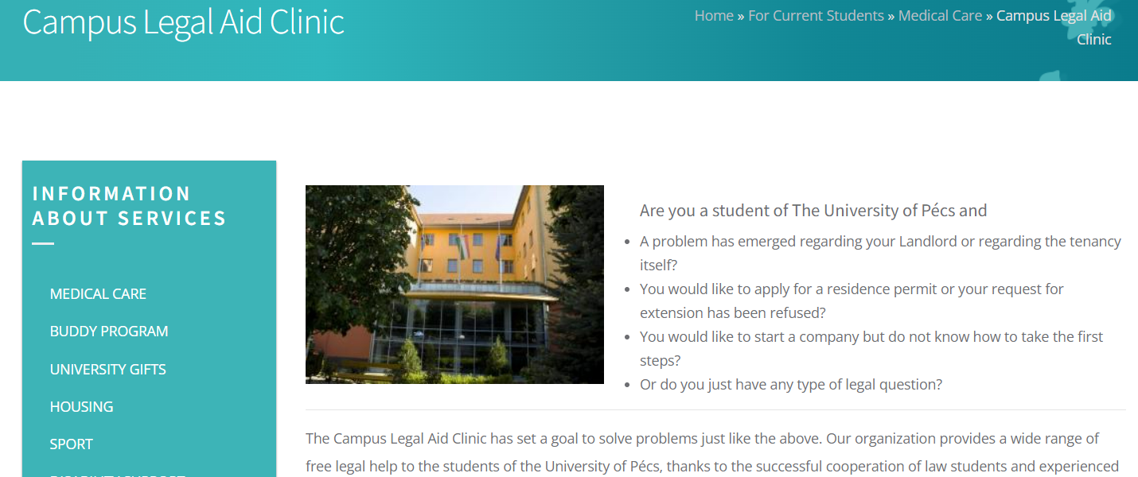
UP Legal Aid Clinic
LEANDODY 2023 PÉCS

Slide 31
Development and Transparency

Slide 32
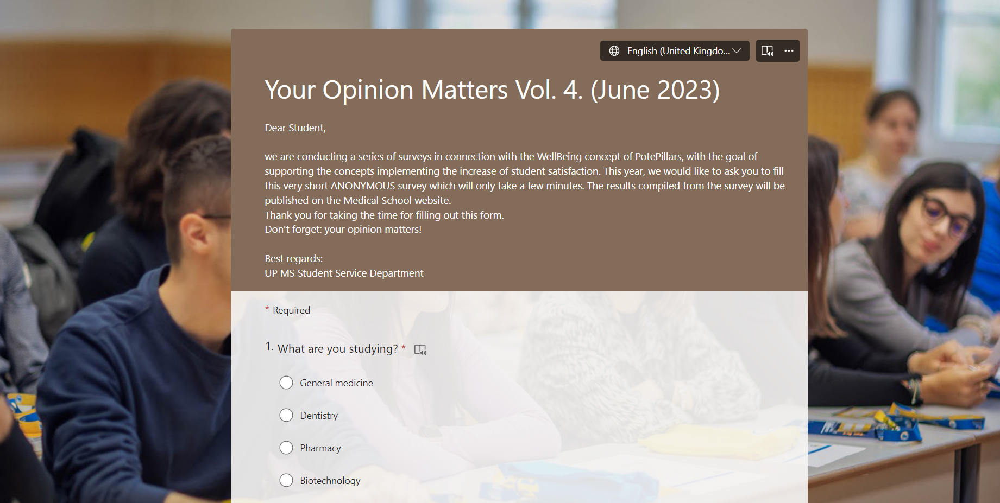
Yearly Student Satisfaction Feedback
LEANDODY 2023 PÉCS

Slide 33
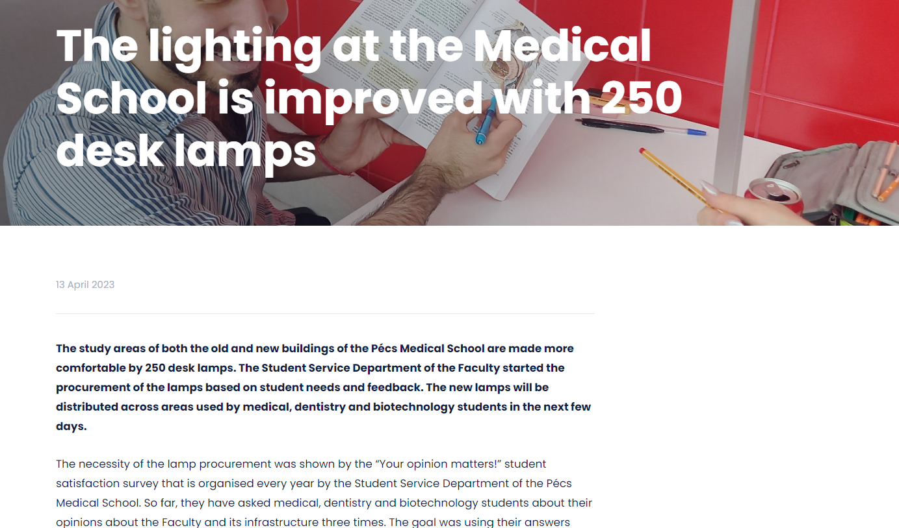
Well-Being projects based on student feedback
LEANDODY 2023 PÉCS

Slide 34
Yearly Student Satisfaction Transparency
LEANDODY 2023 PÉCS

Slide 35
Thank you for your attention!
June 20, 2023

