Slide 1
Department of Anatomy and Clinical Anatomy
Incentivizing active learning via constructive alignment
Asst. Prof. Ivan Banovac
Prof. Vedran Katavić

Slide 2
How do teachers perceive the curriculum and learning process?
Define what students
need to know
Design the lesson
Assessment

Slide 3
How do students perceive the curriculum and learning process?
What will be on the test?
Attending class
What do I need to study
From the student's perspective, assessment IS the curriculum.

Slide 4
How to approach students and teaching?
Focusing on students’ characteristics – „blame the student"
Focusing on teachers’ characteristics – „blame the teacher"
Focusing on what students do – student success depends on whether they do what is taught and tested – "how to improve the system"
Notes:
The student is incapable, does not know how to study, does not have the necessary prior knowledge, has some other immutable characteristic or there is some external factor that the teacher cannot influence
Many teachers experience self-doubt, believing that only by improving their teaching skills will they change student behavior or characteristics.

Slide 5
How to get students to do what we think is important?
Constructive alignment
intended learning
outcomes (ILOs)
assessment
teaching and learning
activities (TLAs)
Notes:
The verbs in the learning outcomes define what we do in class and how we examine it.

Slide 6
How to "align" Anatomy?
24 ECTS points
220 teaching hours Lectures: 50 h Seminars: 50 h Practicals: 120 h
~ 450 students
~ 10000 teaching hours
Notes:
220 h from the student's perspective, 7000 h from the teacher's perspective

Slide 7
Anatomy before and after CA
Before CA
After CA
In class: emphasis on practical work
In the exam: emphasis on cognitive domain
In classes and exams: cognitive, affective and psychomotor domains are included
Notes:
V:
Which prompted us to start implementing constructive alignment
Anatomical section that we did not examine - a lot of students who are not interested in the section hall, less active

Slide 8
Cognitive domain
Remembering/recalling
Understanding
Applying
Analyzing
Evaluating
Creating/Synthesizing

Slide 9
Example of outcomes and questions at the level of analysis (cognitive domain)
Compare the principles of anatomical organization in different parts of the human body
Example question: Compare the principles of venous drainage of the head and neck with the principles of venous drainage in other parts of the body.

Slide 10
Affective domain
Recognize the importance of appropriate academic behavior within the Anatomy course
Evaluate the role of the human body in the process of learning anatomy
Determine the importance of the body donation program
Develop an ethical attitude towards donated bodies and anatomical prosections
How we achieve: interaction during classes and the hidden curriculum are key
How we assess: OSPE (behavior), student evaluation of teaching (attitudes), body donor send-off
Notes:
Explain what OSPE is - an objectively structured practical exam

Slide 11
Psychomotor domain
Apply the skills of anatomical dissection in the presentation and study of anatomical structures
Sketch the principles of anatomical structures and the three-dimensionality of topographic relationships
How we achieve: active dissection, sketching
How we assess: OSPE
Notes:
Students must independently dissect and sketch to reach outcomes in the psychomotor domain

Slide 12
How do we know that constructive alignment has been effective?
Analysis of student success
Analysis of student evaluation of teaching
Cognitive interviews with teachers (evaluation of evaluation)
Notes:
AND:
A cognitive interview is a structured conversation with teachers about their quantitative and qualitative assessment of the achievement of learning outcomes for students that they met in class and on the exam.

Slide 13
CA effect using the example of a problem-solving question ("success")
Percentage of correct answers before the introduction of the appropriate TLA:
2021/2022: 6.35%
Percentage of correct answers after the introduction of the appropriate TLA:
2022/2023: 71.51%
Notes:
APU = TLA (teaching and learning activities)
Achieving an OUTCOME is an indicator of success

Slide 14
The effect of CA on performance in partial written exams
2021/2022
2022/2023
Pass rate: 37.97%
Average passing grade: 2.67
Percentage of excellent grades: 0%
Pass rate: 67.84%
Average passing grade: 3.24
Percentage of excellent grades: 5.56%
Fisher's test (difference in pass rate): P < 0.0001

Slide 15
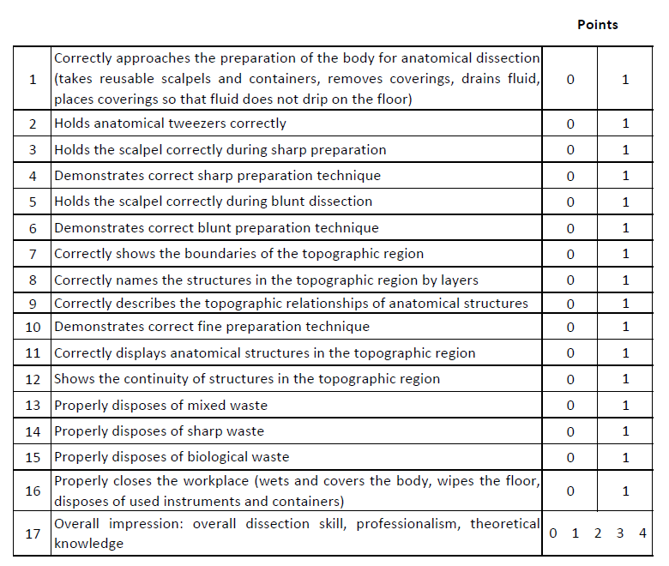
OSPE - dissection
Average success rate: 86.13%

Slide 16
Student evaluation of teaching
2021/2022 | 2022/2023
273/316 (86.4%) | 336/342 (98.2%)
 | 2021/2022 | 2022/2023
Clarity of learning outcomes | 3.16 | 4.01
Alignment of classes and assessment | 2.96 | 3.86
Attitude towards dissection | 3.03 | 4.36
Dissatisfaction with teacher consistency | 16.8% | 4.8%
Dissatisfaction with organization | 11.4% | 1.2%
P<0.0001
Notes:
Explain that the first three lines of statements are on a Likert scale, and the other two lines are the result of qualitative analysis (codes)

Slide 17
Common mistakes when implementing CA
There are NO clearly defined ILOs
Assessment exists, but an appropriate TLA is missing
TLAs exist but there is NO assessment
The "wrong" domain is assessed
The "wrong" verb is assessed
Classes:
2 + 2 = 4
Homework:
734 + 555 – 432 : 69 = 77 x
Assessment:
During the flight of two sheep, one of which is yellow and the other is flying to the left, what is the price of a kilo of asphalt if the cow is 10 years old?
Notes:
Spotting difficulty increase
Examples
2. Questions from material that was never covered at APU - "hidden" in the text, vaguely emphasized importance - any anatomical detail that is "out of context"
3. Any teaching unit or student activity that is NOT evaluated in any way
4. Students dissect most of the APU independently ( psychomotor domain), and their recognition is tested (cognitive domain)
5. The question refers to the high level of the cognitive domain - COMPARE, and the expected answer is from the low cognitive domain - NUMBER;
The announced expectations are in the low levels of the cognitive domain, and the evaluation is in the high levels

Slide 18
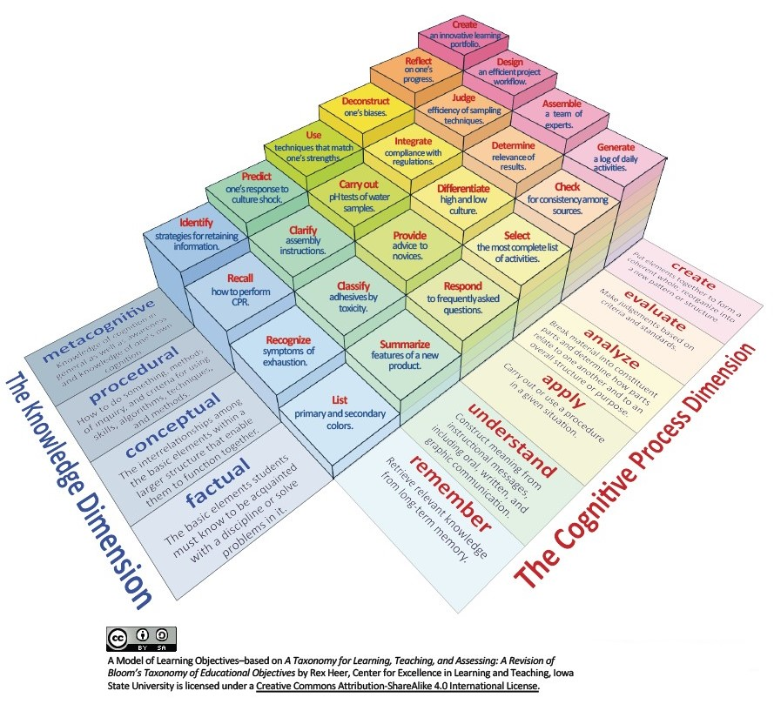
Notes:
Why " misalignment " in the examination of irregular verbs is challenging

Slide 19
Conclusions
CA is extremely important for courses with a heavy teaching load
CA improved student success

Slide 21
Calculation of ECTS points
Item | Hours | Remark | ECTS points
Contact teaching | 220 |  | 6:30
Lectures | 50 |  | 1.45
Seminars | 50 |  | 1.45
Exercises | 120 |  | 3.40
Non-contact teaching | 620 |  | 17.70
Preparation for contact classes | 120 |  | 3.40
Preparation for lectures | 10 |  | 0.25
Preparation for seminars | 50 |  | 1.45
Preparation for exercises | 60 |  | 1.70
Literature | 215 |  | 6,10
Simple text | 65 | 325 pages (5 pages/h) | 1.80
Complex text | 150 | 450 pages (3 pages/h) | 4.30
Tasks for independent work | 100 |  | 2.90
Preparation for the exam | 50 |  | 1.45
Independent study using the premises of the Institute | 40 |  | 1.15
E-learning | 95 |  | 2.70
In total | 840 |  | 24.00

