Slide 1


Anatomy teaching in Cambridge
Human Anatomy Centre, Department of Physiology, Development & Neuroscience

Slide 2

1. What is different about a collegiate university?
2. When is anatomy taught in the medical course?
How are the following emphases achieved?
Clinical relevance
Professionalism
Anatomical research

Slide 3


What is different about a collegiate university?
No “university campus”
Colleges are autonomous (31 in total)
Admissions interviews
College supervisions (small group tutorials)
Each student will have:
Director of Studies (academic progress)
Tutor (general wellbeing)
College nurse, wellbeing officer, chaplain
1. Features of a collegiate university
Notes:
31 Colleges in total, with 2 women-only, 3 mature only and 2 postgraduates only
Admissions interviews are conducted by Colleges

Slide 4




College life
Hall
1. Features of a collegiate university

Slide 5
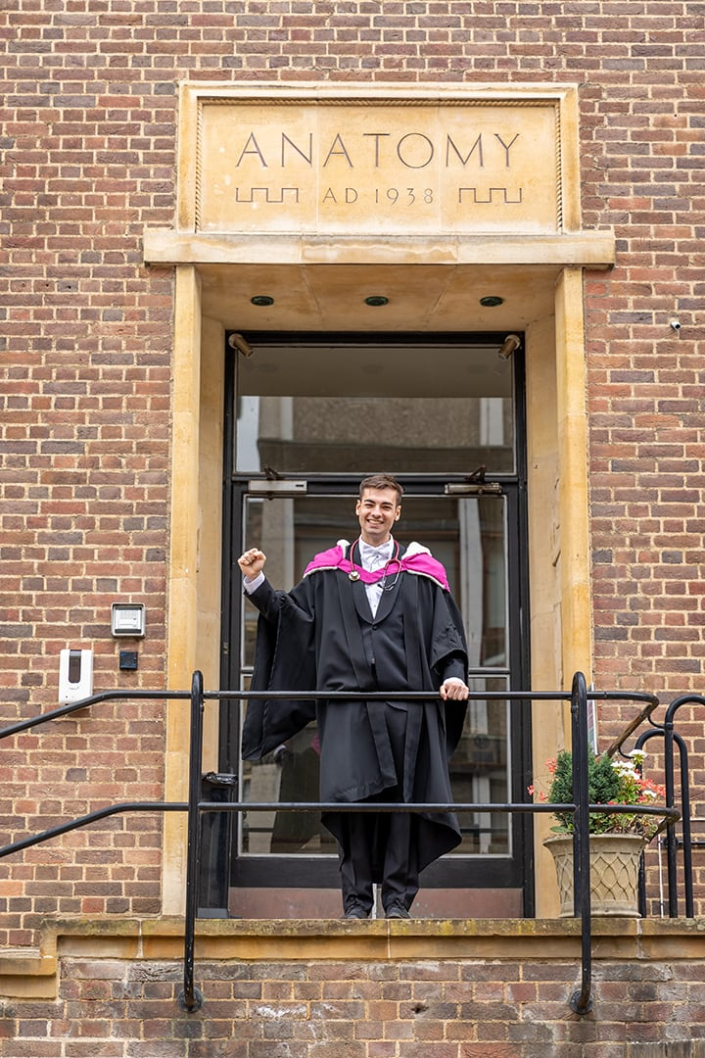
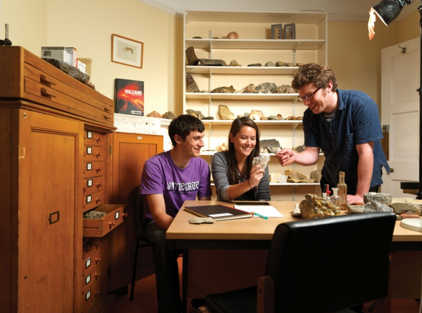
Anatomy Teaching
Central delivery
Anatomy School established in 1716
Lectures and practical sessions
Human Anatomy Centre, Anatomy Building
c.320 students per year
College provision
First dissections in Colleges in 1565
Small groups in college rooms
Resources vary between colleges
Supervisors: anatomists, clinicians
1. Features of a collegiate university

Slide 6
When is anatomy taught in the medical course?
Preclinical years: The Medical Sciences Tripos
Year 1 (Part IA) FAB (Functional Architecture of the Body)
cadaveric dissection
Year 2 (Part IB) HNA (Head and Neck Anatomy)
prosected specimens
Year 3 (Part II) Experimental Project
SaRA (Surgical and Radiological Anatomy)
Clinical years: School of Clinical Medicine and Regional Hospitals
Years 4-6 Anatomy Revision
Student Selected Components
Medical Electives
2. Anatomy in the medical course

Slide 7
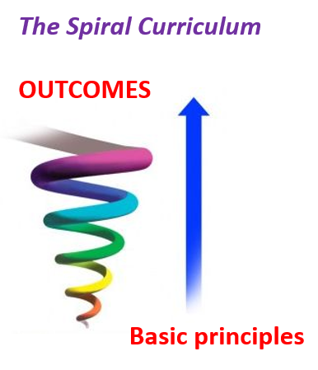
Emphasis on:
Clinical relevance
Professionalism
Anatomical research
2. Anatomy in the medical course

Slide 8
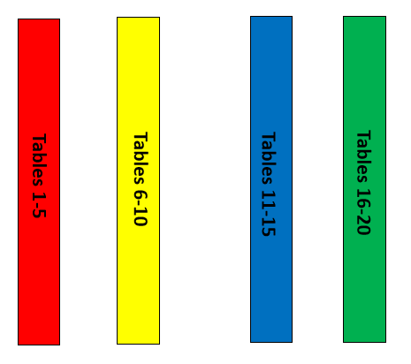
Emphasis on Clinical Relevance
DR Sessions: ultrasound, radiology, clinical examination
Annexe
Dissecting Room
TOUCHSCREENS
TOUCHSCREENS
“Live” demonstration
Rotating between Stations
Osteology and radiology
Prosections
Virtual dissector (Touchscreens)
Ultrasound or clinical examination
Change over and Handover
Dissection Room
Demonstration of variations/procedures
3. Emphasis on clinical relevance

Slide 9
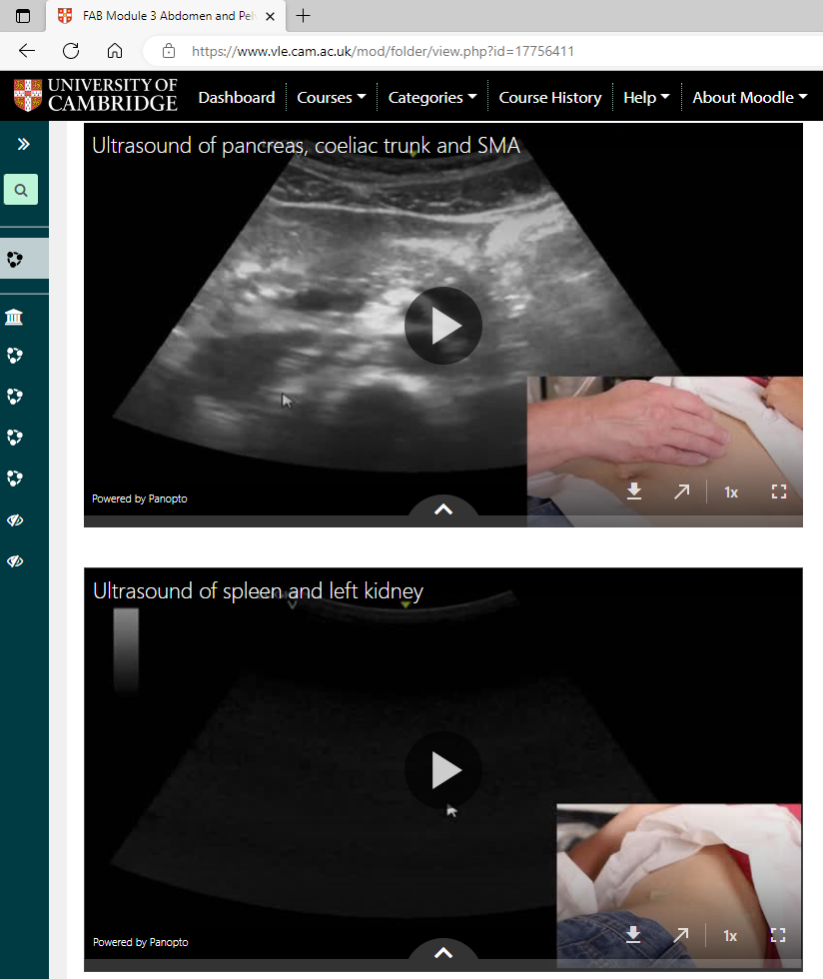
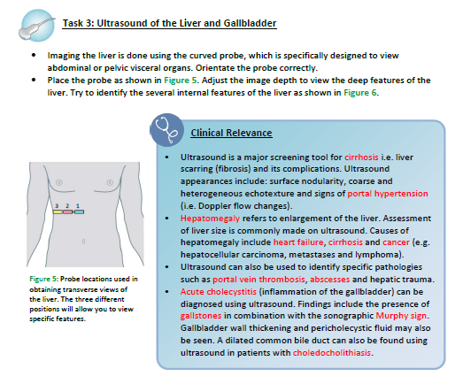
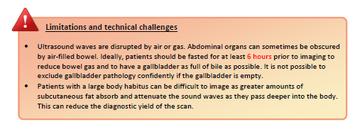
 | FIRST TERM | SECOND YEAR | SECOND TERM
WEEK | FIRST YEAR | SECOND YEAR | FIRST YEAR ONLY
1 | US: Basic principles | US: Revisit basic principles | US: Liver and biliary tract
2 | Clinical: Upper limb vessels | ULTRASOUND – revisit basic principles | US: Pancreas and spleen
3 | US: Upper limb vessels | US: Neck vessels, central lines | US: Kidneys, aorta and IVC
4 | Clinical: Neurological UL examination | ULTRASOUND – Neck vessels and central lines | Clinical: Catheterisation, pelvic and rectal examination (plastic models)
5 | US: Neck vessels | US: Salivary glands | US: Lower limb vessels
6 | US: Thyroid gland | ULTRASOUND – salivary glands | Clinical: Hip and knee examination
7 | US: Thoracic wall | US: Thyroid gland, airway access | US: Lower limb tendons
8 | US: Heart chambers |  | Clinical: Neurological LL examination
3. Emphasis on clinical relevance
Notes:
Over the summer videos created for every US session by consultant radiologist Dr Andrew Grainger on the Moodle – our virtual learning platform
Short video, split screen, positioning of the subject, the transducer, and highlighting the key anatomical structures
Complemented with instruction sheets:
- Learning outcome
- Defined task with instructions, and target images
- Clinical applications, especially the indications, diagnostic significance and use for US-guided procedures
- Limitations and technical challenges

Slide 10
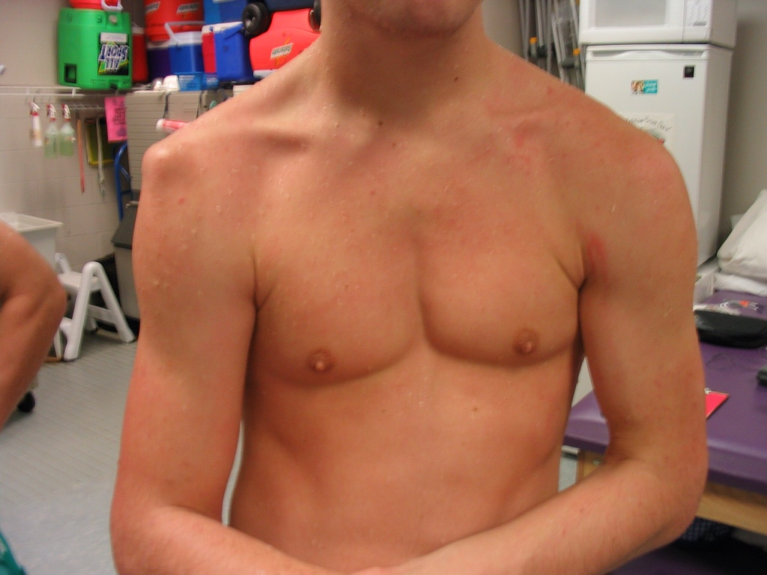
Emphasis on Clinical Relevance of anatomical knowledge
Applied Anatomy seminars: clinical case scenarios
Flipped classroom approach with students preparing cases in advance
College groups allocated for presentations & additional interactive quizzes
4 cases per week to complement dissection of specific regions
During a College rugby match, a 19-year-old left-handed fly-half who was preparing to pass the ball was tackled from behind by an opponent. As he was being tackled, his abducted right arm was driven into the ground. He was in severe pain and unable to move his right arm at the shoulder joint. On examination, his right arm was slightly abducted and externally rotated.
3. Emphasis on clinical relevance
Notes:
Questions:
From the history, what is the most likely diagnosis?
In which direction does this most commonly occur?
Which nerve is especially vulnerable to injury in this condition?
How should this patient be managed?
What do you notice about the patient’s right shoulder?
What is he doing with his left hand and why?

Slide 11

Emphasis on Professionalism
3 Key Outcomes: General Medical Council
Professional values and behaviours
Ethical responsibilities to donors
Tributes for committal & memorial services
Effective teamwork in practical sessions
“Our donors sparked enthusiasm and demanded respect. They were our first patient and forgave us any mistake we made, only wanting to teach us more. They made us consider the reverence of human life and through their donation taught us of the trust all patients will give us. They gave us confidence and awareness, all without uttering a word.”
3. Emphasis on professionalism

Slide 12
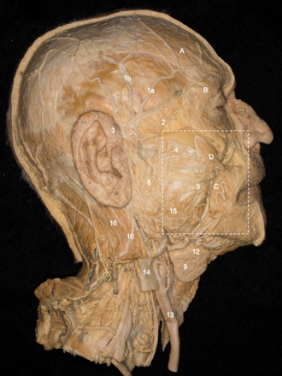
Emphasis on Professionalism
3 Key Outcomes: General Medical Council
Professional skills
Communication in handovers
Presentations in applied anatomy seminars
Manual dexterity and haptic ability
“Prosecting gives you the time to tease out finer structures and finer anatomical details than you could ever hope to in the DR. Opening your toolbox on day one is enough to make any aspiring surgeon giddy. You will develop a feel for which instrument is best suited to each task – the satisfaction this gives is hard to put into words.”
3. Emphasis on professionalism

Slide 13
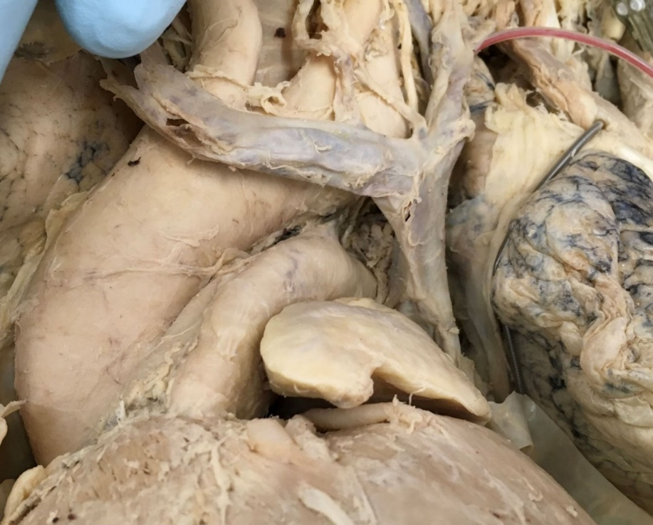
Emphasis on Professionalism
3 Key Outcomes: General Medical Council
Professional knowledge
Applying scientific principles
Awareness of anatomical variations
Surgical and radiological anatomy module
“The Surgical and Radiological Anatomy course has been the best choice I could have made. It has provided me with the foundations of surgical & radiological approaches, as well as the desire to pursue surgery as a career. The lecturers always referred back to the clinical importance of appreciating normal anatomy and variations in order to recognise pathology, which gave clinical context to the content."
3. Emphasis on professionalism

Slide 14
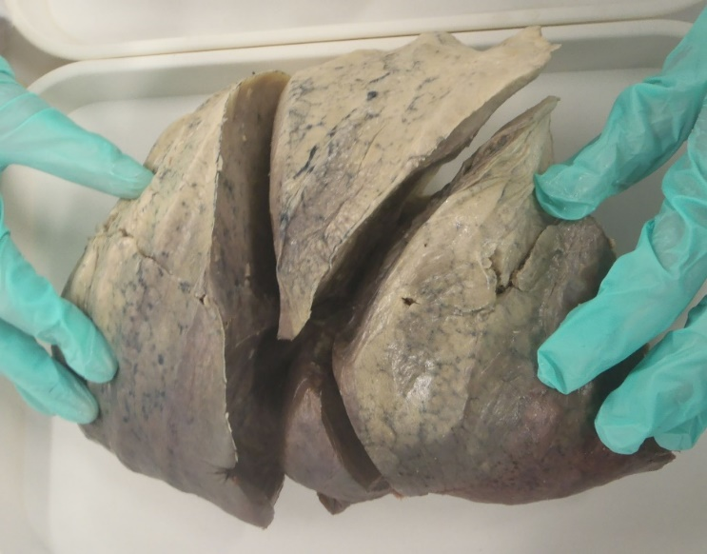
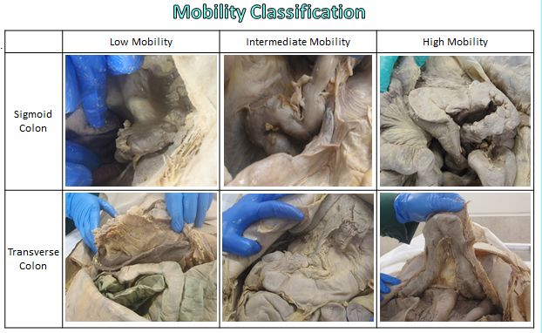
Emphasis on Anatomical Research
“It is argued that all teaching (including that of clinical anatomy) should be research-informed and that the discipline of clinical anatomy should have at its base a vigorous research ethos driven by clinically related problems. In interacting with physicians, the role of the clinical anatomist should be to promulgate a questioning scientific spirit, with its willingness to test and challenge accepted anatomic dicta.” Jones DG et al. (2002) Clinical Anatomy, 3:228-232.
Students participate in data collection
e.g. lung fissures, colonic configuration, etc.
Publications arising from work in department
available on virtual learning environment
3. Emphasis on research

Slide 15
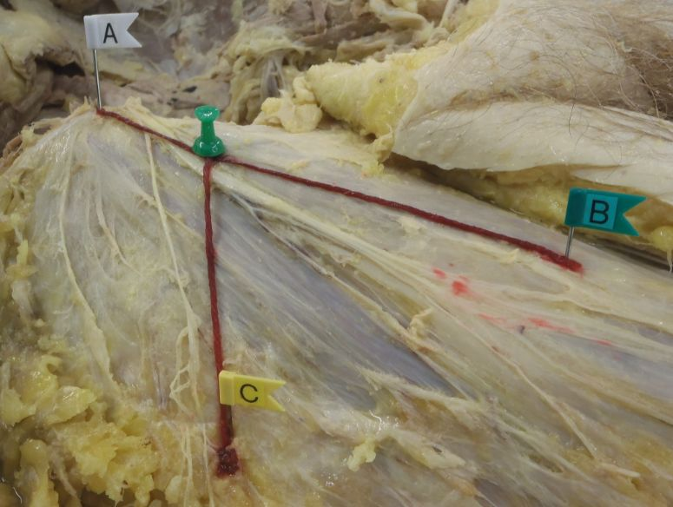
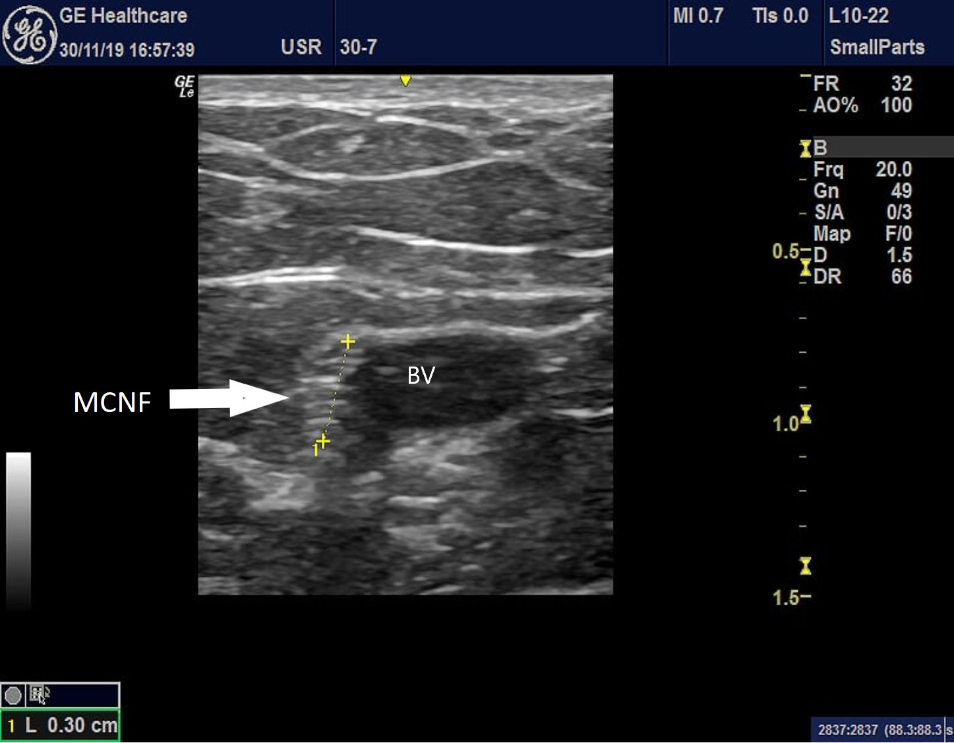
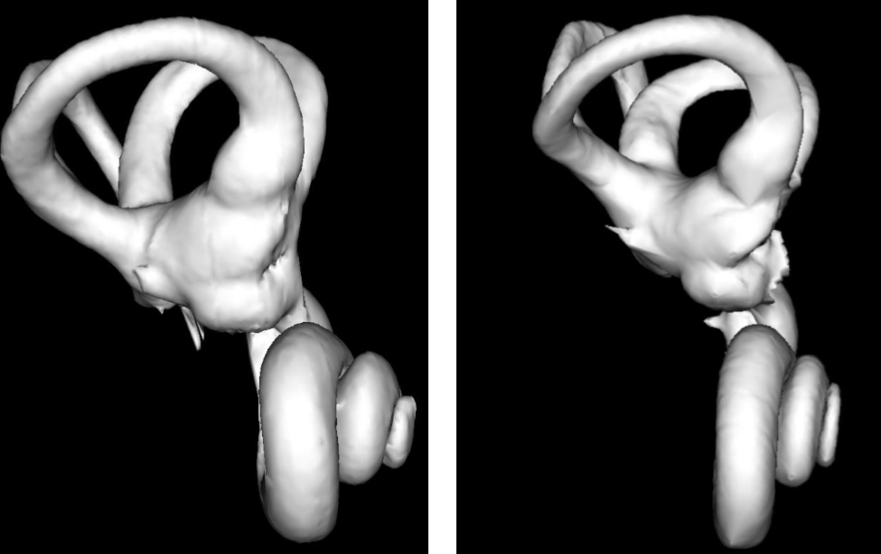
Emphasis on Anatomical Research
Third-year anatomical research projects
e.g. dissection, ultrasound, 3D reconstruction of microCT scans, etc.
Student selected components and medical electives
for clinical students in Years 4-6
Asking clinically relevant questions
Where? How? Why?
3. Emphasis on research

Slide 16
In Summary
Distinctive features of the collegiate system
Small group tutorials
Welfare support
Spiral curriculum with reinforcement of anatomy teaching
Dissection and prosections in preclinical years
Revision and research in clinical years
3. Particular emphasis placed on three areas
Clinical relevance: ultrasound, applied anatomy seminars
Professionalism: behaviour & values, skills, knowledge
Anatomical research: asking the right questions

Slide 17

Thank you for listening!

