Slide 1







The development of the innovative educational method of ACCESSIBLE tourism in Central Europe
2022-2-HU01-KA220-HED-000099410

Slide 2
12. A sensitisation event. A session with persons living with disabilities
Site visit to a best practice project

Slide 3

Proving the importance of accessible tourism: passing on information, facts and figures, the significance of the issue in contemporary tourism and its probably even more important role in the future in tourism
Focusing on the moral aspects of accessible tourism: this segment is not only a lucrative and until now largely untapped segment of tourism but also a segment whose servicing is a moral obligation of us all – society as a whole, businesses and organisations involved in any sector of tourism, and all individuals
Making people with and ones without disabilities meet – the encounters in life are not always obvious
The aim of the sensitisation event

Slide 4
Students of tourism related programmes and subjects in higher education
Staff of secondary vocational schools specialised on tourism and catering
Decision-makers in tourism: TDM organisations, staff of the national, regional and lower-level administration system of tourism, …
Relevant staff of mayor’s offices
Staff of tourism information services
Staff and owners of tourism services
Staff working at attractions
…
Attendees to be invited

Slide 5
Personal contacts
Snowball sampling: participants are asked to assist the moderator of the event in identifying other potential subjects, i.e. other potential participants at the sensitisation event
Directory of organisations (especially NGOs) specialised on the assistance of people with disabilities
Social media like LinkedIn, Meta etc.
People with disabilities to be invited – and how to contact them

Slide 6
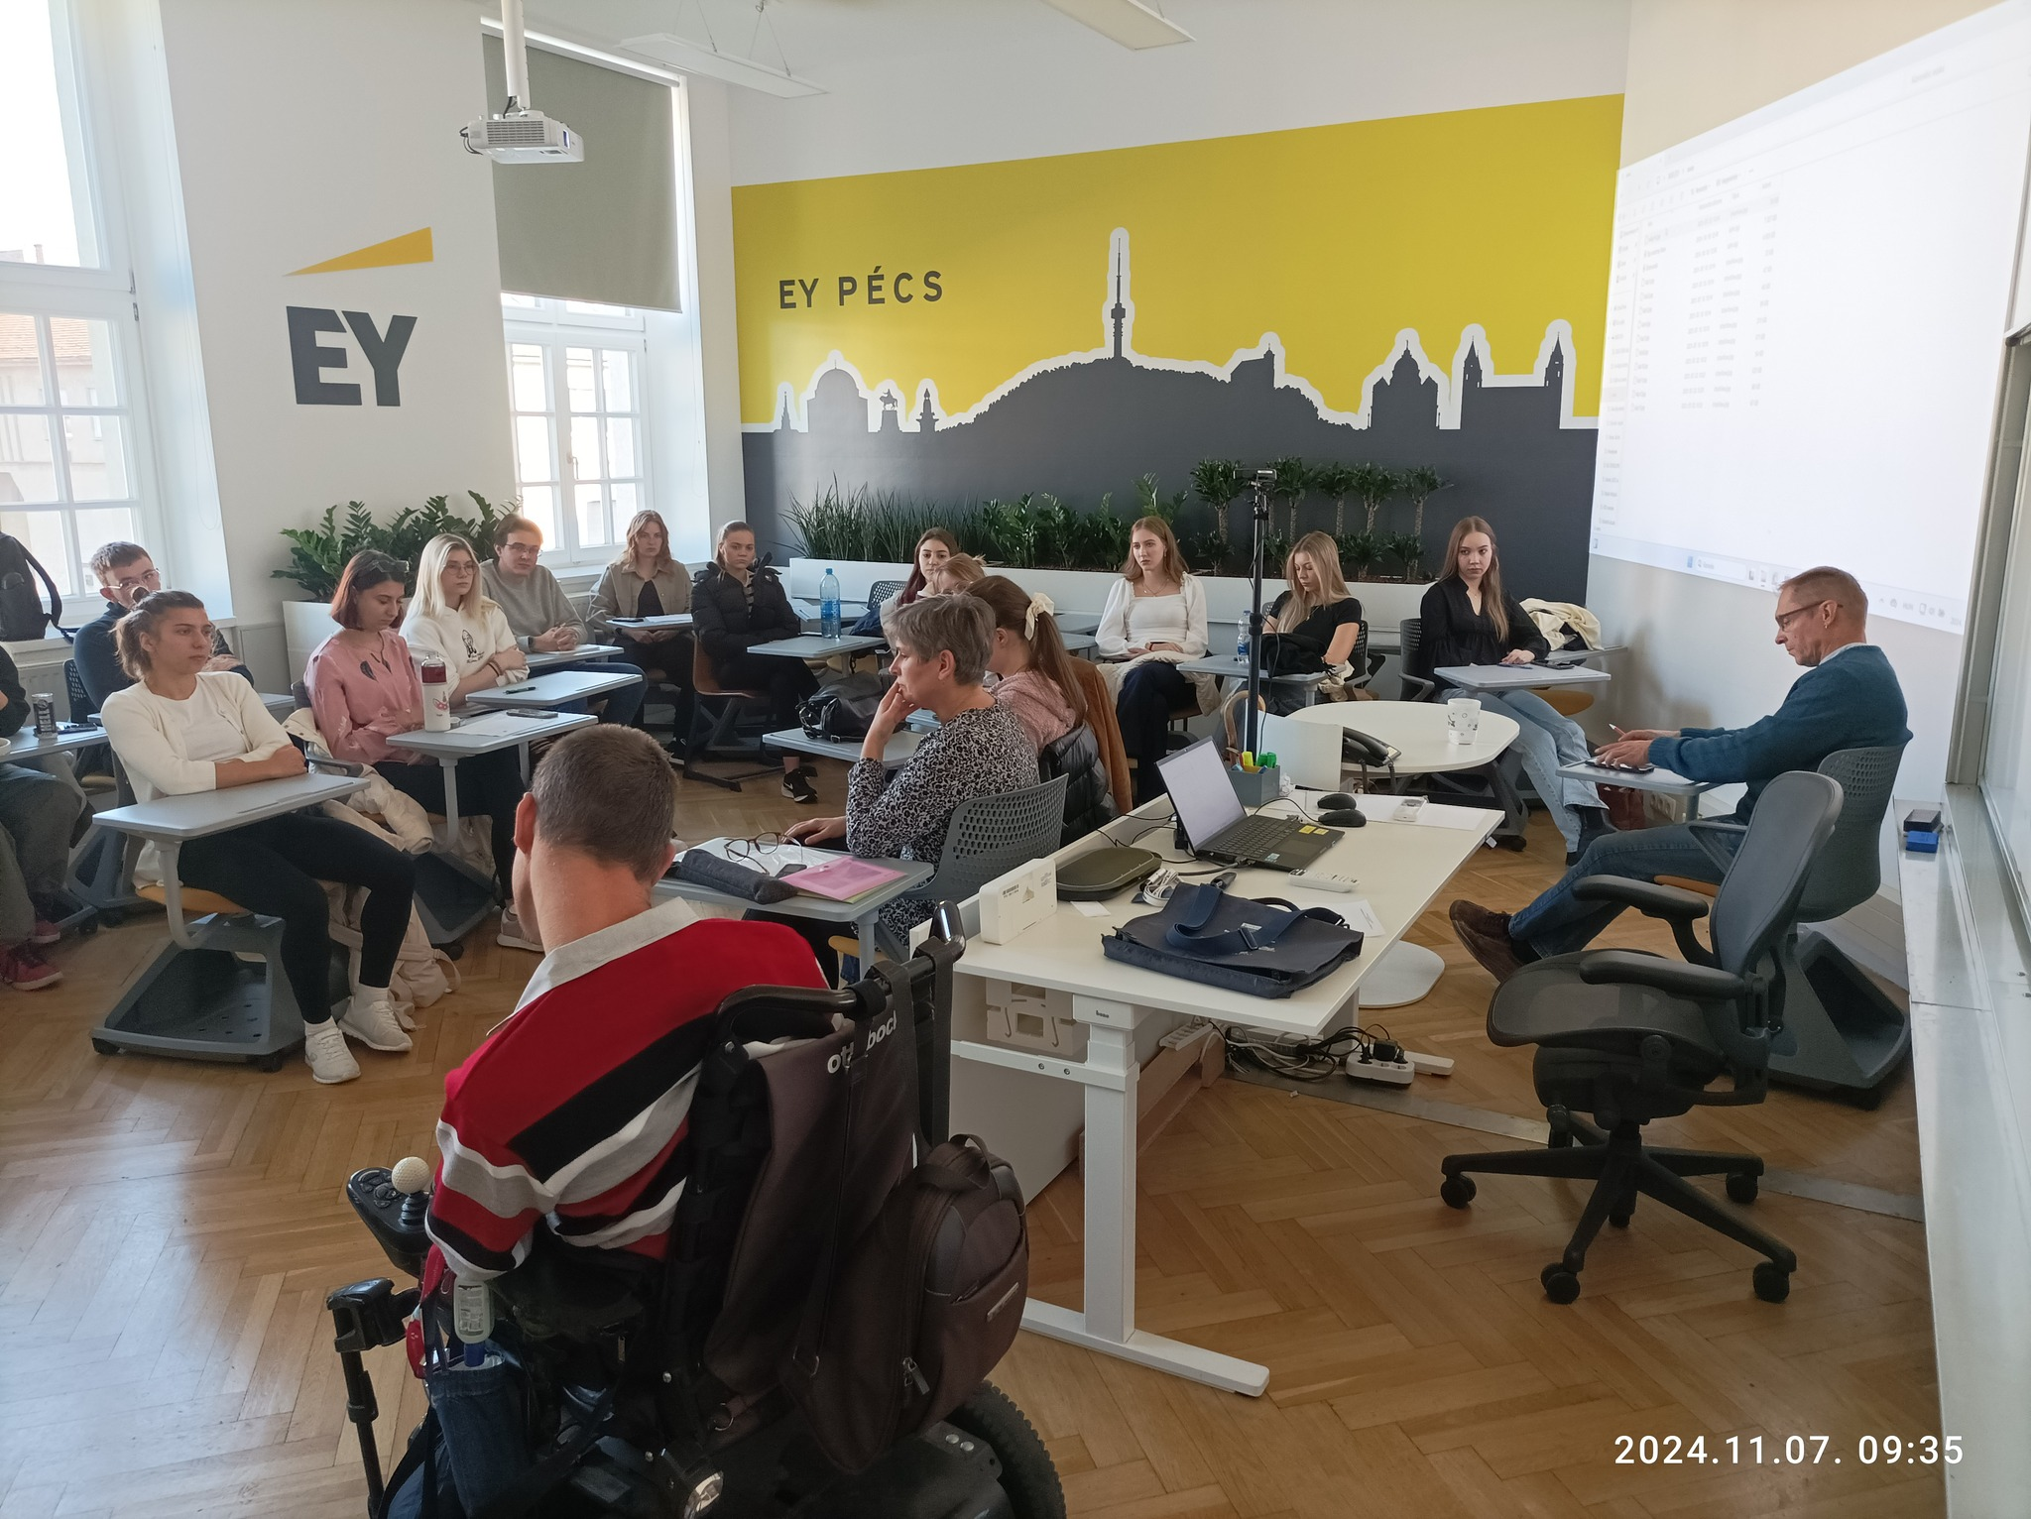
Invited people with disabilities: a blind person and a person in wheelchair and with speech disorder, and an assisting person working for an NGO that helps PwD (sitting opposite to the audience)
Participants: a moderator; students of the course Accessible tourism and The system of tourism in the Tourism and Catering programme at the Faculty of Business and Economics of the University of Pécs
A sensitisation event – Pécs, Hungary, 7 November 2024
Photo by Gonda, T.

Slide 7
A personal encounter of those interested – people living with different disabilities (possibly a blind person or persons, one(s) in wheelchair, one with hearing loss, one(s) with autism or other intellectual disorder etc.)
Presentation of the problems these people come across in their everyday lives and during their travels
Identification of good practices and advice to the non-disables on how to help
Situation games: a person with disability and a non-disabled participant (from the audience) at the event play a real-life situation (managing affairs e.g. at a mayor’s office or a post office, asking for help to cross the road or get on a bus etc.)
Programme(s) of the sensitisation event

Slide 8
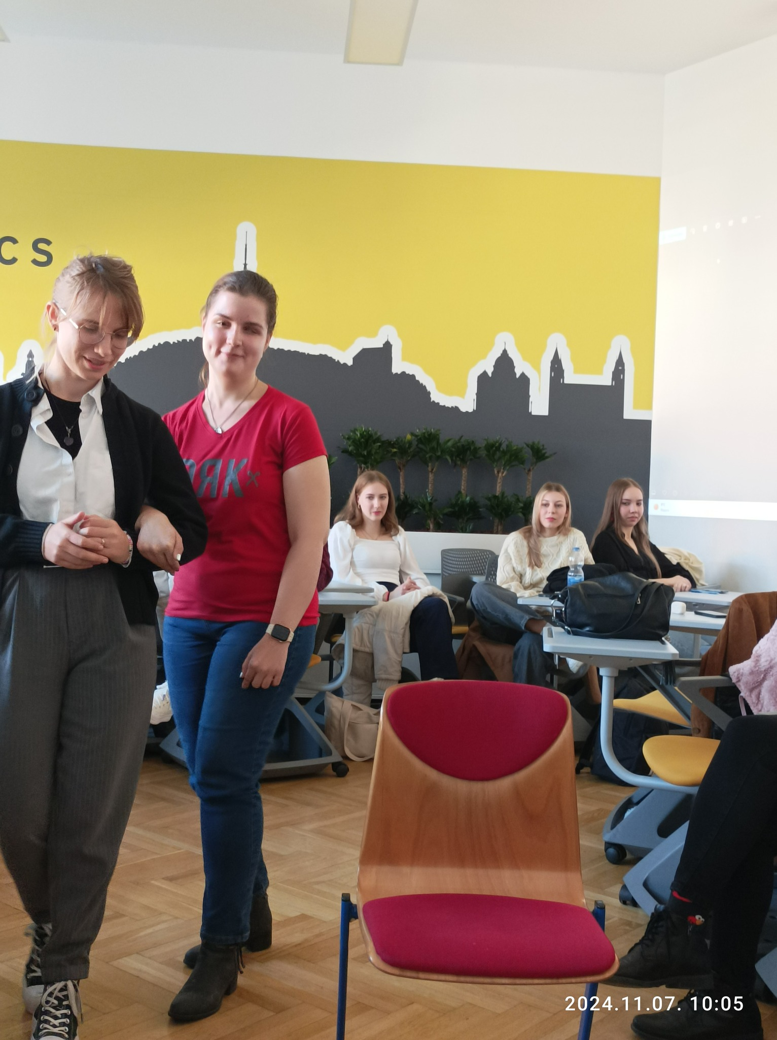
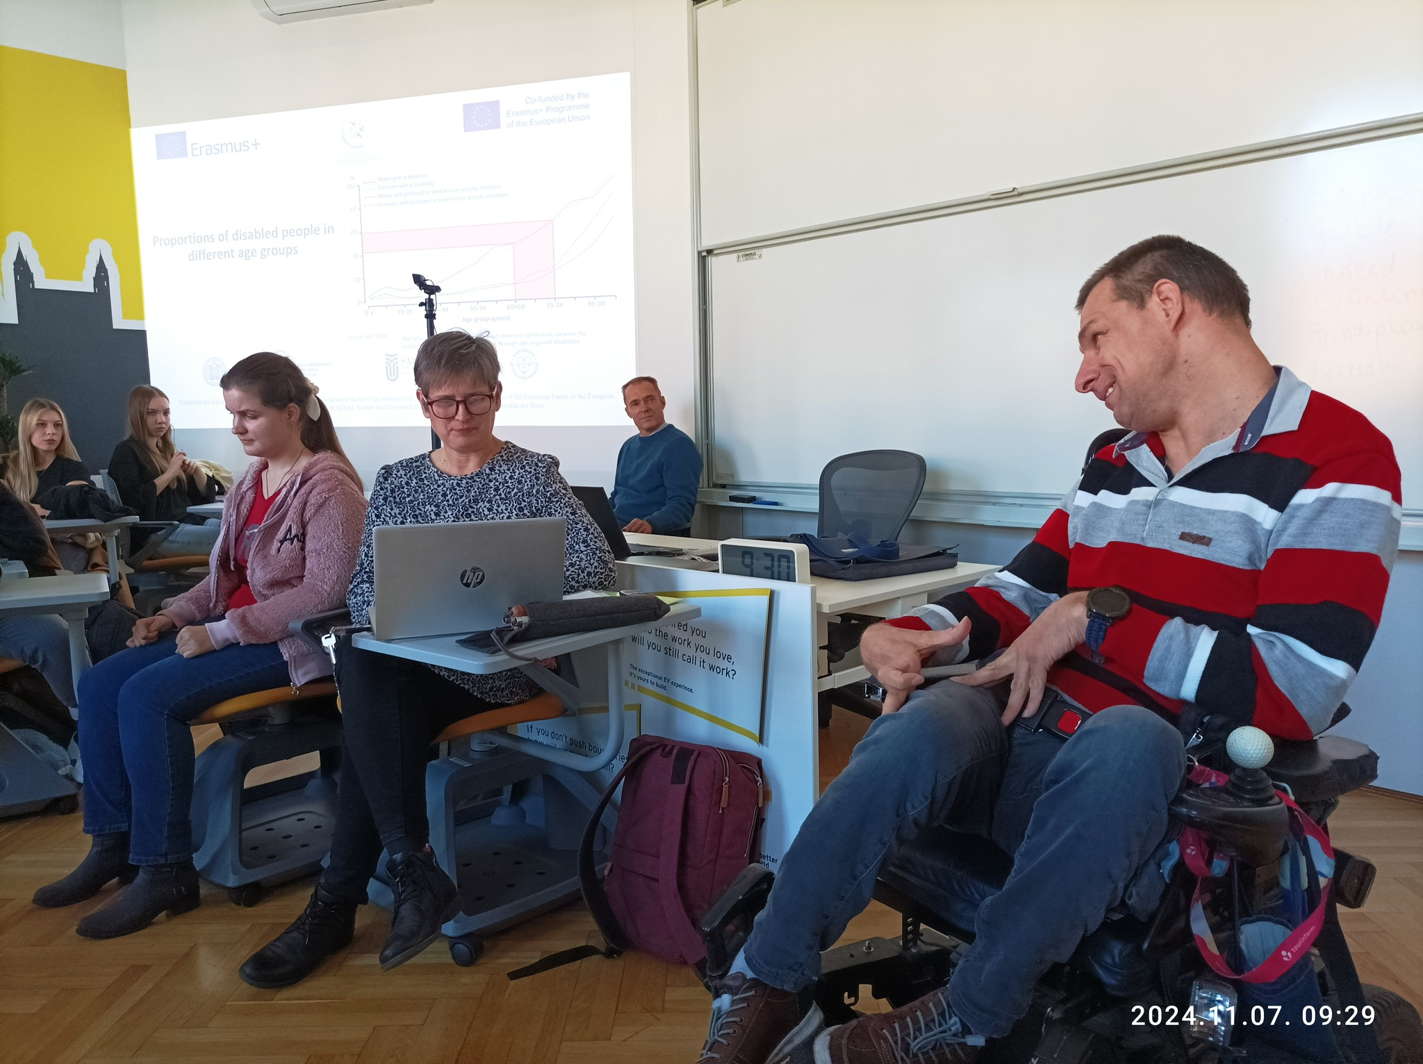
A student (to the left) is taught by a blind person (to the right) about how to help a blind person in a way that is not intrusive
A situation game
→
Pécs, Hungary, 7 November 2024
An invited person with mobility and speech impairment is telling his problem to an “administrator” at an office, i.e. a student in the game
←

Slide 9
Relaxed environment – a university lecture room, a quiet conference room etc.
Enough time should be devoted so that participants can get to know each other
A moderator – possibly the lecturer
Asking for feedbacks from the (non-disabled) participants (after the disabled invitees have left, or as written feedback after the event):
– whether the event changed their attitudes towards people living with disabilities and if so, in what;
– whether they would find it useful to organise an in-house sensitisation event at their organisations;
– what they think they could personally do to promote the issue of accessible tourism;
– etc.
Important issues for the organisation of the sensitisation event

Slide 10
Site visit to a best practice project

Slide 11
“Good practice” means a method or activity that includes ideas and procedures that promote the development of a given business or organisation, in our case the provision of accessible tourism services, the development of high-quality service practices
Accordingly, a good practice should be successful; innovative; applicable in other areas; sustainable; and a positive example for others to follow
What makes a good/best practice?
https://www.accessibletourism.org/?i=enat.en.reports.1740

Slide 12
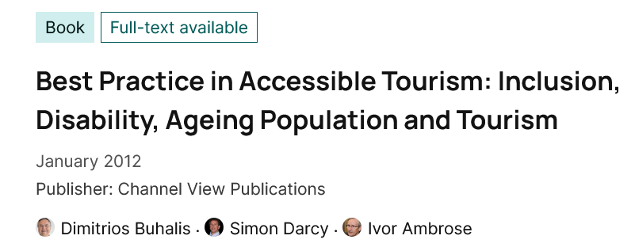
Professional literature (domestic and occasionally international periodicals, books)
Traditional print and electronic media (newspapers, television, radio)
Social media
Non-governmental organisations assisting people with disabilities
Chambers (of commerce and industry, agriculture etc.)
National support schemes
Cross-border cooperations
Personal acquaintances, knowledge
…
Where to collect good practices from?

Slide 13
By and large the same as the circle of attendees to a sensitisation event (presentation 11):
Students of tourism related programmes and subjects in higher education
Participants in a site visit to a good practice
Staff of secondary vocational schools specialised on tourism and catering
Decision-makers in tourism: TDM organisations, staff of national, regional and lower-level administration system of tourism, …
Relevant staff of mayor’s offices
Staff of tourism information services
Staff and owners of tourism services
Staff working at attractions
Decision-makers and staff of a similar organisation or business as the one visited
People living with disabilities, organisations assisting them who might benefit from the experience
…

Slide 14
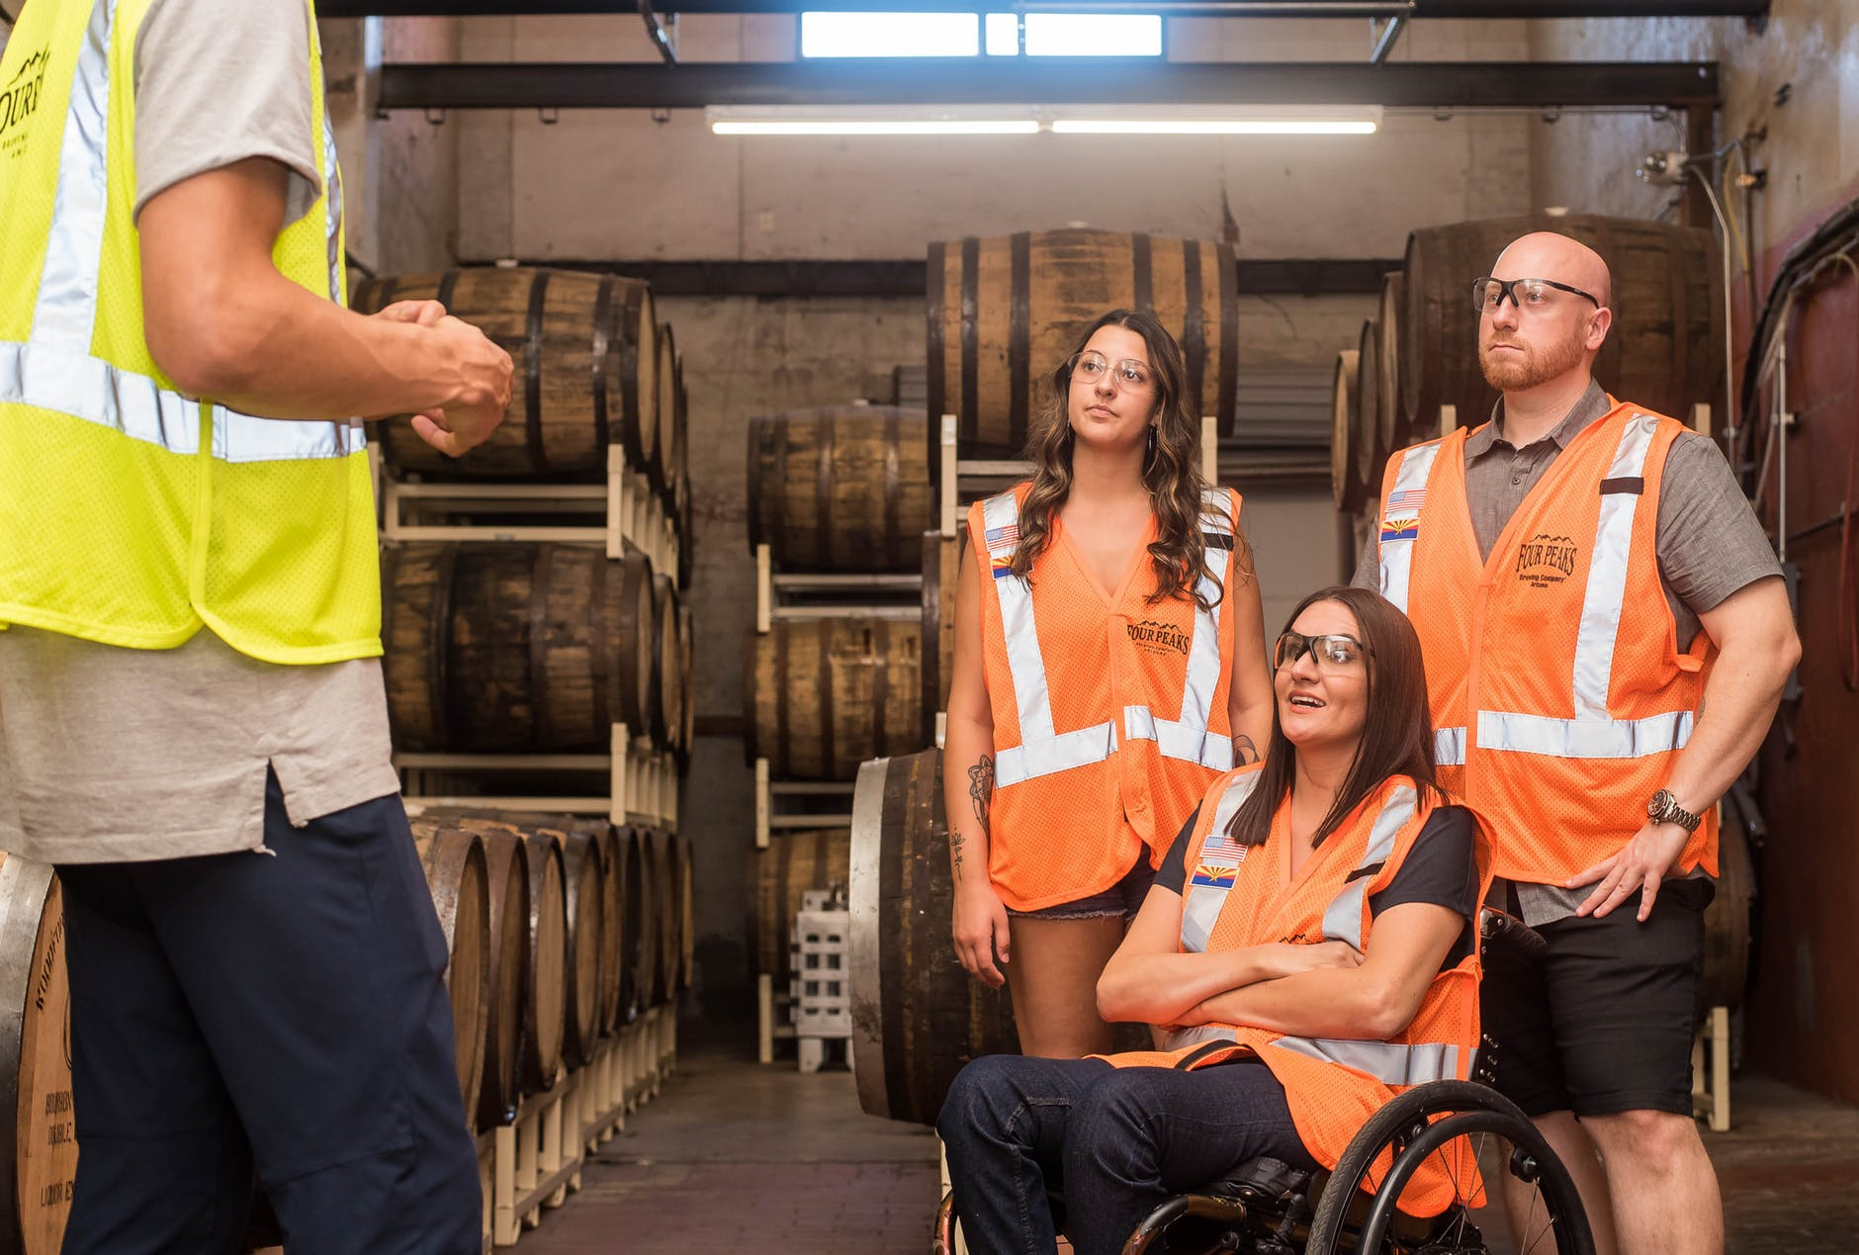
Decision made on what best practice to visit
Get contact person’s details
Agreement on a suitable date
Decision on the circle of attendees who may benefit the most from the site visit
Assessing the interest, possible number of participants
Organising media presence (if necessary)
Organising a site visit
https://employabilities.ab.ca/tips-for-employers-who-want-to-hire-people-with-disabilities/

Slide 15
Greetings by a responsible and competent person
Site visit: introduction to the most useful of most interesting part(s) of the project/site/business/organisation
Q&A session – or questions continuously answered by the host(s)
Get feedback from participants after the visit on what to adapt from the experiences of the site visit
A written memo summarising the findings and the main conclusions, focusing on the adaptability of the good practice elsewhere
Feedback to and thanking the host for the event
Schedule of a site visit to a good practice

Slide 16
Examples for international good practices

