Slide 1
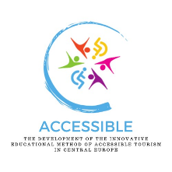
The development of the innovative educational method of ACCESSIBLE tourism in Central Europe 2022-2-HU01-KA220-HED-000099410

Slide 2
10. Good practices in accessible tourism at international level and in the partner countries of the project

Slide 3
For some international organisations engaged with the promotion of the issues of people with disabilities, see Presentation 7 of this course, called “Organisations supporting travel for people with disabilities”
Good practices in accessible tourism at international level

Slide 4
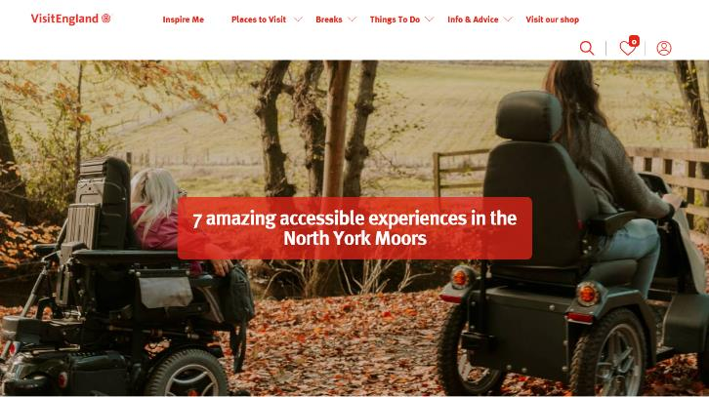
https://www.visitengland.com/accessible-holidays-accommodation-attractions-north-york-moors
Good practices in accessible tourism at international level – VisitEngland

Slide 5
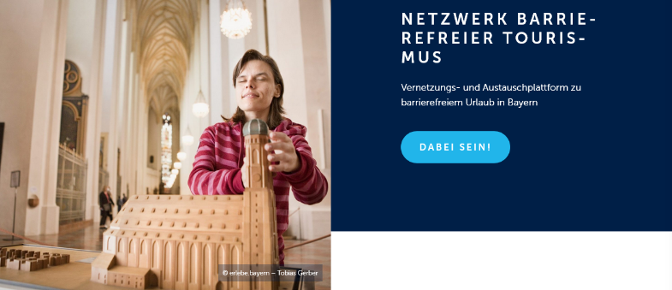
https://tourismus.bayern/destinationsentwicklung/nachhaltige-destinationsentwicklung/barrierefreier-urlaub-in-bayern/
Good practices in accessible tourism at international level – Bayern Tourismus Marketing GmbH , Germany

Slide 6
https://www.awosano.de/gruppen/handicapped-reisen.html
Good practices in accessible tourism at international level – Awo Sano GmbH, Germany

Slide 7
The main problems that prevent tourists with disabilities from travelling include a poor attitude of staff towards disabilities, poor customer service and a lack of information about the services available (Europe Without Barriers, n.d.) Certifications and labels are a valuable source of information for consumers Although important steps have been taken in recent years, much remains to be done to make Europe a truly accessible destination, attractive to millions of international customers who today still prefer destinations that have been best tested from an accessibility point of view (Europe Without Barriers, n.d.)
Good practices in accessible tourism at international level – certification systems

Slide 8
“travel for people with disabilities is unpredictable; difficult or impossible; quality of infrastructure, transport, services and information varies widely both within and between EU member states; and lack of standards increases uncertainty, reduces travel options and allows a lack of accountability to prevail”; “accessible tourism market is relatively unknown and seems difficult to attract with existing channels; visitors’ needs and requirements are unknown or misunderstood – therefore avoided; investment costs are misunderstood and exaggerated; access is seen as a problem rather than a golden opportunity” (Soret, Ambrose & Vicens, n.d.)
Good practices in accessible tourism at international level – need for certification systems

Slide 9
For all these reasons, it was important for ISO to develop the first International Standard that provides requirements and guidelines to enable equal access to tourism for people of all ages and abilities – ISO 21902 (ISO, 2021) This new standard is aimed at “national tourism administrations and tourism boards, municipalities and public bodies responsible for infrastructure policy, development and the legal/regulatory framework” (ISO, 2021) Of great importance as it enables standardisation and ensures the quality and reliability of services provided to people with disabilities
Good practices in accessible tourism at international level – ISO 21902 certification system

Slide 10
ISO standards helpful in reaching accessibility for everyone and everywhere
Step | Standard | Description
The tourist office | ISO 14785 Tourism information offices – Tourist information and reception services – Requirements | Considers elements such as access to the door, but also access to the information they distribute, taking into account hearing and sight
Accessibility at every step of the journey | ISO 21902 Tourism and related services – Accessible tourism for all – Requirements and recommendations | The aim is to help travel and tourism businesses improve their current accessibility arrangements, covering information on all areas of policy making, strategy, infrastructure, products and services that are highly relevant to the entire tourism value chain
Beaches for all | ISO 13009 Tourism and related services – Requirements and recommendations for beach operation | Outlines recommendations such as the design of access ramps and walkways as well as on-site facilities, including toilets, showers and drinking fountains

Slide 11
ISO standards helpful in reaching accessibility for everyone and everywhere
Step | Standard | Description
Tourism for all the senses | ISO 17409 Accessible design – Application of braille on signage, equipment and appliances | Enables visually impaired travellers to access information wherever they are
 | ISO 23599 Assistive products for blind and vision-impaired persons – Tactile walking surface indicators | Helps in visiting new places more easily and safely
Accessibility in all standards | ISO/IEC Guide 71 Guide for addressing accessibility in standards | Recommends that ISO technical committees consider the needs and challenges of people with disabilities when developing standards, especially those related to systems that people use, interact with or need to access

Slide 12
From the perspective of service providers, the ISO Standard 21902 provides them with tools to (UNWTO, n.d.) – eliminate all kinds of access barriers for tourists and locals; – ensure the integrity of the tourism value chain; – raise awareness among the general public; – train tourism official and professionals; – analyse the offerings of competitors and understand the market; – gain knowledge on the benefits and business opportunities that accessible tourism entails; – optimise customer service at tourist information centres; – improve product design, marketing and promotion; – deliver quality accessible experiences; – design economic and fiscal incentives for companies to implement accessibility; – save on costs for improvements in coordination by including accessibility in the planning stage
The ISO Standard 21902 certification system

Slide 13
There are several areas in which public administrations and/or tourism destinations should engage in the development of accessible tourism standards – awareness raising and training, planning, accessibility management, research and innovation, legislation and standardisation, investment, product development, information provision, monitoring and evaluation, dissemination of success stories and ongoing consultation (UNWTO, n.d.)
The ISO Standard 21902 certification system

Slide 14
Belgian Accessibility Office, Toegangelijkheidsbureau (TGB): “The Accessible Tourism Destination Certification Programme (ATDCP) is based on a comprehensive audit of the Destination Management Organisation’s accessible tourism measures, infrastructure, transport, services and visitor information and includes assessments of the accessibility of the outdoor environment, accommodation, attractions, activities and services for visitors, including people with disabilities, older people and families with young children“ (ENAT, 2011)
The Belgian Accessibility Office certification system

Slide 15
Physical accessibility highly depends upon Universal Design (UD): design to meet the needs of all people who wish to use it. This is not a special requirement that only benefits a minority of the population; when an environment is accessible, usable, comfortable and pleasant to use, everyone benefits. By considering everyone’s different needs and abilities throughout the design process, universal design creates digital and built environments, services and systems that meet people’s needs (Centre for Excellence in Universal Design, n.d.) In order to facilitate such design, there are several suggestions how environments can become more accessible
Good practices in accessible tourism – physical accessibility

Slide 16
Suggestions on how environments can become more accessible: Principle 1 – equitable use Principle 2 – flexibility in use Principle 3 – simple and intuitive use Principle 4 – perceptible information Principle 5 – tolerance for error Principle 6 – low physical effort Principle 7 – size and space for approach and use
How environments can become more accessible

Slide 17
E.g. drinking fountains grouped with other facilities to make them easier to find, consistent signage/wayfinding, lighting along perimeter paths, nodes directly connected by paths, rest areas throughout the site, restrooms sized to accommodate large numbers of users simultaneously, signage within sight, signage in other languages and in English, visual and tactile warning surfaces and walls, fences and landscape features that serve as wayfinding to key destinations (Maisel & Ranahan, n.d.)
Good practices in accessible tourism – universal design features in public spaces

Slide 18
Inclusion in and through sport means that every person in every role – whether athlete, coach, official, administrator or spectator – is treated with full respect, dignity, value and belonging. Inclusion includes all populations, regardless of ethnicity, culture, gender, sexual orientation, religion and disability. Sport for inclusion is important because it promotes the values, ideals and visions of acceptance, human rights and non-discrimination. Sport for inclusion questions and challenges the notion of exclusion (The International Platform on Sport and Development, 2020)
Good practices in accessible tourism – sport facilities for PwD

Slide 19
Despite progress in sporting opportunities for PwD, barriers still exist. 2018 Eurobarometer report: disability or illness is the third most common reason – cited by 14% of respondents – for not taking part in regular sport, along with lack of time and lack of motivation or interest (European Parliament, 2021) Such circumstances require appropriate facilities that would meet the needs of all potential tourists. In line with the idea of universal design, and the benefits of sport activities for each individual, sport for inclusion should be in the focus of development strategies worldwide. Either outdoor or indoor, sport activities enhance the quality of life and add value to the overall satisfaction (or frustration as a basis of improvements) of individuals. From that perspective sport is a valuable addition to a person’s life
Good practices in accessible tourism – sport facilities for PwD

Slide 20
“The type of disability may have a specific medical name but whether it really needs to be a disability in everyday life often depends on external factors such as the design of buildings, other people’s attitudes, the tools provided to do a task. For people with disabilities, sport can either be a source of frustration and exclusion or it can provide a remarkable opportunity to shine and thrive. In fact, sport can be the moment when people who live in a world that usually makes life especially difficult for them, suddenly find they can achieve the same as others and, often, even more” (Sport Safe, n.d.)
Good practices in accessible tourism – sport facilities for PwD

Slide 21
Various organisations help with ideas about how sports provision can be adapted to benefit from involving everyone. E.g., Get Out Get Active (GOGA) is a programme that supports disabled and non-disabled people to enjoy being active together. They suggest that before joining a club or venue you could ask (Sport Safe, n.d.)
Good practices in accessible tourism – sport facilities for PwD
if the sessions are disabled-only or mixed;
what equipment and kit you will need and if you can hire it;
how accessible the venue is;
if they can meet your needs and any reasonable adjustments;
what facilities are nearby;
if the session is outdoors;
what policies are in place, for example safeguarding or equality and diversity;
if the activity is appropriate for your age group;
if the instructor is aware of your condition or willing to learn about it;
if first aid is available if they offer free taster sessions

Slide 22
Disability rights movement, increasingly led by people with disabilities, has rallied behind the principle ‘Nothing about us without us’, calling on governments and international organisations to include people with disabilities in planning and decision-making. In recent years, disability advocates have changed this slogan to ‘Nothing without us’, recognising that many challenges affect us all. Social justice, equality and inclusion are buzzwords that alone do not make a meaningful difference for people who are historically marginalised and isolated. Everybody should stand in solidarity with people with disabilities and older people around the world as they demand equal human rights
Good practices in accessible tourism – sensitisation, awareness raising

Slide 23
Psychologists believe that increased contact between people who are different from each other can lead to more harmonious feelings and behaviour (Dunn, 2022). Changing people’s minds happens positively when ● interaction is personal: contact is personal, so people without disabilities can interact with people with disabilities ● people are equal: people from each group are seen as equal in status or value ● there are social norms: expected behaviour in a given situation encourages contact between respective group members ● cooperative activities take place: individuals from each group work together on a project to achieve common, specific goals
Good practices in accessible tourism – sensitisation, awareness raising

Slide 24
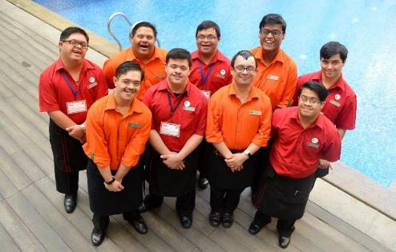
Potentially, employment of PwD could be used as a revenue enhancing strategy if customers are willing to pay more for this type of CSR practices. Furthermore, companies could use the employment of PwD as a brand-building strategy. Many customers might be more willing to visit hotels that employ people with disabilities than those that do not (Köseoglu et al., 2021)
Good practices in accessible tourism – providing jobs for PwD in the tourism sector
The specially-abled ‘Happy People’ at Lemon Tree Hotels
Read more at: https://www.hrkatha.com/practice/the-specially-abled-happy-people-at-lemon-tree-hotels/

Slide 25
At SMEs, accessibility training is often very low on companies’ training and skills priorities: e.g. a survey of tourism businesses carried out by VisitEngland in 2009 found that 21% of businesses that do not currently offer disability awareness training to their staff stated that ‘nothing’ would prompt them to offer this training Similarly, the Accessible Tourism Stakeholders Forum in the UK asked businesses about the likelihood of attending training in the next 12 months. 69% of respondents answered that it was very unlikely or fairly unlikely (Elevator project, 2018)
Good practices in accessible tourism – education and training

Slide 26
Objectives that a proposed and developed training programme should pursue: ● Provide knowledge to staff working in the tourism industry to take accessibility issues into account when renovating, building and designing tourism activities, products and services ● Provide knowledge on the care of customers with special requirements to staff working in the tourism sector ● Identify the main barriers to accessibility of tourism destinations and facilities and provide alternatives for improvement ● Familiarise them with the use of technical aids ● Disseminate the existing legal provisions
Good practices in accessible tourism – education and training

Slide 27
Tourist guides play an important role in making tourism more accessible and inclusive, as they are representatives of the cities, regions and countries in the area for which they are qualified and have a major impact on the overall success of the trip and visitor satisfaction. Inclusive tourist guides are also the way to maintain and improve the quality of guiding services, which is seriously threatened by the deregulation of professional tourist guides at European level. For these reasons it is important to have a manual developed specially for educational purpose for tourist guides, enabling them to obtain knowledge about specific skills required to communicate with this segment of tourists (Elevator project, 2018)
Good practices in accessible tourism – education and training

Slide 28
● the co-creation of disability-inclusive skills and knowledge (content); ● concepts for disability-friendly educational planning; ● disability-friendly legal framework conditions; ● marketing and communication of education providers that promote the inclusion of people with disabilities, using accessible language and media; ● networking and cooperative relationships between the education sector and the disability sector; ● investment in ongoing research to understand the needs of PwD in tourism; and ● disability-friendly teaching and learning methods, processes and procedures in the tourism education environment
Good practices in accessible tourism – interactive success factors that enhance accessible tourism education

Slide 29
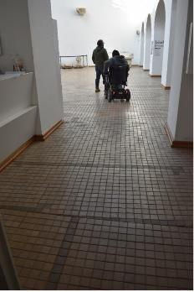
One of the most accessible archaeological museums in Croatia Entrance to the courtyard and the interior of the museum are barrier-free, no raised areas, thresholds or other obstacles. Corridors are spacious and the spatial communication is logical and continuous Entire exhibition is accessible to all visitors, as an elevator of appropriate dimensions leads to each floor. Spacious accessible toilet Content accessible for people with visual and hearing impairments is still to be developed
Good practices in accessible tourism in the project countries – Croatia: Osijek Archaeological Museum

Slide 30
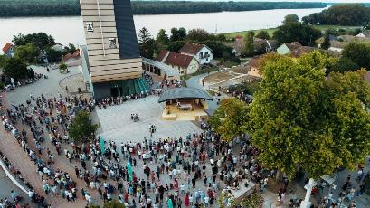
Contemporary sacral object with accessible contents Small paved square in front of the church: completely flat, with benches, as well as surfaces of varying textures leading up to the church that serve as tactile indicators for the visually impaired On the square two accessible viewpoints that can be reached by visitors in wheelchairs with a little help Accessible restroom (to be developed) Nearby a paved Calvary path with roughly the same gradient as the church’s viewpoints, so all can reach the top with some help
Good practices in accessible tourism in the project countries – Croatia: Shrine of Our Lady of Sanctuary of Aljmaš

Slide 31
Association of Tourist Guides of Pula and the Association of the Blind of Istria County have launched the project “Colours of Inclusive Tourism” First tourist guide company in Croatia with members with professional training: they present the world around them in the most suitable way for the blind and visually impaired GPS technology and voice software built into cell phones, with the most important sights of Pula and Premantura. A spoken tourist map of Istria with 134 tourist points created; available via voice computer With cooperation between the Association of Tourist Guides in Pula, the Association of the Blind of Istria County and the Istria Mountain Guides Station, tourist guides and mountaineers will be able to apply the acquired knowledge and skills in guiding and hiking with blind people in their further work with groups of people with disabilities
Good practices in accessible tourism in the project countries – Croatia: Tourist guides in Pula

Slide 32
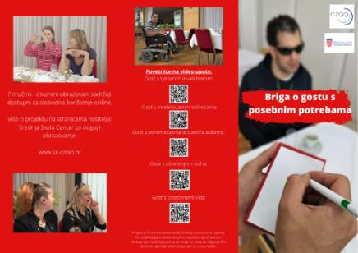
Handbook published in 2020, funded by the Ministry of Tourism and Sports (creators: High School Project – Centre for Education Zagreb in partnership with Centre for Education “Vinko Bek”, Centre for Education “Slava Raškaj”, Zagreb, and the Electrical Engineering School, Zagreb) Very clear instructions on how to serve guests with different types of disabilities. Video examples also included – support procedures for guests with hearing impairment, with intellectual difficulties, with autism spectrum disorders and with physical disabilities
Good practices in accessible tourism in the project countries – Croatia: Manual “Care for guests with disabilities”

Slide 33
Access to the entrance of visitor centres possible by car; in Skradin and Drniš, a tour of the facilities on the floors is possible by elevator; access to the Movement Centre in Laškovica via a ramp; special toilet for wheelchair users Visitor infrastructure includes excursion boats with a transition ramp, buses with access ramp for wheelchair users, paved access to the facilities, paved areas on the plateau Krka Eco-Campus supports accessibility, equal opportunities and social inclusion: accessible facilities for PwD and reduced mobility. Park administration has planned several tasks for the future: full electrification of boat transportation, fully adapted to wheelchair users; conducting training for NP employees to raise awareness of the importance of accessible tourism; and continuous cooperation with associations so as to improve content and sharing experiences
Good practices in accessible tourism in the project countries – Croatia: Wheelchair accessibility in Krka National Park

Slide 34
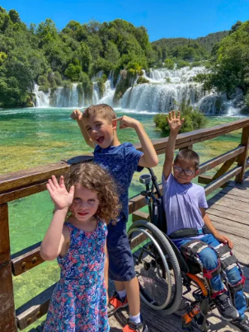
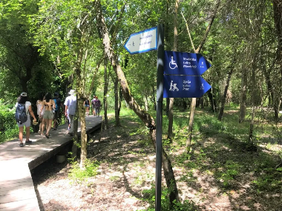
aa
Good practices in accessible tourism in the project countries – Croatia: Wheelchair accessibility in Krka National Park
Source: https://www.apieceoftravel.com/wheelchair-accessibility-at-krka-national-park/
Source: https://wonderswithinreach.com/2023/05/unlocking-the-beauty-of-croatia-top-5-wheelchair-accessible-destinations/

Slide 35
Handbook intended to facilitate the search for customised accommodation and tourist attractions for people with disabilities in the Republic of Croatia. Handbook developed and published by the Ministry of Tourism and Sports and the National Foundation for the Development of Civil Society Aim: to collect all available information on accommodation and attractions in one place. Authors also recommend that users check the current status of suitability with the staff of the facilities before visiting the selected locations. The handbook is available online and is primarily intended to provide all users with accurate and up-to-date data
Good practices in accessible tourism in the project countries – Croatia: Accessible tourism handbook for persons with disabilities

Slide 36
During the design and construction, great attention paid to adapting the facilities for PwD, and associations for PwD also involved in the search for the best solutions Access for PwD to the pool possible from the public garage; 8 parking spaces for PwD Access to the square in front of the main entrance to the swimming pools is possible with an elevator that has built-in buttons with floor numbers in Braille Ramps and a lifting platform provide PwD with direct access from the changing rooms to the outdoor swimming area and the diving pool, so that PwD do not encounter any architectural barriers in the pool areas
Good practices in accessible tourism in the project countries – Croatia: Swimming Pool Kantrida

Slide 37
Special markings on the floors of the swimming pool complex to facilitate movement for blind and visually impaired people. All directions of movement marked with white or yellow stripes, which stand out not only in colour but also in their structure from the surrounding floor Fixed and mobile elevators to allow PwD and people with reduced mobility to enter and exit the pools. Elevator can be moved from one pool to another. Staff are trained to operate the elevator and are always available to assist people with reduced mobility Specially marked seats for wheelchair users in spectator stands. Toilet adapted for PwD Training sessions for people with disabilities are regularly held
Good practices in accessible tourism in the project countries – Croatia: Swimming Pool Kantrida

Slide 38
Examples of good practice regarding accessible tourism activities in Poland: (1) institutional activities at the country level (Ministry of Sport and Tourism) and regional level (Wielkopolska Tourist Organization), (2) tourist guides to the most popular urban tourist destination in Poland, Krakow (“A Guide to Krakow for Tourists with Disabilities”), tourist information about the availability and facilities on tourist trails (“Karkonosze for Everyone”, Piast Trail in Greater Poland), (3) tourist attractions (Invisible Street in Poznań, Brama Poznania ICHOT [Poznan Gate], Museum of the First Piasts in Lednica, Museum of the Archdiocese of Gniezno), (4) open spaces, such as parks and sensory gardens (Spatial Orientation Park in Owińska), (5) an event aimed at educating integration and social inclusion, organised periodically by the community of people with disabilities (OzN) during the International White Cane Day
Good practices in accessible tourism in the project countries – Poland

Slide 39
The Ministry of Sport and Tourism (MSiT) promotes accessible tourism in the context of social tourism as “a priority in the activities of tour operators, travel agencies and tourist information points” Accessibility Plus 2018-2025 Programme is at national scale, focused on universal design of public spaces, products and services in terms of architecture, information and communication. It is included in the activities of the Polish Tourist Organisation and Regional and Local Tourist Organisations. Accessibility is understood as the possibility of independent use of: tourist attractions, information (guides, maps, information points), transport and communication in tourism, routes, paths, tourist trails, and catering, accommodation and sanitary infrastructure
Good practices in accessible tourism in the project countries – Poland

Slide 40
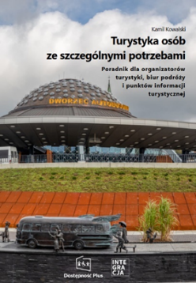
“Tourism for people with special needs”, 2023 – over 4 million Poles (14%) live with disabilities, and people aged 60+ constitute approximately 10 million people, i.e. 25% of the Polish population (and their purchasing power is growing). MSiT recommends a guide titled: “Textbook: Tourism for people with special needs. Guide for tour operators, travel agencies and tourist information points”
Good practices in accessible tourism in the project countries – Poland
Source: https://www.gov.pl/web/sport/turystyka-dostepna-dla-wszystkich

Slide 41
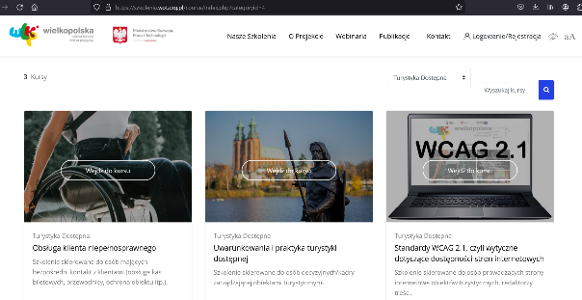
2020, Wielkopolska Tourist Organisation: free training in the field of accessible tourism on the e-learning platform, addressed to all people involved in tourism – addressed both to employees directly serving customers, and managers making strategic decisions The platform also offers full flexibility in acquiring knowledge, no time limit in which the entire training must be completed
Good practices in accessible tourism in the project countries – Poland
Source: https://szkolenia.wot.org.pl/

Slide 42
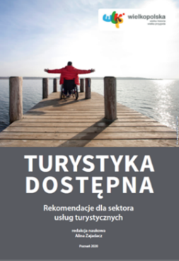
The WOT e-learning platform was created as part of the implementation of a public task entitled: “Improving the safety of tourist services for people with disabilities in the Greater Poland Voivodeship”, co-financed by the Ministry of Development, Labour and Technology in 2020 Courses prepared by a professional team of trainers (practitioners and scientists) to guarantee quality and compliance with the latest knowledge Additional materials: webinars, conferences and manuals
Good practices in accessible tourism in the project countries – Poland
“Accessible tourism” manual – recommendations for the tourism services
Source: https://www.wot.org.pl/wp-content/uploads/WOT_Turystyka_dostepna.pdf

Slide 43
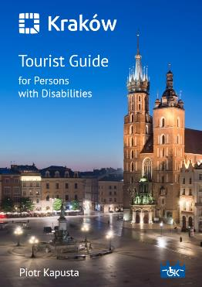
“A Guide to Krakow for Tourists with Disabilities”: a compendium of knowledge on the accessibility of the main attractions for people with disabilities. 2nd edition in 2023 includes the Nowa Huta route and available in 4 languages (Polish, English, French and Russian) The publication can be obtained free of charge from the Department for the Issues of Persons with Disabilities of the Department of Social Policy and Health of the Krakow City Hall, as well as at municipal tourist information points, and can also be downloaded from the website and via QR as an application for mobile devices
Good practices in accessible tourism in the project countries – Poland
https://www.krakow.pl/bezbarier/aktualnosci/202398,60,komunikat,krakow_dla_turysty_z_niepelnosprawnoscia

Slide 44
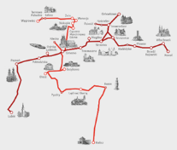
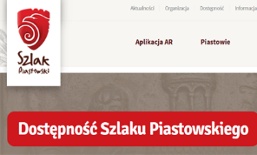
Piast Trail: one of the main cultural trails in Poland, about the history of the first royal dynasty, the Piast dynasty. 2019: Wielkopolska Voivodeship commissioned an analysis of its accessibility for disabled (motor, visual, hearing), seniors and families with children in all (33) facilities of the Piast Trail in the Voivodeship, so as to collect current knowledge about the availability of individual attractions on the trail Catalogue of criteria for assessing accessibility, based on which each attraction assessed and described in an information card posted on the trail’s website. Prepared by experts, it is a reliable source of information for anyone visiting the Piast Trail facilities, with recommendations for facility owners regarding useful, universal amenities
Good practices in accessible tourism in the project countries – Poland
Source: szlakpiastowski.pl

Slide 45
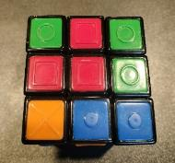
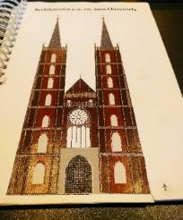
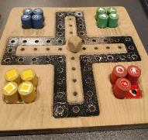
Invisible Street in Poznań: a place that can be visited in absolute darkness, and the guides are blind people. One can experience not only moving around the street without the aid of sight, but also travelling on a tram and sensory experiences (through smell, touch) The guide explains how blind people function in everyday life. One can also take part in workshops explaining facilities for blind and visually impaired people, such as: Rubik’s cube, board games, tourist guides with convex (relief) drawings and a reference scale, such as a human figure placed in each lower right corner of the page
Good practices in accessible tourism in the project countries – Poland
Photos by A. Zajadacz

Slide 46
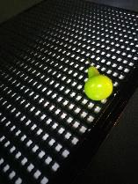
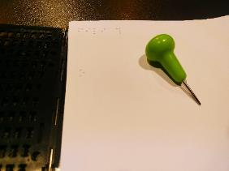
Invisible Street also offers the Whispering Theatre – performances performed live in complete darkness and received only in the audio sphere
Good practices in accessible tourism in the project countries – Poland
Photos by A. Zajadacz

Slide 47
Brama Poznania ICHOT (Poznan Gate): modern, multimedia heritage interpretation centre. One of the facilities well adapted to the needs of people with disabilities, the elderly and visitors with children
Good practices in accessible tourism in the project countries – Poland
Events addressed to PwD, the elderly and families with children. For children, separate audio guide tour path, including fun elements and leading through yellow markers to places adapted for children. Seniors can visit the Gate with a guide in their age group, for blind people: aids, tactical exhibition elements and audio description. All films equipped with translation in Polish Sign Language, also a Polish Sign Language interpreter in real time via video transmission. An elevator and an evac chair (evacuation chair in case the elevator is out of order), outside a lift enabling wheelchair access to the grassy beach by the river
Source: https://bramapoznania.pl
During the tour one can use comfortable seats, as well as portable, light chairs available at the entrance to the rooms

Slide 48
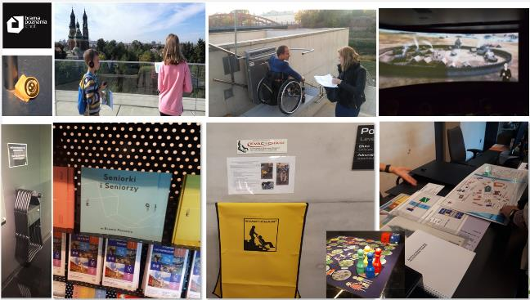
Brama Poznania [Poznan Gate] – examples of good practices in the field of accessibility
Good practices in accessible tourism in the project countries – Poland
Photos by A. Zajadacz

Slide 49
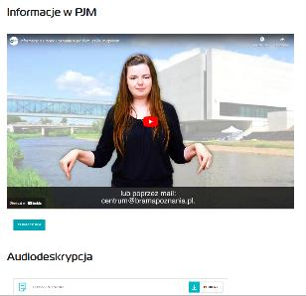
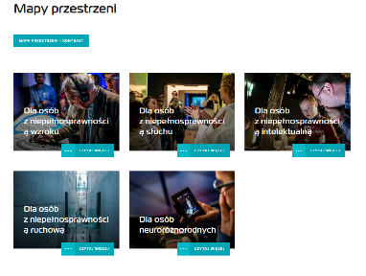
Brama Poznania [Poznan Gate] – information on the website regarding accessibility, including: Polish Sign Language and audio description
Good practices in accessible tourism in the project countries – Poland
Source: https://bramapoznania.pl/dostepnosc

Slide 50
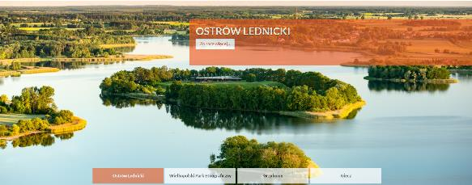
Comprehensive services. During the ferry crossing to the island of Ostrów Lednicki, wheelchair users are assisted to enter the ferry. Paths are gravel, paved, there are ramps leading to the huts with exhibits. The boards at the exhibitions placed at a height and at an angle convenient for reading by people in wheelchairs, and there are viewing places for rest in a multisensory environment by the water, next to fragrant flowers
Good practices in accessible tourism in the project countries – Poland
Museum of the First Piasts in Lednica: good example of making historical places available both outdoors, in buildings, including the historic buildings of open-air museums, and through the organisation of integration events
Source: https://www.lednicamuzeum.pl

Slide 51
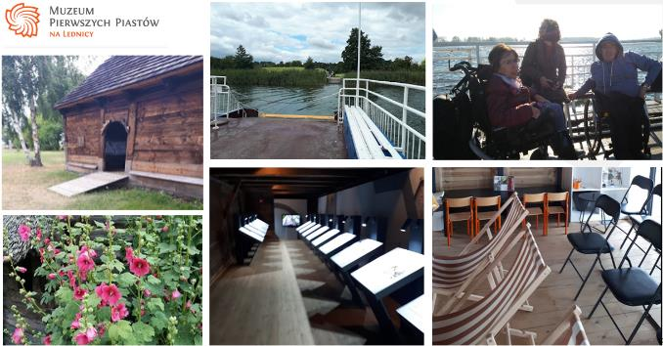
Museum of the First Piasts in Lednica – good practices in the field of outdoor amenities in Ostrów Lednicki
Good practices in accessible tourism in the project countries – Poland
Photos by A. Zajadacz

Slide 52
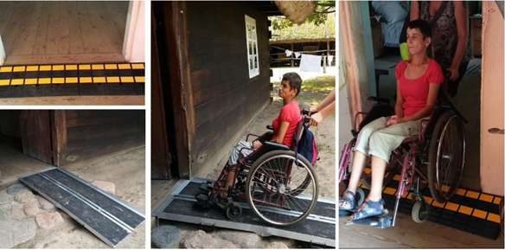
The historic architecture of the cottages in the open-air museum in Dziekanowice uses a simple solution of portable ramps that level thresholds. This allows to avoid interference with the original structures, and at the same time allows people in wheelchairs to overcome stairs and thresholds
Good practices in accessible tourism in the project countries – Poland
Photos by A. Zajadacz

Slide 53
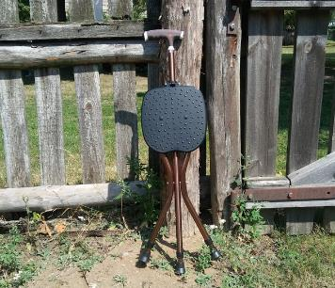
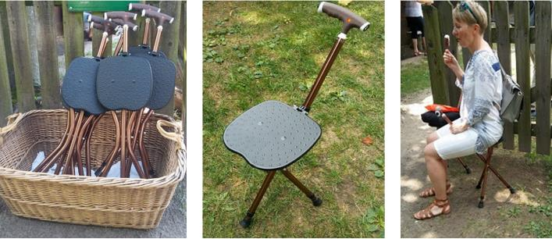
All outdoor facilities have light, portable seats
Good practices in accessible tourism in the project countries – Poland
Photos by A. Zajadacz

Slide 54
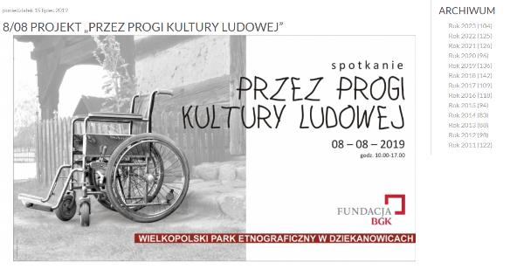
The Museum of the First Piasts in Lednica organises many events and integration workshops, including a cyclical event titled “Through the thresholds of folk culture” in the open-air museum in Dziekanowice: on this day, part of the open-air museum becomes an open place for PwD movement, trained educators conduct both tours and integration activities. One of the most important goals of the event is to make the museum a place accessible to the widest possible audience. Programme is based on the principles of social inclusion, addressed mainly to people struggling with movement and vision problems, and seniors
Good practices in accessible tourism in the project countries – Poland
Source: https://www.lednicamuzeum.pl

Slide 55
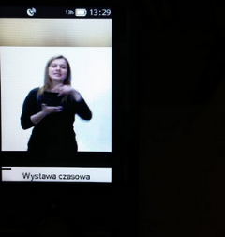
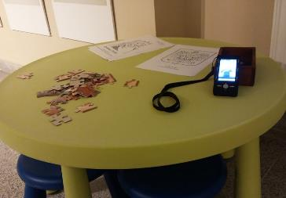
Museum of the Archdiocese of Gniezno: a good practice addressed to deaf and hard of hearing people are tour guides, equipped with recordings in Polish sign language, regarding all the exhibits visited both in the museum, as well as the Gniezno Cathedral (coronation place of the first rulers of Poland, centre of the cult of Saint Adalbert)
Good practices in accessible tourism in the project countries – Poland
A guide with PJM recordings in the Museum of the Archdiocese of Gniezno
Photos by A. Zajadacz

Slide 56
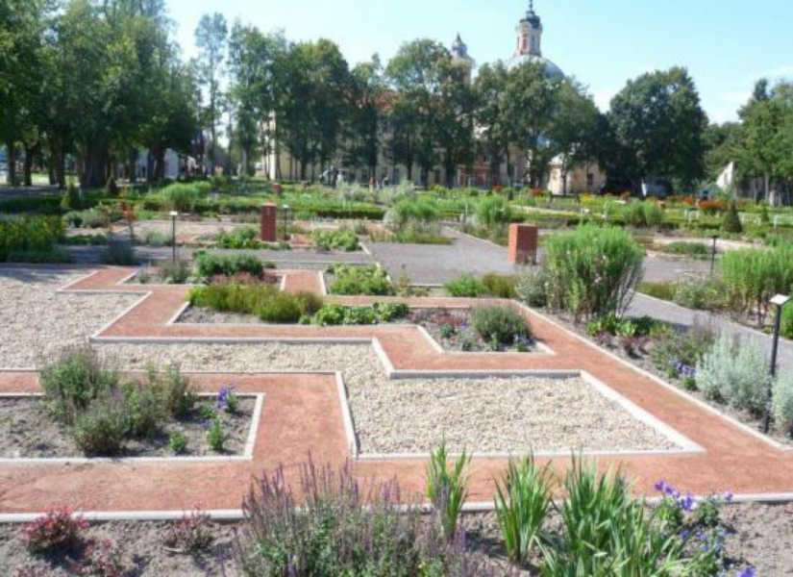
Spatial Orientation Park (2012) at a school for blind children (Special Educational Centre for Blind Children): mainly for children and teenagers, but also open to visitors during designated hours Area of over 2.5 hectares, with, among others: vegetable garden, recreation area, specially designed toys and teaching aids. A safe space, designed with the participation of blind people, with staff to help
Good practices in accessible tourism in the project countries – Poland
https://ppbw.pl/en/opening-of-the-spatial-orientation-park-in-owinska/

Slide 57
Elements that facilitate orientation in space: a clear layout of paths – wide gravel paths, narrow dirt paths with raised edges; different texture of the path surfaces; a playground for games and cycling surrounded by a guide for a wooden cart; green zones with flower beds; tips from other people – there is security in the garden, helpful if blind people visit it on their own, and blind people can work together with the gardener; sounds occurring naturally in the landscape: the sound of water, the creaking of gravel, acoustic devices: stairs playing, sound amplifying cables; benches, tables; curbs (as guides); balustrades; the terrain is flat, does not require ramps; characteristic points that facilitate orientation in space – brick houses, a zoo, a gazebo, sculptures, taps with figurines of various animals
Good practices in accessible tourism in the project countries – Poland

Slide 58
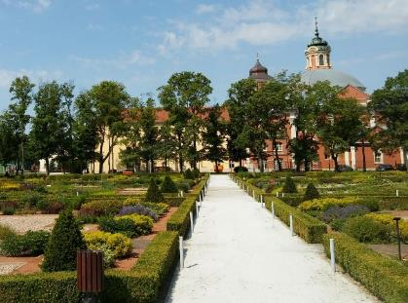
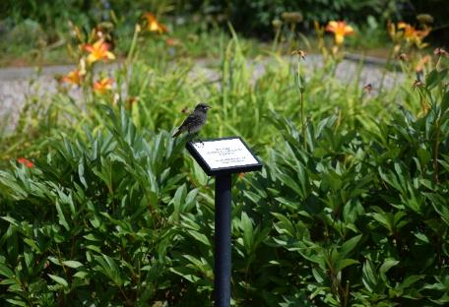
Spatial Orientation Park in Owińska – clear layout of paths; signs with descriptions of plants in Braille
Good practices in accessible tourism in the project countries – Poland
Photos by A. Zajadacz

Slide 59
Spatial Orientation Park in Owińska – different surface textures of paths; diversity – shapes perceptible by touch; a playground for games and cycling surrounded by a guide for a wooden cart
Good practices in accessible tourism in the project countries – Poland
Photos by A. Zajadacz

Slide 60
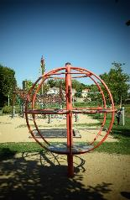
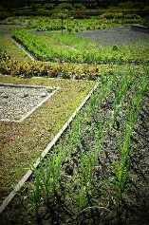
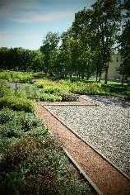
Tools for educating blind and visually impaired people in the Spatial Orientation Park in Owińska include Braille signs; a herb zone, vegetable garden where one can plant and care for plants; blind people can pick vegetables and fruits and taste them; a playground with educational toys, e.g. a globe; numerous interactive toys, e.g. an earthen carillon or a special cage with a system of sound-conducting pipes; tactile graphics, sensory path Sports equipment includes: a treadmill, a climbing wall, trampolines, swings, and a secured area for e.g. cycling The park has taken care of small architectural elements, e.g. mini houses made of various materials: wood, stone, brick – enabling people to learn about the construction of houses by touch
Good practices in accessible tourism in the project countries – Poland
Photos by A. Zajadacz

Slide 61
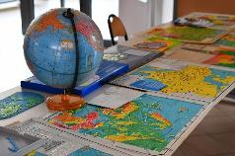
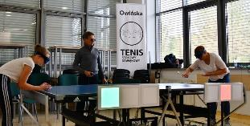
International White Cane Day, celebrated on October 15 since 1969, is intended to remind everyone of the needs of the blind and visually impaired. Aim of the campaign: shape social attitudes based on openness, tolerance, empathy and understanding the needs of visual impairments. In 2023, its celebration, organised by the Special Educational Centre for Blind Children in Owińska, took place at the Collegium Geographicum of the University of Adam Mickiewicz in Poznań
Good practices in accessible tourism in the project countries – Poland
During the meeting, students and lecturers learned about, among others: Braille writing system and electronic devices supporting the blind. They played tactile chess and sound table tennis and saw the typhlomap exhibition. The idea behind organising the meetings is social inclusion through sharing knowledge and experiences in the field of universal design
White Cane Day. Teaching aids; sound table tennis
Photos by A. Zajadacz

Slide 62
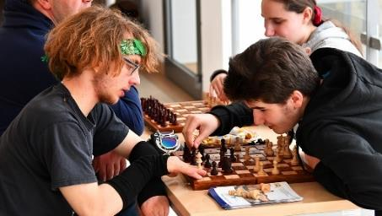
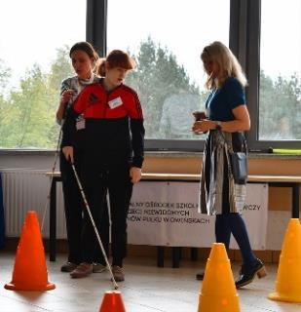
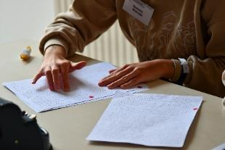
White Cane Day. Chess for the blind; Braille writing; learning spatial orientation
Good practices in accessible tourism in the project countries – Poland
Photos by J. Zwoliński

Slide 63
“Terra Mirabilis project”: initiative for visually impaired people, created jointly by the Babilon Travel Association of Cluj Napoca, Cluj Town Hall and the Cluj Tourist Information Centre. It is educational, mobility enhancing and aims to involve the people concerned in the tourism process The relevance of the initiative lies in the documentation of itineraries in exchange for financial support, and in the training of eight volunteers able to accompany visually impaired (groups of) people along the routes developed. The financial support will finance various guides, maps, information and promotional materials to make Cluj Napoca accessible to the visually impaired, both domestic and foreign tourists
Good practices in accessible tourism in the project countries – Romania: the “Terra Mirabilis project”

Slide 64
The itineraries will include plans of the most important sights, monuments and places of worship that can highlight the multicultural and multi-ethnic dimension of the city. The guides are in Romanian and English, in a format suitable for the visually impaired, i.e. audio guides in large print. These materials are also available in digital format as MP3 audio documents and PDF documents. The project aims to encourage the integration of visually impaired people into the community, access to tourist destinations and the development of interactions between visually impaired people. The innovative nature of the initiative lies in the fact that it offers visually impaired people the opportunity to discover the city’s features, attractions and history
Good practices in accessible tourism in the project countries – Romania: the “Terra Mirabilis project”

Slide 65
The “Square sculpture of Șumuleu” is a joint initiative of the Transylvanian Roads Association, László Orbán, Zsolt Tövissi and Imre Berze, intended to sensitise society and to information to visually impaired people. The sculpture is specifically designed to make the Șumuleu Church of the Cross and other landmarks in the area tactile for visually impaired people, and informative for visitors in wheelchairs, due to the difficult accessibility of the area. Located in the car park next to the Church of Șumuleu, the sculpture models the relief of a circle 900 metres in diameter as the crow flies and the buildings on the site on a bronze relief
Good practices in accessible tourism in the project countries – Romania: Square sculpture of Șumuleu

Slide 66
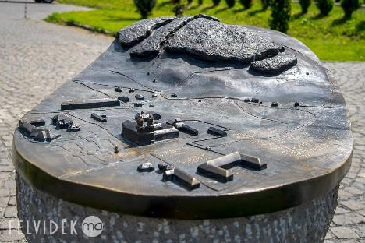
Innovative character of the initiative: its alternative way of presenting the area. Visitors to the area can access and learn about it free of charge. The initiative could be adapted to any destination using different sculptural techniques and 3D printing, which could showcase the major tourist attractions of the site, not only for the visually impaired but also for wheelchair users
Good practices in accessible tourism in the project countries – Romania: Square sculpture of Șumuleu
Source: https://felvidek.ma

Slide 67
Initiative created by the Retezat Tourism Association, to provide information about the mountain area and the possibility to travel to the site, in addition to the visitation of the site by disabled people A trail open to all, but created primarily to serve the disabled and the visually impaired At the foot of the Retezat Mountains, in the Retezat National Park, at Nucsoara Visitor Centre, which offers an experience for adults with disabilities and children with disabilities The trail is 36 metres long and is equipped with ramps and handrails. Along the trail, visitors can observe the footprints of animals living in the mountain range and information about the species has been placed. The trail has been designed to be wheelchair accessible
Good practices in accessible tourism in the project countries – Romania: Original trail for disabled people in the Retezat Mountains

Slide 68
Area easily accessible by car, barrier-free. The design of the area is to provide detailed infrastructure network: plant species on site are tactile and the footprints of animals are visible from wheelchairs. The animal footprints (otter, deer, jackal, wild boar, wolf, bear and chamois) placed on wooden panels in relief to allow visually impaired people to feel their way around and are interesting sight for all visitors Itinerary implemented by the Retezat Tourist Association in collaboration with the Romanian Wilderness Association and the Retezat National Park Directorate, with the support of the Romanian-American Foundation and the Partnership Foundation The good practice can be adapted without modification in the visitor centres of the national parks in the country, but can also be developed and sustained in schools, kindergartens and educational institutions
Good practices in accessible tourism in the project countries – Romania: Original trail for disabled people in the Retezat Mountains

Slide 69
Initiative by Motivation Foundation Romania, Buda, Ilfov County: map created for information and mobility of tourists, mainly for PwD who use wheelchairs for transport The map is a tool that provides a useful source of information and centralises data on accessible sites in Romania. Motivation’s accessibility trademark is registered Aim of the initiative is to provide wheelchair users with information on the accessibility of accommodations, city spaces and tourist attractions. Access to information on the web is increasingly important, so it is also a purpose of the website Resources are needed to continuously survey the sites and facilities and to update the database on a regular basis
Good practices in accessible tourism in the project countries – Romania: Internet accessibility map

Slide 70
A hiking guide available in Romanian and English, designed to sensitise and inform, aimed first of all at people with reduced mobility, wheelchair users, and mainly at the routes available in Brasov County Descriptions of almost 60 routes in six mountain ranges in the Brasov area, classified according to difficulty. Routes are accompanied by explanatory maps, pictures and useful information Very useful tool for PwD, but also for families with children, teachers, associations, NGOs, to help them find their way around the mountains around Brasov. Information contained: right routes for children, depending on their age, equipment and experience; information on the safety of the routes for PwD, families and children
Good practices in accessible tourism in the project countries – Romania: Hiking guide for families with children and PwD

Slide 71
An agrotourism pension in Luncavita, Tulcea County, developed with the support of the National Rural Development Programme, with sensitisation, mobility improvement and tourist attraction character Special attention to people with disability; manager of the pension is a wheelchair-bound disabled person. The pension therefore caters for this special target group, with well thought-out equipment, no thresholds, special bathrooms, comfortable and spacious areas. The accommodation is adapted to the characteristics of the area (cultural traditions of Dobrudza, recipes of the Danube Delta)
Good practices in accessible tourism in the project countries – Romania: Valea Fagilor Agropension

Slide 72
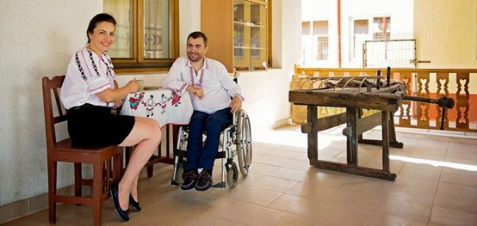
Traditional environment, natural attractions, leisure activities (hiking, angling, cycling, astronomy, participation in agricultural work) Visitors can discover local cultural heritage, participate in local events and festivities. Rooms, bathrooms and dining room are adapted to specific needs, in addition to being easily accessible by car
Good practices in accessible tourism in the project countries – Romania: Valea Fagilor Agropension
https://www.pensiuneavaleafagilor.ro/despre-pensiunea-valea-fagilor-luncavita

Slide 73
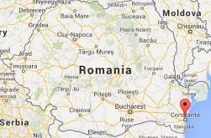
The initiative is a set of activities for sensitisation, education and mobility improvement on the Romanian coast, a joint collaboration (of M24Seven Europe, RAPTronic, RAP Development, RAP Instal, Petroterm SRL, Sorla and Dobra from Constanta, AQUA Carpatica, Martin Eughenia and Gabriel Voitis) Event accessible to all disabled, but they are trying to provide a special beach experience for disabled travellers. The “Sea and Beach for All” initiative took place in August 2017 and August 2021, when the first disabled beach in Romania opened in Mamaia. With the agreement of the tourism operator that owns the “Pupa Beach”, a part of the beach was built right next to the lifeguard tower, for safety and to ensure easy access for people with disability disabilities
Good practices in accessible tourism in the project countries – Romania: Sea Beach for All

Slide 74
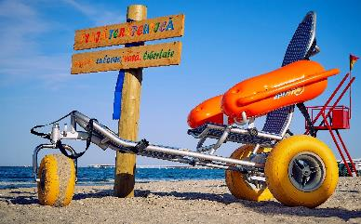
Good practices in accessible tourism in the project countries – Romania: Sea Beach for All
“Pupa Beach” is located directly at the entrance to the Mamaia resort, properly signposted and accessible from the street by a ramp for disabled persons. Wooden access road to the accessible part of the beach, where three floating Mobi-chairs are available for disabled bathers. Beach equipped with six special sunbeds with umbrellas, special toilets and changing rooms adapted to the needs of the disabled. Mobi-chairs float in the sea to provide safe bathing for people with reduced mobility. Special sun loungers for disabled, free of charge
The floating chair in the “Sea and beach for all” project
Source: https://www.romania-insider.com

Slide 75
Romania’s first disabled-friendly trail, created jointly by the Corund-Praid Nature Conservancy and the Corund Tourist Association for education and information, while facilitating mobility and making the attraction accessible. The initiative is designed to serve all people with disabilities. Trail opened in 2013 in the area’s nature reserve to attract wheelchair visitors The Corund-Praid Nature Reserve inaugurated the Peat Bog Trail in the Pine Mountains, which has been designed to allow disabled people to move around unhindered. The trail is part of a Natura 2000 nature reserve. Visitors can gain an insight into the typical flora and fauna of the taiga and the threats they face
Good practices in accessible tourism in the project countries – Romania: the “Peat bog” in Fântâna Brazilor

Slide 76
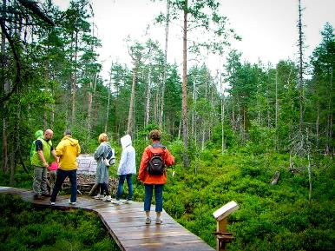
Trail is interactive, with educational and interactive panels along it, providing information about the plants and animals living there. Information panels available in English, Hungarian and Romanian. The initiative could provide a special educational and learning experience for PwD, in addition to the attraction of hiking in nature. The trail is innovative as it offers a unique opportunity for people with disabilities to learn about the plant species in the area by making it accessible
Good practices in accessible tourism in the project countries – Romania: the “Peat bog” in Fântâna Brazilor
Source: https://borvizek.hu/en/property/fantana-brazilor-bog.html

Slide 77
Educational and mobility development tool for active recreation for PwD. Team implementing the exercise is composed of ski instructors, mountain guides and a number of active and mobile people. It provides accessible outdoor activities for disabled people During the summer, they organise tours using specially designed bicycles that can be used by PwD: designed for off-road use, with the disabled person sitting in the front seat and a person behind him/her to control the equipment and assist the disabled in getting on and off In winter, disabled people can learn to ski using special ski chairs. Depending on the type of chair, they offer different degrees of independence for disabled. Again, a guide is needed, but people with minor disabilities can use the equipment with a more moderate level of independence, which provides different levels of difficulty for those interested
Good practices in accessible tourism in the project countries – Romania: Nurture in nature. The movement is for everyone

Slide 78
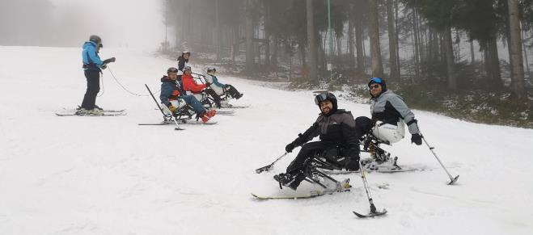
Aim is to make active recreation available to disabled people and all nature lovers, both in winter and summer. The initiative is innovative in that it uses special equipment to provide a physical activity experience that a certain segment of society cannot otherwise experience
Good practices in accessible tourism in the project countries – Romania: Nurture in nature. The movement is for everyone
Source: https://www.facebook.com/NiNadventuresWorld/

Slide 79
A project created by the travel agency Accessible Romania by Sano Touring to make it easier to visit the different attractions for a variety of disabled target groups, such as people with reduced mobility or hearing impairments The service provider promotes various tourism products and destinations in Romania, mostly in English. Thematic tours include accessible Transylvania tours, wine and gastronomy tours in Romania. City visits are organised to Brașov, Constanta, Sibiu and Bucharest. Bathing holidays are offered in Băile Felix, Covasna and Sovata. With the help of special equipment, all PwD can participate in different tourist programmes like any other person in society
Good practices in accessible tourism in the project countries – Romania: We bring Accessible Romania to the world

Slide 80
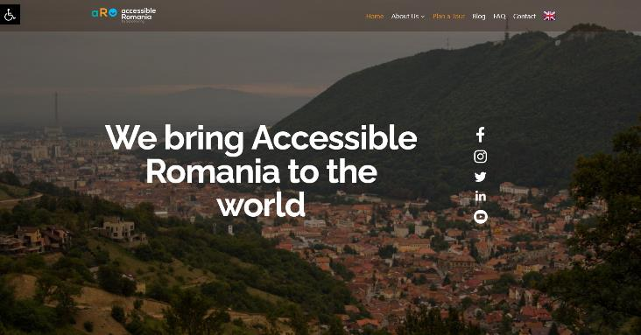
Good practices in accessible tourism in the project countries – Romania: We bring Accessible Romania to the world
https://accessibleromania.com/

Slide 81
An initiative to improve mobility that can be tried by all PwD. Activity launched by CaiacSMile organisation in Cluj-Napoca for the winter period 2021-2022; special equipment purchased to make the ski slopes accessible for people with mobility disabilities Events organised on the ski slopes and supervisors and mountain trained to use the equipment. Accessible ski slopes offer disabled people the opportunity to practise independently Three of the CaiacSMile club’s flagship members became accredited ski instructors in 2022. 2022-2023 ski season: eight camps of six days were organised at different times and in different locations on accessible ski slopes, where disabled people skied together with members of the club. More than 50 disabled people learned to ski independently using the Monoski device, joined by hundreds of people with various disabilities who enjoyed the skiing experience
Good practices in accessible tourism in the project countries – Romania: Skiing for people with mobility disabilities

Slide 82
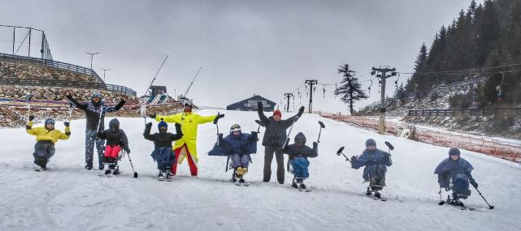
Exercise therapy is one of the most effective ways to overcome anxiety and improve quality of life, both physically and mentally. PwD should be the first to have access to these forms of therapy, yet they are the first to be denied this right because they do not participate in traditional or adapted competitive sports
Good practices in accessible tourism in the project countries – Romania: Skiing for people with mobility disabilities
Source: https://www.caiacsmile.ro

Slide 83
“Special Olympics” initiative created by the Special Olympics Foundation: a good practice aimed at sensitising and educating society, while contributing to the mobility of the tourists concerned Special Olympics is a movement that helps people with intellectual disabilities to be accepted and included in society as active members of their communities, but it is accessible to all PwD. It seeks to challenge passivity, injustice and intolerance The Foundation’s goal is to enable PwD and their families to participate in various sports competitions, educational activities in schools, training, and condition assessments to increase the employability of adults with disabilities
Good practices in accessible tourism in the project countries – Romania: Special Olympics

Slide 84
Good practices in accessible tourism in the project countries – Romania: Special Olympics
Source: https://specialolympics.ro

Slide 85
The project is a joint initiative of the CED Romanian Experience Centre, Accessible Romania by Sano Touring and Accessible Romania. The information service software, basically intended for the transmission of barrier-free institutions and events, provides assistance to all PwD, which contributes to the sensitisation of society, education and information of the affected persons The creators of the software developed the application for people living with a wide range of disabilities, who can choose the locations, facilities and events they want to visit based on various information, as well as find out about the accessibility of each programme
Good practices in accessible tourism in the project countries – Romania: AUDARA (Audit Accessibility Romania)

Slide 86
AUDARA allows the preparation of accessibility reports for institutions with cultural activities. As a result, cultural institutions will be more inclusive for the relevant target group of the population AUDARA develops around 300 parameters based on accessibility criteria provided by the Romanian legal framework, analysis of good practices from around the world, and theoretical and practical experience of accessibility and accessible tourism experts
Good practices in accessible tourism in the project countries – Romania: AUDARA (Audit Accessibility Romania)
https://audara.eu/

Slide 87
Good practices in accessible tourism in the project countries – Hungary
For more information about the activity of Access4you, see Presentation 7 of this course, called “Organisations supporting travel for people with disabilities”

Slide 88
PeopleFirst Association, with the support of the Strengthening Civil Communities, developed an attention-grabbing, barrier-free guided tour in 2019, and introduced it as a permanent city themed tour in 2021 in cooperation with the Pécs TourInform office. Its aim is to sensitise and involve society The guided tour gives a different perspective to the participants, showing how PwD can get to a particular sight in Pécs. Participants can try the tour in a wheelchair, get glasses modelling visual impairment, be introduced to hearing impairment with earplugs, use white canes to feel kerbs and guide rails, and walk with a guide dog
Good practices in accessible tourism in the project countries – Hungary: Hidden City Tor-Tour

Slide 89
Good practices in accessible tourism in the project countries – Hungary: Hidden City Tor-Tour
Source: https://peoplefirst.hu/en/projects/hidden-city-tor-tour/

Slide 90
Members of the People First Association – Pécs, in pairs (always one disabled and one able-bodied with no disability), tour restaurants, cafés, hotels, shops, tourist attractions of Pécs, sports and cultural institutions, or public institutions, and personally map out which premises are barrier-free, and then, with consent of the owner(s), put the sticker they have designed and made on the glass of the entrance door 10×10 cm sticker that can be applied from the inside, similar to Visa, Mastercard, etc. stickers. Not too colourful, not distracting, but it draws attention to the fact that the premises are barrier-free. If the facility has an accessible toilet, a toilet will appear in the bottom right-hand corner of the sticker
Good practices in accessible tourism in the project countries – Hungary: “Stickers project” of PeopleFirst in Pécs

Slide 91
Good practices in accessible tourism in the project countries – Hungary: “Stickers project” of PeopleFirst in Pécs
Source: https://peoplefirst.hu/directory/akadalymentes-pecs/cafe-frei/

Slide 92
Since 2017 Orfű has hosted Accessible Tourism Day: main aim of the festival-style event is to provide PwD with experiences they would otherwise not be able to have, or only with difficulty, but which are popular and self-evident services for the non-disabled. A fun for everyone, disabled and able-bodied alike, allowing them to have a good time while discovering that disabled peers are just as human as those without disabilities. An important goal is inclusion, to sensitise society and to make the able-bodied society aware of the abilities and opportunities of PwD and how to help them. Lasting impact of the event is an increase in the number of accessible accommodations in Orfű, and tourism service providers and local government staff are more empathetic and professional about accessible tourism than they used to be
Good practices in accessible tourism in the project countries – Hungary: Accessible Tourism Day in Orfű

Slide 93
The event allows stakeholders to experience tourism in a way that is otherwise not available to them, with the help of almost 100 volunteers. Wheelchair users can be lifted into a kite boat or sailing boat, severely disabled people can be harnessed to ride a motorbike, and people who are completely blind or severely disabled due to brain damage can try driving a car. By offering a range of experiences, the organisers hope to demonstrate that, with the right will and good intentions, physical barriers can be overcome and a range of experiences can be made available to people with disabilities
Good practices in accessible tourism in the project countries – Hungary: Accessible Tourism Day in Orfű

Slide 94
Good practices in accessible tourism in the project countries – Hungary: Accessible Tourism Day in Orfű
Source: https://www.facebook.com/turizmus.akadalymentes/

Slide 95
Angling is most popular hobby (also) in Hungary, with a significant multiplier effect The initiative seems to address the needs of only one specific target group, but this target group includes tens of thousands of people in Hungary (the angling community has more than 800,000 members) As a significant proportion of PwD can only travel with an escort and cannot access the angling sites on their own, family members and escorts are an additional indirect target group Organisational, communication and technical solutions can be adapted to other outdoor sports (e.g. archery, hunting)
Good practices in accessible tourism in the project countries – Hungary: Creation of accessible angling venues

Slide 96
The venue is Access4you certified
Good practices in accessible tourism in the project countries – Hungary: Creation of accessible angling venues
https://cshe.hu/index.php?oldal=12

Slide 97
In Hungary, accessible tourism has not yet been integrated into the basic tourism and hospitality education, despite the fact that around 10% of the population in Hungary is affected by this issue and that many of them face serious barriers to their participation in tourism By sensitising and educating tourism professionals of the future, it is possible to improve the quality of the tourism experience of PwD and thus raise their quality of life Students who complete the training will be more receptive and sensitive to the specific needs of PwD and will have a higher level of knowledge to meet these needs. The businesses and organisations that employ them or are set up by them will improve the competitiveness of the destinations concerned in the tourism market
Good practices in accessible tourism in the project countries – Hungary: optional university BSc course “Accessible Tourism”

Slide 98
Disabled people invited share their experiences with participants of the course
Good practices in accessible tourism in the project countries – Hungary: BSc course “Accessible Tourism”
Photos by T. Gonda

Slide 99
Dear Participant! We honestly hope that you have found this inventory of good practices useful, interesting and thought-provoking. We are aware of the fact that the list is far from being complete, there are many other good practices that could not be listed here, for lack of time and space – and there must be quite a few that we do not even know about. Should you have information on any good practice in accessible tourism, from any country or destination, please, contact us and share these with us! Thanking you for the cooperation, on behalf of the team of the Accessible+ Project, Zoltán Raffay (raffayz@ktk.pte.hu)
Good practices in accessible tourism in the project countries – a kind request to the dear participant

