Slide 1
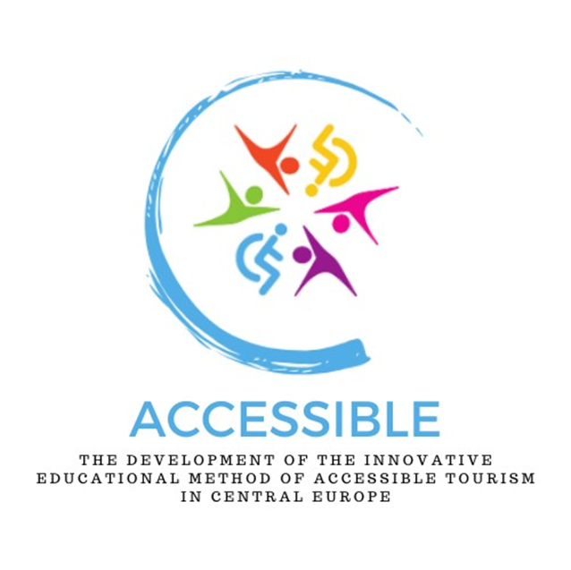
The development of the innovative educational method of ACCESSIBLE tourism in Central Europe 2022-2-HU01-KA220-HED-000099410

Slide 2
9. The issue of communication and ICT barriers in tourism

Slide 3
It is not only physical/body obstacles that can keep us from travelling but there are also communication and language barriers that can hinder a successful and beatific tourist experience Language allows for the expression of emotions, the sharing of feelings, the telling of stories and the communication of complex messages and knowledge. Language is our greatest intermediary, enabling us to connect with and understand each other – but it can also separate us from each other In addition to the physical “impairments” – mobility, sight, hearing, etc. – there is also a cognitive dimension to disability, and those who are unable to communicate might be placed in the group of those with disabilities
Communication and language barriers – preliminary thoughts

Slide 4
Overcoming language barriers is essential for the tourism sector Cohen and Cooper: “Language barriers are, as everyone knows, an important obstacle to transcultural communication.” (Cohen & Cooper, 1986) Studies have shown that language barriers affect tourists’ destination choice and spending decisions (Cohen & Cooper, 1986) The tourism industry should therefore make great efforts to overcome language barriers between hosts and tourists (Gillovic et al., 2018)
Communication and language barriers – preliminary thoughts

Slide 5
Tourists are very much aware of this difficulty, which has a significant impact on the choice of destination, the preparation for the trip, the scope and content of their interaction with the locals, and the quality of their experience (Cohen – Cooper, 1986) A survey of more than 3,000 Hungarian residents aged 15-74 years (Csapó et al., 2018), conducted in 2018, in the pre-Covid-19 pandemic period, included a scrutiny of the travel behaviour of the Hungarian population, including the reasons for not travelling: besides non-travellers lacking one or more of the three basic conditions of tourism (motivation, discretionary income, leisure time), the lack of language skills is also a serious barrier seen by many people
Communication and language barriers – preliminary thoughts

Slide 6
The language barrier is often only mental; it is possible to travel even without language skills (domestic tourism or the use of gadgets), even though the experience will be somewhat less (which cannot even be said for a domestic trip) For classic drop-outs, the main reason is the lack of financial means, but the reluctance to travel can also be due to a lack of language skills. Among the specific answers to the question “What are your reasons for not travelling?”, lack of money and lack of time rank first and second, while the other reasons are negligible, but lack of language skills is in third place, slightly ahead of lack of company
Communication and language barriers – preliminary thoughts

Slide 7
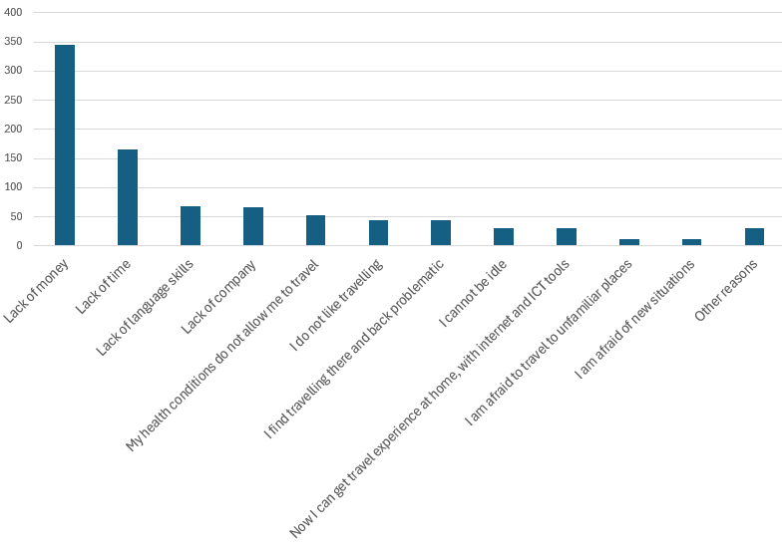
Communication and language barriers – preliminary thoughts
lack of language skills
Reasons for not travelling among respondents to a questionnaire survey in Hungary, 2018
Source: Csapó et al., 2018

Slide 8
With more than 7 000 living languages in the world it is very likely that the language of the tourist will be different from that of the host Half of the world’s population uses “only” 23 languages Distinction between languages according to the number of people who speak them as a mother tongue or as a learnt language: although Mandarin Chinese is the most widely spoken mother tongue in the world, the most widely spoken language in the world in 2023 was English English is now the only real world language and the language of business and technology – and tourism
Communication and language barriers – preliminary thoughts

Slide 9
Most widely spoken languages in the world, 2024
Language | Total number of speakers (million) | Number of native speakers (million)
English | 1.452 | 372.9
Mandarin | 1.118 | 929
Hindi | 602 | 343.9
Spanish¹ | 548 | 474.7
French | 280 | 79.9
(Modern Standard) Arabic² | 274 | 0
Bengali | 272.7 | 233.7
Russian | 258.2 | 154
Portuguese³ | 257.7 | 232.4
Urdu | 231.3 | 70.2
¹ Spanish is the second most widely spoken language in terms of native speakers
² Modern Standard Arabic (MSA) is the only language that has no native speakers: Arabic is made up of countless dialects and all Arabic speakers actually speak a local version. Media (newspapers, films, televisions) use MSA, also an academic language used in literature and politics
³ The most widely spoken language in the southern hemisphere
Source: www.berlitz.com

Slide 10
Most widely spoken languages in the world, 2024
Language | Total number of speakers (million) | Number of native speakers (million)
Indonesian⁴ | 199 | 43.6
German | 134.6 | 75.6
Japan⁵ | 125.4 | 125.3
Nigerian pidgin⁶ | 120.7 | 4.7
Marathi | 99.1 | 83.1
Telugu | 95.7 | 82.7
Turkish | 88.1 | 82.2
Tamil⁷ | 86.4 | 78.4
Yueh Chinese | 85.6 | 85.2
Vietnamese | 85.3 | 84.6
⁴ Not the mother tongue of the majority – more of a second language for mutual understanding in a country with more than 200 languages used
⁵ First language in the list spoken in only one country. 99% of the Japanese are native speakers
⁶ By 2050, Nigeria will be the fourth most populous country in the world, so the pidgin language can move up the rankings
⁷ With over 5000 years of history, it is the oldest living language in the world
Source: www.berlitz.com

Slide 11
English is even more dominant: lack of knowledge of English, today the only true world language, is also an information and communication handicap Currently more than 1 billion websites in the world, 18% of them being active (https://siteefy.com) 53% of the 10 million most visited websites in the world are in English, while Chinese accounts for only 1.8% Also a big gap for Spanish: first language of nearly half a billion people, compared to 5.1% of websites in this language Also interesting to note that while German is the second most spoken language online, in live speech it is not even in the top ten
Most widely used languages on the Internet, 2024

Slide 12
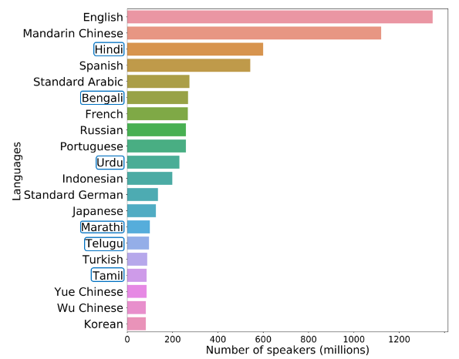
Most widely spoken languages in the world, 2024
Source: Dey et al. 2022

Slide 13
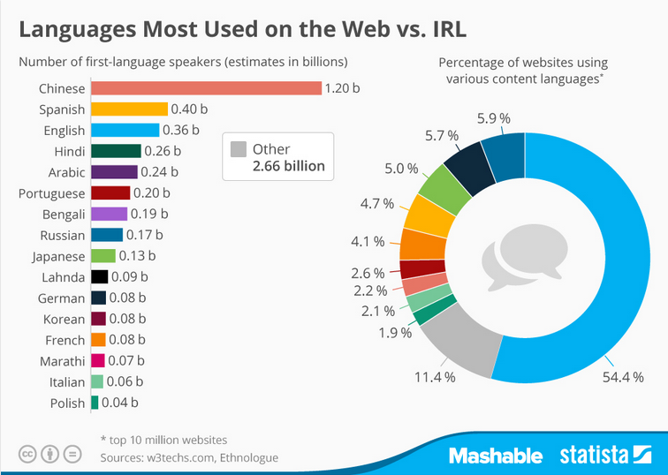
Languages most widely used on the Internet, 2024
Source: www.statista.com

Slide 14
Communication barriers arise when a tourist visits a country and does not understand the language of the local population In countries with several languages or widely differing versions, dialects of the same language, this problem can arise within borders, even without travelling abroad – there are countries in the world where dozens, even hundreds of languages are spoken, the record keepers being Papua New Guinea and Indonesia with no less than 840 and 711 languages, respectively (https://www.statista.com)
Language barriers in tourism

Slide 15
English is the language spoken or at least minimally understood in most destinations The problem arises when either the tourist or the local inhabitants do not know each other’s language or a third language such as English Technological advances are helping to overcome communication barriers, but these require adequate financial resources, internet access and translation time – another source of barrier Signs with basic information on buildings or attractions are usually written in several languages. It is almost impossible to translate all of them into all languages
Language barriers in tourism

Slide 16
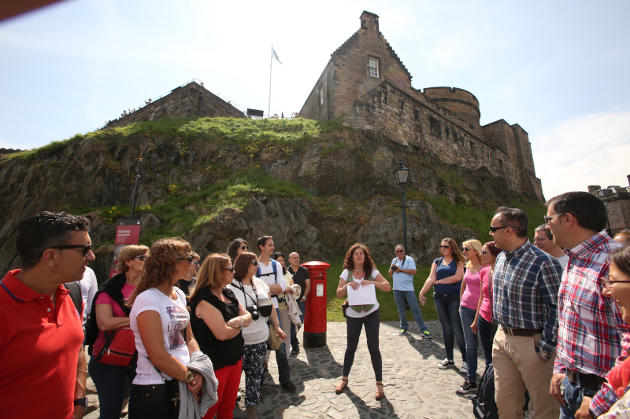
The problem affects different types of tourists differently. In Cohen’s approach, where the two basic types of tourists are institutionalised and non-institutionalised tourists (Cohen, 1984), organised and individual mass tourists typically live in the environmental bubble of their own society, from the safety of which they observe and experience the alienation of the host environment This bubble contains a linguistic component in addition to the familiar environment, food and other services
Language barriers in tourism
https://www.feg-touristguides.com/stga.php

Slide 17
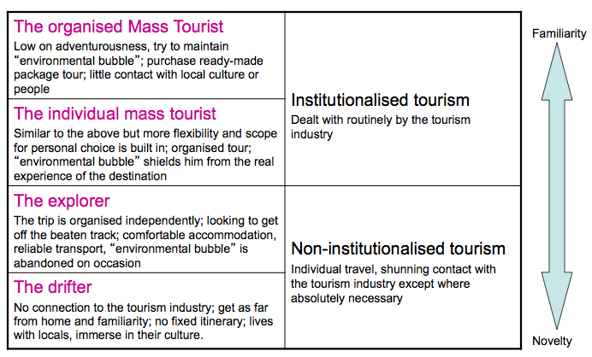
Institutionalised tourists rely on the organised system of tourism where language problems are less typical Non-institutionalised tourists rely more on themselves – and their own language skills
Cohen’s tourist types

Slide 18
Most or all employees of tourist establishments dealing with tourists have a relatively high level of language proficiency: a prerequisite for employment in hotels, restaurants, souvenir shops, travel agencies and car rental agencies In the most developed countries in terms of tourism, at least some of the staff are multilingual and are thus able to communicate with tourists from all the main countries of origin in their own language
Cohen’s institutionalised tourists and their communication

Slide 19
Guided tours to major attractions are organised by language groups so that each tourist can be guided in his or her own language Institutionalised tourists rarely dare to step outside their own environmental bubble, and even when they do, they are accompanied by a guide: they typically encounter virtually no communication problems with locals that would require even minimal linguistic adaptation
Cohen’s institutionalised tourists and their communication

Slide 20
Real explorers and travellers (i.e. the non-institutionalised type of tourist, with significant travel experiences) make limited or almost no use of the services provided by tourist facilities (including the use of language intermediaries – guides, tour guides, interpreters), and are therefore more exposed to the host environment’s alienness than the typical mass tourist They do not seek the protection of the bubble of the tourist establishment and are well beyond the periphery of the tourist system within which the individual mass tourist operates. In exchange for a more authentic experience, they also take a higher level of risk also in terms of language. They may be assisted by mediators
Cohen’s non-institutionalised tourists and their communication

Slide 21
In addition to formal mediators – guides, travel agencies etc. – there are also informal mediators without the responsibilities of mediators; their role is often invisible but very subjective and important. Informal mediators include the media, friends, relatives, souvenirs, photographs, as well as tourism workers, other tourists and members of the local community (Marinovic – Simić, 2018) Other types of linguistic mediators, such as self-proclaimed local guides, taxi drivers and others lurking around hotels and offering their services, may be even more unscrupulous mediators than professional guides in mediating communication between tourists and locals – that is, they may not promote barrier-free services but are more likely to generate linguistic barriers and other obstacles even reaching beyond language barriers (Cohen – Cooper, 1986)
Cohen’s non-institutionalised tourists and their communication

Slide 22
In international tourism various tools to reduce cultural and communication barriers Use of certification by tourism operators and destination management organisations, the use of signs, pictures, pictograms instead of written communication, education of local people and encouraging community participation in tourism (local people interested in tourism are much more likely to learn the language of visitors than their counterparts who do not benefit from tourism) Pictograms in a restaurant can help you avoid problems with food allergies and intolerances, for example, but unfortunately these signs are not necessarily standardised yet
Tools to manage barriers – supply side

Slide 23
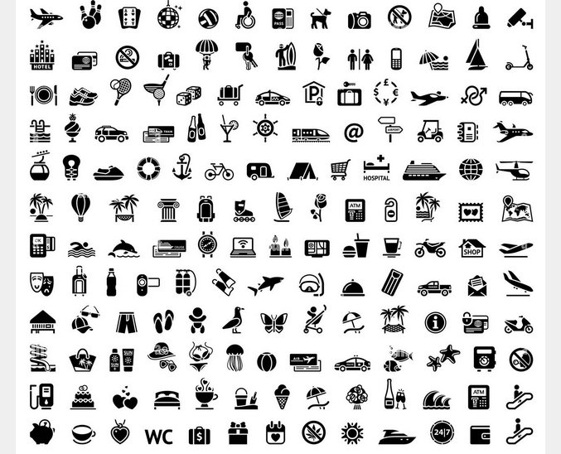
See the wheelchair in the top line – direct assistance to those who are not only linguistically disabled
Pictograms used in tourism
https://www.shutterstock.com/hu/search/tourism-symbols?image_type=illustration

Slide 24
Use of non-verbal communication, communication without spoken words (tone of voice, gestures, posture, touch and sight), intentionally or unintentionally In non-verbal communication, decoding the message requires a thorough knowledge of the sender’s and receiver’s culture, situation and circumstances. When people from culturally different countries meet in a tourist interaction, barriers can arise if they are not familiar with each other’s culture (Marinovic & Simić, 2018) For example, some hand gestures can be positive but also highly offensive depending on where on the globe you are, and even on the direction in which you turn your palm
Tools to manage barriers – demand side, i.e. the tourists

Slide 25
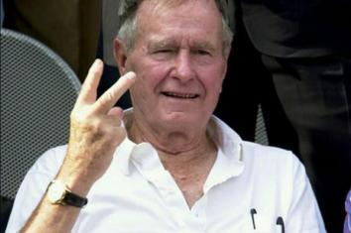
President George H.W. Bush, in an attempt to be friendly to a group of protesters in Australia, unintentionally delivered the British equivalent of extending the middle finger President George H.W. Bush during a visit to Australia in 1992, believing he was being friendly and supportive to a group of peace protestors in Canberra, gave the “V-for-victory” or “peace sign” as he drove past in his limousine. Unfortunately, he presented the symbol with his palm facing inwards, as is customary for the hand gesture in the United States – but in the British Isles, and also in Australia, the palm should face outwards to express peace, with the gesture presented by an inward palm signifying the same as an extended middle finger in American culture
Non-verbal communication – a gesture gone wrong
https://historycollection.com/17-mishandled-international-events-throughout-history/

Slide 26
Communicating in writing – if the tourist or host has at least a minimum knowledge of the other language, written communication can reduce some of the misunderstandings that come with being verbal (accents, fast speech) Learn English – it seems obvious that everyone should learn the most important world language today, so that it can be the intermediary language in tourism (too), but not everyone may have the motivation and the opportunity to do so Go on holiday to a place where they speak the language or a foreign language spoken by the tourist – but this again narrows the range of potential destinations
Tools to manage barriers – demand side, i.e. the tourists

Slide 27
Learn the language of the destination country – very few tourists make the effort to learn the language of the host country for a trip of a few days or weeks at most a year. Also, it narrows down the range of potential destinations. It is more common and simpler to purchase and use language books or simplified dictionaries as a tool to ensure minimum language competence Apps: including language ones (Google Translate, Duolingo, iTranslate, Memrise, Busuu); other apps that make communication unnecessary, such as journey planners (Citymapper, MAPS.ME, Roadtrippers, Google Maps), Uber, etc. However, dependence on apps can also create barriers: they can make a user who is too much dependent on them vulnerable in the event of a phone running out of battery, breaking down, being damaged or stolen; no signal; no internet connection; expensive roaming, etc.
Tools to manage barriers – demand side, i.e. the tourists

Slide 28
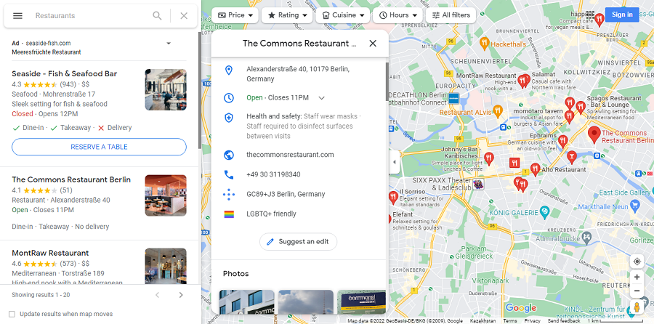
How to find a restaurant using Google Maps

Slide 29
Sign up for a beginner’s course: locals working in the destinations have often seen others struggling with language barriers, are used to dealing with the needs of tourists and often run beginner’s courses. By taking just one or two classes tourists can learn the most common phrases and questions, such as how to order in a restaurant, ask where the toilet is, etc. Learn the basic rules of pronunciation: this often overlooked aspect can be incredibly important when learning a language, as speaking with an incorrect accent or intonation is unlikely to be understood
Tools to manage barriers – practical tips by travel portals

Slide 30
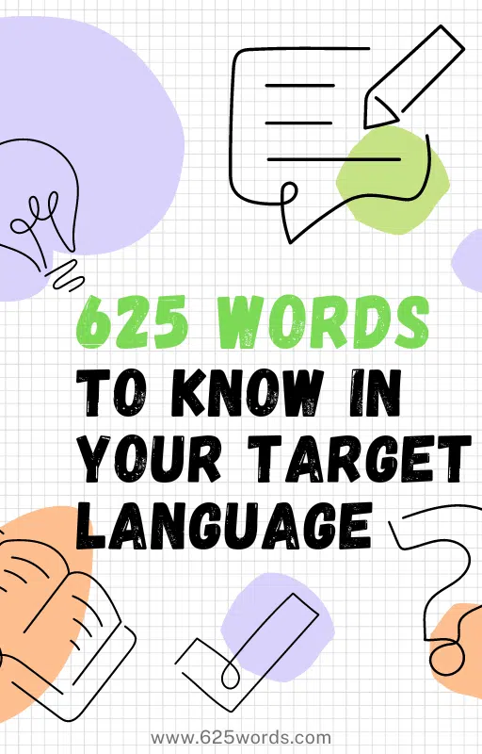
Look for situations where you need to use the language: the best way to get used to dealing with language barriers is to start using the language little by little: for example, by going out for dinner or shopping alone Check out Gabriel Wyner’s list of common words (https://625words.com/): the language guru has compiled lists of the 625 most common words – Adler came in at 200 (Adler, 1980, cited by Cohen & Cooper, 1986)
Tools to manage barriers – practical tips by travel portals
https://625words.com/

Slide 31
Don’t feel uncomfortable if you feel you have failed: accept the discomfort, because venturing outside your comfort zone is in itself respectable. Instead of being held back by deficient language skills, consider it a strength that you are able to communicate at all at any level Body language as a means of communication across all borders, continents and cultural differences. E.g., a waiter who asks if we want more coffee usually nods towards the empty cups on the table. Use these actions and non-verbal cues and see how far you can get with non-verbal communication; Keep phone charged and with enough data traffic: a smartphone is a reliable tool that can help you out of any awkward situation that may arise (map apps, translation apps, etc.). However, it is advisable not to rely too much on technology (https://www.gadventures.com/blog/language-travel/)
Tools to manage barriers – practical tips by travel portals

Slide 32
Communication in tourism is not just about using language, but also about exploiting the opportunities – and avoiding the pitfalls – of ICT in an increasingly digitalised industry The digitisation of tourism services is transforming the structure of the sector by changing barriers to entry, facilitating price comparisons – a major accessibility benefit for consumers, the demand side –, and revolutionising sales channels via the internet, optimising costs and improving production efficiency – an invaluable benefit for the supply side, the service providers (Gutierriz et al., 2023)
Ensuring info-communication accessibility in tourism

Slide 33
Use of information technology in tourism (also) seems to be of a fundamentally barrier-free nature, as it removes obstacles such as lack of information, language barriers in some cases (booking accommodation, flights, cars, etc. can be done via the Internet without language barriers, in one’s own mother tongue in most cases). It greatly facilitates decision-making: e.g. when choosing an accommodation or other service provider, user reviews can be an orientation in themselves (making the collection of information about the service providers through other communication channels unnecessary), but also allowing specific factors to be searched for through booking platforms, such as accessibility, thus greatly reducing the uncertainty associated with travel
Ensuring info-communication accessibility in tourism

Slide 34
On the website of the largest accommodation mediator, booking.com, only wheelchair accessibility can be entered under “Facilities” as a criterion for narrowing down the search results, but the more attentive traveller can scroll down and find a “Property accessibility” tab and a “Room accessibility” tab, with no less than seven and eleven aspects, respectively (with overlaps of course) There is information about (1) Property Accessibility and (2) Room Accessibility
Ensuring info-communication accessibility in tourism

Slide 35
Property and room accessibility features on booking.com
Room Accessibility
Entire unit located on ground floor
Upper floors accessible by elevator
Entire unit wheelchair accessible
Toilet with grab rails
Adapted bath
Roll-in shower
Walk-in shower
Raised toilet
Lower sink
Emergency cord in bathroom
Shower chair
Property Accessibility:
Toilet with grab rails
Raised toilet
Lowered sink
Bathroom emergency cord
Visual aids (Braille)
Visual aids (tactile signs)
Auditory guidance

Slide 36
Tourism management has by now become completely inseparable from information technology, so having the right digital skills is of paramount importance for tourism businesses Digitalisation and Web 4.0 are redefining jobs and creating new ones, requiring new competences and skills Digital literacy of consumers is also becoming increasingly important. History seems to repeat itself again: every improvement creates new barriers as well – those unable to use the latest info-communication tools may be in a handicapped situation, e.g. if the planning and implementation of the travel can only be done through info-communication tools and solutions
Ensuring info-communication accessibility in tourism

Slide 37
The most important future digital skills on the side of the supply side include online marketing and communication skills, social media skills, MS Office skills, skills in using operating systems and skills in monitoring online reviews (Carlisle et al., 2021) The largest gaps between current and future skill levels are found for artificial intelligence and robotics skills, as well as augmented reality and virtual reality skills, but these skills, together with computer programming skills, are the least important digital skills
Ensuring info-communication accessibility in tourism

Slide 38
It is not enough for employees to be digitally literate; it is also needed by consumers. As more and more of the travel organisation activities is done by the travellers themselves, unlike in previous decades (when the hard work of organising a trip was usually assigned to professional travel agencies), and more and more functions by service providers are delegated to tourists, in order to save time and money (e.g. self-check in at airports), digital literacy is becoming a more and more essential need for travels, and the lack of such skills leaves traveller handicapped, disabled in a way One can find guides on the use of such self-service solutions, e.g. airport self-check in (www.tripsavvy.com), but finding and using these guides also needs at least basic digital skills
Ensuring info-communication accessibility in tourism

Slide 39
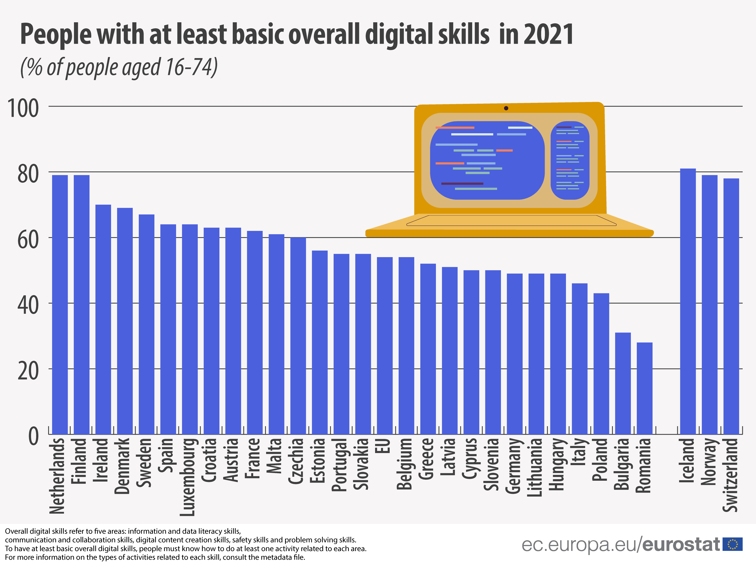
One would expect that the majority population is digitally literate in the European Union, but the fact is that in 2021 far less than two-thirds of the total population of the Union aged 16–74 had at least basic digital skills, and in about a third of the countries concerned this share remained below 50% (https://data.europa.eu)
Proportion of people with at least basic digital skills, EU and EEA, 2021

Slide 40
Actors in the world of travel communicate almost exclusively in the national language(s) of the countries, or almost exclusively in English – but human beings in search of tourist experiences are extremely diverse also in terms of education. If the majority cannot use English, the world’s number one transfer language, at least at a minimum level, they will find themselves in a world of obstacles which will (or could) affect the quality of their tourism experience Rise of so-called artificial intelligence, free translation algorithms that can be used with relative ease on the digital platforms might alleviate the world of travel, but on the one hand they are far from perfect and are unlikely to become so in the next decade (Csepeli, 2020), and, even if they do become so, the excessive dependence on them might even create further obstacles in travels (in case of technical failures, lack of signal etc.)
Ensuring info-communication accessibility in tourism

Slide 41
One example for the provision of accessibility is the concept of so-called easy-to-use and easy-to-understand websites: the development of a truly easy-to-understand and manageable, mostly visual and graphical structure, which makes central messages and information that the website provider considers important understandable and accessible to people with mental disabilities Unfortunately, this type of accessibility solution, which includes accessibility elements, is very limited in scope in almost all regions of the world Furthermore, where it is available, it is almost exclusively part of the online pages of NGOs representing the disability group concerned (https://topdisabilitywebsites.co.uk)
Ensuring info-communication accessibility in tourism

Slide 42
The concept of easy accessibility, combined with some creativity, could be implemented, for example, as a layer of sites operated by the tourism industry to attract visitors and make services available. This would be necessary, firstly, to enable a new segment of people with functional disabilities to become potential travellers in the world of travel, and secondly, to make it easier to overcome the above-mentioned (usually English) language gaps, without the need for any other digital translation aids
Ensuring info-communication accessibility in tourism

Slide 43
The rapidly widening and deepening flow of information created by digitalisation, in addition to an almost untapped wealth of opportunities, is generating at least as many sources of danger Impersonalisation, for example, can in many cases generate distortions and inequalities of experience which can prevent the development of a genuine traveller’s attitude and the desire to become one This is true not only for people who have a strong need for classic accessibility, but also, for example, for the over-65 generation, the so-called “silver generation travellers”
Ensuring info-communication accessibility in tourism

