Slide 1
The development of the innovative educational method of ACCESSIBLE tourism in Central Europe 2022-2-HU01-KA220-HED-000099410

Slide 2
8. Technical and organisational solutions for accessibility

Slide 3
The right to travel for leisure and enjoyment is a fundamental human right for individuals with disabilities, just as it is for those without disabilities. Adequate facilities and well-trained personnel are essential prerequisites to cater to the needs of this market (Ozturk et al., 2008) Individuals with disabilities face various challenges while travelling, and these challenges can impact their willingness to engage in travel activities. The literature highlights four primary barriers to disabled people’s travel activities: these are intrinsic, economic, environmental, and interactive barriers (McKercher et al., 2003)
Technical solutions for accessibility in tourism – preliminary thoughts

Slide 4
Several studies have shown the willingness of people with disabilities to integrate into tourism, also showing that people with disabilities typically travel with family and friends, and less often with an accompanying person who helps to overcome barriers (Zaluska et al., 2022) For people with disabilities who require the constant presence of a caregiver to carry out daily tasks, the positive and helpful attitude of the caregiver is important, in addition to the fact that in many cases they require constant presence (Eusébio et al., 2023)
Technical solutions for accessibility in tourism – preliminary thoughts

Slide 5
In case of the travel of people with reduced mobility, not only physical presence and emotional support are key: attention must be paid to the quality of the place to be visited, the availability of specialised infrastructure, the cost of the means of transport and the cost of the travelling companion (Friman – Ollson, 2023) In the case of transport, unhindered access to public transport is essential. It is key to provide transport facilities that accommodate wheelchair users and to design stations with accessibility in mind, thereby creating a barrier-free public transport infrastructure (Park – Chowdhury, 2022)
Technical solutions for accessibility in tourism – preliminary thoughts

Slide 6
Access to information helps people with various limiting physical or mental disabilities in the planning process by helping them to find places to visit, taking into account their specific needs. This information gives them the opportunity to find out about accessible accommodation, transport, and tourist attractions Information on accessible accommodation is essential for people with disabilities (Apostolidou – Fokaides, 2023): it should include the accessibility of the different rooms (such as doors without thresholds, positions of light switches and handles accessible from wheelchairs, appropriate design of bathrooms and public spaces), but also information on the availability of specific facilities relevant to them on online booking platforms Access to information on public transport is also an essential part of the planning process for travellers: they can decide on the most optimal travel options and alternatives
Technical solutions for accessibility in tourism – the importance of information

Slide 7
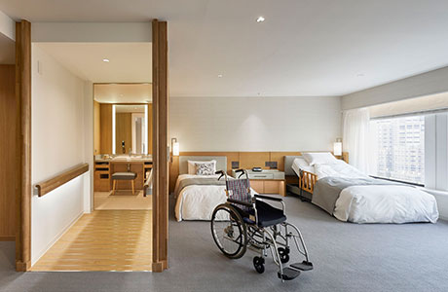
A good example: informing image of an accessible hotel room, Keio Plaza Hotel, Tokyo – ease of access to and movement within the room by wheelchair is clearly visible
Technical solutions for accessibility in tourism – the importance of information
https://www.keioplaza.com/rooms/universal.html

Slide 8
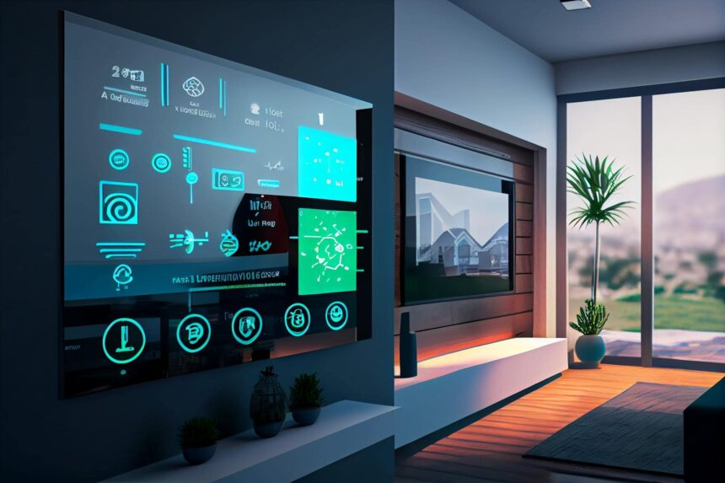
Smart devices can also enable automated control of hotel rooms, if the hotel management believes that these advances can improve equal opportunities for people with disabilities (Cassia et al., 2020). In this case, it may be appropriate to implement smart lighting, smart temperature and climate control, automatic flushing of toilets in bathrooms, automatic control of water pressure and water temperature in showers
Technical solutions for accessibility in tourism – smart devices
https://www.technology-innovators.com/smart-hotels-and-room-automation-creating-intelligent-guest-environments/

Slide 9
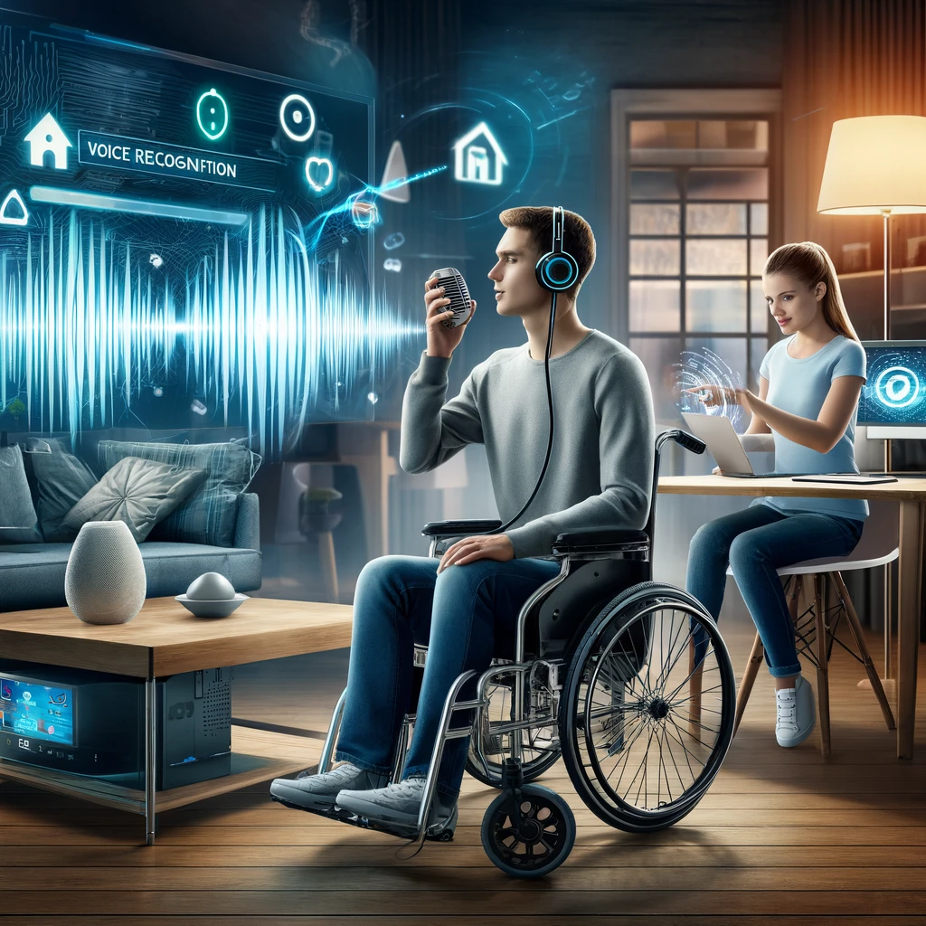
In both tourist accommodation and public transport, there are initiatives to develop interactive control units, often based on voice control or motion detection (Joyojeet, 2015). Voice-activated and motion-activated accessible infrastructure is particularly beneficial for people with reduced mobility, as they can greatly facilitate the opening and closing of doors, thus facilitating access to buildings and boarding and alighting from public transport
Technical solutions for accessibility in tourism – smart devices
https://know-the-ada.com/empowering-the-disabled-through-voice-recognition/

Slide 10
The most optimal place to find out about the accessibility of tourist attractions is also in this case the online space, where it is useful to find out about the accessibility of different museums, parks, restaurants, events, but in this respect, quick and easy access to the necessary information is essential (Zaluska et al., 2022)
Technical solutions for accessibility in tourism – the importance of information
https://access4you.io/en

Slide 11
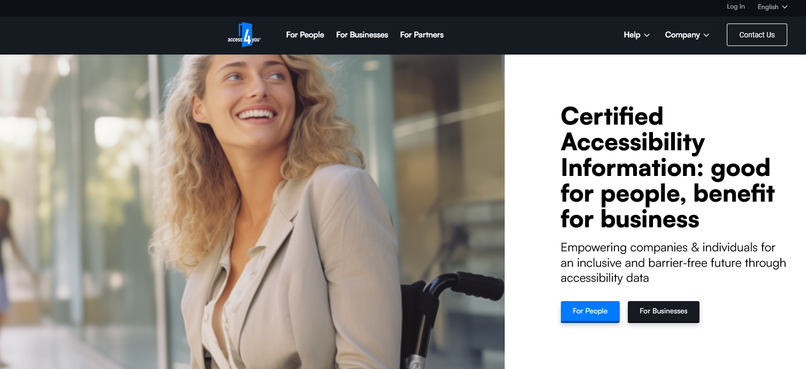
Technical solutions for accessibility in tourism – the importance of information

Slide 12
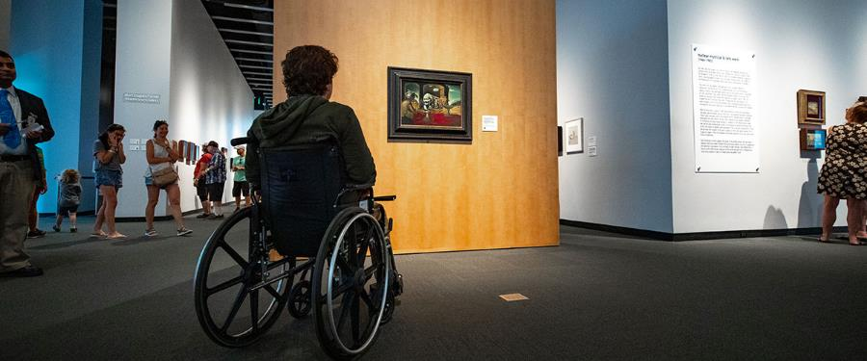
They can contribute to the comfortable and safe viewing of different exhibitions and exhibits. Museums, galleries and other culture-related facilities usually have accessible entrances, ramps, lifts, spacious exhibition halls, which usually facilitate transport. At the same time as providing access to the building, it is also useful to provide audiovisual aids and tactile surfaces to help visitors find their way around and gather information
Technical solutions for accessibility in tourism – cultural venues
https://thedali.org/visit/accessibility/

Slide 13
Every day, inventions are emerging that have an impact on improving our quality of life, supporting and simplifying our everyday tasks. These can significantly facilitate the lives of both people with disabilities and people without disabilities and their integration into society (Mensah-Gourmel et al., 2022) For innovative solutions, it is essential to achieve technical accessibility in order to ensure that all potential users have sufficient access to the information they need (Bigham et al., 2010). In this respect, the user must have different digital competences, which together can achieve technological accessibility (Farkas et al., 2022) – see ‘The issue of language and communication accessibility’ The widespread use of artificial intelligence is having an impact on our private lives, at work, in education and in many cases it is also making our travel easier, whether it is finding our way around, gathering information or planning our travel financially
Technical solutions for accessibility in tourism – innovative technologies and inventions

Slide 14
With this in mind, it is important to note that the whole travel industry needs to integrate the progressively evolving technology into the service delivery by facilities. The gradual development of the internet, social media and smartphones, which provides easy and rapid access to these, has enabled businesses and consumers alike to access information quickly and to maintain in constant contact with each other, resulting in a significant increase in the flow of information, both real and unreal (Apostolidoi – Fokaides, 2023). The free flow of information allows services to be personalised, taking into account individual preferences, thus bringing tourism services closer to people with disabilities
Technical solutions for accessibility in tourism – technology

Slide 15
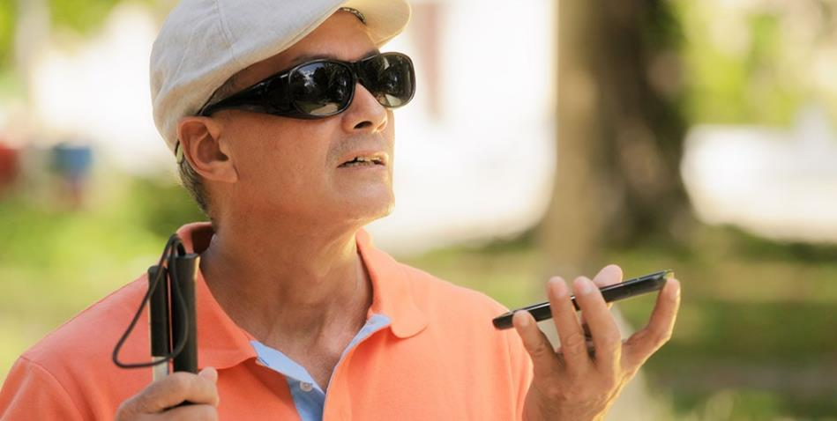
Most mobile devices have embedded functions that allow the reading of written materials and messages, thus helping visually impaired people to find their way around. This functionality also helps them to navigate between tourist accommodation and other facilities, in case they want to find information relevant to them (Alves et al., 2022)
Technical solutions for accessibility in tourism – mobile devices
https://assileye.com/blog/new-assistive-technology-for-the-blind/

Slide 16
In addition to online accessibility information, websites have been created to give potential travellers an insight into the nature of a tourist attraction. These websites can provide an experience not only for ordinary tourists, but also for people with disabilities and reduced mobility who are unable to visit tourist sites of interest to them These online platforms provide an insight into the different localities through virtual reality, but in this case the street view of the map developed by Google can also help to get to know the different destinations
Technical solutions for accessibility in tourism – adequate websites

Slide 17
In order to achieve barrier-free travel, it is advisable to use different navigation tools and applications, as these can help to find accessible locations and to know their accessibility in advance. There are initiatives to help visitors to discover a cultural heritage site, usually by highlighting buildings that are important attractions for the area (Farkas et al., 2022c) Websites and applications that provide useful information content for people with disabilities and help them to navigate through various accessibility solutions can contribute to their social inclusion and tourism experience (Cassia et al., 2020)
Technical solutions for accessibility in tourism – adequate websites

Slide 18
VR and AR contribute to enabling people with disabilities to learn about the destination and the accommodation they want to visit before they actually travel VR enables people with disabilities to take virtual tours that approximate reality and can be viewed despite their mobility barriers. Tours are often detailed, can provide interactive experiences for the user Applications developed to communicate AR enable up-to-date and stationary accessibility information to be communicated, helping travellers to find the entrances, lifts and assistive devices designed for them. These applications and initiatives can help potential visitors to avoid inconvenience surprises and facilitate the process of planning their journey
Technical solutions for accessibility in tourism – virtual reality and augmented reality

Slide 19
Tools to help people with disabilities, not to help them find their way around, but rather to help them with their mobility and alleviate the symptoms of their disability. Examples of such devices: Wheelchairs available in motorised form. This may be an optimal choice, particularly for people who are limited not only in the use of their lower limbs but also in the adequate mobility of their upper limbs. In this case, motorised wheelchairs that can be controlled by the various muscles of the mouth may be mentioned The proper usability of wheelchairs also depends on the buildings they visit having infrastructure that allows for barrier-free access
Special devices alleviating the symptoms and assisting PwD

Slide 20
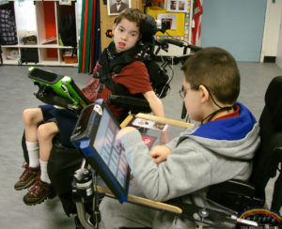
Persons with speech impairments can also be assisted by features that allow them to emit voice messages, also using their oral muscles (Joyojeet, 2015). These devices can assist movement and communication through a combination of a computer and software (Laabidi et al., 2014)
Special devices alleviating the symptoms and assisting PwD
https://ussaac.org/aac-info/aac-devices/

Slide 21
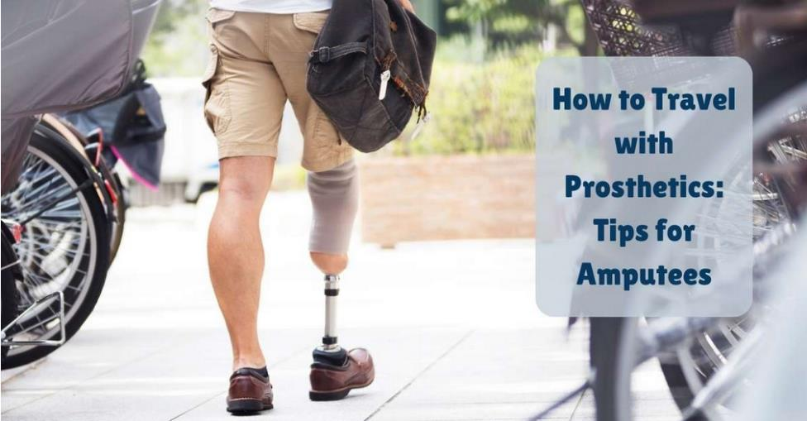
Among the disabled, especially those who have lost a limb, it is possible to use prostheses that can replace the limb to some extent, and can help them to perform basic movements (Aleksandrova & Nenakhova, 2019)
Special devices alleviating the symptoms and assisting PwD
https://www.protechortho.com/how-to-travel-with-prosthetics-tips-for-amputees/

Slide 22
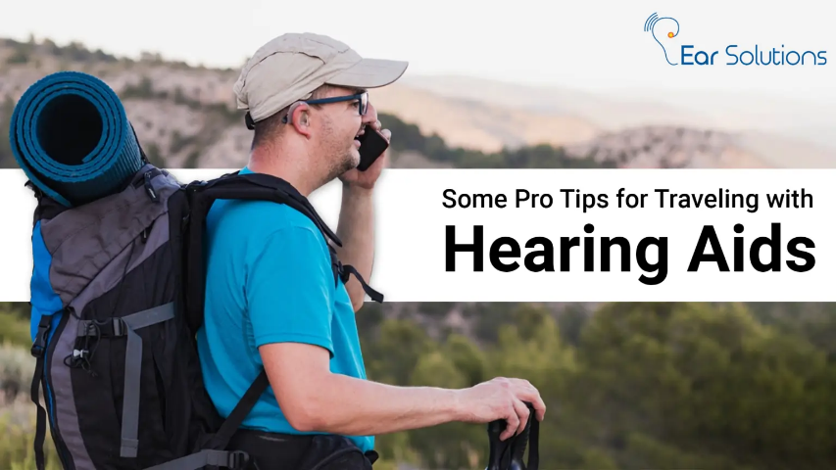
People who live with hearing loss have the possibility to use various hearing aids designed to amplify the sound fragments they encounter in their environment For people with visual impairment, glasses and contact lenses of varying strengths, depending on their condition, can help to improve their vision, but medical interventions can also improve the performance of the eye
Special devices alleviating the symptoms and assisting PwD
https://earsolutions.in/traveling-tips-with-hearing-aids/

Slide 23
The insufficient availability of tourist offers and specific infrastructure for individuals with disabilities can be attributed to various factors: (1) lack of awareness among tourism providers (2) additional costs (3) no enforcement of regulations and guidelines (4) complexity of designing infrastructure and tourist offers to PwD (5) societal attitudes and stigmas surrounding disabilities (6) negative perceptions (7) lack of collaboration
Specific solutions in tourism for accessibility – deficiencies

Slide 24
There may be a lack of awareness among tourism providers about the specific needs and requirements of individuals with disabilities. This lack of awareness can result in a failure to prioritise and invest in accessible infrastructure and services Creating and maintaining accessible infrastructure can involve additional costs. Businesses and destinations may be hesitant to invest in modifications or new facilities, especially if they perceive a limited demand, or face financial constraints
Specific solutions in tourism for accessibility – deficiencies

Slide 25
While some regions have regulations and guidelines regarding accessibility for individuals with disabilities, enforcement may be inconsistent. In areas where regulations exist, the lack of strict enforcement can reduce the incentive for businesses to invest in accessible infrastructure Designing infrastructure and tourist offers that cater to a wide range of disabilities can be complex. Achieving true inclusivity may require innovative design solutions and a commitment to accommodating diverse needs
Specific solutions in tourism for accessibility – deficiencies

Slide 26
Societal attitudes and stigmas surrounding disabilities can also contribute to the neglect of creating accessible tourist offers. Negative perceptions may result in a lack of motivation to address the needs of individuals with disabilities. Collaboration among various stakeholders, including government bodies, tourism operators, disability advocacy groups, and architects, is essential for creating accessible tourism. The absence of effective collaboration can impede progress in developing inclusive infrastructure and services
Specific solutions in tourism for accessibility – deficiencies

Slide 27
Businesses may underestimate the potential market for accessible tourism. Improving accessibility can not only cater to individuals with disabilities but also attract a broader customer base, including families and older individuals who may benefit from accessible features Tourism staff may lack the necessary training to assist individuals with disabilities. Proper training is crucial to ensure that staff can provide the appropriate support and services required for a positive travel experience
Specific solutions in tourism for accessibility – deficiencies

Slide 28
Efforts to address these challenges involve - raising awareness, - promoting inclusive design practices, - providing training for tourism professionals, and - fostering collaboration among various stakeholders to create a more accessible and inclusive tourism industry As societal awareness and expectations evolve, there may be an increasing demand for accessible travel options, encouraging the industry to invest in and prioritise inclusive tourism offerings
Specific solutions in tourism for accessibility – tackling the deficiencies

Slide 29
Accessible accommodations: Implementing ramps, elevators, accessible rooms, and bathrooms equipped with grab bars and lowered fixtures. Smart technologies like voice-activated controls and adjustable bed heights also enhance accessibility Accessible attractions and experiences, museums and exhibits: Implementing features like tactile exhibits, Braille signage, audio descriptions, and accessible seating options in theatres, museums, and other tourist spots. Interactive exhibits using touchscreens and tactile displays for visitors with visual impairments
Specific solutions in tourism for accessibility – common practices

Slide 30
Accessible transportation: Designing transportation modes (buses, trains, planes) with ramps, lifts, priority seating, and adequate space for wheelchairs. Some places have introduced wheelchair-accessible taxis or ride-sharing services Accessible pools and spas: Accessible pools and spa-type facilities not only serve an enjoyment function but can also play an important therapeutic role for people with various disabilities, e.g. in the case of therapeutic pools or special equipment. It is very important for all facilities to have several pools providing an aquatic experience that can be safely used by people with reduced mobility and other disabilities
Specific solutions in tourism for accessibility – common practices

Slide 31
Accessible outdoor recreational facilities: an important component of the tourist experience is the use and “consumption” of the landscape and nature. This can be experienced authentically by people with disabilities if there are accessible routes, transport and transport solutions available Other technological solutions: different technological solutions can be a good complement to tourism offer, a valuable experience or a good way to explore and understand other attractions. Nowadays, the range of tools and innovative solutions is constantly expanding, and tourism is also implementing them, with some elements being adapted for people with disabilities
Specific solutions in tourism for accessibility – common practices

Slide 32
Accessible room design: spacious rooms to allow easy manoeuvrability for wheelchair users and people with mobility aids. Electrical outlets at waist height, shelves, cabinets and landline telephones with low heights, adjustable beds, movable furniture Sometimes suites are a desirable option for PwD, since they often travel with caregivers Bathroom accessibility: roll-in showers with grab bars and a folding shower seat are built in for people with mobility impairments. Non-slip flooring materials Accessible washbasins: sinks with space underneath for wheelchair users and adjustable height options are needed Visual and audible alarms: they provide an extra safety measure for people with visual impairments
Specific solutions in tourism for accessibility – accessible accommodations

Slide 33
Assistive technology integration can bring connectivity features: Wi-Fi and connectivity features to support the use of assistive technologies. Charging stations for electronic mobility devices and assistive technologies available to provide accessible charging Accessible routes and entrances: ramps and elevators must be designed so that all routes and entrances are easily accessible to wheelchair users, no thresholds or other barriers. Automatic doors can also be a good solution Clear signage: the use of clear and visible signs showing accessible routes and facilities. Large print materials for guests with low vision
Specific solutions in tourism for accessibility – accessible accommodations

Slide 34
Accessible parking and other outdoor spaces: specially designed and signposted parking areas close to the entrance with adequate width and adjacent access aisles. Drop-off zones and access areas for visitors with mobility impairments. Wheelchair-accessible paths, paved, wheelchair-accessible walkways in all areas where tourists can visit Intelligent technology in rooms: special room control technology operated via mobile apps or voice commands for people with mobility or dexterity challenges. Included closed captioning on televisions ensures that televisions offer solutions for guests with hearing impairments
Specific solutions in tourism for accessibility – accessible accommodations

Slide 35
Staff training: training personnel for disability issues so that staff will be aware of the needs of guests with disabilities and can provide assistance. Staff should possess adequate communication skills to interact respectfully and efficiently with guests of all abilities Accessible common areas of the hotel: seating options for disabled people too in common areas. Lounges, restaurants and meeting rooms designed to be accessible Emergency evacuation plans: accommodations establish personalised emergency evacuation plans for guests with disabilities. There is also specific staff training on emergency procedures, staff need to be prepared and instructed in emergency situations
Specific solutions in tourism for accessibility – accessible accommodations

Slide 36
Creating accessible museums and exhibitions is fundamental for ensuring that individuals with disabilities have equal chances to engage with cultural and educational experiences Attractions based on vision are especially a great challenge for visually impaired people. For this, there are some good solutions around the multisensory technologies Many considerations and solutions for making museums and exhibits more accessible are nowadays available, making the cultural experience accessible for all
Specific solutions in tourism for accessibility – accessible attractions and experiences, museums and exhibits

Slide 37
Accessible building design: ramps and elevators with appropriate slope ratios to ensure wheelchair access to all areas, if possible, even without assistance Clear pathways: wide and barrier-free pathways for easy navigation, with curb-cuts, especially for individuals using mobility aids Accessible seating and viewing areas: specific spaces with better visibility or perspective for individuals with disabilities. A variety of seating options, including benches and chairs with armrests for individuals who may need additional support. Rest areas with comfortable seating throughout the museum
Specific solutions in tourism for accessibility – accessible attractions and experiences, museums and exhibits

Slide 38
Accessible tours and guides: tours with sign language interpreters, audio guides, or guides well-versed in accessibility needs. Museum staff is trained to provide assistance and guidance to visitors with disabilities. Museums often offer guided tours specifically designed for individuals with visual or hearing impairments, with trained guides providing detailed descriptions Adaptive equipment: wheelchairs, walkers, or other mobility aids for visitors who may require them during their visit to ensure they can access and enjoy attractions comfortably
Specific solutions in tourism for accessibility – accessible attractions and experiences, museums and exhibits

Slide 39
Tactile and Braille signage: tactile maps and models for people with visual impairments to understand the layout of the museum or other attractions Audio descriptions: audio guides which offer detailed vocal descriptions about exhibits for visitors with visual impairments. Audio guides in multiple languages. Captioning and subtitling for videos and multimedia presentations for people with hearing impairments. Transcripts of these texts provide written versions of audio content Accessible restrooms and facilities: universal design is needed for restrooms, including adequate space for manoeuvrability and support bars, including changing rooms for individuals with disabilities, especially those who require assistance
Specific solutions in tourism for accessibility – accessible attractions and experiences, museums and exhibits

Slide 40
Sensory-friendly spaces: quiet areas are designated for individuals with sensory sensitivities, for autistic persons, who may need a break from the stimulation. Sensory-Friendly Exhibits include elements that appeal to various senses Online accessibility information: website needs to provide information on exhibits, accessibility features, and virtual tours. A good website offers online resources, such as digital guides and pre-visit materials Educational programmes for all: inclusive workshops develop educational programmes accessible to individuals with disabilities, at all levels. Learning materials provide accessible information, such as digital textbooks, large-print captions and multisensory materials
Specific solutions in tourism for accessibility – accessible attractions and experiences, museums and exhibits

Slide 41
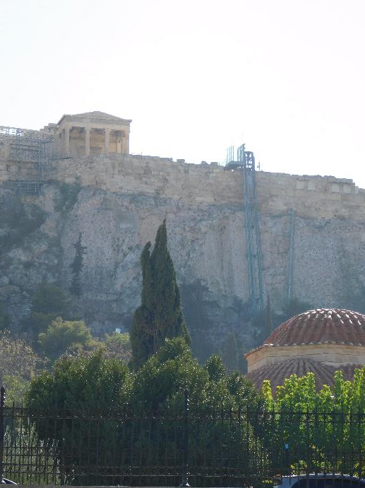
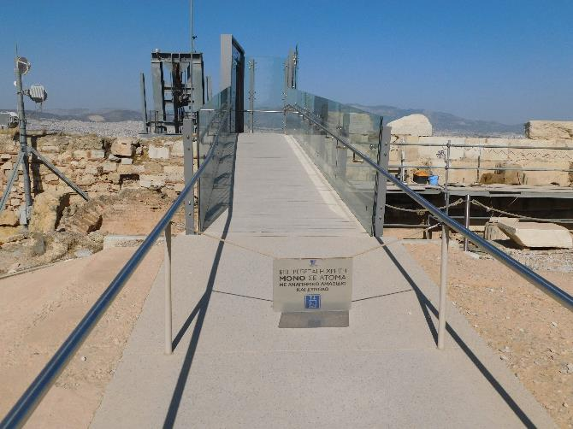
May not be pleasant for the eye, but allows the access of people in wheelchairs to one of the world’s most famous monuments
A good example for accessibility at an attraction – elevator at the Acropolis, Athens
Photos by Raffay, Z.

Slide 42
Footways and sidewalks, parking: design should take into account the needs of all potential users. Footways and sidewalks not obstructed by garbage, construction debris, tree roots, or other objects. No obstructions created by street vendors, parked cars, and utility poles Certain minimum dimensions: a footway or sidewalk should be at least 2000mm wide in areas with moderate to heavy pedestrian traffic, or 1500mm in less heavily trafficked areas. Around shops and bus stops, the footway will ideally be at least 3000 – 3500mm wide Designated accessible parking spaces and drop-off zones near transportation hubs and tourist attractions
Specific solutions in tourism for accessibility – transportation solutions

Slide 43
Vehicles accessible with wheelchairs: vehicles modified with ramps or lifts to accommodate wheelchair users, especially in short range transportation Taxis, rideshare services and public transportation need to have wheelchair-accessible components. The urban systems of transportation should include low-floor buses, ramps, and designated spaces for wheelchairs. Long-range bus and train services need to have additional services, such as proper toilet and resting times, assistance for disabled people, low counters at desks Real-time tracking and alert apps: real-time information on the location and accessibility status of public transportation services. With these travellers can plan their journeys more effectively
Specific solutions in tourism for accessibility – transportation solutions

Slide 44
Audio and visual announcements, on-board information: public transportation systems equipped with these inform passengers of stops and other important things. Individuals with visual or hearing impairments can navigate public transportation independently with the help of clear announcements Air travel: airports with assistive technologies, such as curb cuts, boarding ramps, accessible restrooms, and visual or auditory navigation aids. Persons with disabilities should be able to take on board mobility aids such as walking frames, crutches or foldable wheelchairs, free of charge, and should be stored within the confines of the cabin. Battery powered wheelchairs are usually carried in the hold of the aircraft
Specific solutions in tourism for accessibility – transportation solutions

Slide 45
Accessible cruise ships, ferries and other marine vessels: accessible cabins, elevators, and other facilities. Maximum slope of ramps for wheelchairs should be 1:20 At least one entrance/exit accessible for people with limited mobilities without stairs and steps and marked with the international symbol for disabled installations Accessible rental cars, shared transportation: vehicles with features like hand controls and wheelchair ramps. Some shared mobility options can also be open for people with certain (light) disabilities. Bike-sharing and scooter-sharing, with accessible options for individuals with diverse needs Training for transportation personnel: regular raining programmes for transportation staff to enhance their awareness and skills in assisting passengers with disabilities
Specific solutions in tourism for accessibility – transportation solutions

Slide 46
Assistive technologies in tourism, especially rental services for devices like wheelchairs, mobility scooters, hearing aids, but also assistance services play a crucial role in enhancing the travel experience for individuals with disabilities. Rental services for assistive audio-visual or digital devices make tourist destinations more accessible. Wheelchairs and mobility scooters provide individuals with mobility impairments opportunities to visit tourist sites independently, creating a sense of autonomy and self-reliance during their travels
Specific solutions in tourism for accessibility – transportation solutions

Slide 47
Accessible pools and spas are part of the recreational experience, but they can go beyond mere recreational facilities. They usually have a positive impact on physical health, social inclusion, empowerment and educational awareness, fostering a more inclusive and equitable society. Allowing accessibility to these services aligns with the principles of universal design, making possible that everyone can participate and enjoy the benefits of health and spa tourism
Specific solutions in tourism for accessibility – accessible pools and spas

Slide 48
Access areas with installed ramps or sloped entries Pool elevators or other transfer systems Accessible changing rooms and restrooms with sufficient space for wheelchair users and elements like grab bars and accessible seating. People with disabilities may visit an aquatic facility with family, friends or caregivers: provision of family or unisex restrooms Poolside circulation zones: pathways around the pool and spa are wide, level, and non-slippery Zero-entry or beach entry pools: gradual slope, creating a beach-like entry
Specific solutions in tourism for accessibility – accessible pools and spas

Slide 49
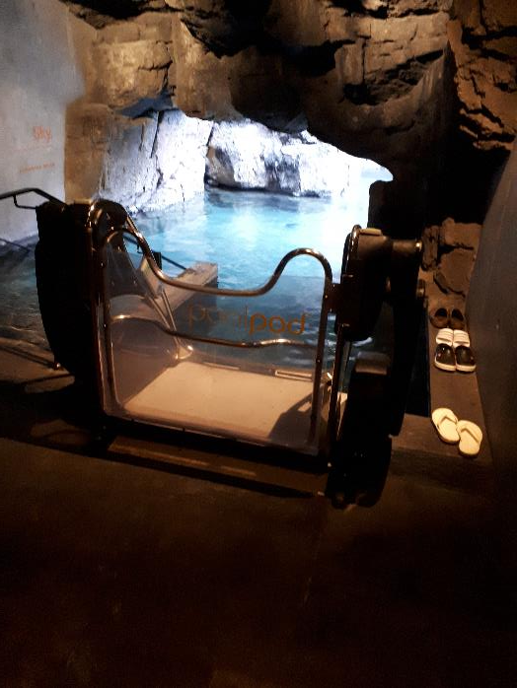
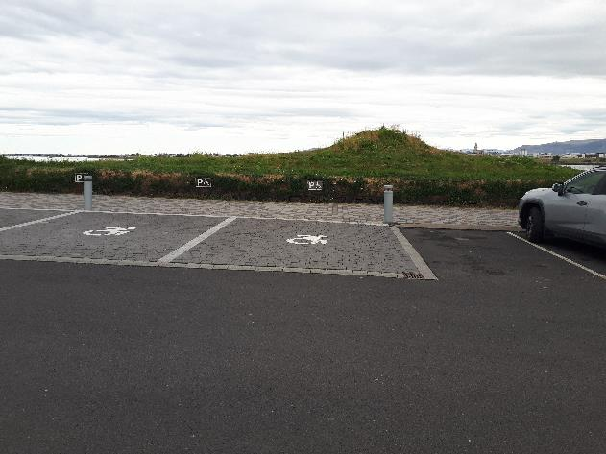
Car parking places designed for cars transporting people in wheelchairs: wider than normal places and right at the entrance
Good example for accessibility at a spa: Blue Lagoon, Reykjavík, Iceland
Photos by Raffay, Z.
Pool elevator

Slide 50
Handrails and grab bars in strategic locations around the pool and spa areas, also in changing rooms, toilets and other wellness areas Adaptive equipment: extra safety and comfort in certain situations, such as pool wheelchairs, floating devices or transfer benches Signage and information: clear and visible indications about accessible routes, accessible features, and information about available accommodations
Specific solutions in tourism for accessibility – accessible pools and spas

Slide 51
Temperature control features offer an option for everybody to ensure that the temperature of the water is comfortable for individuals with sensory sensitivities or conditions affected by temperature fluctuations Accessible seating can be built in pools or resting areas, with proper back support for individuals who may need a break or rest between activities
Specific solutions in tourism for accessibility – accessible pools and spas

Slide 52
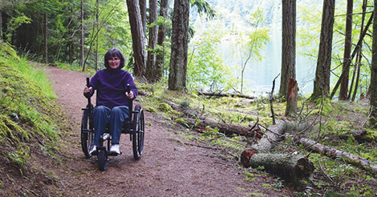
The most accessible routes, cycle routes, etc. are often found in regions with national parks or attractive natural sites Accessible outdoor places can bring easy use for other categories as well: families with small babies in a stroller, for example
Specific solutions in tourism for accessibility – accessible outdoor recreational facilities
https://www.dnswm.org/providing-accessibility-in-the-great-outdoors/

Slide 53
Accessible trails and paths: paved or with firm, stable surface to facilitate easy movement for individuals using wheelchairs or mobility devices. At the same time, the use of clear and visible signage that includes symbols and tactile information for individuals with visual or cognitive impairments is also important Smooth transitions between different surfaces and gradients, no obstacles for wheelchair users Wheelchair-accessible seating areas: designated seating areas with ample space for wheelchair users to comfortably enjoy the surroundings. Picnic tables installed with spaces designed to accommodate wheelchairs
Specific solutions in tourism for accessibility – accessible outdoor recreational facilities

Slide 54
Adaptive sports and recreation equipment offer sport experience for disabled persons: handcycles, adaptive bicycles or kayaks All-terrain wheelchairs rented for use on trails or uneven surfaces Accessible playgrounds covered by rubber or another accessible ground material, to ensure a safe and comfortable play area for people using mobility devices. Installing inclusive play structures that cater to children of all abilities, including those with physical and sensory impairments
Specific solutions in tourism for accessibility – accessible outdoor recreational facilities

Slide 55
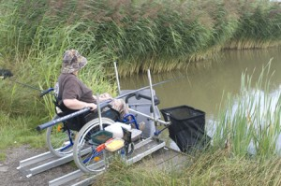
Accessible angling and boating facilities: angling docks with accessible features (lowered railings and spaces for wheelchairs) Adaptive equipment for boating activities Accessible restrooms and changing rooms: wheelchair accessible, with proper space, support bars, and accessible fixtures
Specific solutions in tourism for accessibility – accessible outdoor recreational facilities
https://www.anglinglines.com/blog/disabled-anglers-platform/

Slide 56
Sensory gardens: self-contained garden areas that allow visitors to enjoy a wide variety of sensory experiences, for individuals with visual or sensory impairments. Designed to provide opportunities to stimulate the senses, both individually and in combination, in ways that users may not usually encounter. Sensory gardens, as a form of horticultural therapy can be used in the education of special-needs students, including autistic people, dementia etc. (https://www.sensorytrust.org.uk/resources/guidance/sensory-gardens-planning)
Specific solutions in tourism for accessibility – accessible outdoor recreational facilities

Slide 57
Inclusive event spaces designed with accessible seating areas during outdoor events and performances Accessible parking, with good placement and clearly marked indicators, close to the entrance of the recreational area Community engagement: feedback systems for gathering inputs from individuals with disabilities, ensuring ongoing improvements and inclusivity in outdoor recreational spaces
Specific solutions in tourism for accessibility – accessible outdoor recreational facilities

Slide 58
Technological innovations: a number of innovative solutions to address challenges faced by people with special needs in tourism: web platforms like access@tour by action aims to increase knowledge transfer and collaboration among stakeholders in accessible tourism (J. Alves et al., 2022); projects that focus on creating digital tools and content in sign language to improve accessibility to cultural heritage sites for deaf tourists, with technologies like holography and mobile applications (Escudeiro P. et al., 20223); moreover, smart technologies to provide accessible transportation and destination information through platforms such as websites, mobile applications, and virtual reality These technological advancements are crucial in promoting inclusivity and enhancing the overall tourism experience for individuals with disabilities (Zabłocki M. et al., 2022)
Specific solutions in tourism for accessibility – other technological solutions

Slide 59
Augmented reality (AR) applications provide travellers with visual impairments with audio descriptions of surroundings, navigation assistance, and information Mobile apps for navigation and other smart navigation and wayfinding tools, like Google Maps or specialised ones provide information on public transportation and walking routes, wheelchair-friendly paths, and locations of accessible facilities (restrooms, entrances, etc.) Indoor navigation systems help better navigation within airports, hotels, and public spaces for individuals with visual impairments
Specific solutions in tourism for accessibility – other technological solutions

Slide 60
Websites and online resources – if complied to accessibility standards (like WCAG) – ensure navigation for users with disabilities. Screen reader compatibility, text alternatives for images, and clear navigation. Adjustable text size, high contrast modes, and simple navigation Virtual tours and 360-degree videos offer self-controllable tours or pre-recorded films of attractions, allowing individuals with mobility challenges to experience places they might find difficult to visit physically
Specific solutions in tourism for accessibility – other technological solutions

Slide 61
Wearable technologies like smart bracelets or tags interact with infrastructure, they can guide visually impaired tourists by providing location-based information and directions Online booking platforms allow users to specify their needs and preferences, can be integrated with assistive technologies to facilitate the booking process for PwD Communication apps designed for special needs (e.g. individuals with communication disorders) help to express needs and preferences. Language translation apps. These digital solutions aim to create an inclusive environment
Specific solutions in tourism for accessibility – other technological solutions

Slide 62
Equality of persons is of increasing importance: everyone, regardless of gender, ethnicity or health status, should enjoy the same rights. Each person has different characteristics, acquired knowledge, skills and health conditions. A significant part of society is made up of a community of people who live with congenital or life-long disabilities. People who live with a disability of some kind often face barriers, whether in learning, employment or transport. The governmental sector, the business community and society have a shared responsibility to promote the inclusion of people with a physical or mental disability (Eusébio et al., 2023)
Specific solutions in tourism for accessibility – other technological solutions

Slide 63
Technological innovations facilitate access to information, help the integration of PwD into society, improve their communication with people around them, and contribute to their quality of life These issues are of growing importance for modern tourism management, not only in terms of the size of the untapped market sector, but also in terms of meeting the ESG criteria that businesses will have to report on in the near future. The introduction of these initiatives will be a potential attraction for investors and financing organisations
Specific solutions in tourism for accessibility – other technological solutions

