Slide 1
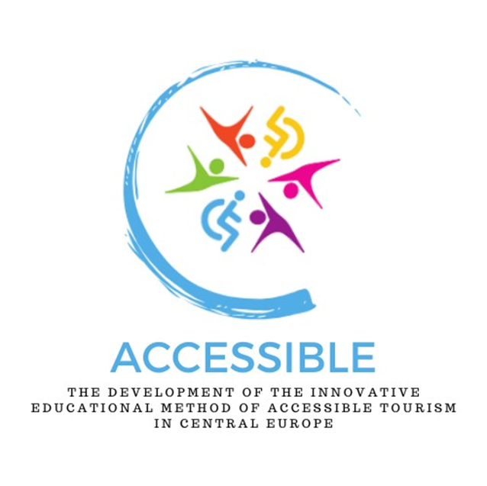
The development of the innovative educational method of ACCESSIBLE tourism in Central Europe 2022-2-HU01-KA220-HED-000099410

Slide 2
7. Specific characteristics of the countries involved in the research. Focus and results of country-specific research on accessible tourism

Slide 3
Accessible tourism is an increasingly common subject of research, the results of which have significant cognitive and application significance. Qiao et al. (2022) in the article: Accessible tourism: a bibliometric review (2008–2020) presented an overview of publications on this topic published in English-language journals The following overview of studies in Croatia, Hungary, Poland and Romania complement the information on studies whose results have been largely published in the national languages
Specific characteristics of the countries involved in the research – preliminary thoughts

Slide 4
Although accessible tourism is receiving more and more attention in national policy and is becoming increasingly important in planning tourism products and removing access barriers, academic research is lagging behind Extensive search in relevant databases (search terms used: “accessible tourism”, “inclusive tourism”, “people with disabilities”, “tourists with disabilities”, “Croatia”, “limitations”, “inclusion”): only six papers that deal with this specific topic, all of which published since 2019
Country-specific research on accessible tourism – Croatia

Slide 5
Gonda (2021): specifics of the travel demand of PwD, with a special focus on analysing the most popular tourism products from the perspective of PwD. A survey conducted in Hungary and compared with the results of studies in Germany, Italy, Spain and Croatia. The research results show that PwD are strongly in favour of the policy of inclusion, their frequency of travel is higher than the average of the total population and therefore it seems reasonable to pay adequate attention to this segment of tourism demand. Although this study provides a valuable insight into the current level of satisfaction of PwD in Croatia, the sample is quite small and therefore not really representative (Croatia being only one of four markets analysed for comparison with Hungary). Research results cannot be generalised
Country-specific research on accessible tourism – Croatia

Slide 6
Gregoric et al. (2019): identify the need for adaptation of tourism facilities for PwD in Croatia. Authors emphasise that although tourists and travellers with disabilities want to be equal members of the community and enjoy all tourist facilities without restrictions, theyare the ones often restricted due to the inadequacy of tourism facilities. Results show that the offer should be significantly improved to meet the needs of tourists with different types of physical disabilities. Authors also propose several recommendations for improvement (appropriate plans and knowledge for the management of tourism destinations; focusing on new forms of tourism, better adapted to the needs of people with any type of disability; encouraging collaboration between health facilities, tourism communities, family businesses, small business owners, apartment renters, who would offer a joint range of resources for disabled individuals; working to remove mental barriers; and training tourism staff about PwD) Sample representative, results can be considered reliable on which development policies can be based
Country-specific research on accessible tourism – Croatia

Slide 7
Pókó (2022): an exploratory study that expands knowledge by highlighting the circumstances and difficulties that PwD face during their travelling experiences. Study conducted in Hungary and Croatia to identify the objectives of the motivation of PwD for travelling. Contribution of this article: emphasising the need for new travel services for PwD at both national and international levels. Author proposes the following recommendations to improve accessible tourism services: a reliable online database of trips and accessible facilities in Croatia and Hungary to encourage more people to opt for trips and cultural programmes or trips to nature; more products and programmes (gastronomy, concerts, sports) should be accessible in tourism that do not primarily target PwD but meet their needs; with more reliable and diverse online information about accessible tourism, about the places that are easily accessible by wheelchair, more people would opt for a trip to nature, sports and extreme sports
Country-specific research on accessible tourism – Croatia

Slide 8
Popović et al. (2022) point out that PwD encounter various challenges when travelling and many of them do not travel at all. Theoretical framework of paper: an overview of the necessary conditions for designing tourism products accessible and usable for all. Authors emphasise that, contrary to popular belief, accessible tourism goes beyond mobility to include people with intellectual, mental, visual, speech, hearing, stroke and other conditions. The study covered five towns and municipalities in Istria County, the five most important tourism destinations. The aim of this research was to examine the following elements of destinations in terms of their accessibility: a) physical planning and other relevant documents of municipalities; b) activities of organisational units or individuals; c) participation in projects; d) being informed on activities caried out in the city by third parties (collaboration, coordination and networking)
Country-specific research on accessible tourism – Croatia

Slide 9
The results by Popović et al. have indicated that none of the selected cities and municipalities has a study or programme for the purpose of equalising the opportunities of people with disabilities, but activities and measures are an integral part of any town’s development strategies, social programmes, spatial plans and health plans, some of which are from past planning periods. Although this particular study does not include people with disabilities in the sample, its contribution lies in the fact that it is one of the few to look at local government units and their role in accessible tourism. One of the authors’ conclusions is that consideration of accessibility should be included as standard in any responsible tourism policy in order to recognise these vulnerable groups and create revenue streams for accessible destinations
Country-specific research on accessible tourism – Croatia

Slide 10
Paper by Škaja et al. (2019) deals with the topic of accessibility in Zagreb for power wheelchair users, with transportation being one of the key elements for people with disabilities when deciding about the destinations which they are going to visit. The research examines the physical barriers that power wheelchair users encounter while moving around Zagreb. A participatory approach was applied, and wheelchair users were included in the part of the research where navigability of the streets was assessed and the barriers which made moving difficult or impossible were also assessed and mapped. Based on the conducted research, accessibility maps were created, and a corresponding interactive GIS map was uploaded online
Country-specific research on accessible tourism – Croatia

Slide 11
In conclusion, Škaja et al. believe that the prospects for utilising the work on the issues presented lie both in the further elaboration of the navigation methodology and in the development of a mobile application to direct wheelchair users to the optimal routes to their desired destination. In addition to information on the accessibility of pavements and the physical barriers on them, it would be very beneficial if the application also included information on the accessibility of public facilities and public transport, thus creating an integral system of support for people in wheelchairs moving around the city of Zagreb. Results of research could be used for the development of inclusive solutions for transport, which would also be used for tourism purposes to remove the barrier for PwD and enable them to participate in tourism experiences specifically in the city of Zagreb
Country-specific research on accessible tourism – Croatia

Slide 12
Tubic et al. (2022) emphasise that the tourism offer must be adapted to people with disabilities, who must be treated as an integral part of tourism demand. An accessible infrastructure, a multidisciplinary approach to the guest and the understanding of vulnerable groups by all actors involved in tourism are important factors in the creation of a specific tourism offer Considering that communication in tourism is based on direct access to guests, it is necessary to use different methods and tools to address PwD. With regard to the necessary adaptation of tourism content for these individuals, this paper aims to show to what extent there are tools for easier interpretation of content in the national parks of Croatia
Country-specific research on accessible tourism – Croatia

Slide 13
The empirical research of Tubic et al. focuses on identifying and analysing people with disabilities, lines for easier orientation, tactile digital sensors, adapted mobile applications, audio descriptions in places, adapted sanitary facilities and others The research instrument: in-depth interview, research conducted on a convenience sample of directors of Croatian national parks The contribution of the research is reflected in the overview of the current state of equipment of national parks for the needs of accessible tourism development. The study carried out shows that accessible tourism in national parks is not yet established and is only in the process of adapting its content to people with disabilities
Country-specific research on accessible tourism – Croatia

Slide 14
Tubic et al. state that, with virtually no statistical monitoring of this segment in national parks, the actual number of people who would need certain assistive technologies to facilitate the interpretation of tourism content is not known. There is still a lot of room for improvement in the interpretation of tourism content for this segment, of which the respondents are aware. Considering that the population with disabilities predominantly obtain information from internet sources, it is disappointing that only a small number of respondents have edited websites – so the segment is poorly informed and does not visit National Parks. If the population with disabilities decides to travel, they should first and foremost make a request for the organisation of a tourist tour, while the individual NPs do not even have the possibility to adapt a tour for this segment. The problem continues in the training of staff
Country-specific research on accessible tourism – Croatia

Slide 15
Only at the end of the first two decades of 21st century started Hungarian researchers to deal with this issue more intensively 2004: short study entitled “Tourism opportunities for people with disabilities in Hungary” published in the periodical Turizmus Bulletin (Tourism Bulletin) (Végh, 2005, p. 26), in which the author makes statements still valid today, ranging from the (unfortunately still) unfavourable situation of people with disabilities in Hungary to the fact that their travel needs are basically no different from those of their ‘healthy’ counterparts. She analyses the needs and problems of those involved in “paratourism” in the areas of transport, accommodation, spas and animators
Country-specific research on accessible tourism – Hungary

Slide 16
Also in Turizmus Bulletin a study by Gálné Kucsák on the situation and opportunities for visually impaired people in tourism in Hungary (Gálné Kucsák, 2008, p. 55): while more and more places are becoming accessible for the disabled, when thinking about accessibility we tend to forget the visually impaired target group whose vulnerability is a major deterrent to both every day and leisure travel. The study concludes that the main reason why visually impaired people are not offered accessible tourism is the lack of information 2009: Csesznák et al. in a paper entitled ‘Ensuring fuller access for people with disabilities,’ published by the Szentendre Ethnographic Museum, discuss the problems of accessibility in museums (Csesznák et al., 2009). The study describes professional cooperation between institutions for people with disabilities and museums in order to create equal opportunities
Country-specific research on accessible tourism – Hungary

Slide 17
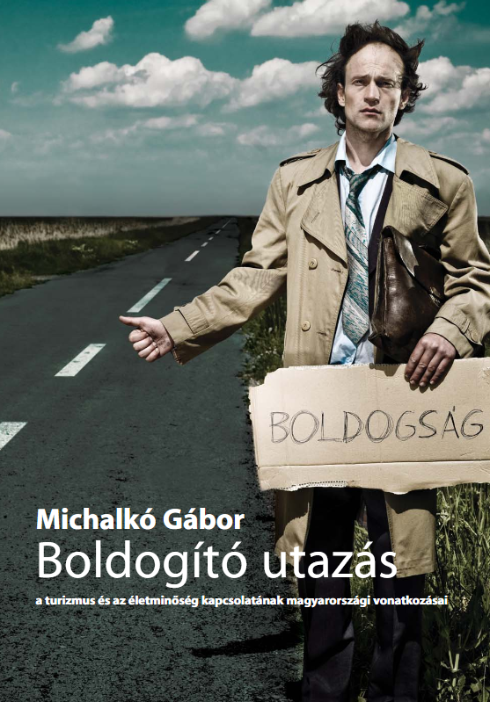
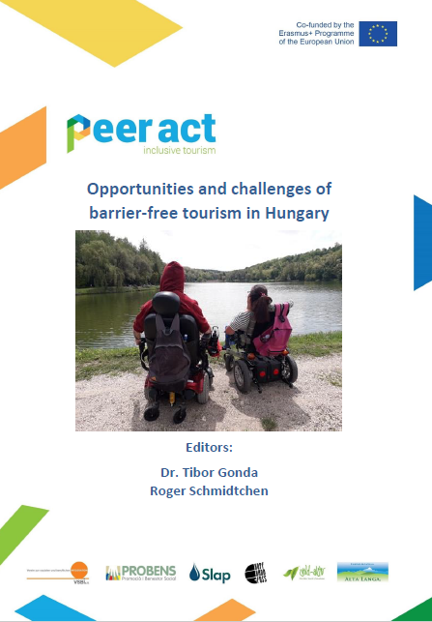
Since 2010, the number of articles on the subject in Hungary has been increasing A book (tangentially) dealing with the issue: Beatific travel – Hungarian aspects of the relation of tourism and quality of life (Michalkó, 2010); a book (chapter) written as a research summary: Accessible Tourism in some European countries – findings and results of an empirical survey, Peer-AcT Project (Raffay & Gonda, 2020); The Primacy of Technical accessibility in tourism product development (Farkas, 2019)
Country-specific research on accessible tourism – Hungary

Slide 18
Doctoral theses: – Performance sport for people with disabilities and its impact on different sport arenas (Dorogi, 2012); – Special needs in tourism – the place, role and potential of people with disabilities in the tourism sector (Gondos, 2020); – The potential for fulfilment in existential disability – Insights into the meaning of the concept (Farkas, 2020) Papers published in Hungarian academic journals: – Paratourism and conflict management in the hotel industry (Kovács & Kozák, 2016); – The potential of equal opportunities for people with disabilities in tourism (Gondos, 2019); – Innovative good practices in barrier-free tourism (Raffay & Gonda, 2020); – Accessibility and parasport tourism opportunities in the European Union (Zsarnóczky, 2018a) – One possible way to achieve fuller accessibility through the use of trusts (Farkas & Nagy, 2020)
Country-specific research on accessible tourism – Hungary

Slide 19
Articles of Hungarian authors in international journals: – The Future Challenge of Accessible Tourism in the European Union (Zsarnóczky, 2018) in the Vadyba Journal of Management in Lithuania; – The impact of tourism on the quality of life (Gonda, Nagy & Raffay, 2019), in in Interdisciplinary Management Research / Interdisziplinare Managementforschung; Travelling Habits of People with Disabilities (Gonda, 2021) published in the Romanian Geojournal of Tourism and Geosites; – The Phenomenon of European Accessibility as a Special Niche in Active Tourism (Zsarnóczky & Zsarnóczky-Dulházi, 2019) in the Romanian Journal of Tourism Challenges and Trends – 2018, the Polish Journal of Management Studies published an empirical study on the influences of management’s attitudes towards employees with disabilities in the hospitality sector by Sharma, Zsarnóczky & Dunay
Country-specific research on accessible tourism – Hungary

Slide 20
In recent years, the study of this issue has entered the mainstream of tourism research: Erasmus+ project Peer Act, which included a major and influential research project (Gonda & Raffay, 2020a; 2021), exploring some good practices of accessible tourism in Hungary and internationally in five countries (Raffay & Gonda, 2020) and conducting a questionnaire survey among people with disabilities A short research summary and a workshop paper presenting the full research results (Gonda & Raffay, 2021). The results have generated considerable national and international interest
Country-specific research on accessible tourism – Hungary

Slide 21
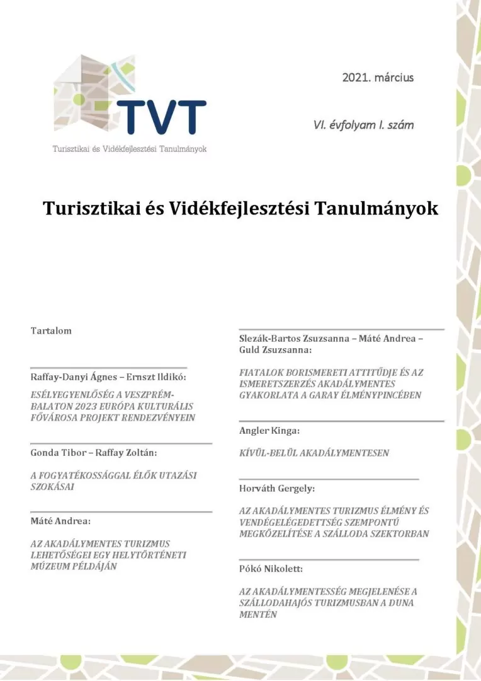
Initiative in 2020 to bring together all Hungarian tourism researchers interested in the topic: a scientific conference organised in Orfű in September 2020, attended by most of the Hungarian researchers working on accessible tourism Conference speakers were given the opportunity to publish their articles in the first – special – issue of the periodical Turisztikai és Vidékfejlesztési Tanulmányok, TVT (Tourism and Rural Development Studies) in 2021
Country-specific research on accessible tourism – Hungary

Slide 22
Sensitivity of the journal Turisztikai és Vidékfejlesztési Tanulmányok to this topic remained even after the 2021 thematic issue: – Raffay-Danyi and Ernszt (2021) examined the issue from the perspective of Veszprém, European Capital of Culture in 2023; – in 2022, Farkas & Raffay tried to approach the issue of equal access from a new angle and from new perspectives using the method of investigation of the discipline of philosophy Among the Hungarian journals, only TVT has developed a strong workshop on equal access in tourism After 2020, only one study on the topic was published in the other leading Hungarian tourism journal, Turizmus Bulletin (Farkas, Raffay, & Dávid, 2022b) A further result of the Peer Act research mentioned earlier was that Hungarian researchers were able to make international contacts. In this context, a scientific volume was published in Germany, with Hungarian authors publishing in it (Gonda & Raffay, 2020a)
Country-specific research on accessible tourism – Hungary

Slide 23
The quality and depth of research results in Hungary has reached a level of international scientific interest. This is also supported by the fact that, in addition to WoS-qualified conference proceedings, several Q1 and Q2 journals have enabled the publication of research results in recent years (Farkas et al., 2023; Farkas, Raffay, & Petykó, 2022) Temporary collaborations were created for the better use of synergies between research activity and publications collaboration between colleagues from the Faculty of Business Economics to the University of Pécs, the BGE Budapest Business School, BGE and the Hungarian University of Agriculture and Life Sciences is noteworthy, also resulting in prestigious international publications (Farkas et al., 2022b; Farkas et al., 2022)
Country-specific research on accessible tourism – Hungary

Slide 24
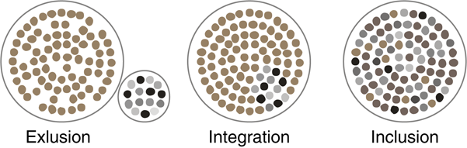
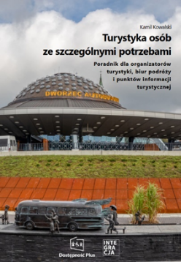
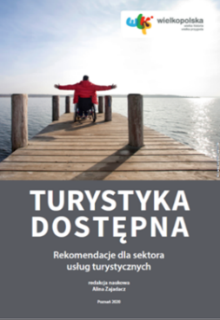
The literature review includes scientific publications and tourist manuals that have been developed mainly in the last ten years, in relation to tourism available in Poland. The selected publications focus primarily on tourism for people with disabilities and the elderly, and, in broader contexts, also on the needs of people travelling with children
Country-specific research on accessible tourism – Poland

Slide 25
Publications on the tourism of people with disabilities are very diverse: theoretical approaches (a.o. Zajadacz, 2015); review studies (a.o. Lubarska, 2018); empirical research (a.o. Popiel, 2014; Żbikowski, Siedlecka, & Kuźmicki 2019; Magiera, 2020; Trybuś, 2023); practical tourist guides addressed to this group of recipients (a.o. Kapusta, 2018) The paper: Evolution of models of disability as a basis for further policy changes in accessible tourism (Zajadacz, 2015) is a new, critical perspective on the selected models of disability, the key to which is the search for optimal solutions in the development of accessible tourism. Results of studies give tourism providers important data on an increasingly competitive tourism market, and also affect changes in how people with disabilities, the elderly, are viewed, from the category of “relatively poor” to “attractive, using a wide range of services”
Country-specific research on accessible tourism – Poland

Slide 26
Lubarska (2018) in Overview of the classification of barriers and constraints to tourism for people with disabilities attempted to answer the question what classifications of barriers to tourism for people with disabilities are used by researchers Popiel (2014) referred to one of the most popular tourist cities in Poland – Krakow. Results presented in the article under the title Pawing the way to accessible tourism on the example of Krakow. The paper generated relevant knowledge about the travel needs and barriers of people with disabilities, in order to assess the current level of accessibility in the tourism sector in Krakow, especially in accommodation options, museums, offered services on selected examples
Country-specific research on accessible tourism – Poland

Slide 27
Research by Żbikowski, Siedlecka and Kuźmicki (2019) on rural areas in Determinants of tourist activity of people with disabilities living in rural areas. Aim of research and analyses: attempt to assess the impact of selected factors over tourist activity of PwD and factors related to the immediate environment of PwD. A total of 5 000 respondents in the quantitative research (adults with legally recognised disabilities) Magiera’s paper (2020) on the leisure time of people with disabilities: broader context of the determinants of tourism for PwD, which is free time. Purpose of study: identify forms of free time and the possibility of their use in terms of the needs and preferences of PwD. It was important to show the forms of leisure time, which are used and willingly chosen by the PwD, as well as the important role of tourism and theatre in the lives of people with disablements
Country-specific research on accessible tourism – Poland

Slide 28
Trybuś (2023) referred to the broad context of determining the tourism of PwD in her article The Influence of Personal Qualities of Disabled People on Their Tourist Activity. Purpose of the study: determine the impact of a group of selected characteristics on the tourist activity presented by PwD, diagnostic survey by questionnaire. Analysis of the research questionnaire content allowed selecting questions describing the specific aspect of tourism activity performed by the disabled, on which analysing correlations between these variables and the characteristics of the respondents carried out Tourism of people with sensory disabilities (including deaf people, blind people) was the subject of research. Its results can be found in publications such as (Manczak & Bajak, 2020; Zajadacz, 2012; Zajadacz, 2014; Zajadacz & Szmal, 2017; Zajadacz & Lubarska, 2019)
Country-specific research on accessible tourism – Poland

Slide 29
Manczak and Bajak (2020): results of a research on deaf and blind people in Beacons in museums: the case of people with disabilities sensory. They identified the importance of beacons in the market communication of the Museum of King Jan III’s Palace at Wilanów and the Princes Czartoryski Museum in Krakow with people with sight and hearing impairment. In-depth interviews carried out in the listed museums using the analysed solution The authors confirmed the accepted thesis that beacons support the process of market communication with sensorically disabled tourists visiting museums
Country-specific research on accessible tourism – Poland

Slide 30
Zajadacz’s results of a ten-year research: monograph Tourism of Deaf People. A Geographical Perspective (2012). Also, issues of tourist information adapted to the needs of deaf people discussed in detail in the articles: Sources of tourist information used by Deaf people. Case study: the Polish Deaf community (2014) and Accessible Tourism for Deaf People in Poland: The SITur and SITex Programs as Proposals for Accessible Urban Information (Zajadacz & Szmal, 2017) The book (Zajadacz, 2012) deals with the issue of accessibility of tourism to deaf people using sign language. It presents the results of the author’s research into particular traits of tourist activity of deaf people, analysed against the background of the reference group of hearing individuals in Poland, with the social model of disability taken into consideration
Country-specific research on accessible tourism – Poland

Slide 31
Tourism and recreation of the blind: subject of research of, among others, Zajadacz and Lubarska, results published in the monograph Sensory gardens as universal places of recreation adapted to the needs of blind people in the context of human-environment relations (Zajadacz & Lubarska, 2020). Main conclusions are also presented in the article: Sensory gardens in the context of promoting well-being of people with visual impairments in the outdoor sites (Zajadacz & Lubarska, 2019) Aim of the study: define the conditions to be met so that a sensory path/garden is a universal space, supporting experiences to the blind and partially sighted. Study confirmed the usability of previous recommendations in the field (e.g. stimulation of the senses of hearing, smell and touch). Access to the place and the composition of the garden to be planned in a way that allows independent usage by the blind and partially sighted. Basic facilities in terms of spatial orientation, safety and information must be provided, together the attractiveness of the garden
Country-specific research on accessible tourism – Poland

Slide 32
Tourism of older people presented in numerous studies (Bąk, 2012; Grzelak-Kostulska & Hołowiecka, 2012; Kunysz et al., 2017, Markiewicz-Patkowska, 2018; Żmuda-Pałka & Siwek, 2019, Borzyszkowski & Michalczak 2021) Bąk (2012) in the article entitled Tourism in the face of an aging society drew attention to the demographic changes taking place in European society and their consequences on the tourism services market. Specific characteristics of tourism of elderly people identified. Author emphasised that the increasing number of elderly people in the population structure is not only a challenge for economic and social policies, but also a powerful new challenge for market of goods and services
Country-specific research on accessible tourism – Poland

Slide 33
Grzelak-Kostulska and Hołowiecka (2012) also analysed “Senior tourism in Poland – socio-demographic conditions”. Authors attempted to analyse the factors significantly influencing tourist activity of the elderly in Poland. Analysis included the selected conditions, both of a global character (demographic modernisation, social modernisation, globalisation and technological progress) and individual determinants of tourist activity (age, health, professional activity and financial situation) Kunysz et al. (2017): research on a local scale among the inhabitants of the city of Rzeszów, east Poland. Results discussed in the article Participation in Tourism and Physical Recreation of Elderly People Rzeszów Inhabitants. Authors to show participation of elderly people in tourism and physical recreation as well as the motivations affecting their behaviour
Country-specific research on accessible tourism – Poland

Slide 34
Markiewicz-Patkowska et al. (2018) in article Senior tourism in the context of the economic status of the retired in Poland defined the notion of a senior, presented the changing forms of tourist activity undertaken by seniors in various periods of the 21st century in the context of their economic situation. Conclusions: one should expect that the conviction of the seniors with reference to the benefits of active recreation and tourism will translate into the popularisation of the healthy, active lifestyle Żmuda-Pałka and Siwek (2019): results of a research in the publication Senior Tourism – Opportunity and Challenges of Accommodation Facilities in the Context of an Aging Population, Based on the Example of Krynica-Zdrój in Poland. Demographic changes related to the aging of the population affect many aspects of our lives. The age structure of the population is changing, and a wide group of recipients is a chance for development for many enterprises connected with senior and spa tourism
Country-specific research on accessible tourism – Poland

Slide 35
Article Tourism policy for seniors. An overview of selected practices by Borzyszkowski and Michalczak (2021): models of impacting the senior tourism market. A review of activities resulting from tourism policy undertaken at various levels and by different entities. Authors describe selected activities aimed at increasing tourist activity of seniors in Europe so as to see to what extent these experiences can be useful in other settings and why such initiatives should be implemented in Poland. Based on results of their desk research, they formulate recommendations for tourism policy in Poland The topic of accessible tourism in a broad context relating to the needs of PwD, the elderly, and those visiting with children addressed in many publications (a.o. Zajadacz, 2017; Zajadacz & Lubarska, 2019; Szał, et al., 2021). Zajadacz (2017) in the paper: Attitudes of Future Tourism Sector Employees Towards Organise Accessible Tourism drew attention to the role of the tourist services sector in the implementation of the principles of the development of accessible tourism
Country-specific research on accessible tourism – Poland

Slide 36
Several articles, including Development of a Catalogue of Criteria for Assessing the Accessibility of Cultural Heritage Sites (Zajadacz & Lubarska, 2019) and Assessment of the adaptation of tourism supply of cultural heritage objects for the elderly in the context of accessible tourism (Szał et al., 2021) also present the criteria for assessing the accessibility of cultural heritage sites as tourist attractions from the point of view of the needs of several social groups: persons with disabilities, elderly people and visitors with children. Three basic components are of key importance: physical/technical preparation, tourist information system and the skills and competences of the staff serving guests
Country-specific research on accessible tourism – Poland

Slide 37
For many places, towns and regions, tourist guides addressed to the environment of people with disabilities developed, e.g. guide Kapusta Guide to Krakow for disabled tourists (2018), updated many times Recently, many textbooks, collections of good practices in the field of social accessible tourism, addressed to the tourism industry published: monographs edited by: Głąbiński (2020): Efficiently for the disabled, Zajadacz (2020): Accessible tourism. Recommendations for the tourist services sector (2020) or Stasiak (2021): Social tourism in Poland. Good practice guide
Country-specific research on accessible tourism – Poland

Slide 38
Publications of a diverse nature, ranging from theoretical approaches, through presentations of the results of empirical research of cognitive and applied importance, to guides to good practices and tourist guides addressed to the tourism industry and tourists themselves Over the last decade, a change in nomenclature, related to the evolution of the perception of the needs of people with disabilities. Availability has become a common term in Polish language in the context of meeting these needs. In relation to tourism, there was also an adaptation of the term taken from English “accessible tourism”, in favour of previously used names such as “tourism without barriers”, “tourism for disabled people” or “tourism for all
Country-specific research on accessible tourism – Poland

Slide 39
Despite the beauty and allure of Romanian destinations, disabled individuals often encounter obstacles when seeking to engage in travel and tourism activities. Inadequate infrastructure, lack of accessible accommodations, limited transportation options, and insufficient awareness of the needs of disabled travellers contribute to these challenges Such barriers not only restrict disabled individuals’ ability to experience the country’s cultural and natural wonders but also hinder the growth of an inclusive tourism industry
Country-specific research on accessible tourism – Romania

Slide 40
Pașcalău-Vrabete and Băban (2018): experiences of mobility-impaired individuals in terms of disability and inclusion/exclusion; their identity formation and efforts to challenge disabling societal constructs in the context of post-socialist Romania. Research involved analysis of 11 semi-structured interviews, leading to the identification of five major themes: feeling different, redefining normality, being perceived as part of a ‘different regnum’, facing physical barriers, and grappling with the impact of the past while envisioning a desired future. Participants’ narratives emphasise the urgency of challenging medical-productivist perspectives of disability at the social, individual, and institutional levels. The study underscores the crucial role PwD play in promoting such transformative social changes
Country-specific research on accessible tourism – Romania

Slide 41
Oreian and Rebeleanu (2016): comprehensive examination of the social economy’s role in facilitating the socio-professional integration of individuals with disabilities. It analyses an institution that has successfully established social economy structures, with a particular emphasis on the functioning of its protected units. Moreover, the study delves into the gender-specific aspects of employability for individuals with mental disabilities, while also highlighting the influence of the institution’s services on their ability to secure and retain employment. Social economy serves as a complement to the efforts made by duty bearers in facilitating the professional integration of people with disabilities. It enables their access to the job market by adapting workplaces to accommodate their specific needs and abilities
Country-specific research on accessible tourism – Romania

Slide 42
Mihaela, 2019: new tourism market of the future is social tourism, created to make travel tourism accessible to consumer groups such as disadvantaged people and people with disabilities. The aim is to improve accessibility in general and accessibility of travel options, which in fact creates opportunities for new business development In Romania, since the early 2000s, a number of social tourism programmes closely linked to social policies at the national level (Simon et al., 2017) Simon et al. (2017): social tourism, including tourism for PwD, is at a low level in Romania. Pool of tourism opportunities in Romania is under-dimensioned compared to the real needs. A lack of complete information on social tourism, including tourism data for the disadvantaged. The tourism associations that run social tourism programmes do not have annual analyses, so we cannot get a realistic picture of how many people from disadvantaged groups are currently benefiting from existing but scarce opportunities at national level (Simon et al., 2017)
Country-specific research on accessible tourism – Romania

Slide 43
A study by Mihaela (2019): detailed overview of accessibility tourism efforts in Romania in recent years. Since 2013, Motivation Foundation Romania has created the first online platform, a national map of accessible places, where public institutions, places of entertainment and leisure, accommodation and facilities and their surroundings can be found (available at www.accesibil.org and is designed for PwD). Map can also be used by tourism operators to develop tourism services for PwD Another initiative of Motivation Foundation Romania is the assessment of the accessibility of buildings. Among the few tourism and hospitality service providers, it is worth highlighting that the Băile Felix complex and the Royal Courtyard in Piatra Neamţ meet the accessibility criteria
Country-specific research on accessible tourism – Romania

Slide 44
Babaita (2014): a research on the specific field of tourism in Romania that deals with the issue of tourism for PwD, highlighting the need to develop a social model for PwD, not yet formulated in the tourism literature. The aim of the questionnaire survey was to find out whether Romanian society is open and ready to accept this new segment, i.e. whether the needs of consumers with special needs are taken into account in the tourism market Examined the attitudes of Romanian society towards this issue, namely the attitudes and behaviour of people without disabilities towards PwD. In addition, the research was aimed at exploring the reasons that lead to negative feelings towards persons with disabilities
Country-specific research on accessible tourism – Romania

Slide 45
Văduva et al. (2021) analysed the main obstacles that exist today by studying international literature on accessible tourism, and made some suggestions for improving; also, they highlight the need to raise awareness of the need for accessibility at world level The study shows that the demand for accessible tourism services is increasing, mainly due to the growing number of people with disabilities. This has led to the creation of international symbols, but there are still many problems in the field of accessible tourism: environmental (participation in activities in tourist destinations, lack of communication), infrastructural (accessibility of buildings, transport, booking facilities) or social (attitudinal barriers, low level of specific training for accessible tourism)
Country-specific research on accessible tourism – Romania

Slide 46
Study by Văduva et al. (2021) on the specific circumstances of tourists with disabilities also shows that tourism in this area is still in its infancy, with much to be done to make more tourism services accessible to PwD: accessible tourism can be improved by improving accessibility of facilities, improving transport, accessibility of attractions and destinations, and cooperation between stakeholders Recommendations for better implementation of accessible tourism: creation of public-private partnerships, international cooperation, human resources training, improving accessibility to destinations by diversifying transport systems, adapting transport modes, and diversifying attractions and destinations. They also stress the importance of making more destinations accessible to PwD and of promoting this type of tourism
Country-specific research on accessible tourism – Romania

Slide 47
Main objective of the article by Butnaru (2010): identify the challenges faced by customers, especially those with disabilities, when choosing a tourist accommodation. The article also seeks measures and solutions to eliminate these obstacles. These barriers exist in rural tourism, some are independent of the tourism industry, being the effect of the policy of the respective country, others depend on the perception of the manager of the accommodation tourist agency, tourist area, the term hospitality Tudorache et al. (2017) presented the challenges encountered in applying European Tourism Indicators System (ETIS) in the context of Brasov County, situated mostly in the Romanian Carpathians. ETIS was configured initially with a total of 27 core indicators and 40 additional (optional) indicators
Country-specific research on accessible tourism – Romania

Slide 48
Tecau et al. (2019): issues regarding the intention of responsible tourism to increase accessibility of tourist destinations for children with disabilities and their families. Aim: identify and analyse the obstacles encountered by families with disabled children during their tourism experiences, by qualitative research via focus group interviews, specialised in the education of disabled children and regular schools where these children are studying Main finding: in Romania there is a lack of sufficient preparation among authorities, tourists, and employees to include atypical tourists, such as disabled children and their families, in tourism activities. Their tourism activities is limited in Romania (mainly by cultural and economic factors) In Romania, attitudinal barriers are significant challenges, arising from both individuals with disabilities and society at large. The society is not adequately prepared, educated, or empathetic towards accommodating individuals with disabilities, contributing to the difficulties they face in engaging in tourism activities
Country-specific research on accessible tourism – Romania

Slide 49
Munteanu et al. (2014): competitive strategies that can be adopted by hotel managers in resorts on the Black Sea coast of Mamaia, Romania, taking into account consumer expectations and best practices in the tourism industry. Among other important infrastructure and service elements, they pointed out that facilities for tourists with disabilities can be found in four sampled hotels Another article on the accessibility of tourism in Romania by Rabontu (2018): to examine the level of development of tourist facilities catering to individuals with disabilities in both accommodation and catering establishments, considering the growth of inclusive tourism on a national and international scale. It employs research methods to analyse the existing statistical data pertaining to this topic. After a statistical data analysis, the author concludes that in Romanian tourism the accessibility of PwD is at very low level
Country-specific research on accessible tourism – Romania

Slide 50
A research (Tecău, 2017) was conducted with the primary aim of confirming the need for a software platform in Romania to help PwD to navigate accessible and safe tourist routes and facilities. Research sought to identify safety issues that may affect PwD or their companions while travelling. According to the opinion of the interviewees, PwD would like to go on excursions, and the majority of them have a greater need for such experiences, so a software product could help to ensure travel safety and information communication. The respondents highlighted the need to organise an information campaign for the members of the society to raise awareness of the problems faced by PwD when travelling, thus sensitising people to this issue
Country-specific research on accessible tourism – Romania

Slide 51
A study by Cernaianu-Sobry (2011) on people with disabilities, including sports tourism, in Romania and France, revealed that in Romania the majority of hotels, transport, facilities and tourist sites are not accessible to people with disabilities. At the same time, the law is quite different, according to Article 21 of the Romanian Law 448/2006: ‘The competent authorities of the public administration are obliged to facilitate access for people with disabilities to cultural values, heritage and tourism, sports and leisure activities’ Cernaianu-Sobry, 2011: despite Romania’s abundant natural and anthropogenic resources, if the Romanian tourism infrastructure is not adapted to people with disabilities, this market segment and business opportunity will remain untapped
Country-specific research on accessible tourism – Romania

Slide 52
A study by Simon et al. (2018) assesses the existence of camps for students in Romania, including facilities for people with disabilities. There is basically a shortage of places for such camps at the national level: for example, on the coast, in the County of Constanta, there were only 236 boarding places in camps for children with disabilities in 2017 Epuran et al. (2020): qualitative research to identify the main barriers faced by people with disabilities in Romania when travelling, especially when travelling for tourism. People with disabilities like to and do travel for tourism purposes, but they usually inevitably encounter obstacles during their trips. The majority of the respondents in the survey prefer the Romanian coast
Country-specific research on accessible tourism – Romania

Slide 53
Epuran et al. (2020): a short survey conducted in Brasov County shows that the issues faced by people with disabilities are still not given much attention. Those accompanying individuals with disabilities also face difficulties due to a lack of information about tourist destinations. Accessibility problems are particularly faced by people with physical and mobility impairments, such as location, accessibility of different tourist attractions and access to public transport (e.g. lack of space for wheelchairs or lack of ramps) Brătucu et al. (2016): a study on tourists’ perceptions of tourist destinations in Brasov County in terms of accessibility for people with disabilities. The biggest problems as seen by respondents: accessibility of destinations for people with disabilities, access to transport, inadequate infrastructure and problems with facilities
Country-specific research on accessible tourism – Romania

Slide 54
Bratucu et al. (2015): it would be recommended to improve accessibility for people with disabilities in destinations, such as the introduction of bus services that allow wheelchair access and easier access to tourist attractions and accommodation Babaita (2012) reveals, through a survey of 60 sample hotels in Arad and Timisoara, the extent to which the infrastructure of hotels is adapted to the needs of tourists with disabilities, and insights into the opinion of hotel managers on the travel opportunities for this segment Babaita et al. (2011), examining the barriers to tourism for people with disabilities in Romania, state that Romanian society does not provide sufficient assistance to people with disabilities in Romania, but there is also a problem with respect for fundamental rights
Country-specific research on accessible tourism – Romania

Slide 55
Crismariu’s (2017): growing interest in accessible tourism in Romania in recent years and growing importance of this market. Awareness raising and early stages are taking place in the country. In the early phase, the aim is to lay the groundwork in this area (training the right staff and formulating the principles and actions needed in the development phase) Bordeianu (2015): accessibility in tourism is an important pillar of sustainable transport and is now central to tourism policy. In Romania, legislation on disability is not well understood, and legislation is uncertain and not well enforced in practice. Majority of people working in the tourism sector are unaware of accessibility. Today in East-Central Europe the majority of tourism workers and enterprises have a superficial knowledge of how to develop accessibility for their business; on the other hand, they do not consider it important enough
Country-specific research on accessible tourism – Romania

Slide 56
The accessibility of travel and tourism services for disabled individuals in Romania remains a work in progress. By addressing the challenges and investing in accessible infrastructure, Romania has the potential to become a more inclusive and welcoming destination for travellers of all abilities. This exploration of accessible tourism literature in Romania sets the stage for a deeper understanding of the current situation and the ongoing efforts to ensure that disabled individuals can explore and enjoy the country’s treasures with ease and dignity
Country-specific research on accessible tourism – Romania

