Slide 1
The development of the innovative educational method of ACCESSIBLE tourism in Central Europe 2022-2-HU01-KA220-HED-000099410

Slide 2
6. Characterising the demand for accessible tourism and the specific needs of people with disabilities in their tourism activities

Slide 3
The tourism sector is becoming more inclusive and accessible, focusing on meeting the needs of individuals with disabilities as part of a larger cultural trend This group’s increasing importance in the tourism industry due to the better recognition of their economic and social impact, as well as their essential entitlement to dignified and rewarding travel experiences Implementing accessible tourism practices demonstrates the industry’s dedication to catering to a market segment with substantial economic potential, all while upholding the principles of sustainable and responsible tourism
The market of people with disabilities as a tourism segment

Slide 4
Economic importance: PwD are an important segment of the tourism industry, possessing significant financial influence The growing number of tourists with disabilities is influenced by society’s acknowledgment of their economic importance and the ethical obligation to provide fair tourism opportunities. This change is not just necessary for business success but also a key factor in gaining a competitive edge, providing organisations with a distinct approach to differentiate themselves in a saturated Also, growing need for tourist experiences tailored to the specific requirements of travellers with impairments: goes above the fundamental accessibility standards required by the law, aiming for travel experiences that are smooth and completely engaging. The tourism industry’s initiatives to accommodate tourists with disabilities not only directly benefit them but also enhance the overall quality and attractiveness of tourism products, making locations more appealing to a wider range of customers
The market of people with disabilities as a tourism segment

Slide 5
To adequately cater to visitors with disabilities: comprehensive approach to accessibility is needed (physical access, clear information, and customised services) Need to promote an inclusive attitude among service providers and the public, creating an environment where all tourists feel accepted and appreciated Emphasising accessibility in tourism allows firms to establish a unique position in a very competitive sector. Accessible tourism offerings serve as distinctive marketing points, appealing to both PwD and a wider demographic that prioritises diversity and corporate social responsibility Strategic difference improves a company’s reputation and builds client loyalty, creating a strong basis for long-term success
The market of people with disabilities as a tourism segment

Slide 6
Incorporating accessible tourism practices is also crucial for promoting sustainable and ethical tourism goals by promoting social inclusion, equity, and universal access to leisure and travel Although progress has been made for the inclusion of PwD in the mainstream tourism industry, there are still obstacles. The constraints are the requirement for universally implemented accessibility standards and thorough staff training on disability awareness Increasing involvement of individuals with disabilities in the tourist sector reflects the industry’s overall dedication to inclusivity (significant economic and social impact of this demographic). A vast potential in the accessible tourism market by fully embracing its difficulties and opportunities. This initiative benefits both tourists with disabilities and enhances the tourism experience for all – a more inclusive, sustainable, and responsible tourism sector
The market of people with disabilities as a tourism segment

Slide 7
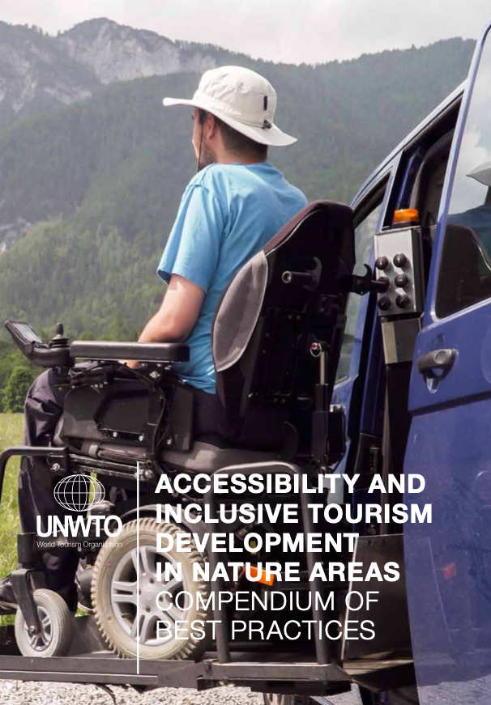
Physical and loco-motor impairments encompass a diverse range of issues: difficulties in movement, coordination, and physical performance, congenital disabilities like cerebral palsy or disabilities acquired through conditions such as spinal cord damage or amputation The World Health Organization emphasises the importance of prioritising physio-disability-oriented development for inclusive tourism
People with physical and locomotor disabilities
https://www.accessibletourism.org/?i=enat.en.reports.2241

Slide 8
Essential components of accessible tourism for people with physical and locomotor disabilities Accessibility: providing unrestricted access to all tourism facilities – transportation, lodging, and tourist sites etc. Doors, elevators, and bathrooms must be completely accessible to anyone facing mobility difficulties Accommodation adaptations: adjustable beds, emergency call buttons, and accessible toilet fittings to improve comfort and safety beyond baseline accessibility standards Transportation Solutions: accessible transportation choices such as modified vehicles and assistance services to enable those with disabilities to move freely
People with physical and locomotor disabilities

Slide 9
Essential components of accessible tourism for people with physical and locomotor disabilities Inclusive activities: activities should be flexible to ensure complete involvement of those with physical and locomotor limitations, by e.g. offering adapted equipment and providing accessible trips and excursions Information and Ccommunication: accessible information regarding tourism products and services is crucial for effectively planning and enjoying travel experiences – e.g. guaranteeing that webpages, brochures, and signage are clear and easily accessible Staff training and awareness: among tourism sector staff about the requirements of tourists with physical disabilities for fostering an inclusive and hospitable atmosphere
People with physical and locomotor disabilities

Slide 10
Although there has been improvement, there are still some obstacles such as insufficient infrastructure, biased attitudes, and lack of knowledge. To address these difficulties, it is necessary to implement thorough measures such as regulatory changes, building infrastructure, and running awareness initiatives to promote inclusivity in the tourism industry Meeting the requirements and overcoming the barriers faced by tourists with physical and locomotor disabilities is not only an issue of rights but also a chance to improve the inclusion and attractiveness of the tourism sector that can enhance experiences for all tourists, including those with disabilities, by prioritising accessibility, lodging, transportation, and information, fostering a more inclusive and welcoming travel environment
People with physical and locomotor disabilities

Slide 11
Sensory disabilities impact an individual’s capacity to interpret sensory input (hearing, vision, or both) The tourist industry must modify its services and environments to be more inclusive, enabling those with sensory difficulties to enjoy travel completely and independently Travellers with sensory disabilities are an important component of the tourist business and have unique requirements for their complete engagement in tourism activities. The tourism industry may provide inclusive and enjoyable experiences for them by establishing specific accessible measures, training workers, and adopting new solutions
People with sensory disabilities

Slide 12
Sensory disorders can vary from slight to extensive hearing loss, low vision to complete blindness, or a combination known as deafblindness Individuals with sensory disabilities encounter distinct obstacles when navigating and enjoying tourism activities, necessitating specific attention. Accessible tourism for individuals with sensory disabilities encompasses physical environment accessibility and the provision of information in accessible formats, as stated by the World Federation of the Deaf and the World Blind Union
People with sensory disabilities
https://wfdb.eu/about-us/

Slide 13
Providing accessibility for people with hearing impairments Key adaptations of accommodations to overcome communication obstacles and protect safety: Visual alert systems: in hotels and public areas in order to notify individuals of emergencies, doorbells, or telephones ringing Sign language interpretation and captioning: sign language interpreters or captioning services during tours, performances, and informational sessions Assistive listening devices (ALDs): ALDs in museums, theatres, and guided tours to enhance experience Accessible communication channels: information desks, booking services, and customer support accessible via text messaging, email, or live chat options
People with sensory disabilities

Slide 14
Providing accessibility for people with visual impairments Tactile maps and Braille signage: tactile maps, models, and Braille signage in accommodations, tourist attractions, and public transportation to aid navigation Auditory information systems: audio guides and descriptive tours in museums, galleries, and outdoor sites to provide context and information Accessible digital content: Websites and digital platforms should comply with Web Content Accessibility guidelines (WCAG) to ensure that information is accessible through screen readers Orientation and mobility assistance: offering personalised orientation and mobility assistance in hotels and at attractions can significantly enhance the travel experience for blind or low-vision guests
People with sensory disabilities

Slide 15
Information accessibility: Accessing information in many formats – audio descriptions, Braille, large print, and sign language interpreting services so that all travellers have access to information on tourism services, emergency protocols, and cultural activities Communication support: sign language interpreters or assistive listening equipment is crucial in tours, attractions, and customer service interactions for complete participation Adapted experiences: tailored experiences to meet sensory preferences of guests, e.g. offering tactile tours for persons with visual impairments or providing visual aids for guests deaf or hard of hearing Technology and innovation: .g. mobile apps providing navigation aid, audio descriptions, or captioning Training and awareness: Staff training on the requirements of individuals with sensory disabilities and effective communication techniques
Specific needs in tourism activities of people with sensory disabilities

Slide 16
Despite improvement, obstacles still exist in fully integrating those with sensory disabilities into the tourism sector: lack of knowledge among tourist operators, inadequate training on disability inclusion, and the necessity for broader use of accessible technologies and information formats Various venues and organisations have become pioneers in providing accessible travel for individuals with sensory disorders. The British Museum and the Natural History Museum offer tactile tours and audio-described tours. The Smithsonian Institution conducts sign language tours and captioned videos
Specific needs in tourism activities of people with sensory disabilities

Slide 17
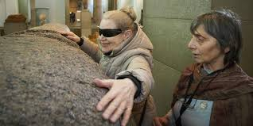
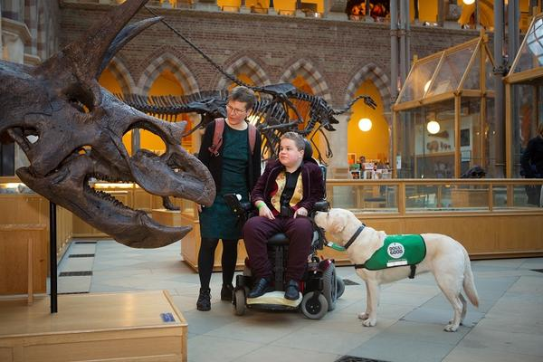
Specific needs in tourism activities of people with sensory disabilities
https://www.britishmuseum.org/visit/accessibility-museum
https://oumnh.ox.ac.uk/accessibility-0

Slide 18
Individuals with intellectual disabilities are a heterogeneous population on the disability spectrum, with varying levels of limitations in intellectual functioning and adaptive behaviour Intellectual impairments refer to a variety of conditions that cause cognitive limits, impairing an individual’s capacity to learn, communicate, and do daily duties. These diseases, such as Down syndrome, can be either congenital or acquired. The American Association on Intellectual and Developmental Disabilities (AAIDD) highlights the need of providing assistance that improve an individual’s functioning in all parts of life, including participation in tourism activities
People with intellectual disabilities

Slide 19
Simplified information: Clear and straightforward language should be used to communicate information about tourism services, facilities, and activities. Symbols or visuals can also enhance understanding Social inclusion: make people with intellectual impairments feel welcome and included in tourism activities, e.g. through inclusive programming and by cultivating a culture of tolerance and acceptance among staff and visitors Safety and security: individuals with intellectual impairments have various levels of independence, making travel safety and security a top priority: offering information and assistance as needed, also, making sure accommodations and activities are safe and supportive
Inclusive tourist experiences for people with intellectual disabilities

Slide 20
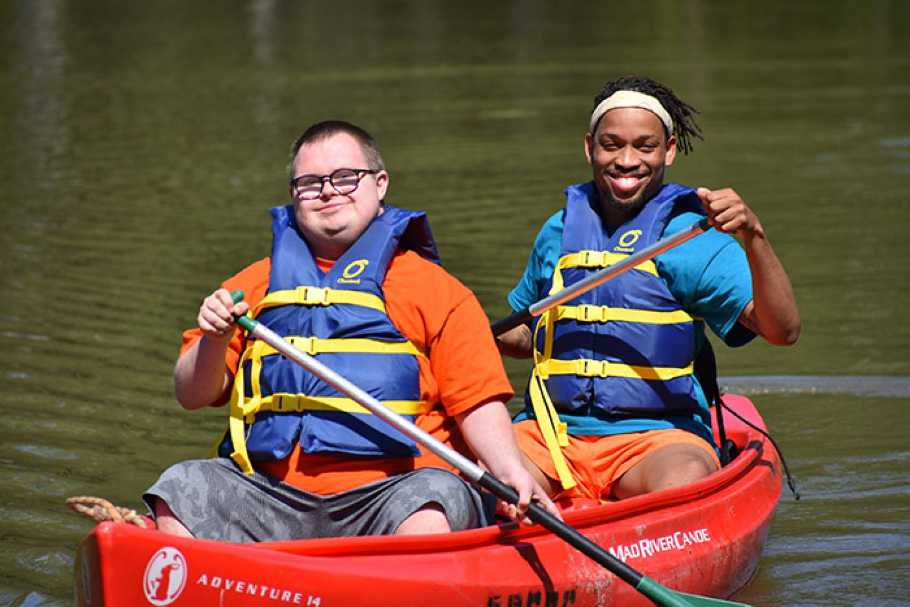
Adaptive programmes: tailored to the interests and abilities of travellers with intellectual disabilities e.g. flexible activities that can be tailored to specific requirements and preferences Staff training: on recognising intellectual disabilities and appropriate communication strategies for offering quality service and support to passengers with these disabilities
Inclusive tourist experiences for people with intellectual disabilities
https://www.acacamps.org/article/camping-magazine/capturing-inclusive-camp-experiences-teens-without-disabilities-through-photography-dialogue

Slide 21
People with intellectual impairments frequently experience problem in full participation in tourism: societal attitudes and preconceptions, a lack of accessible information, and physical barriers inside tourist destinations Difficulty of travel preparations and the necessity for support services might be substantial impediments Several groups and venues have made efforts in accessible tourism for people with intellectual disability: e.g. Special Olympics events to show how sports tourism may be made accessible and enjoyable for athletes with intellectual impairments, providing insights into best practices for broader tourism accessibility
People with intellectual disabilities

Slide 22
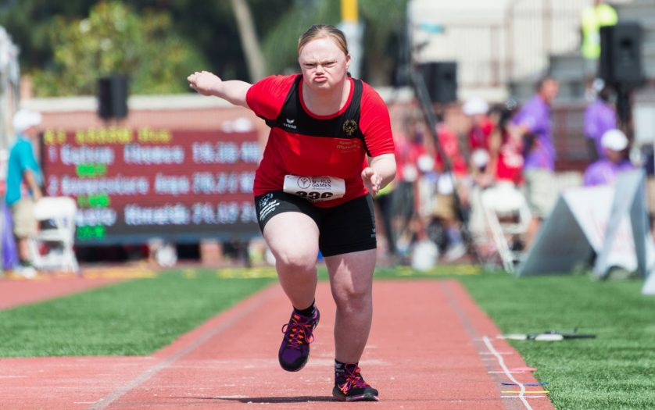
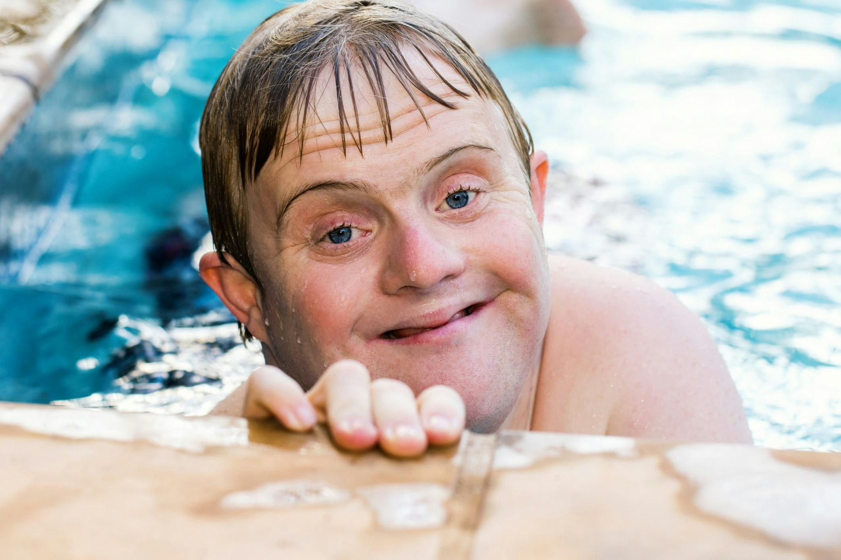
Special Olympics for people with intellectual disabilities
https://disabilityinsider.com/2020/11/24/sports/spain-to-review-competition-categories-of-athletes-with-intellectual-disabilities/
https://www.disabilitysupportguide.com.au/talking-disability/special-olympics-australia-makes-a-splash-in-melbourne

Slide 23
A distinct and significant demographic in the context of accessible tourism Mental and physical illnesses refer to a wide range of ailments that can impair people’s movement, sensory perception, cognitive ability, and mental health Depression, anxiety disorders, chronic illnesses such as diabetes, heart disease, and mobility disabilities require special concerns in the tourism industry To be inclusive of these passengers, specialised techniques that address both apparent and unseen problems are required
People with mental or physical illness

Slide 24
Accommodations tailored to this group’s different needs – quiet rooms for individuals with anxiety problems or accommodations near amenities for those with mobility issues Supportive transportation options: supportive transportation options include preferential seating for those with chronic pain or weariness, as well as help for those with cognitive impairments Accessible information and communication: clear and concise information on tourist and emergency health services – easily available websites and pamphlets outlining the level of physical activity required in tours and attractions
People with mental or physical illness

Slide 25
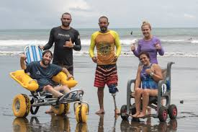
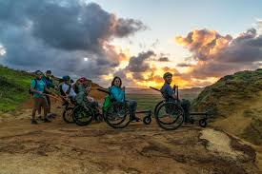
Inclusive activities: activities that cater to all abilities, including people with physical disabilities and mental health concerns Mental health support: mental health assistance and quiet locations for decompression to enhance safety and enjoyment of travellers with mental illnesses
People with mental or physical illness
https://www.adventuretravelnews.com/accessibility-in-adventure-travel

Slide 26
Travellers with mental or physical diseases confront a number of challenges: societal stigma, a lack of empathy from care providers, and inadequate accommodations To address these issues: ongoing staff training centred on empathy and support for travellers with health difficulties; working with health professionals to provide useful insights into establishing more accessible and helpful tourism experiences Several venues and service providers have established standards for inclusion: some resorts provide wellness retreats expressly tailored for those with mental health disorders, with therapeutic activities and support services; cities have established comprehensive accessibility measures for people with physical illnesses
People with mental or physical illness

Slide 27
The world’s population ages – an increased demand by older adults, including those with age-related difficulties. Addressing these demands not only corresponds with the principles of inclusivity and equality, but also creates new economic opportunities for the tourism industry Age-related disadvantages cover a wide range of problems – mobility, sensory capacities, cognitive functioning, and overall health. Conditions such as arthritis, limited mobility, impaired hearing and vision, and cognitive illnesses such as dementia must be carefully considered in the context of tourism These diverse issues make it necessary to create an environment that encourages older individuals to participate in tourism Older travellers require physical accessibility as one of their primary needs: to hotels, transportation, attractions, and public areas that have ramps, elevators, and handrails to help those with mobility difficulties
People with age-related disadvantages

Slide 28
Sensory accessibility: for travel experience for older adults with hearing and vision impairments, tourism services should offer sensory aids like hearing loops, large print materials, and clear signage Cognitive accessibility: tourism with cognitive disabilities, such as dementia, requires clear information and orienting aids. Staff training to recognise and support individuals with cognitive problems can significantly improve their travel experiences Comfort and convenience: priority seats, extended check-in periods, and rest spaces to provide comfort and convenience for senior travellers Healthcare accessibility: older visitors, particularly those with chronic diseases, require easy access to healthcare services and emergency medical support. Information about local healthcare facilities and services should be easily accessible
People with age-related disadvantages

Slide 29
Main problems in facilitating tourism for people with age-related disadvantages are physical infrastructure barriers, societal attitudes, and a lack of information about older adults’ special needs Opportunities include training employees to be sensitive to these needs, investing in universal design principles, and leveraging technology to deliver new solutions that improve accessibility and enjoyment for older travellers Successful efforts, such as age-friendly city programmes and resorts specialising in senior tourism, show how the sector can adapt to better serve older adults. These examples show the need of comprehensive planning, from infrastructure to service design, in building inclusive environments for travellers with age-related disadvantages
People with age-related disadvantages

Slide 30
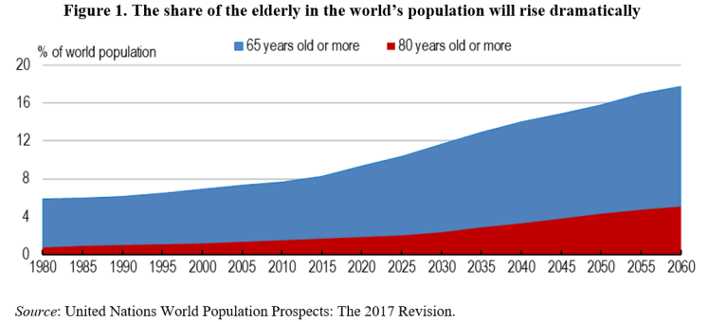
Adapting tourism methods to accommodate the requirements of people with age-related disabilities is not just an ethical issue, but also a strategic opportunity for the tourism sector
People with age-related disadvantages
https://oecdecoscope.blog/2019/09/11/is-age-just-a-number-meeting-the-economic-challenges-of-a-graying-world/

Slide 31
In recent years, tourism worldwide and in Central Europe has seen a considerable change towards inclusion, notably in terms of increasing engagement of individuals with disabilities Such joint efforts demonstrate the value of stakeholder collaboration in breaking down barriers and creating a universally accessible tourism experience People with disabilities are increasingly participating in tourism, a positive trend that reflects broader cultural shifts towards inclusivity and accessibility. This increase can be linked to a variety of factors, including legal advances, technical innovations, and shifting perspectives of disability in the tourist sector and society
Increased participation of people with disabilities in tourism

Slide 32
Legislative frameworks have an important role in making tourism more accessible. The 2006 adoption of the United Nations Convention on the Rights of Persons with Disabilities is a key milestone in pushing for handicapped people’s rights to participate in all parts of society, including tourism Following the treaty, numerous countries enacted national legislation to improve accessibility to tourism services and infrastructure The European Union’s approval of the European Accessibility Act in 2019: legal commitment to removing barriers and increasing participation in tourism for individuals with impairments
Increased participation of people with disabilities in tourism

Slide 33
Technological improvements: also crucial role in increasing the engagement of PwD in tourism – innovations like accessible websites, mobile applications designed for people with different disabilities, and virtual reality tours have made the sector more accessible These technologies help with planning and navigation, but they also improve the travel experience for people with impairments - e.g. apps that provide audio descriptions of landmarks and exhibitions for visually impaired visitors Accessible tourism is now viewed as an integral part of the mainstream tourism sector, rather than a niche market. A growing number of tourist operators provide unique packages and services for disabled travellers – from adaptive adventure activities to customised cultural tours
Increased participation of people with disabilities in tourism

Slide 34
Barriers to Participation Despite improvements, people with disabilities still face difficulties to full participation in tourism activities. This includes: Physical barriers: Inadequate infrastructure, including transportation and tourism sites, continues to be an issue Informational barriers: Inaccessible and unreliable information about tourism services and locations Attitudinal barriers: e.g. prejudices and stereotypes that can impact the quality of service provided to travellers with disabilities
Increased participation of people with disabilities in tourism

Slide 35
Strategies for Enhancing Participation Efforts to improve the engagement of PwD in tourism have focused on different strategies: Legislative measures: to ensure accessibility in tourism facilities and service Technology and innovation: utilising assistive technologies and digital platforms can increase information access and travel convenience Education and training: programmes to raise awareness and understanding of accessibility concerns among tourist personnel Collaborative projects: international collaboration programmes share best practices and resources to increase accessibility across boundaries (EU-funded projects that promote accessible tourism through collaborations between member states, NGOs, and business stakeholders)
Increased participation of people with disabilities in tourism

Slide 36
While progress has been made, future efforts must address remaining infrastructure gaps, promote cross-sector collaboration, and capitalise on technological improvements to provide more intuitive and user-friendly travel experiences for PwD To summarise, increased participation of persons with disabilities in tourism is a multidimensional phenomenon fuelled by governmental assistance, technical innovation, and a shift in industry perspectives. These improvements not only improve the travel experience for PwD, but they also contribute to a more inclusive and equitable tourism industry The rising participation of individuals with disabilities in tourism reflects the collaborative efforts of governments, NGOs, the corporate sector, and the disabled population itself
Increased participation of people with disabilities in tourism

Slide 37
The Development of Accessibility Standards in Tourism Notion of accessibility in tourism has evolved considerably over time from eliminating physical obstacles for those with disabilities to a diverse array of accommodations, services, and experiences designed to make tourism accessible to everyone, irrespective of physical or sensory limitations Perspective on accessible tourism has transitioned from seeing it as a niche market to acknowledging it as a fundamental component of mainstream tourism Transition shown by the growing implementation of universal design principles to create settings accessible to all individuals and guaranteeing that tourist infrastructure, lodgings, and services are accessible to the widest possible demographic. By these, destinations not only adhere to regulatory mandates but also elevate the overall quality and attractiveness of their offers
Higher standards for accessibility in tourism

Slide 38
Advantages of Accessible Tourism in Economic and Competitive Contexts Accessible tourism encompasses not just inclusion but also economic rationale: individuals with impairments constitute a substantial and expanding market segment, and their share rises when including the aging population and those with transitory or situational impairments. Locations and enterprises that prioritise accessibility often have advantages (enhanced consumer loyalty, elevated satisfaction levels, improved market distinction) Moreover, accessible tourism corresponds with the objectives of sustainable and responsible tourism: by enhancing accessibility to locations, companies address the requirements of tourists with disabilities while promoting social fairness and inclusion, essential components of sustainable tourism. This strategy leads to a more resilient tourism sector
Higher standards for accessibility in tourism

Slide 39
Improving Tourism Quality via Accessibility Integrating accessibility into tourism services and infrastructure significantly improves the overall quality of the visitor experience. Better accessibility of hotels and tourist destinations assists PwD while also fostering a more comfortable and pleasurable experience for all visitors. Ramps, elevators, accessible facilities, and sensory-friendly surroundings are valued by diverse visitors (families with strollers, senior travellers, those recuperating from injuries) Accessible tourism also tackles informational and attitudinal obstacles. By offering transparent and accessible information on tourist services and destinations, and by educating staff to be more inclusive and empathic, the tourism sector may enhance service quality for all, acquiring and keeping a diverse consumer base
Higher standards for accessibility in tourism

Slide 40
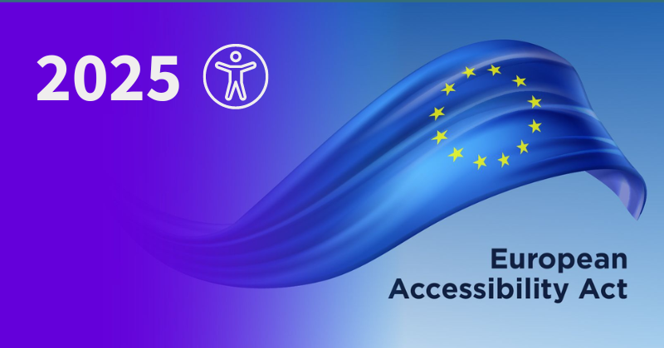
The Function of Legislation in Advancing Accessibility Legislation is to promote elevated standards of accessibility in tourism. International frameworks like the UNCRPD and the European Accessibility Act have significantly advanced accessible tourism These legislative frameworks require that public areas, including tourist sites, be accessible to all persons, establishing a baseline norm for accessibility in tourism services
Higher standards for accessibility in tourism
https://www.accessibility.org.au/preparing-for-the-european-accessibility-act-2025-navigating-the-future-of-digital-accessibility/

Slide 41
The developing discipline of accessible tourism has resulted in a substantial paradigm shift in tourism marketing, with a strong emphasis on meeting the unique needs of disabled guests. This development in the tourism sector is due to a better understanding of this special market segment, distinguished not only by its diversity but also by the unique problems it poses The purposeful shift to incorporate inclusive marketing materials, emphasising the accessibility aspects of travel products, and actively engaging with accessibility advocates and organisations represent a substantial change from traditional marketing tactics: to build a more inclusive tourism environment in which accessibility is not simply an add-on but a core component of the tourist experience
Responses of tourism marketing to the challenges of accessible tourism

Slide 42
Understanding the marketplace A thorough examination of the demographic of tourists with disabilities is a critical component in adapting marketing tactics for accessible tourism Extensive market research is needed to identify their travel preferences, accessibility requirements, and preferred communication channels Gaining these insights is critical for creating marketing initiatives that not only resonate with this demographic but also address their individual requirements in an effective and empathic manner. Understanding the market entails more than just collecting data; it also entails empathising with the lived experiences of disabled travellers, ensuring that marketing strategies are not just informed but also shaped by this demographic’s actual needs and goals
Responses of tourism marketing to the challenges of accessible tourism

Slide 43
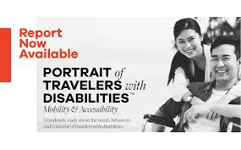
Inclusive marketing communication The application of Web Content Accessibility Guidelines (WCAG) for digital platforms ensures that marketing communications are accessible to a wide range of people, including those with disabilities Furthermore, including photos and tales of travellers with impairments in marketing materials promotes a more inclusive narrative. This technique not only challenges prevalent assumptions, but also develops a sense of belonging and representation among this group, adding authenticity and inclusivity to the marketing narrative
Responses of tourism marketing to the challenges of accessible tourism
https://www.mmgyglobal.com/news/portrait-of-travelers-with-disabilities/

Slide 44
Highlighting accessibility features In response to rising demand for accessible tourism, marketing techniques are increasingly emphasising the accessibility elements of tourism offers: giving extensive information regarding the physical accessibility of buildings and services, such as wheelchair ramps, accessible restrooms, and sensory-friendly environments Tourism companies can attract disabled tourists who would otherwise be unsure about the suitability of the place or service by transparently advertising the existence of accessible features. This kind of transparency not only helps potential travellers with disabilities make decisions, but it also promotes destinations and service providers as inclusive and accommodating, increasing trust and loyalty
Responses of tourism marketing to the challenges of accessible tourism

Slide 45
Engaging with accessibility advocates and organisations Strategic collaboration with accessibility advocates and organisations is a best practice in the marketing of accessible tourism. These collaborations provide vital insights into the demands of disabled passengers and help to confirm tourism operators’ accessibility promises Such collaborations go beyond mere advice to include a co-creative process in which accessibility advocates help shape marketing tactics that authentically address the needs of disabled travellers. These relationships not only improve the legitimacy of tourism products but also widen the reach of marketing messages by tapping into established networks and groups in the field of disability advocacy
Responses of tourism marketing to the challenges of accessible tourism

Slide 46
Training and sensitisation Training and sensitising marketing teams about accessibility challenges is critical for developing greater empathy and understanding in marketing communications Training programmes are designed to educate marketing and customer service teams on the language of accessibility, the range of disabilities, and the importance of taking a compassionate approach to all communications Also, such programmes provide teams with the knowledge and skills they need to successfully respond to requests from passengers with disabilities, ensuring that all encounters are knowledgeable, respectful, and helpful
Responses of tourism marketing to the challenges of accessible tourism

Slide 47
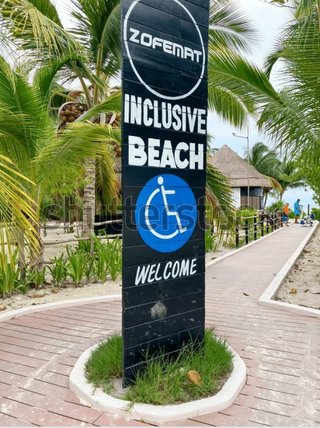
Using social media and user-generated content Social media and user-generated content: new opportunities for marketing accessible tourism. Travellers with disabilities are increasingly sharing travel experiences online, providing honest insights about accessibility of places and services. Tourism marketers use these platforms to share real-life tales and stories, fostering a sense of community and trust among potential passengers Engaging with user-generated content not only boosts marketing efforts, but it also allows for immediate feedback and continual improvement in accessibility options
Responses of tourism marketing to the challenges of accessible tourism
https://www.shutterstock.com/hu/image-photo/playa-del-carmen-quintana-roo-mexico-2512081351

