Slide 1
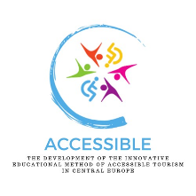
The development of the innovative educational method of ACCESSIBLE tourism in Central Europe 2022-2-HU01-KA220-HED-000099410

Slide 2
5. Organisations supporting travel for people with disabilities

Slide 3
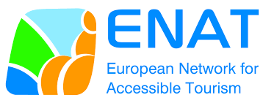
European Network for Accessible Tourism (ENAT)
ENAT is an innovative initiative focused on making tourism accessible to everyone. The beginning and actions highlight the increasing acknowledgment of accessible tourism as not only a specialised business but also as a basic entitlement for people with disabilities The role, significance, and various actions of ENAT are considerable in promoting travel for individuals with disabilities in Europe and other regions

Slide 4
ENAT believes in inclusive tourism, allowing individuals with disabilities, the elderly, and those with mobility issues to travel with respect, comfort, and freedom. The group serves as a liaison that unites stakeholders in the tourist industry, such as governments, businesses and consumers, going beyond advocacy ENAT plays a vital role in promoting collaboration and understanding among different groups to enhance inclusivity in the tourism sector
European Network for Accessible Tourism (ENAT)

Slide 5
ENAT’s work is important due to its holistic approach to accessibility ENAT pushes for enhancements in infrastructure, service supply, and awareness to address physical, informational, and attitudinal barriers to travel This comprehensive viewpoint guarantees that initiatives aimed at improving accessibility consider all the various requirements and difficulties encountered by travellers with impairments (https://www.accessibletourism.org/)
European Network for Accessible Tourism (ENAT)

Slide 6
Research and Development: ENAT engages in research and development programmes to gather essential data on the requirements, choices, and financial influence of disabled travellers. This research provides evidence-based policy recommendations and industry standards, ensuring they are based on practical experiences and requirements Training and Education: ENAT provides training programmes for tourism personnel to enhance their knowledge and skills in offering accessible services. The classes encompass several subjects, including creating user-friendly websites and delivering customer service tailored to the requirements of disabled passengers
European Network for Accessible Tourism – programmes and projects

Slide 7
Certification and Quality Labelling: ENAT has created a certification method to assist consumers in recognising firms that adhere to high accessibility requirements. This approach helps businesses enhance their accessibility and provides travellers with a reliable emblem of accessible services Policy Advocacy: ENAT interacts with policymakers at the national and European levels to support legislation and regulations that encourage accessible tourism. It has helped incorporate accessibility issues into important EU tourist and transport policy
European Network for Accessible Tourism – programmes and projects

Slide 8
Networking and Collaboration: ENAT facilitates networking and collaboration among its members to exchange knowledge, experiences, and resources. Stakeholders from all sectors collaborate through conferences, workshops, and online forums to share best practices and establish collaborations Public Awareness Campaigns: ENAT conducts public awareness programmes to alter attitudes and enhance understanding of the significance of accessible tourism, emphasising the advantages of accessibility for everyone. The campaigns aim to debunk misunderstandings and highlight the economic, social, and cultural benefits of inclusive tourism
European Network for Accessible Tourism – programmes and projects

Slide 9
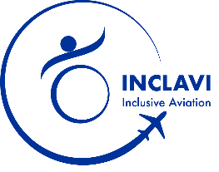
INCLAVI – Inclusive Aviation: Aims to address the inconsistencies in the training of current and future aviation professionals, that relate to competences and skills necessary to enable smooth journeys for all air travellers, no matter what their special conditions or disabilities The project, funded by the European Commission ERASMUS+ Partnerships for Innovation programme and supporting the EU Commission’s strategy for the rights of persons with disabilities 2021-2023, aims to ensure the full social and economic inclusion of disabled people on an equal basis with others and the opportunity to move freely in the EU regardless of their support needs – also in the air
European Network for Accessible Tourism – Current projects
September 2022 – August 2025
Project Website: https://www.haaga-helia.fi/fi/hankkeet/inclavi-inclusive-aviation

Slide 10
SENIOR ECO-NECT. “Supporting the emergence and the development of European ecosystems dedicated to silver and ageing economy” The overall objective of Senior Eco-Nect project is to prepare a joint action plan to support the emergence and the development of European ECOsystems dedicated to silver and ageing ECOnomy as well as ensuring the inclusivity and interconNECTivity between all the key innovation stakeholders of the sector and cross-sectors also in the air
European Network for Accessible Tourism – Current projects
July 2022 – June 2024
Project Website: https://www.senior-eco-nect.com

Slide 11
FEEL IT. “A Pioneer Curriculum for Designing Tourism Experiences for Deaf and Hard of Hearing People” The goal of the FEEL IT project is to train deaf people and people with hearing impairments on the basic tasks and skills to work as travel agents offering high quality and authentic tourism packages and experiences for their peers. FEEL IT will also train travel agents and tour operators in designing accessible tourist packages for deaf and hard of hearing people
European Network for Accessible Tourism – Current projects
February 2022 – January 2025
Project Website FEEL IT: https://feelit.infoproject.eu/

Slide 12
ACCESSTOUR. Accessible Tourism for Inclusion and Value Creation in Rural Areas of Norway Project funded by the Norwegian Research Council. ACCESSTOUR, led by Nordland Research Institute will help tourism providers in rural areas to realise the potential that lies in making destinations more accessible to all
European Network for Accessible Tourism – Current projects
September 2021 – 2025
Project Website: https://www.accessibletourism.org/?i=enat.en.enat_projects_and_good_practices.2251

Slide 13
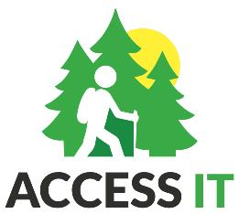
For information on a a number of projects realised with the participation of ENAT in 2009 – 2024, see https://www.accessibletourism.org/?i=enat.en.projects
European Network for Accessible Tourism – past projects
Innovation for Accessible Tourism in Natural and Rural Areas
Newscat: New Skills for Customized Accessible Tourism
Access Angels: Guardian Angels of Accessible Travellers in Rural Areas
Europe Without Barriers: Accessible Tourism Itineraries & Training (EWB)

Slide 14
The European Network for Accessible Tourism is crucial in promoting barrier-free travel. ENAT – advocates for the rights of tourists with disabilities and showcases the wider advantages of accessible tourism for society through its diverse activities and initiatives – plays a crucial role in the network of organisations that facilitate travel for individuals with disabilities, ensuring that people of all physical abilities can enjoy the beauty and variety of Europe and its project countries
European Network for Accessible Tourism – summary
More information at https://www.accessibletourism.org/

Slide 15
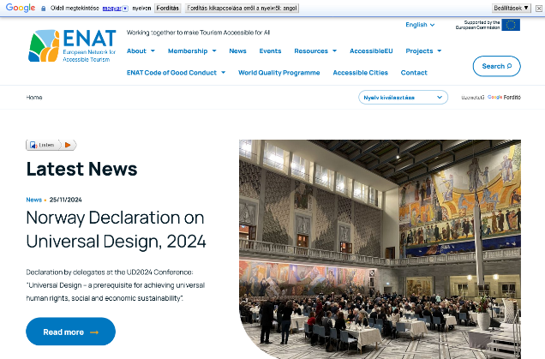
ENAT website – late November 2024
https://www.accessibletourism.org/

Slide 16
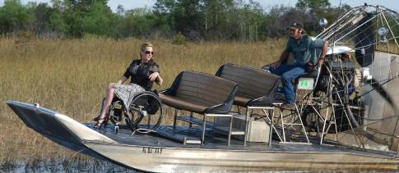
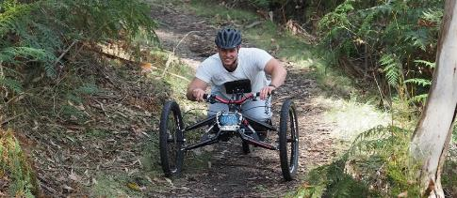
Formed in 2007, initially as a vehicle to publish accessible travel information via its web site travability.travel Now Travability is a part of a worldwide group whose mission is to create equality in accessibility in the hospitality and travel industries Travability’s mission is to be agents of change; to inspire people who have never travelled before to do so, and to inspire others to do more. To encourage all cultures of the world to see disability as an integral part of life, and to provide the motivation and tools to the tourism industry to allow them to create accessible environments that enable inclusion in an economically sustainable way
Travability
More information at https://travability.travel/

Slide 17
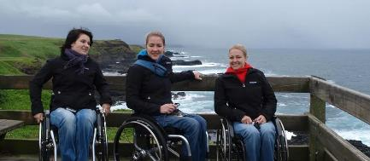
Travability offers a full travel agency service, continually expanding contacts to offer the greatest variety possible of accessible and inclusive holidays worldwide An extensive network of international travel agents – can put guests with special needs in contact with a suitable specialist Services: itinerary planning; flight and hotel bookings, attractions; hire cars or vans (with hand controls if required); hire equipment; cruising holidays; private yacht charters; fully escorted group tours; business travel and conferences
Travability – services
More information at https://travability.travel/

Slide 18
Examples from Central-Eastern Europe: Croatia
Tourist offer in Croatia for people with disabilities is still quite sparse and fragmented. The biggest challenge faced by people with disabilities is the quality of information about the specific segments of the offer: for this reason, various organisations participate in this process in order to create a quality product in the context of accessible tourism
Looking at the market from the perspective of private companies: currently no travel agency that specialises in the needs and requirements of people with disabilities – there used to be one, but no longer
Important to know that the national government is making great efforts to raise awareness of this tourism product and to give tourism employees the opportunity to participate in special workshops aimed at improving understanding and knowledge of this segment of tourists

Slide 19
Examples from Central-Eastern Europe: Croatia
Several NGOs are involved in creating a platform for knowledge sharing – not only those working to improve the quality of life of people with disabilities, but also those working to improve the quality of life of older people also in need of better accessibility
The collaboration of these individual initiatives in creating a more accessible, universal design of various facilities will hopefully lead to an organisation that specialises in this particular segment of tourists, providing them with access to tourism services and experiences, but most importantly, accurate and reliable information on the availability and quality of accessibility of destinations

Slide 20
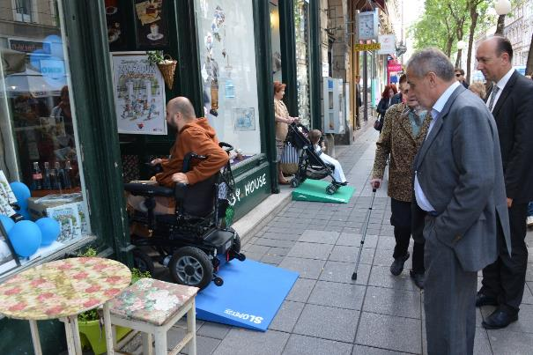
Examples from Central-Eastern Europe: Croatia
Creating accessibility with mobile ramps, downtown Zagreb – not for wheelchair users, only
Source: https://www.zagreb.hr

Slide 21
Examples from Central-Eastern Europe: Poland
Examples of good practice for accessible tourism in Poland are diverse. A few of these:
institutional activities at national level (Ministry of Sport and Tourism) and regional level (Wielkopolska Tourist Organization),
tourist guides to the most popular urban tourist destination in Poland, Krakow (“A Guide to Krakow for Tourists with Disabilities”), tourist information about the availability and facilities on tourist trails (“Karkonosze for Everyone”, Piast Trail in Greater Poland),
tourist attractions (Invisible Street in Poznań, Brama Poznania ICHOT [Poznan Gate], Museum of the First Piasts in Lednica, Museum of the Archdiocese of Gniezno),
open spaces, such as parks and sensory gardens (Spatial Orientation Park in Owińska),
an event aimed at educating integration and social inclusion, organised periodically by the community of PwD during the International White Cane Day

Slide 22
The Ministry of Sport and Tourism (MSiT) in Poland promotes accessible tourism in the context of social tourism as “a priority in the activities of tour operators, travel agencies and tourist information points” Accessibility Plus 2018-2025 Programme was developed on a national scale, focused on universal design of public spaces, products and services in terms of architecture, information and communication This programme is included in the activities of the Polish Tourist Organisation and Regional and Local Tourist Organisations. Accessibility is understood as the possibility of independent use of: tourist attractions, information (guides, maps, information points), transport and communication in tourism, routes, paths, tourist trails, and catering, accommodation and sanitary infrastructure
Examples from Central-Eastern Europe: Poland

Slide 23
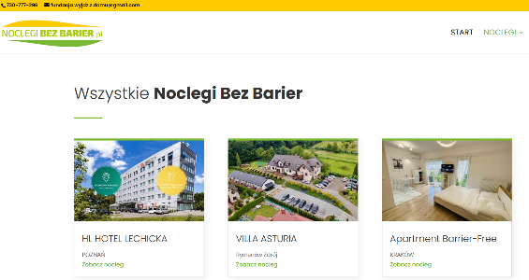
https://www.gov.pl/web/sport/turystyka-dostepna-dla-wszystkich
Examples from Central-Eastern Europe: Poland
https://noclegibezbarier.pl/noclegi/

Slide 24
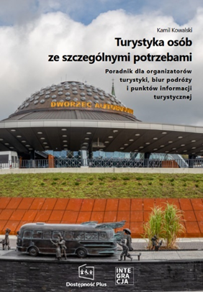
The Ministry of Sport and Tourism recommends a guide titled Textbook: Tourism for people with special needs. Guide for tour operators, travel agencies and tourist information points MSiT’s website also includes a list of good practices and solutions, including a database of guides, standards, guidelines, references to legal acts, programmes and portals containing data on the availability of e.g. accommodation facilities
Examples from Central-Eastern Europe: Poland
https://www.gov.pl/web/sport/turystyka-dostepna-dla-wszystkich

Slide 25
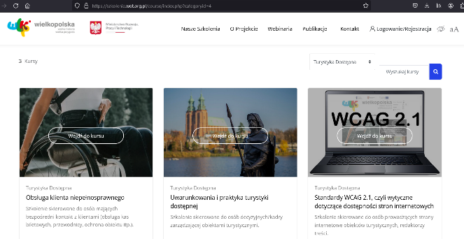
Wielkopolska (Greater Poland) Tourist Organisation (WOT): free training in the field of accessible tourism on an e-learning platform, addressed to all people professionally involved in tourism The training is addressed both to employees directly serving customers, as well as to managers and people making strategic decisions. Each course ends with a test verifying the acquired knowledge, and the training participant who obtains a positive result receives a certificate
Examples from Central-Eastern Europe: Poland
https://szkolenia.wot.org.pl/

Slide 26
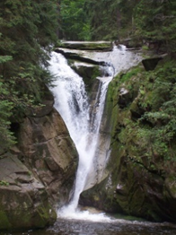
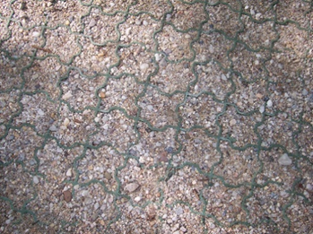
“Karkonosze for All”: project implemented in Polish-Czech partnership, in Poland by Karkonosze Sejmik of People with Disabilities (KSON). KSON employees tested tourist trails and places available to people with disabilities on the Polish side of the mountains and in the nearby foothills: tourist trails, tourist attractions and for competitive tourism
Examples from Central-Eastern Europe: Poland
Photos by A. Zajadacz

Slide 27
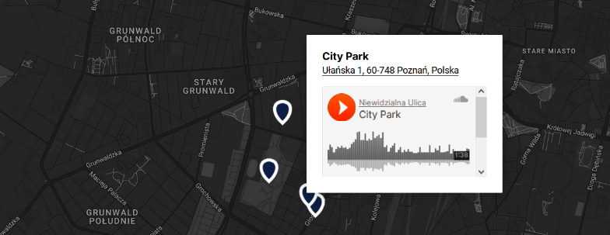
Sound Panorama of the Łazarz Housing Estate in Poznań: a project financed by the Department of Culture of the City of Poznań and includes an interactive audio map with the most characteristic places of the district. To listen to the recordings, simply click on any marker on the map
Examples from Central-Eastern Europe: Poland
https://niewidzialnaulica.pl/panorama-dziekowa-osiedl-lazarza/

Slide 28
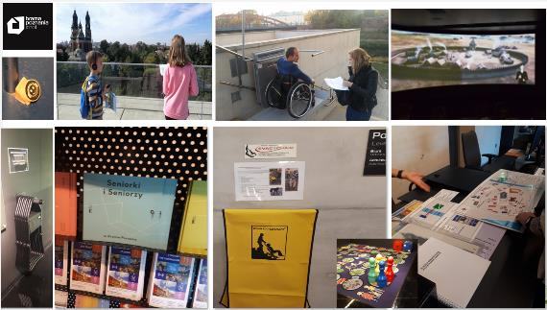
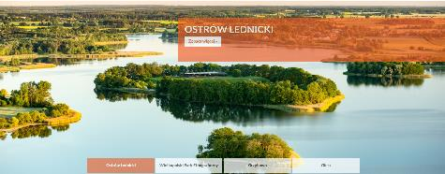
For Poland’s several further good examples, see presentation 8 of this course: “Good practices in accessible tourism at international level and in the partner countries of the project”
Examples from Central-Eastern Europe: Poland

Slide 29
In Romania a number of social tourism programmes have appeared in recent years, closely linked to social policies at national level (Simon et al., 2017). Social tourism, including tourism for people with disabilities, is at a low level in Romania, underdimensioned compared to the real needs of the population categories that benefit from tourism activities at lower prices A lack of complete information on social tourism, including tourism data for the disabled. The tourism associations that run social tourism programmes do not have annual analyses of participation data, participating businesses, accommodation, venues, number of tourists, etc., so we cannot get a realistic picture of how many people from disadvantaged groups are currently benefiting from existing but scarce opportunities at national level (Simon et al., 2017)
Examples from Central-Eastern Europe: Romania

Slide 30
Since 2013, Motivation Foundation Romania has had certified training courses for professionals based on the curricula developed by the World Health Organization (WHO). At the same time, it has created the first online platform, a national map of accessible places, where public institutions, places of entertainment and leisure, accommodation and facilities and their surroundings can be found. The map is available at www.accesibil.org and is designed for people with disabilities. It can also be used by tourism operators who want to develop tourism services for people with disabilities (Mihaela, 2019)
Examples from Central-Eastern Europe: Romania

Slide 31
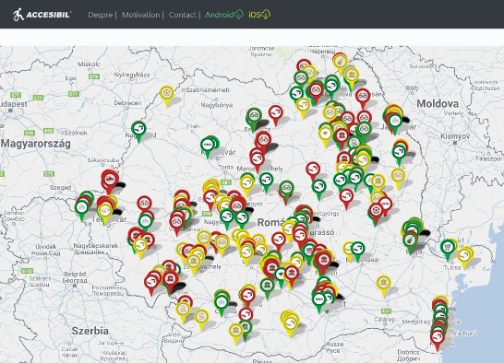
Another initiative of Motivation Foundation Romania is the assessment of the accessibility of buildings, which allows a building to obtain an accessibility mark from the State Office of Inventories and Trademarks. Among the few tourism and hospitality service providers, it is worth highlighting that the Băile Felix complex and the Royal Courtyard in Piatra Neamţ meet the accessibility criteria (Mihaela, 2019)
Examples from Central-Eastern Europe: Romania
https://www.accesibil.org/

Slide 32
Babilon Travel Association, Cluj-Napoca Town Hall, Cluj-Napoca Tourist Information Centre assist people not able to see at all (Terra Mirabilis project) Transylvanian Roads Association and Retezat Tourism Association assist people not able to see at all and those with reduced mobility (at Square sculpture of Șumuleu and trail for disabled people in the Retezat Mountains, respectively) AECO Romania, Outdoor Education and Cultural Association offers hiking guide for families with children and people with disabilities M24Seven Europe, RAPTronic, RAP Development, RAP Instal, Petroterm SRL., Sorla and Dobra, and AQUA Carpatica operate Pupa Beach at Mamaia, a beach accessible for people with reduced mobility
Examples from Central-Eastern Europe: Romania

Slide 33
Corund-Praid Nature Conservancy and Corund Tourist Association allow people with reduced mobility to access the nearby peat bog Nurture in Nature in Harghita County provides the joy of movement to people with reduced mobility but also to those who have sight of hearing disorders Accessible Romania by Santo Touring is a travel agency that allows people with reduced mobility and people with hearing impairment to partake in tours at different locations CaiacSMile makes it possible for people with reduced mobility to have a skiing experience Special Olympics Foundation organises sports competitions, school education, courses in Romania for people with intellectual disabilities
Examples from Central-Eastern Europe: Romania

Slide 34
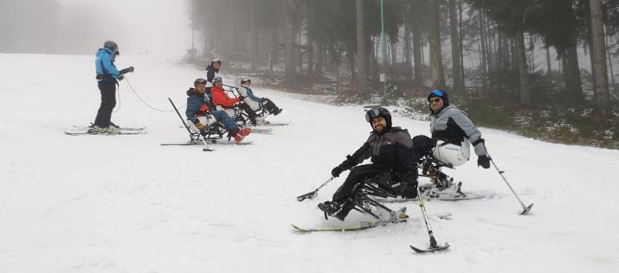
For Romania’s several further good examples, see presentation 8 of this course: “Good practices in accessible tourism at international level and in the partner countries of the project”
Examples from Central-Eastern Europe: Romania
https://www.facebook.com/NiNadventuresWorld/

Slide 35
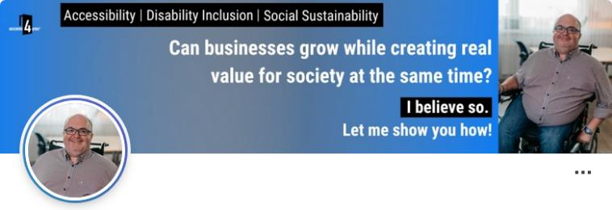
The trademark access4you® is an international certification mark, currently registered in the European Union and the United Kingdom. Its creation was inspired by an unpleasant experience of its creator, Balázs Berecz: a problem caused by a property advertised as fully accessible but in reality, inaccessible by wheelchair
Examples from Central-Eastern Europe: Hungary
Access4you
“…I realised that being helpful is not enough. We need a common language about accessibility that we all understand and speak. I decided that we were going to do it.”
https://hu.linkedin.com/in/balázs-berecz

Slide 36
The Access4you mark provides detailed and reliable information on the accessibility of the built environment for people with different disabilities – mobility, visual, hearing and cognitive special needs. This helps people with disabilities themselves and their relatives, and also property owners and companies: in addition to providing a detailed picture of the accessibility of their premises, the Access4you certificate also effectively supports business and sustainability objectives The Access4you database and mobile app, which contains detailed profiles of more than 700 international locations, is available free of charge to everyone. The site profiles are based on a 1,000-point criteria system, compiled according to the criteria of 8 stakeholder groups and provides information filtered by impact, with precise dimensions and a range of useful photos
Examples from Central-Eastern Europe: Hungary
Access4you
(https://access4you.io/about-us)

Slide 37
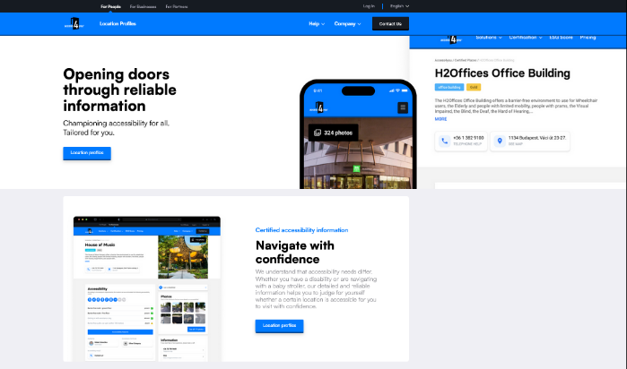
Access4you’s website – late November 2024
Basic options:

Slide 38
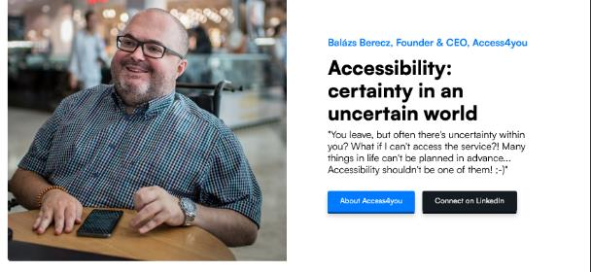
Services offered by Access4you

Slide 39
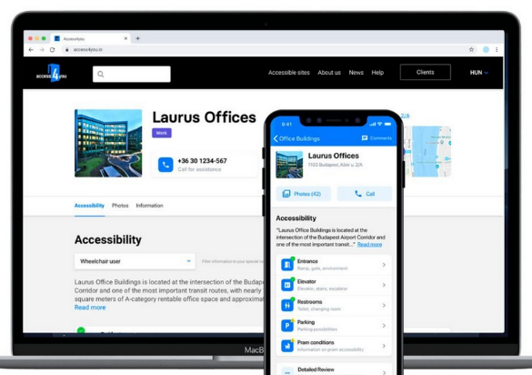
Access4you’s app for finding accessible places
Source: https://access4you.io/

Slide 40
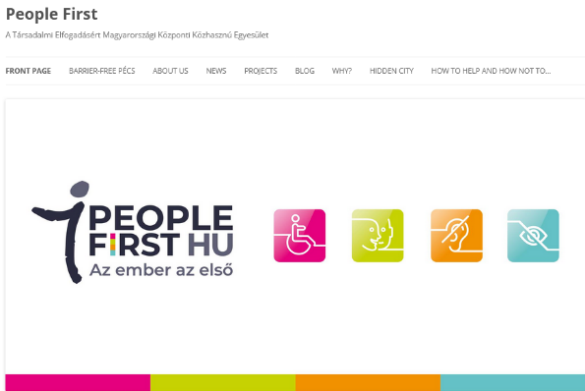
“We don’t make a difference between man and man, for us is the People first! Our association operates as a first and currently single Hungarian member of an international network in Pécs. Our main goals are to support independent living at all levels, accessibility, and the widespread promotion of accessible tourism.”
PeopleFirst
Examples from Central-Eastern Europe: Hungary

Slide 41
PeopleFirst gives useful advice on how to help and how not to someone (also as a tourist) with… – a physical disability; – a hearing impairment; – a visual impairment; – autism; – an intellectual disability Maintains a database on barrier-free facilities in the city of Pécs
Examples from Central-Eastern Europe: Hungary
PeopleFirst

Slide 42
Accessible Pécs Downloadable Materials Pécs For All People First Association looked at the institutions, tourist attractions, entertainment options and hospitality services to gain practical information on them. Information is collected in an Accessible Pécs database. The aim of the publication is to support independent living, to motivate the companies and institutions of Pécs to shift towards accessibility, and to promote accessible tourism on a large scale. The joint publication of the People First Association and the Local Government of Pécs can be accessed at https://pecs.hu/en/accessible-pecs-downloadable-materials-pecs-for-all/
Examples from Central-Eastern Europe: Hungary
PeopleFirst & the Municipality of Pécs

Slide 43
MEOSZ (Mozgáskorlátozottak Egyesületeinek Országos Szövetsége, Hungarian Alliance of Associations of Disabled People) is the most important national advocacy organisation for people with disabilities. The Association is also one of the oldest and – with its one 160,000 active members – the largest NGOs in Hungary. The number of local associations is nearly 90. Anyone with a disability can be a member, and so can parents of children with disabilities. Supporters, relatives, sympathisers and supporters can also join the movement. The associations have set up more than 900 local groups to liaise directly with their members, covering the whole country
Examples from Central-Eastern Europe: Hungary
MEOSZ
https://www.meosz.hu/

Slide 44
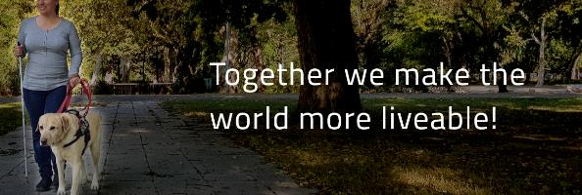
The Hungarian Federation of the Blind and Partially Sighted (Magyar Vakok és Gyengénlátók Országos Szövetsége, MVGYOSZ) was founded in 1918 by blind officers wishing to dispose about their fate on their own. Their vision is a world in which the visual impairment is not an obstacle to an independent life, and blind or partially sighted people enjoy the same rights and quality of life as any other fully sighted person
Examples from Central-Eastern Europe: Hungary
MVGYOSZ
https://www.mvgyosz.hu/en/mvgyosz-mainpage/

Slide 45
The Hungarian Association of the Deaf and Hard of Hearing (Siketek és Nagyothallók Országos Szövetsége, SINOSZ) was founded in 1907. The work of SINOSZ is driven by commitment to equal opportunity. Their vision is a world where the sign language of the deaf is part of the national culture and where the deaf and those who have partial hearing loss are helped on the road to active social participation in national life SINOSZ secures social acceptance of people who are deaf or hard of hearing and advocates for the establishment of education, employment and transportation conditions that promote independent living. Deaf and hard of hearing members and their friends and relatives and national and international experts help SINOSZ realise their goals
Examples from Central-Eastern Europe: Hungary
SINOSZ
https://sinosz.hu/about-us/

Slide 46
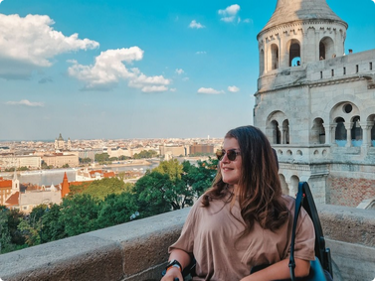
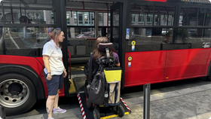
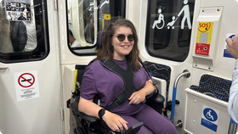
For Hungary’s several further good examples, see presentation 8 of this course: “Good practices in accessible tourism at international level and in the partner countries of the project”
Examples from Central-Eastern Europe: Hungary
https://www.rollonadventures.com/fun-wheelchair-accessible-activities-in-budapest-hungary/

