Slide 1
The development of the innovative educational method of ACCESSIBLE tourism in Central Europe 2022-2-HU01-KA220-HED-000099410

Slide 2
3. Historical changes in the situation of people with disabilities, the changing attitudes of societies to disabilities and disabled persons

Slide 3
Every society is plausibly characterised by its relationship to disabled people In advanced economies, the opportunities in life for people with disabilities in employment, travel, recreation, access to services, etc. appear to be the same or at least not significantly less favourable than those of their non-disabled peers Humanity now has the technological solutions and social (legal) possibilities to ensure a life without disabilities for all
Historical changes in the situation of people with disabilities – preliminary thoughts

Slide 4
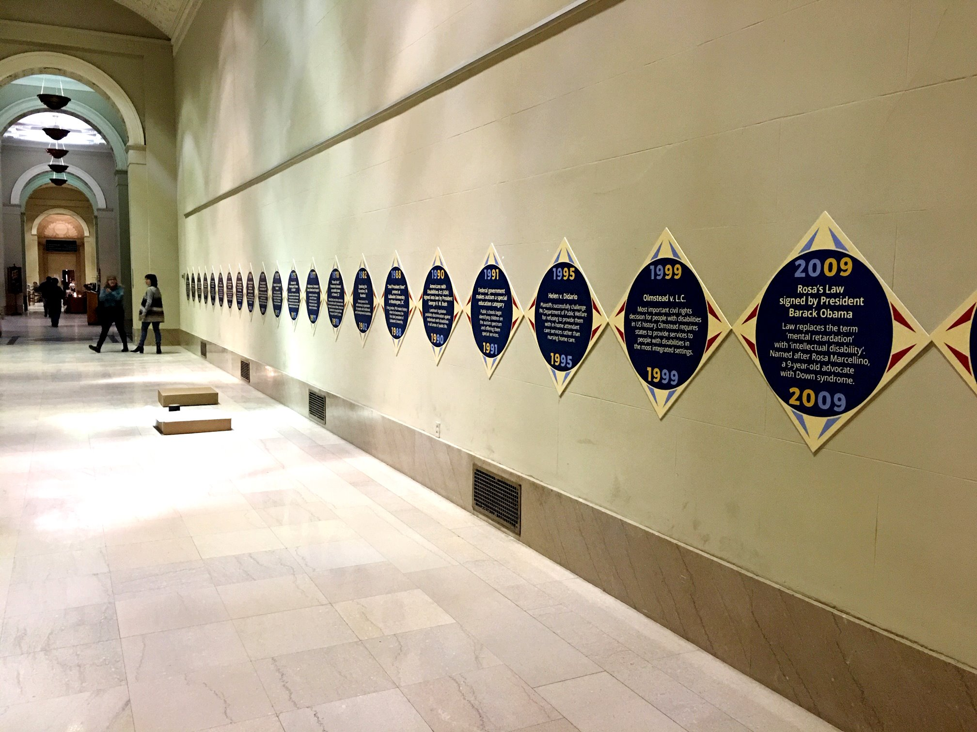
The period of accessibility in the history of human civilisations is only a few decades, maybe a century – a very short period during which the specific needs and requirements of people with disabilities have been addressed by the majority of society and by legislation and the state
Historical changes in the situation of people with disabilities – preliminary thoughts
Disability Rights Movement history timeline pictured at Philadelphia’s Parkway Central Library
https://disabilities.temple.edu/resources/disability-rights-timeline

Slide 5
For most of the history of human societies, there have been at least prejudices (mostly negative ones) against people with disabilities Today we focus the problem of people with disabilities encountering difficulties when travelling – for thousands of years, the mere existence was a daily hardship for them Worse still, it was considered a sensation to display someone who was visibly physically or mentally handicapped, see the institution of the freak shows that reached their peak of popularity in the second half of the 19th century and in the early years of the 20th century (Putova, 2018; Kirkwood, 2017)
Historical changes in the situation of people with disabilities – preliminary thoughts

Slide 6
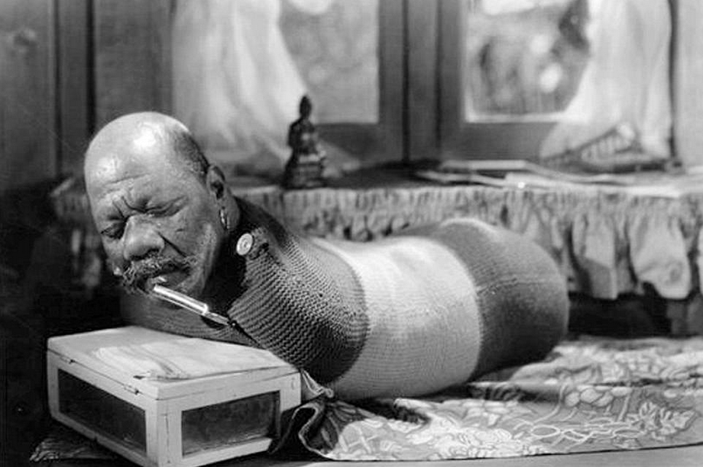
He was known as the ‘Human Caterpillar’ because he had been born limbless. For entertainment he would roll himself over and light cigarettes with only his mouth
Disabled person on display – Freak Show
https://www.dailymail.co.uk/news/article-4856604/Photos-display-19th-century-freak-shows.html

Slide 7
Humiliation was common in the world until the beginning of the last century, and to this day we cannot say that the situation of people with disabilities has been resolved Even in the most tolerant societies, there are still prejudices against people with disabilities, see ableism (Friedman, 2017) There are societies where superstitious prejudices against minorities in general still exist today Even in societies relatively advanced in accessibility, there are still difficulties in transport and in daily administration In many countries, the needs of people with disabilities are still not taken into account when new facilities are built, old ones are rebuilt, transport is installed and made accessible, etc.
Historical changes in the situation of people with disabilities – preliminary thoughts

Slide 8
Throughout history, different ages and cultures have responded to disability and impairment (and old age and serious illness) in a wide variety of ways The literature on disability history is rather “handicapped”, poor (Könczei, 2019), and mostly restricted to medical history, picture books for medical students: providing knowledge about types of illness, and sometimes presenting more or less repulsive images, often for its own sake, to provoke horror, and thus without social scientific analysis or interpretation Not much is known from these sources about the everyday lives of the disabled people in the given culture in the given era, or the typical reactions of society, so we have to approach the cultures of the given era not with our own values and standards, but with our own perceptions and prejudices, which can give rise to many misunderstandings
Historical changes in the situation of people with disabilities – preliminary thoughts

Slide 9
The community-social relationship to people with physical or mental disabilities is determined by the image of the human body and mind that the age has created This is no different in modern societies: people with disabilities are seldom recognised or appreciated. For members of modern societies – influenced by the media and advertising – health, youth, independence and beauty are the ultimate values. The stereotype of “what is beautiful must be good” operates in the everyday thinking of members of society, the idea of “what is beautiful is good, what is good is beautiful” (Plato, 2005), which originates in Greek philosophy and has been shaped by the consumerist world of today, according to the following image: only what is beautiful is good
Historical changes in the situation of people with disabilities – preliminary thoughts

Slide 10
Although the problem of disability has been known since the ancient times, it is known in its widespread and severe form only since the 20th century, only. It has become a worldwide problem since the mid-20th century: (1) in the old days, people who were born or who became disabled did not usually live long lives, whereas today’s medicine can give long and meaningful lives to those who would have had no chance of survival before industrial societies; and (2) modern age produces disability in many ways (unhealthy workplaces, unhealthy lifestyles, dangerous transport, excessive consumption of medicines, daily exposure to of harmful chemicals etc.)
Historical changes in the situation of people with disabilities – preliminary thoughts

Slide 11
The rehabilitation approach has also only been around for a few decades. In the animal kingdom, the injured individual is in the vast majority of cases doomed to extinction due to the Darwinian principle of “survival of the fittest”. What distinguishes human society from animal society is, among other things, that the complex (barrier-free) system that humans have built enables them to operate social institutions that make it possible to avoid the consequences mentioned above at the animal level (Könczei, 2019; Farkas et al., 2022c)
Historical changes in the situation of people with disabilities – preliminary thoughts

Slide 12
The most distant source of prejudice against disabled people is presumably in part an atavistic, ancient instinct from which even “modern” man cannot always escape A further possible explanation is that disability itself was, in most historical periods and in most cultures, deeply associated with transcendence: from prehistoric times to the so-called modern times of today, it has been believed to have its origin somewhere beyond the visible, tangible world – or, even worse, it was a “just” punishment by God for some sin committed Atavistic, ancient instincts, pagan superstitions, wrongful religious convictions and the otherness of the disabled person, alongside and interacting with the dominance of the major cultures (Könczei, 2019)
Historical changes in the situation of people with disabilities – preliminary thoughts

Slide 13
Although relatively little information exists about how long prehistoric people lived (having access to too few fossilized human remains has made it difficult for historians to estimate the demographics of any particular group), we have no reason to believe that disabled individuals had much chance of survival in ages prior to organised societies and a minimum level of care Main factors limiting life expectancy were infant deaths and early deaths caused by malnutrition or disease Even in the “modern” times of the prehistoric era, in the Paleolithic and Neolithic are, life expectancy was 20–33 years, with a very high proportion of infant mortality: in these times it was only the fittest that could survive
Historical changes in the situation of people with disabilities – prehistoric times

Slide 14
It is in artefacts from Mesopotamia that we first discover the connection that vulnerability and disability in human and social consciousness are most deeply linked to the search for transcendence Although we know little about the relationship of members of society to the disabled persons and their place in the community, we do know that they did not only try to forecast future from oil and smoke, but also “freaks”: they were seen as prognostic omens, signs that helped to predict the future, and were thought to be influenced by forces from the other world “If there was no rational, mundane explanation for the disability, they looked for something otherworldly. If the disability is of otherworldly origin, it seems to be capable of what worldly thinking is generally incapable of doing: seeing the future.” (Hegedüs et al., 2011)
Historical changes in the situation of people with disabilities – Mesopotamia

Slide 15
The Torah not only lays down as a basic rule for sacrifice that only animals without blemish may be sacrificed (Leviticus 22:21), but there is much more to the priests’ duties: “For the generations to come none of your descendants who has a defect may come near to offer the food of his God. No man who has any defect may come near: no man who is blind or lame, disfigured or deformed; no man with a crippled foot or hand, or who is a hunchback or a dwarf, or who has any eye defect, or who has festering or running sores or damaged testicles.” (Leviticus 21:17-20) Even worse was the case of those who were disabled by leprosy, the leper – if someone was “diagnosed” with leprosy, it was considered a “providential punishment” for slander, and the infected person, as an unclean person, had to live outside the camp from then on. After his eventual recovery, he could return to the community after certain rituals
Historical changes in the situation of people with disabilities – Ancient Judaism

Slide 16
The question is whether it was the disdain and severe prejudice against the disabled persons that excluded them from the community In addition to the transcendent context and the imperative character, the text also contains the hidden meaning that a person with a disability, marginalised, excluded, and in difficulty, has the right to live a human life on an equal footing with the rest of society. This is the basis for the obligation to provide assistance
Historical changes in the situation of people with disabilities – Ancient Judaism
https://www.scripture-images.com/bible-verse/kjv/leviticus-21-18-kjv.php

Slide 17
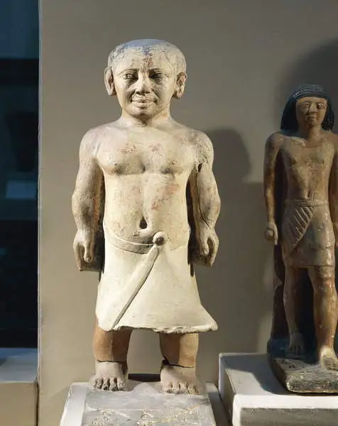
People in ancient Egypt did not “revere” the dwarf man as a fairground entertainer at all, as so many other cultures did, but rather associated him or her with positive human and divine qualities Dwarf Khnumhotep from the 22nd-21st centuries BC, during the reign of the 6th Dynasty, may have been a slave-supervisor, i.e. he did not live on the margins of society, and was entrusted with an important position
Historical changes in the situation of people with disabilities – Ancient Egypt
https://egypt-museum.com/dwarf-khnumhotep/

Slide 18
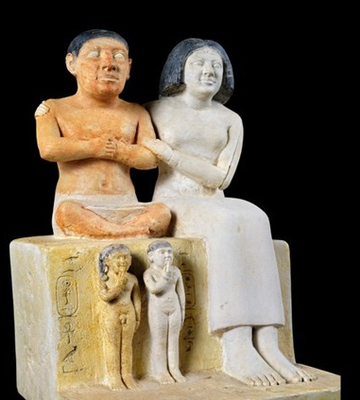
Seneb, the dwarf from the 13th century BC, is interesting not only from a social rehabilitation point of view, because of his disability, quite severe by today’s standards, but also from an occupational rehabilitation point of view: he was the head of the Pharaoh’s huge textile mill, i.e. he was an important and respected figure in the society of his time, and held many titles, including priesthood. He received various gifts from the emperor not only for his loyalty
Historical changes in the situation of people with disabilities – Ancient Egypt
https://egymonuments.gov.eg

Slide 19
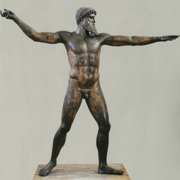
Health was at the top of the hierarchy of values, health and wholeness the ideals of the time, no sharp distinction between health of body and soul For ancient Greeks, a beautiful body was considered to be direct evidence of having a beautiful mind: anyone considered beautiful was automatically a good person, and the Greeks actually had a word for this: “Kaloskagathos”, i.e. gorgeous to look at, insinuating a good person A concept still followed today, consciously or subconsciously – villains portrayed in films and television tend to be society’s view of “ugly” whereas the hero is generally considered “beautiful” (www.eternalgoddess.co.uk)
Historical changes in the situation of people with disabilities – Ancient Greece
www.eternalgoddess.co.uk

Slide 20
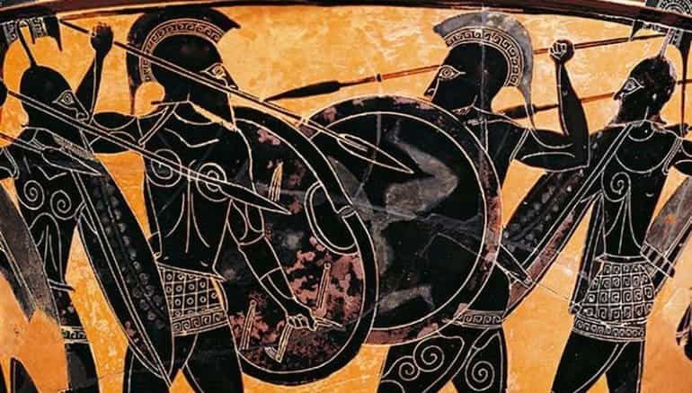
Several life situations and activities in ancient Greece carried the imminent possibility of serious and permanent physical injury, but there were many ways of becoming disabled in Hellas other than hard physical labour: it was war in the first place. In Sparta, a warrior who was seriously injured in battle was held in public esteem and respect
Historical changes in the situation of people with disabilities – Ancient Greece
https://www.realmofhistory.com/2022/06/04/facts-spartan-army-warrior/

Slide 21
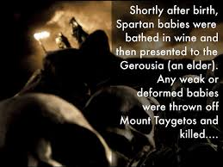
Infamous tradition, the opposite of institutional support for children born with disabilities: “selection” of infants Plato: “... those who... are born crippled shall be put away in an inaccessible, secret place, according to the order and manner of the place” (State 460c) Aristotle did not disapprove this cruel practice, either: “... no freak-born child should be brought up...” (Politics 1335b) The contradiction is resolved by the fact that Greek society of the time did not consider a handicapped infant to be truly human, so the permanent exclusion (i.e. killing) of a handicapped infant from society was not, according to the moral norms of the time, seen as taking a human life (although the killing of “weak” babies at Taygetos seems to be a myth, only – https://www.science.org/content/article/ancient-greeks-didn-t-kill-weak-babies-new-study-argues)
Historical changes in the situation of people with disabilities – Ancient Greece
https://www.haikudeck.com/sparta--business-presentation-9NV1yLoxaA

Slide 22
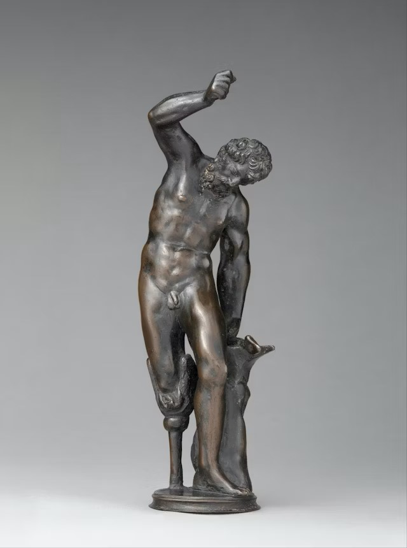
Important aspect of the relationship to disability in Greek culture of the time was that physical disability was almost never automatically associated with an inferior character In fact, there was an unadulterated Greek hero who, despite his severe, congenital physical disability, was a full-fledged citizen of mythology and dazzled both god and man with his smithery: Hephaestus – albeit his disability was the result of (mainly) divine punishment: another example of the seemingly eternal human fascination with the derivation of disability from divine punishment in Greek thought
Historical changes in the situation of people with disabilities – Ancient Greece
https://mythopedia.com/topics/hephaestus

Slide 23
Decimus Iunius Iuvenalis, a satirist widely known in Rome, is the author of the oft-quoted saying: “a sound mind in a sound body”. Although at first reading this may imply that only in a healthy body can the soul be healthy, that is, someone with a physical disability may also have defects of character, in fact there is no evidence to suggest that Roman culture was clearly anti-disabled The original quotation from Iuvenalis also suggests this out of context; if we read the whole of the invocation to the deities, we would not even think that he was speaking against physical disability Although there is also a line from Virgil: “Virtue appears peculiarly graceful when associated with beauty” (Gratior est pulchro veniens a corpore virtus: Aeneid, v. 344), this too is more a praise of beauty and harmony than a sign of the anti-disability attitude of Roman culture
Historical changes in the situation of people with disabilities – Ancient Rome

Slide 24
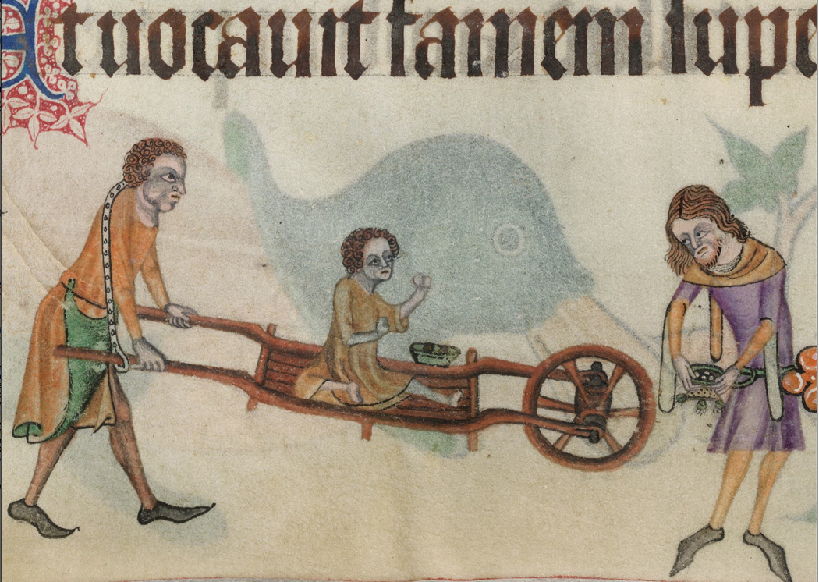
Perhaps the most interesting and exciting period of history in terms of societies’ perceptions of disability is the Middle Ages (although only posterity is likely to find this interesting and exciting, not those who lived with a disability in these centuries) This era being closer to the present, we are likely to have considerably more information about the social perception of people with disabilities than we have from the time of antiquity
Historical changes in the situation of people with disabilities – The Middle Ages
https://www.medieval.eu/disability-middle-ages/

Slide 25
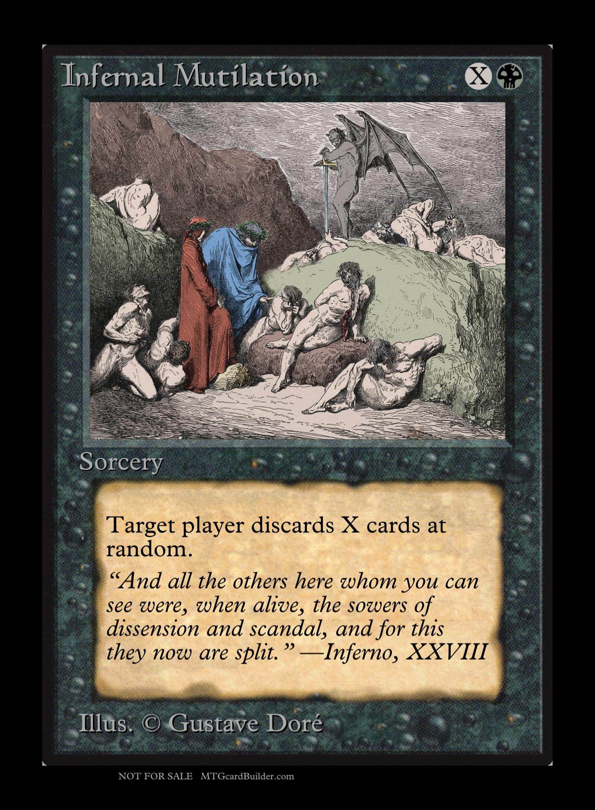
Many of the beliefs mentioned earlier reinforced: people of the age preferred to populate their immediate environment with miraculous creatures, and being born with a disability was no surprise to them Good, beautiful, came from God, so behind not beautiful, or even “deformed”, medieval man suspected evil otherworldly forces or God’s punishment In Dante’s Divine Comedy (excellent exposition of the medieval worldview and thinking): the punishment for a serious lack of character in this world is physical disability, often mutilation, in hell (In antiquity, the Middle Ages, and even in modern times, certain capital sins were often punished by the justice system with mutilation)
Historical changes in the situation of people with disabilities – The Middle Ages
https://www.reddit.com/r/magicTCG/comments/194zuj4/custom_universe_beyond_divine_comedy_doré1861/?rdt=40575

Slide 26
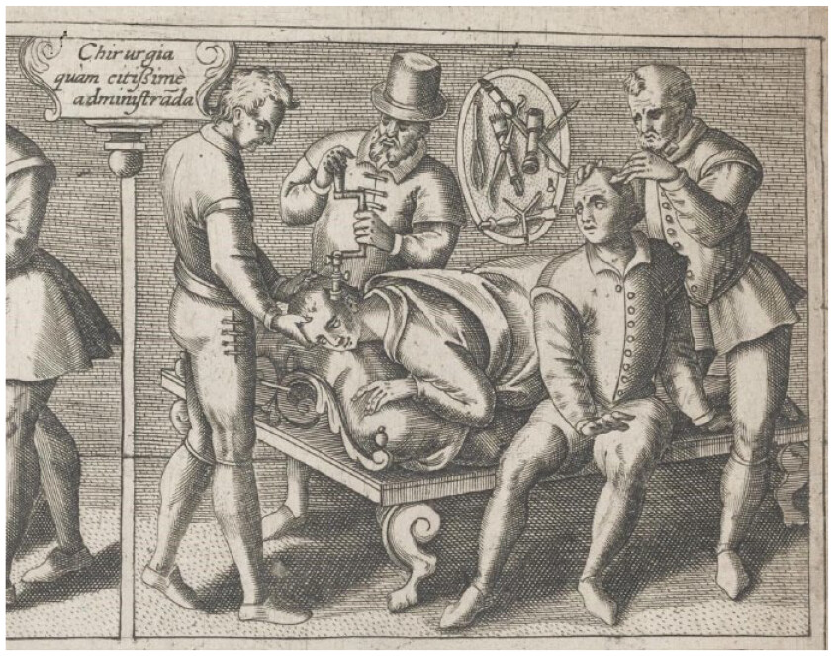
The practices used to “cure” those with disabilities, especially mental ones, seem rather stomach-turning today One of these methods was “trephining” or trepanation, where one would be treated by receiving a hole in their skull (or trephine) so that the evil spirits can leave their head
Historical changes in the situation of people with disabilities – The Middle Ages
https://journals.sagepub.com/doi/full/10.1177/17504589241253486?journalCode=ppja

Slide 27
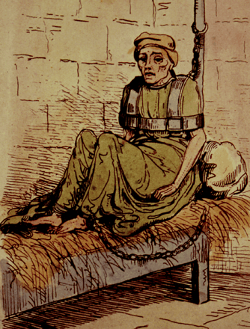
In Early Medieval Ages people still believed that the fluids caused mental illness, so, in order to bring balance back to the body, extracting blood was a common medical treatment, and any form of bleeding was used A unique form of shock treatment in the medieval ages: the mentally ill would be thrown into cold waters so that the shock would “bring them to their senses”, or tied up closely so that they could hardly move
Historical changes in the situation of people with disabilities – The Middle Ages
https://about-history.com/

Slide 28
Negative prejudices against disabled people stemmed partly from society’s perception of disability not in terms of its actual characteristics, but in a highly coloured form, spread by word of mouth After the Industrial Revolution we can already find a specific form of occupational rehabilitation in England: in the 1690s there were manufactories employing people with intellectual disabilities – but the aim was by no means the same as today’s rehabilitation and equal opportunities objectives, and far from being noble, it was more prosaic: to preserve the production secrets of the manufactory
Historical changes in the situation of people with disabilities – The Middle Ages

Slide 29
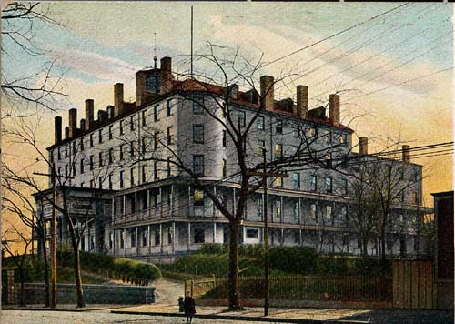
Organised care for mentally handicapped children began in the modern era, mid-1700s: by Jacob Rodrigues Pereire, continued by Jean Marc Gaspard Itard Johann Jacob Guggenbühl founded the first institute, the Abendberg Both Itard and Guggenbühl worked in a very hostile and provocative social climate. The latter consistently educated the “souls” entrusted to his care in a healthy and natural atmosphere The first institute in the Western Hemisphere was founded by Samuel Gridley Howe in Massachusetts: New England Asylum for the Blind (now Perkins School for the Blind)
Historical changes in the situation of people with disabilities – The New Age
New England Asylum for the Blind
https://aphmuseum.org/exhibits/online-exhibit/building-a-future-u-s-residential-schools-for-blind-and-visually-impaired-students/perkins-school-for-the-blind-ma/

Slide 30
Care of the disabled only became a legal obligation with the French Constitution of 1793, Article 21 of which made it a constitutional rule: “Public assistance is a sacred debt. Society owes subsistence to unfortunate citizens, either by obtaining work for them or by providing means of existence to those who are unable to work.” (https://alphahistory.com) These are in fact the two conditions that are still essential for the development of rehabilitation in the modern sense: the disabled person is at the centre of the rehabilitation process; and society must assume constitutional responsibility for disabled citizens
Historical changes in the situation of people with disabilities – The New Age

Slide 31
Core of rehabilitation work was still care, the breakthrough came in the 20th century – brought about by the two World Wars, an unprecedented increase in the number of disabled This led to the establishment of disability cooperative movements, the creation of large care institutions in several countries and the development of group employment in response to the demand, particularly in those countries that had suffered the greatest losses in the war United States and Canada: institutions and financial support for the blind already in the 1910s and 1920s
Historical changes in the situation of people with disabilities – The New Age

Slide 32
First rehabilitation law enacted in the United States in 1919, and the states had a federal rehabilitation programme as early as in the 1920s In the Netherlands the first legislation was enacted in 1919, under which disability pensions were paid in the event of temporary or permanent incapacity, but generally after 52 weeks After the Second World War, in 1945, a centre for the rehabilitation of war-wounded was set up, which later served as a model for the establishment of similar institutions for the care of civilians (In between the World Wars, a process just in the opposite direction was visible in the Third Reich, partly driven by the idea of eugenics)
Historical changes in the situation of people with disabilities – The New Age

Slide 33
The 20th century also brought many positive achievements for people with disabilities: the process of rehabilitation moved from the original focus on care and assistance to one of self-sufficiency, independence, integration and inclusion Two movements worth mentioning here: (1) Independent Living Movement; and (2) The movement for deinstitutionalisation by people with intellectual disabilities and their parents
Historical changes in the situation of people with disabilities in the New Age – the last century

Slide 34
Independent living is the right of people with disabilities to self-determination; a philosophy, approach and practice of living; and an opportunity to live an equivalent life They must first be empowered to want independent living and then they will act to achieve it. The Independent Living Movement is therefore primarily a movement for people with severe disabilities who cannot live without personal assistance The disabled person must have access to correct and complete information in order to be able to make choices and decisions, and to be in a position to buy the services of their choice. It is society’s responsibility to create the conditions for this
Progressive movements for people with disabilities – The Independent Living Movement

Slide 35
Growing civil rights movement of the 1960s → disabled people to assert their rights more fully University of California, Berkeley: four severely disabled young men’s access to buildings and dormitories was almost impossible, so they were accommodated in the university hospital One of them fought against his isolated, foster care situation, he wanted to live independently with personal assistants, on an equal footing with his fellow students Many people joined the fight – tens of thousands of people suffered from exclusionary discrimination, paternalistic care by family and residential institutions across the United States So began the civil rights movement Independent Living Movement across America, later Europe and then the world
Progressive movements for people with disabilities – The Independent Living Movement

Slide 36
Independent Living Centres set up, functions: (1) organising a personal assistance service with public funding; (2) advice and support for fellow citizens; (3) fight for equal rights against discrimination through demonstrations, blockades of buildings, transport, etc.; (4) fight for integrated education, employment, equal pay; (5) organising meetings and forums with city leaders and politicians (Hutchison – Pedlar 1999)
Progressive movements for people with disabilities – The Independent Living Movement

Slide 37
Americans with Disabilities Act (ADA) passed in 1993: people with disabilities are citizens with full rights and discrimination against them because of their disability is against the law Now hundreds of Independent Living Centres in the US and all over the world The movement is about people with disabilities taking control of their lives, making decisions for which they are responsible (they know best what they need and what is best for them – whereas in the past, it was always professionals or family members who made decisions for them, believing that they were not capable of thinking for themselves) Self-determined, independent living means that we decide when, where and from whom we get the personal help that we need because of our disability. We set our own priorities and organise our own lives
Progressive movements for people with disabilities – The Independent Living Movement

Slide 38
Role of society: ensure equal participation in all aspects of life through legislation, guaranteeing the right to housing, health care, assistive devices, personal assistance, mobility, communication, access to information, education, training, employment, political activity, education, etc. Independent living is very often confused with and equated to self-sufficiency, which is the goal of rehabilitation, but is far from being the same as independent living. Independent living for people with disabilities has moved away from the traditional rehabilitation approach, which tries to adapt the person to an environment that is designed for them. The environment must be adapted to the needs of the disabled person (less a matter of money and more a matter of attention)
Progressive movements for people with disabilities – The Independent Living Movement

Slide 39
An Independent Living Centre in the United Kingdom
https://www.lbhf.gov.uk

Slide 40
Movement of people with intellectual disabilities and their parents for deinstitutionalisation means the dismantling of large, closed institutions and the creation of smaller, human-scale, humane living environments that are more conducive to human rights A human rights-based approach to disability is one that emphasises equality and inclusion. It recommends the gradual repeal of laws allowing institutionalisation of people with disabilities, as well as mental health legislation allowing for treatment without consent and detention based on impairment
Progressive movements for people with disabilities – The movement for deinstitutionalisation

Slide 41
“People with disabilities are often assumed to be unable to live independently. This is rooted in widespread misconceptions, including that people with disabilities are not capable of making good independent decisions and that they need institutionalised ‘special care’.” ... “In many cases, cultural and religious beliefs may also fuel this stigma, as well as the historical influence of the eugenics movement. For too long, these arguments have been used to wrongfully deprive people with disabilities of their freedom and to segregate them from the rest of the community by placing them in institutions.” – European Parliament’s Committee on Social Affairs, Health and Sustainable Development
Progressive movements for people with disabilities – The movement for deinstitutionalisation

Slide 42
Transformation of residential institutional services is just one element of a wide range of changes in areas such as health care, rehabilitation, support services, education and employment, and it also has an important role to play in the social perception of disability Simply moving individuals to smaller institutions, community homes or other congregate settings are not sufficient, nor are they consistent with international legal standards
Progressive movements for people with disabilities – The movement for deinstitutionalisation

Slide 43
As a result of the Independent Living Movement and the movement for deinstitutionalisation, new international laws were created and the attitude towards PwD changed fundamentally throughout the modern world, emphasising the responsibility of society as a whole 1973: the United States Congress passed a rehabilitation law that prohibits discrimination against individuals with a qualifying disability 9 December 1975, the United Nations General Assembly adopted the Declaration on the Rights of Persons with Disabilities, which summarises in 13 points the main rights they enjoy (from their right to human dignity, civil and political rights, protection against all forms of exploitation, to the right to live in a family)
Progressive movements for people with disabilities – the prohibition of discrimination

Slide 44
“Year of Disabled Persons” in the early 1980s United Nations adopted the Standard Rules on the Equalization of Opportunities for Persons with Disabilities in the first half of the 1990s Although they do not have binding legal force, adherence to the Standard Rules represents a strong moral and political commitment by governments to ensure equal rights for persons with disabilities. The Standard Rules summarise human rights in a total of 22 points, in four broad chapters covering all aspects of the lives of persons with disabilities: basic conditions for ensuring equal participation; target areas for equal participation; implementation measures; and monitoring tools The basic conditions for ensuring equal participation include awareness-raising, health care, rehabilitation and support services, while the eight target areas for equal participation are accessibility, education, employment, income maintenance and social security, family life and personal integrity, culture, recreation and sport, and religion
Progressive movements for people with disabilities – the prohibition of discrimination

Slide 45
Historical changes in the situation of people with disabilities are reflected in the evolution of disability models. Many theoretical concepts have been presented in the literature (Buhalis & Darcy 2011, Forrester & Davis 2011, Zajadacz, 2015), from ethical, through medical, social and economic to geographical model of disability
Historical changes in the situation of people with disabilities – Evolution of models of disability

Slide 46
In the ethical model (Goffman 1963; Imrie 1997), disability was treated as a stigma (also as a punishment for offenses) In turn, the medical model (Parsons, 1951; Hahn, 1986; Bickenbach, 1993; ICF, 2002, Gaines, 2004) treats disability as functional loss, as a problem within the individual that requires medical intervention or “fixing”. Critiques of this model highlight its tendency to pathologise disability and overlook social and environmental factors (Shakespeare, 2013)
Historical changes in the situation of people with disabilities – Evolution of models of disability

Slide 47
On the back of criticism of the medical model, the social model of disability was developed. It shifts the focus from individual impairments to the barriers created by society that prevent full participation and inclusion of people with disabilities. Disability is seen as a social construct resulting from societal norms, attitudes, and physical or attitudinal barriers. This model emphasises the need for social change and the removal of barriers to enable full inclusion and participation (Oliver, 1990; Barnes & Mercer, 2010)
Historical changes in the situation of people with disabilities – Evolution of models of disability

Slide 48
In turn, the economic model of disability is based on conclusions emerging from the functioning of the medical model and social model. This concept presents disability in the light of diverse needs generating demand on the tourism market (Forrester & Davis, 2011). The needs of people with disabilities and the elderly are perceived in terms of segmentation and personalisation in the tourist services. This model also emphasises that full and equal participation in social life for disabled people equates with the ability to perform socially valued roles, particularly in the field of work (Geue, 2023)
Historical changes in the situation of people with disabilities – Evolution of models of disability

Slide 49
The geographical (geospatial) model of disability applies experience gathered to date (connected to the medical model and social model) and focuses mainly on the interrelation between PwD and geographical space (Zajadacz, 2015). Geographers connect the nature of factors causing disability (disabling nature) both with social and spatial aspects of the human environment, they promote solutions which are more “inclusive”, and which provide access to sites and the full scope of life within society taking different degrees and types of disability into consideration. The geographical model also aims to remove social “tensions” related to the social model which treats disability as a process of social exclusion (Chouinard et al., 2010)
Historical changes in the situation of people with disabilities – Evolution of models of disability

Slide 50
The geographical model of disability assumes that limited ability is caused by both individual conditions (connected to a specific dysfunction) and those of the surrounding physical and social environment creating the restrictions which occur in the PwD – environment (social, physical) relation. The geographical model has accepted a significant paradigm in that it treats needs connected to various types and degrees of disability not as “special” but as one of many which occur in contemporary society. The central postulate is not to concentrate on “disabilities”, but to focus on various social needs and adapt the geographical environment (social, as well as physical) accordingly (Imrie, 2012, Zajadacz, 2014)
Historical changes in the situation of people with disabilities – Evolution of models of disability

Slide 51
Evolution of models of disability: Models of social exclusion, integration and inclusion of people with disabilities

Slide 52
Exclusion refers to the process of actively keeping individuals or groups out of certain social, political, or economic activities, opportunities, or spaces. In practice it means the following: systematic denial of access or participation, lack of accommodation for diverse needs or backgrounds; social, economic, or political marginalisation Integration involves incorporating individuals or groups with diverse backgrounds or characteristics into existing systems, structures, or environments. This process involves (1) focus on assimilating individuals into mainstream settings, (2) limited modifications or accommodations to existing systems, and (3) emphasis on bringing diverse individuals together without necessarily addressing underlying barriers
Evolution of models of disability: Models of social exclusion, integration and inclusion of people with disabilities

Slide 53
Inclusion is a more comprehensive approach that aims to create environments where all individuals, regardless of their backgrounds or characteristics, are valued, respected, and fully participating members of society. Characteristic features of inclusion include (1) emphasis on removing barriers and creating equitable opportunities for all, (2) recognition and celebration of diversity and individual differences, (3) active efforts to ensure that everyone’s needs are met and that all voices are heard. In summary, exclusion involves actively preventing individuals or groups from participation, integration means incorporating diverse individuals into existing systems without necessarily addressing underlying barriers, while inclusion focuses on creating environments that are accessible, equitable, and welcoming to all. Inclusion goes beyond mere presence or assimilation, striving for meaningful participation, belonging, and empowerment for all
Evolution of models of disability: Models of social exclusion, integration and inclusion of people with disabilities

