Slide 1
The development of the innovative educational method of ACCESSIBLE tourism in Central Europe 2022-2-HU01-KA220-HED-000099410

Slide 2
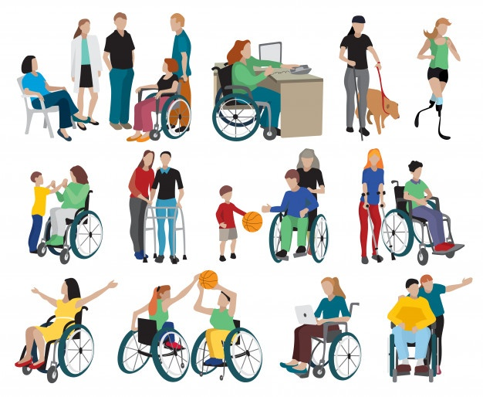
2. Definition and types of disabilities. Characterising the demand for accessible tourism
https://wecapable.com/types-of-disabilities-list/

Slide 3
The concept of disability has preoccupied researchers for decades, with numerous small and large-scale studies being conducted in an attempt to develop a definition that provides a comprehensive, global description of disability (Grövnik, 2009) The problem of developing a single definition comes from the fact that there are three different approaches to the concept: (1) disability as a functional limitation, (2) disability as an administrative definition, and (3) disability as a subjective definition
The concept of disability

Slide 4
(1) disability as a functional limitation: most widespread (2) disability as an administrative definition: legal or administrative definition of disability, which derives from the distribution of welfare benefits, i.e. the group of people in society who are entitled to receive state support for this purpose. It is about individuals who are legally recognised as disabled and who receive various care services and/or benefits (3) disability as a subjective definition: it refers to individuals who perceive themselves as disabled, a kind of voluntarily defined subjective disability Research and statistics show that these approaches result in different figures for the number of people with disabilities, depending on which approach is taken (Grövnik, 2009)
Different approaches to disability

Slide 5
An evolution over the decades As public policy has changed, the meaning behind the term has evolved depending on different social and cultural contexts (Francis – Silvers, 2016) Once a common view: it is for doctors to determine disability – the approach to disability is now a more common and controversial topic, which has changed with the emergence of civil rights protection Today, the most controversial issue is no longer who counts as disabled, but whether or not persons limited in some way in their ability to exercise their rights are able to do so, and whether or not fair access is provided to these persons
The changing meaning of disability

Slide 6
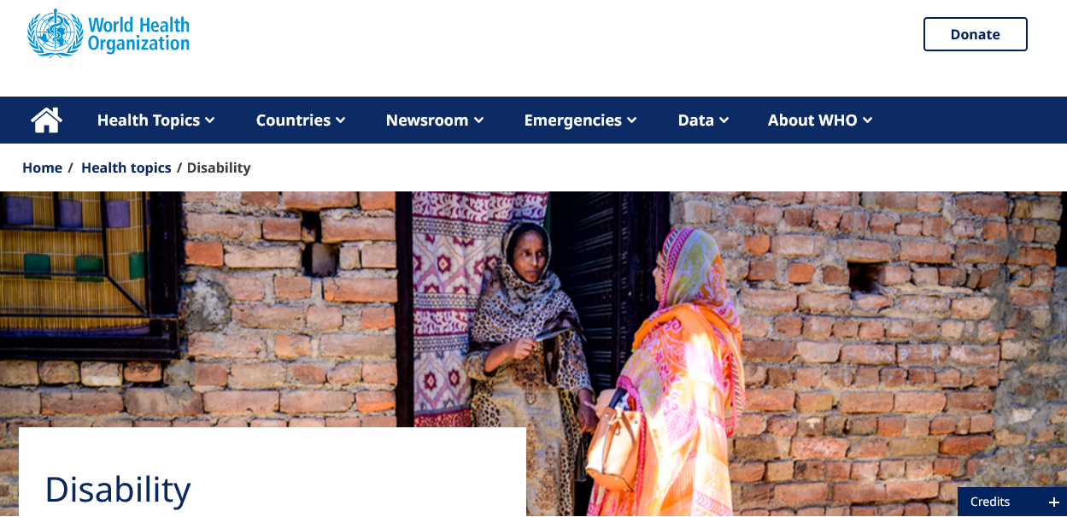
According to the World Health Organization, ‘disability’ is an umbrella term used to describe and identify impairments resulting from illness and injury, physical as well as mental or emotional functional limitations/disabilities. The WHO definition distinguishes three concepts, differing in level and content: impairment, disability and handicap
The definition of disability by the WHO
https://www.who.int/health-topics/disability#tab=tab_1

Slide 7
Impairment refers to any abnormality or deficiency in the psychological or physiological structure or role of a person (health impairment) Disability refers to a person’s reduced ability to do certain activities: transport, self-care, work, learning, etc. Handicap: a social disadvantage resulting from an impairment or disability that limits or hinders an individual’s daily life. Disadvantage is in fact the socialisation of the impairment or disability
The definition of disability by the WHO

Slide 8
Several descriptive models of disability since the 1970s Medical approaches were followed the social model of disability, which strongly criticises the medical model, considering it outdated and oppressive (Beaudry, 2016) According to the latter model, environmental factors contributing to disability should also be taken into account Social model of disability formulated by scientists distinguishes between social exclusion resulting from disability and impairment resulting from physical limitation. Disability is now defined not only in functional terms but also in terms of the limitation of activity caused by a social factor. In this approach, the focus is not on physical disability but on participation in activities (Shakespeare, 2010)
Descriptive models of disability

Slide 9
Depending on the perspective taken: - the naturalistic view sees disability as a biological trait - constructivist view sees disability as a partially socially constructed phenomenon In addition, there is a new concept in the literature, the concept of marginalised functioning (Jenkins & Webster, 2021): it refers to the relationship between the physical abilities of an individual and their social (mental) world. This concept aims to combine physical and psychological factors when talking about disability
Present two existing views on physical disability

Slide 10
Medical perspective (end of the 19th century): disability is linked to ill-health, in this period abnormal biological functioning is linked to disability
Definitions of disability in historical context
Fawcett Memorial, Vauxhall Park, Vauxhall, Henry Fawcett (1833-1884) was a blind academic, statesman and postmaster-general who campaigned for public open spaces. The statue shown here was demolished in the early 1960s
https://historicengland.org.uk/research/inclusive-heritage/disability-history/1832-1914/

Slide 11
The pre-civil rights perspective (early to mid-20th century): the general view of disability as a functional disability emerged, and it was then collectively addressed in policy Discrimination during this period, with the result that some people with disabilities were excluded from access to common services In fact, statutory support schemes were introduced for them, based on medical diagnoses for individuals. The judgements were not always uniform, leading to disagreements, e.g. about whether or not someone was fit for work
Definitions of disability in historical context

Slide 12
Civil rights perspective (second half of the 20th century): exclusion and discrimination of this group recognised Efforts made to give people with disabilities equal access to public buildings, public transport and education. Civil rights legislation to end discrimination against people with disabilities and to ensure accessibility in all areas. Underpinning these efforts is the view that disability disadvantage is to some extent not a biological deficiency but a social discrimination
Definitions of disability in historical context

Slide 13
Ethical perspective: this aspect refers to the fact that disability has different meanings in different contexts, its extent also varies according to the context, and this often creates ethical difficulties (e.g., in cases where employment is involved and the individual concerned would like to work) The question concerns whether the individual (regardless of the existence or severity of the disability) has been subjected to disability discrimination and whether his or her right to fair social opportunities has been violated
Definitions of disability in historical context

Slide 14
Adopted in 2006, binding on EU Member States, part of the EU legal order According to the UN Convention on the Rights of Persons with Disabilities, a person with a disability is any person who has a long-term physical, mental, intellectual or sensory impairment which, together with a number of other barriers, may limit that person’s full, effective and equal participation in society. The Convention aims to ensure that persons with disabilities have the same right as all other persons to the enjoyment of the highest attainable standard of health
Definition by the UN Convention on the Rights of Persons with Disabilities

Slide 15
Disability has many different approaches and forms; in many cases the term is not clearly defined, because by disability we do not only mean mobility impairment, visual impairment, hearing impairment, developmental disability, intellectual disability, learning disability or disability related to a long-term health condition – people can also have invisible disabilities such as allergies, or we should mention the elderly
Definitions of disability – closing remarks

Slide 16
The elderly are more vulnerable to developing some form of disability in old age due to their age (Zsarnóczky, 2018) According to the European Commission (EC, 2010), more than one third of people aged 75 and over are affected by a disability that limits them to some extent, and this proportion is expected to increase as the EU population ages. This is why the European Commission’s Disability Strategy sets out the goal of enabling people with disabilities to enjoy their rights and participate in society – to be achieved through the following priorities: accessibility, participation, equality, employment, education and training, social protection, health and external action
Definitions of disability – closing remarks

Slide 17
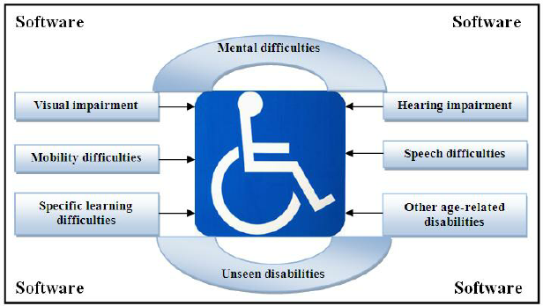
There are many different approaches to the concept of disability, and its meaning has changed over time. The following standard definition can be adopted as a valid definition for our purpose: disability refers to a physical or mental condition that refers to some kind of physical or mental impairment of an individual, and as a result, the individual faces barriers in their daily life (Zsarnóczky, 2017)
Definitions of disability – closing remarks
https://www.researchgate.net/publication/264422652_Disability-Aware_Software_Engineering_for_Improved_System_Accessibility_and_Usability/figures?lo=1

Slide 18
Not a simple task: there are several different categorisations based on the perspective used to group these individuals. If a medical diagnosis is used, then a statistical data set calculated in the current situation must take into account the fact that at any time a disability may potentially develop for some individuals, so there may be situations where this classification is not valid for the time being, but may occur in the future Disability is not a condition but a process, which may be progressive, static or intermittent Disability can arise in different situations and stages of life: at birth, in childhood or adulthood, in relation to an injury, or as a result of genetic conditions
Classification of people with disabilities – preliminary thoughts

Slide 19
Most common and familiar classification: four basic types of disability – physical, intellectual, mental and sensory (not necessarily coinciding with groupings found in the literature) (1) A physical disability is a condition affecting a part of a person’s body that impairs or limits physical functioning or mobility (caused by genetics, disease or injury): people with mobility impairments (2) People with intellectual disabilities have difficulties with self-care, safety, communication and social interaction. Causes can be genetics, illness, injury. It includes e.g. deficits in speech and language skills (3) Mental disability: disorders of thought, emotion and behaviour. It may be caused mainly by brain injury or abnormal neurological development. It can include bipolar disorder, depression, schizophrenia and bulimia (4) A sensory disability affects a person’s hearing, sight, touch, smell or taste. This includes autism spectrum disorder, blindness and hearing loss
Classification of people with disabilities – approaches

Slide 20
Another approach with four main categories of disability: visually impaired, hearing impaired, mobility impaired and cognitively impaired (Crow, 2008) (1) Visual impairment – three types: total blindness, low vision and colour blindness (2) People with hearing loss may have a reduced ability to hear certain frequencies (pitches) and may have hearing difficulties (3) People with motor impairments are people with physical or locomotor disabilities who face a range of difficulties in carrying out their activities, depending on the severity and type of impairment. A wide range of conditions is associated with motor disabilities, e.g., some people in this group have limited use of their hands, others have no use of their hands at all (4) For people with cognitive impairments, memory, perception, problem solving and conceptualisation can be challenging – autism, brain injury, epilepsy, mental or neurological impairments
Classification of people with disabilities – approaches

Slide 21
Disability is a condition or function in which an individual is at a significant disadvantage compared to his or her normal level of functioning The term refers to individual functioning, including physical impairment, sensory impairment, cognitive impairment, intellectual impairment, mental impairment and various types of chronic illness. A disability may affect organs or parts of the body, but it may also affect a person’s participation in different aspects of his or her life
Classification of people with disabilities – WHO

Slide 22
2001: WHO published the International Classification of Functioning, Disability and Health (ICF). Primary aim: a useful tool for describing the health status of the population and for international use. Intended to be a standardised common framework to enable communication about health and health care across different disciplines around the world ICF is a systematic grouping of people with different health conditions, distinguishing between the concepts of functionality and disability (1) Functionality: umbrella term including all bodily functions, activities and participation (2) Disability: also an umbrella term that refers to impairments, activity limitations or participation restrictions ICF is not just about people with disabilities: a universal classification of health-related conditions
Classification of people with disabilities – WHO

Slide 23
2 defining parts: functional ability and disability (1) and contextual (environmental) factors (2). The latter refers to the whole context of an individual’s life, factors that may affect the health status of the individual. The classification further divides the two main categories into two subdivisions (ICF, 2001)
Classification of people with disabilities – WHO
(1). Functional ability and disability
(a) Functions and structures of the body
(b) Activities and participation
(2). Contextual (environmental) factors
(c) Environmental factors
(d) Personal factors
Source: by the authors, based on ICF, 2001

Slide 24
(a) Body function: physiological (including psychological) functions of the body systems; structures: anatomical parts of the body (such as organs, limbs and their components). In both cases, the damage (deviation/loss) is significant (b) Activities and participation: an individual cannot participate in or perform an activity (c) Environmental factors: physical, social and attitudinal factors in which people live. Generally external factors, independent of individuals. They can have positive or negative effects on an individual’s health (d) Personal factors: specific background of the individual’s lifestyle referring to characteristics that are not necessarily part of the health status assessment: fitness, lifestyle, habits, upbringing, education, etc. These factors may play a role at any level of disability
Classification of people with disabilities – WHO

Slide 25
It codes individuals in terms of their health status so that problem solving and interventions are not just for the individual but have an impact on society and the attitudinal behaviour of society Any intervention programme created for these groups can be used to assess whether the programme has been effective. Implications of using the ICF in intervention can be as follows (Bornman, 2004): (1) by highlighting the strengths of people with disabilities, it focuses on their participation in their specific social environment, helping them to interact with others (2) it contributes to wider participation through targeted programmes for members of a society (3) it focuses on environmental factors to promote awareness, social inclusion and improve attitudes towards disability
The benefits of WHO’s ICF classification

Slide 26
Two types of orientation towards disability: ‘cultural majority’ orientation and minority or ‘subcultural’ orientation (Darling, 2003) The ‘cultural majority’ orientation refers to the acceptance of and/or access to generally accepted norms of appearance and ability on the part of the individual Minority or ‘subcultural’ orientation is based on the value of diversity on the part of people with disabilities, i.e. it implies acceptance that alternative norms (special cases) exist alongside majority norms. In this form of orientation, an individual may choose to reject mainstream norms and prioritise their disability identity
Identity consciousness of people with disabilities in the literature, typology

Slide 27
Based on the two orientations above, Darling (2003) defined a typology of identity consciousness of people with disabilities, which may change over time (people may go through these processes), but basically fall into one or the other category at a given time, as they place themselves in society, as they orient themselves, as they inform themselves in society
Identity consciousness of people with disabilities in the literature, typology

Slide 28
By the Danish author Bank-Mikkelsen, who in 1969 stated “...to enable people with intellectual disabilities to achieve an existence which is as close as possible to normal living conditions” (Disability Studies Glossary, 2009) This has given rise to an overarching theoretical concept that disability should increasingly be seen as a normal form of human life. In addition, the so-called “affirmation model” has emerged in the literature, according to which disability should be seen as part of a positive social process (Darling, 2003)
Identity consciousness of people with disabilities – the concept of normalisation

Slide 29
Darling (2003) distinguishes the following categories in which an individual with a disability can be classified based on their identification with each type: normalisers; crusaders; affirmers; situational identifiers; rejectors; apathetic; isolated reinforcers
Identity consciousness of people with disabilities in the literature, typology

Slide 30
Normalisers: people who accept the norms of the majority society and more or less succeed in developing a way of life in which the majority society lives. They are those whose disability is usually not very visible; they may even choose to present themselves as “normal” Crusaders: those who accept the norms of the cultural majority but do not have access to a normalised way of life. Therefore, they become involved in the disability subculture, primarily for self-advocacy and social change
Darling’s categories of the disabled based on their self-identification

Slide 31
Affirmers: individuals who identify with the disability subculture in order to achieve their goals. In contrast to the previous category, their identification is strong, they see their disability as their own, their primary identity Situational identifiers: individuals who are able to maintain multiple identities at the same time, depending on which one suits them. Sometimes they accept the majority norms, other times they accept the subculture
Darling’s categories of the disabled based on their self-identification

Slide 32
Rejectors: people who desire normalisation but cannot achieve it, but who also lack access to a disability subculture. They may be illiterate or live in poverty or isolated areas. Such individuals are more likely to be exposed to the norms of the majority culture Apathetic: individuals who remain apathetic or completely uninformed. Individuals who suffer from a serious mental illness or learning disability are most likely to be included Isolated reinforcers: people who have no access to the disability subculture. As soon as they become aware of it, they are likely to join the disability subculture
Darling’s categories of the disabled based on their self-identification

Slide 33
There are several different classifications of people with disabilities People with disabilities do not form a large homogeneous group; they are individuals with a variety of unique characteristics (Zsarnóczky, 2017) There are many types of disability and many consequences for the socialisation of individuals in society Very important to have a positive social attitude and to apply policies appropriately in order to improve the situation and living conditions of people with disabilities in society Many different subgroups can be defined: the terms used should not be stigmatising or discriminatory, but should encourage educational, health and social policy efforts appropriate to the condition
Classification of people with disabilities – closing remarks

Slide 34
Given that the focus of this course is on the participation of people with disabilities in tourism, the specific target groups of accessible tourism should be considered It is important to note from the perspective of accessible tourism that the following 4 basic categories (disabilities) are distinguished for the participation of disabled individuals in tourism: (1) sensory (visual, hearing), (2) communication (speech-related impairments), (3) physical (mobility, temporary disability, age-related disability) and (4) intellectual (or psychosocial) In addition to these 4 basic categories, there is also a so-called multiple disability
Classification of people with disabilities – closing remarks

