Slide 1
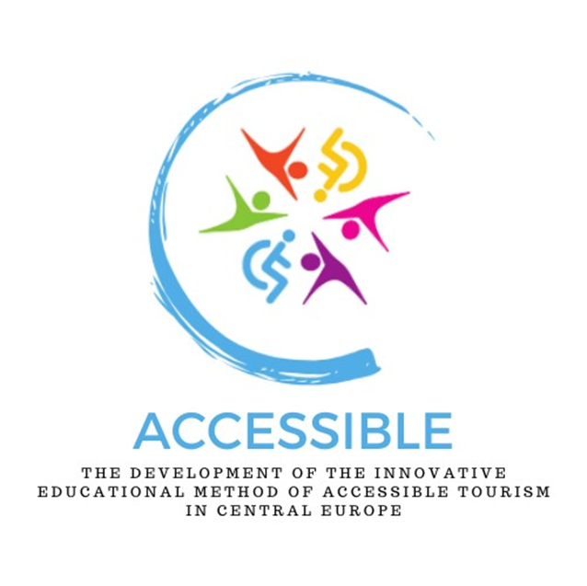
The development of the innovative educational method of ACCESSIBLE tourism in Central Europe 2022-2-HU01-KA220-HED-000099410

Slide 2
1. The theoretical basis of equal access and tourism. The significance of accessible tourism

Slide 3
“Aiming to promote responsible, sustainable and universally accessible tourism in the framework of the right of all persons to use their free time for leisure pursuits or travel with respect for the choices of society of all peoples” (Global Code of Ethics for Tourism, UNWTO, 1999) “…affirm the right to tourism and the freedom of tourist movements, state our wish to promote an equitable, responsible and sustainable world tourism order, whose benefits will be shared by all sectors of society in the context of an open and liberalized international economy, and solemnly adopt to these ends the principles of the Global Code of Ethics for Tourism” (Global Code of Ethics for Tourism, UNWTO, 1999
Preliminary thoughts
Everyone, regardless of their physical, sensory, or cognitive capacities, should be given the opportunity to travel!

Slide 4
The tourism industry has failed so far to adequately meet the requirements of people with disabilities for an excessively long period of time – a large part of the population is unable to fully participate in or enjoy the activities offered by the industry Researchers, educators, and professionals working in the tourism sector are encouraged to critically investigate ways in which tourism might be made more accessible, inclusive, and ultimately more fulfilling for all individuals as a result of this divide
Preliminary thoughts

Slide 5
Equitable access in tourism is to guarantee that the pleasure of travelling and discovering is accessible to all, without exception Inclusive tourism seeks to incorporate individuals who have traditionally been marginalised or excluded from participating in tourism: by acknowledging and rectifying these exclusions, the tourism sector may actively contribute to a wider social integration Many stakeholders in the sector are already committed to initiatives aimed at adapting tourism services to different consumer profiles to support the principle of ‘Tourism for All’ in order to ensure equal access. It is now becoming increasingly clear that the benefits of accessibility are not only for people with disabilities but for the whole population
The importance of equal access in tourism

Slide 6
Accessible tourism is a significant economic opportunity by targeting demographic categories now generally neglected, such as seniors and individuals with disabilities. Providing accessibility can greatly improve the visitor experience, appealing to a wider range of people and resulting in higher economic benefits Accessibility is now widely acknowledged by the industry as a fundamental component of the market, rather than a specialised niche, and is seen to have significant potential for growth From an economic standpoint, accessible tourism plays a crucial role in boosting national income, particularly within the framework of European economic cooperation, with unrestricted mobility and accessibility. Adopting accessible tourism methods not only promotes economic development but also cultivates a more inclusive society
The importance of equal access in tourism

Slide 7
The concept of ‘Tourism for All’, first seen in the ‘Tourism for All’ campaign in the UK in 1989 (Baker, 1989), was defined as follows: ‘That form of tourism that plans, designs and develops leisure and free time tourist activities that can be enjoyed by all types of persons no matter their physical, social or cultural conditions.’ ‘Tourism for All’ - is a concept that applies to the whole population and includes not only accessibility aspects but also other aspects of tourism such as social tourism. The latter focuses on the possibility of involving population groups with different economic and social characteristics as factors in the integration of tourism; - promotes universal accessibility in the tourism industry, with its roots in ethical principles. It goes beyond simply removing physical obstacles to improve the overall tourist experience for all individuals, regardless of their physical ability. Also, adopting an inclusive approach in tourism is not just a matter of human rights, but also a strategic measure that improves the quality of tourist sites and benefits the entire tourism ecosystem
What does accessible tourism mean?

Slide 8
Social tourism takes a broader view of its potential beneficiaries, as it aims to combat inequalities and the exclusion of people from different cultural backgrounds, those with less financial resources or those living in disadvantaged regions The link between the two concepts is obvious, as people with disabilities are in many cases also considered to be financially disadvantaged
Links between social tourism and accessible tourism

Slide 9
Travel experience for those with impairments is often hindered by - inconsistencies in accessible information; and - fragmented and inadequate service provisions It is crucial to have accurate information and uninterrupted accessible systems that empower individuals with disabilities to travel with assurance and completely relish their experiences. To overcome these obstacles, it is necessary to have a cohesive strategy that involves all relevant parties within the tourism sector (state, NGOs, service providers etc.)
Obstacles to achieving completely accessible tourism

Slide 10
Article 3 “1. The fundamental aim of the Organization shall be the promotion and development of tourism with a view to contributing to economic development, international understanding, peace, prosperity, and universal respect for, and observance of, human rights and fundamental freedoms for all without distinction as to race, sex, language or religion. The Organization shall take all appropriate action to attain this objective.”
Accessibility in the statutes of the World Tourism Organization

Slide 11
Article 7 (Right to tourism): the Code makes specific reference to persons with disabilities: (1) the universal right to tourism should be seen as a consequence of the right to rest and leisure as enshrined in Article 24 of the Universal Declaration of Human Rights; (2) social tourism should be developed with the support of the public authorities (as people with disabilities are a significantly higher proportion of the socially disadvantaged, even financially deprived group, this is particularly important for them); (3) family, youth and student tourism, as well as tourism for the elderly and people with disabilities, should be encouraged and facilitated
Accessibility in the Global Code of Ethics for Tourism

Slide 12
Universal accessibility is still a goal to be reached: there is a need to change mindsets and models for the delivery of tourism services (to respect the human rights of people with disabilities and their families, and also to meet a significant market need that can increase the competitiveness and growth of tourism destinations and businesses) Tourism is a defining social phenomenon of our time: it can no longer be seen as an economic sector, only, but as an integral part of human life and a factor that has a significant impact on everyday life Tourism is a source of wellbeing and subjective happiness, a means of personal fulfilment and self-fulfilment: it is unacceptable that certain social groups are excluded from it because of some kind of disability Although people with disabilities are nowadays increasingly involved in tourism activities, there are still barriers that hinder access to tourism services
Need for better accessibility in tourism

Slide 13
Accessibility is not only a requirement for people with disabilities, as they are not the only beneficiaries Tourist destinations that address these requirements and see accessibility as a positive measure can gain a competitive advantage over other destinations These destinations will find that their product and service offerings evolve to facilitate the tourist experience, promote better access to services and improve the quality of life for all their residents and visitors
Need for better accessibility in tourism

Slide 14
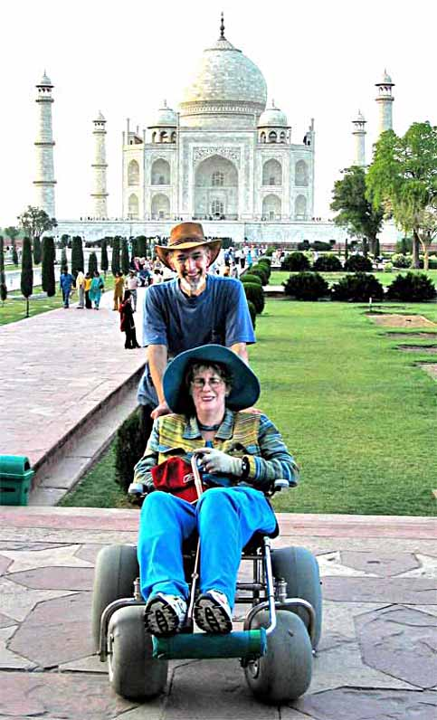
Tourism is no longer simply an economic sector, a service sector with a specific offer, but a social phenomenon that affects the daily lives of people in society, has a significant impact on their quality of life and is closely linked to their standard of living and well-being Tourism is an exceptional means of strengthening new personal relationships and fostering ties of family and relatives For the majority of people tourism is an activity bringing happiness
Why accessibility in tourism really matters
http://www.disabledtravelersguide.com/

Slide 15
In modern and civilised societies direct or indirect discrimination against any minority (race, ethnicity, religion, age, language, gender, sexual orientation) in any area of life is prohibited, including the right to travel and the prohibition of discrimination in tourism At the level of declarations, accessibility is no longer an issue, but reality is different A paradigm shift has taken place since the 1990s, thanks (also) to the focus on human rights. This change of approach is based on the idea that people with disabilities should not be hidden or excluded from others but should be given the same opportunities as able-bodied people, thus promoting social inclusion This trend signifies a forthcoming period in which tourism is genuinely accessible to all, in line with wider social and economic objectives of inclusiveness and fairness
Are “advanced” countries fully accessible?

Slide 16
Accessible tourism involves intentional and coordinated actions to remove physical, informational, and attitudinal barriers, providing equal opportunities for everyone, particularly those with disabilities, to engage in tourism and lead a satisfying life. This concept extends further than just physical access and includes a holistic approach to guaranteeing the involvement of all travellers, regardless of their physical or sensory restrictions Implementing accessible or barrier-free tourism is filled with difficulties: inadequate infrastructure that does not meet various requirements; subpar service quality; and the widespread lack of surroundings that adequately accommodate the accessibility demands of individuals with disabilities
The concept of accessible tourism and the difficulties in defining the topic

Slide 17
The difficulties are frequently worsened by insufficient legal frameworks and a lack of agreement on what is efficient and all-encompassing accessibility. Broadening the term barrier-free or accessible tourism we also need to deal with inclusive tourism which aims to eliminate the inherent exclusivity traditionally associated with the tourism industry The objective is to integrate marginalised or excluded people into the tourism sector in a manner that is advantageous and uplifting. This approach not only improves the travel experience for these groups, but also strengthens the social structure of tourist locations by promoting increased cultural interchange and understanding
The concept of accessible tourism and the difficulties in defining the topic

Slide 18
Most people take living without barriers for granted, but in fact, some 10% of the European population has a disability. In developed countries, accessibility is also receiving increasing attention in the organisation of tourism supply, partly out of humanity and partly in recognition of the significant business potential In the most general terms, accessible tourism is tourism that is equally accessible to all, including people with disabilities, people with temporary disabilities, older people, people with young children and multi-generational families. So, the main areas of analysis of equal access are the same as the main topics of the supply side of tourism: accommodation; hospitality; tourist attractions; transport; communication. Of these, it is perhaps the accessibility of attractions that is most addressed in the literature, probably in the context of the fact that a significant proportion of attractions are public facilities owned by the state (and making them accessible is often problematic)
The concept of accessible tourism and the difficulties in defining the topic

Slide 19
Defining the target group for accessible tourism is also problematic. In many cases, the public does not even include in the target group those who, due to their special situation, are members of the target group for a shorter or longer period of time, only: e.g. pregnant women, people with temporary disabilities undergoing surgery, or the elderly The proportion of the elderly in the overall population is also steadily increasing and many forms of accessibility are an essential need for them. Many therefore live with a permanent or temporary disability which can be a barrier to their lives and a barrier to their journeys. In fact, accessible tourism is a continuous effort to make all destinations, tourist products and services accessible to all people, regardless of their physical limitations, disabilities or age, and whether they are private or public tourist sites (United Nations – Promoting Accessible Tourism for All)
The concept of accessible tourism and the difficulties in defining the topic

Slide 20
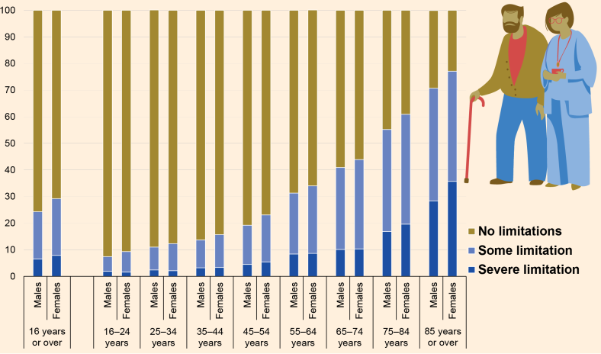
Proportions of disabled people in different age groups
Source: Eurostat

Slide 21
Still no internationally accepted and agreed definition of “accessible tourism”: the concept itself has evolved considerably over the last ten years. Two factors make it difficult to adopt a single, common definition: (1) Research of accessible tourism and the evolution of the concept over time has led to a number of synonyms for accessible tourism in different countries without a common concept being agreed (e.g. inclusive tourism, accessible tourism, adapted tourism, tourism for all, barrier-free tourism, accessible tourism and universal tourism); (2) Since tourism has been linked to the concept of accessibility, there have been many attempts to define the term concretely, but no agreement on a single definition has been reached, despite the increasing prominence of the concept. All experts on the subject have different definitions, no international consensus on a definition satisfying all stakeholders
Difficulties in defining the topic

Slide 22
‘A series of activities performed during free time devoted to tourism by people with restricted capacities that makes their full functional and psychological integration possible and so full individual and social satisfaction is obtained.’ (Lawrence et al. 1996) ‘A process of enabling people with disabilities and seniors to function independently and with equity and dignity through the delivery of Universal Tourism products, services and environments.’ (Darcy, 2006)
Accessible tourism – two examples of early definitions
definition includes mobility, visual, auditory and cognitive dimensions of accessibility

Slide 23
In the background to the term: there was an initial conceptual idea of integrating people with disabilities into tourism by removing existing barriers. There was an aspiration for accessibility along the whole tourism value chain (travel, host area and tourism services). Following the United Nations Convention on the Rights of Persons with Disabilities (UNCRPD, 2006), a paradigm shift has taken place, and a more positive approach adopted, focusing on accessibility as a measure to create an accessible environment for all, regardless of the abilities of individuals. The new concept of accessible tourism is no longer applied only and exclusively to tourists with disabilities, but rather to the adaptation or re-design of the tourist environment to make it accessible to all groups of the population
“Barrier-free tourism”

Slide 24
The current trend is to integrate the concept of accessible tourism with the overall idea of universal design, adding other, more global aspects (Darcy et al., 2010), such as: - Expanding the range of stakeholders (population); - The relationship between disability and older people; - Accessibility as a useful factor for as many people as possible; - Universal design or design for all as a means of achieving accessibility
Universal design

Slide 25
Universal design – a brief outline
Source: A Blueprint for the Development of a Successful Accessible Tourism Strategy. http://travability.travel/Submissions/a-blueprint-for-accessible-tourism.html

Slide 26
‘Accessible Tourism is tourism and travel that is accessible to all people, with disabilities or not, including those with mobility, hearing, sight, cognitive, or intellectual and psychosocial disabilities, older persons and those with temporary disabilities.’ (Economic and Social Commission for Asia and the Pacific, 2009)
New, more comprehensive definitions of accessible tourism
https://www.greenpolicyplatform.org/

Slide 27
‘Accessible tourism is the ongoing endeavour to ensure tourist destinations, products and services are accessible to all people, regardless of their physical limitations, disabilities or age. It encompasses publicly and privately owned tourist locations. The improvements not only benefit those with permanent physical disabilities, but also parents with small children, elderly travellers, people with temporary injuries such as a broken leg, as well as their travel companions.’ (Miller et al., 2010)
New, more comprehensive definitions of accessible tourism

Slide 28
One of the definitions used in recent academic publications on the subject, including all the concepts previously described: accessible tourism is a form of tourism that involves strategically designed collaborative processes between stakeholders that ‘enable people with access requirements, including mobility, vision, hearing and cognitive dimensions of access, to function independently and with equity and dignity through the delivery of universally designed tourism products, services and environments’ (Darcy & Dickson, 2009)
New, more comprehensive definitions of accessible tourism

Slide 29
The benefits of accessibility in tourism are evident to all people throughout their lives: people with permanent and temporary disabilities, people with specific health problems, the elderly and families with young children (Buhalis & Darcy, 2011) The concept of accessible tourism has evolved from the idea of accommodation or adaptation to accommodate people with disabilities in tourism to the concept of quality tourism for all, with the understanding that accessibility is an important part of this quality. It is likely that new definitions will continue to emerge, as tourism is not an exact science but rather a constantly evolving and growing phenomenon, influenced by a range of political, socio-economic, cultural and environmental factors
(Further) progress of the definitions of accessible tourism

Slide 30
Can be almost anyone, temporarily or for life More than 1 billion people, and this number is expected to grow: due mainly to ageing and other health factors (Darcy, 2002; Yau et al., 2004) Majority of older people, although they have some limitations and require accessibility, do not consider themselves as disabled. However, the specific needs of older people should be given special attention when considering accessible tourism. Research has shown that there is a very strong correlation between ageing and disability (WHO 2007) Mann et al. (2005) also argue that older people with some form of disability may not necessarily become disabled if they can find ways to adapt to this impairment. In most cases, however, the majority of these older people are unable to compensate for their disability and thus become disabled. The link between disability and ageing is clear and supported by statistical data as well
The target group for accessible tourism

Slide 31
Senior travellers (“young senior tourists – between age 55-54” and “senior tourists – aged more than 65”, MTÜ, 2017) are more likely to have much more leisure time and less seasonal travel, so they can be motivated to travel during off-peak periods, outside school holidays, thus reducing the problem of seasonality in sensitive destinations The ageing population in developed countries poses a new challenge not only for the health system but also for tourism and recreation. Many hotels and travel agencies are looking at the prospects of attracting a growing number of older people and have started to create special products for this new target group, the “senior tourists”, such as special tours for over-65s (UNWTO, 2016)
Senior travellers: opportunities and challenges in tourism

Slide 32
Important to identify new demographic challenges and the changing social structure: tourism industry must respond to the demographic challenge of an ageing population with new types of tourism and new service technologies At the same time, development of tourism services for older people is hampered by social prejudices (seniors are seen as an insolvent demand, with no special needs and often perceived as survivors) However, there are examples of companies that have adopted strategies to increase supply for older people. This is the so-called “3G” holiday mode, a holiday for 3 generations (children + parents + grandparents) together. In the US, children and grandchildren are increasingly going on holiday with grandparents. Hotels and holiday complexes are developing multifunctional guest apartments for extended families due to the longer length of stay (30-60 days) and the interests and needs of different generations (Farkas et al., 2023)
Senior travellers: opportunities and challenges in tourism

Slide 33
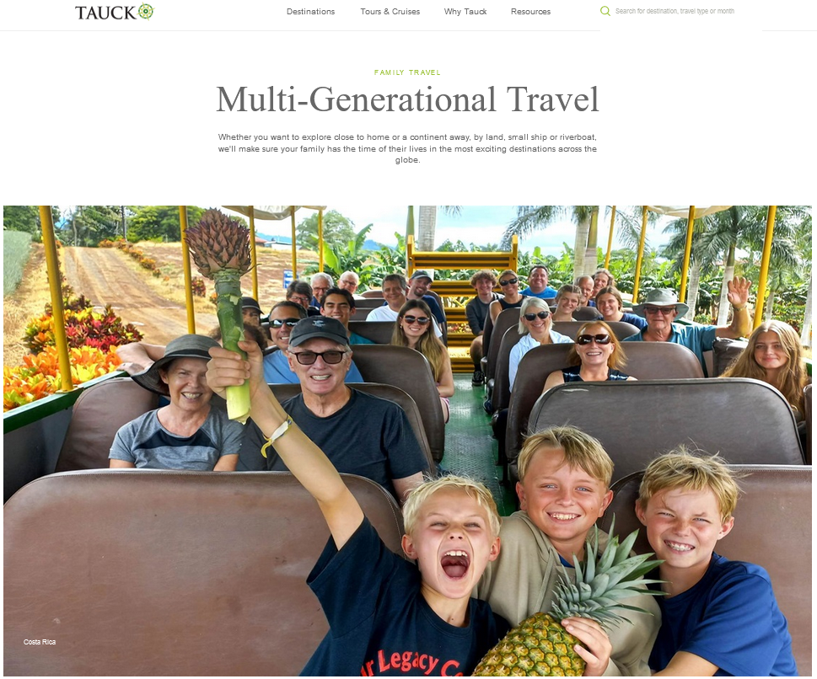
“Why Tauck Bridges? Tauck Bridges is a travel company, built for and by families who want to experience the world together. Our trips are tailor made for travelers age 8 to 88+ and feature guided adventures and activities that bridge generations, cultures and communities wherever we travel. With Tauck Bridges, family fun is key. Ease of travel is a must. And shared memories and friendships are all-important. So that families like yours make the most of your time together, we manage the day-to-day details for you and include everything you need for an unforgettable family vacation in one upfront price, without the worries or the work. All of which promises priceless peace of mind – and then some.”
https://www.tauck.co.uk/guest-travel/multi-generational-travel

Slide 34
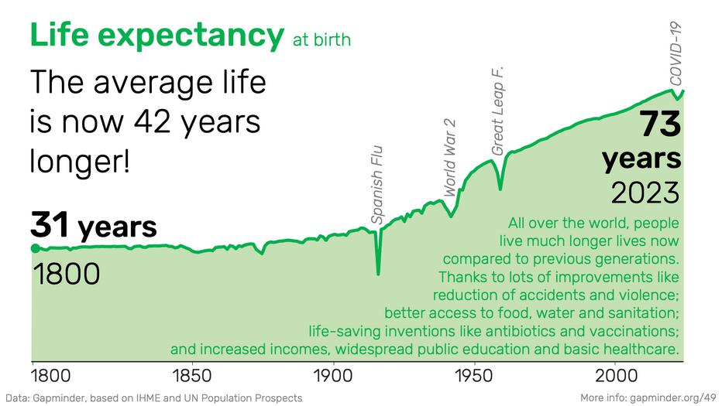
Aging of societies
Special needs in older age are common to almost everyone, but there are also many other life situations that may give rise to special needs: e.g. people undergoing rehabilitation after an accident; or families with young children (Darcy – Dickson, 2009)
https://www.gapminder.org/facts/life-expectancy-increased/

Slide 35
Fortunately, now it is accepted that it is our human, ethical, moral and legal duty to facilitate travel for people with disabilities and to provide the necessary physical conditions The fact that tourism for people with disabilities is also an important economic issue cannot be neglected, as they are currently a largely unexploited niche segment of the tourism market Technological advancements are also crucial in promoting accessible tourism (virtual reality and augmented reality can replicate vacation experiences, thereby enhancing accessibility and reducing the challenges faced by those with impairments in tourism). Also, technology enables the development of tailored tourist profiles, which can assist service providers in meeting individual requirements more efficiently (McKercher & Darcy, 2018)
The state of accessible tourism now

Slide 36
The establishment of policy and legislative frameworks also has a vital role in determining the conditions and structure of accessible tourism Efficient policies can lead to surroundings that cater to the requirements of disabled visitors by enforcing accessibility standards and raising awareness among stakeholders about the significance of inclusivity. In order to provide a unified strategy to establishing barrier-free tourism, it is necessary to integrate such policies across all levels of governance (Dredge, 2019)
The state of accessible tourism now

Slide 37
We can state that the concept of barrier-free tourism aims to ensure equal access for all individuals, but its definition and execution are intricate and filled with difficulties. Integrating wise policy, strategic planning, and technical innovation can greatly improve the possibility of barrier-free tourism. This presentation emphasises the significance of adopting a comprehensive strategy that takes into account the varied requirements of all tourists in order to promote an inclusive, sustainable, and prosperous tourism sector
The state of accessible tourism now – conclusion

